Slide 1
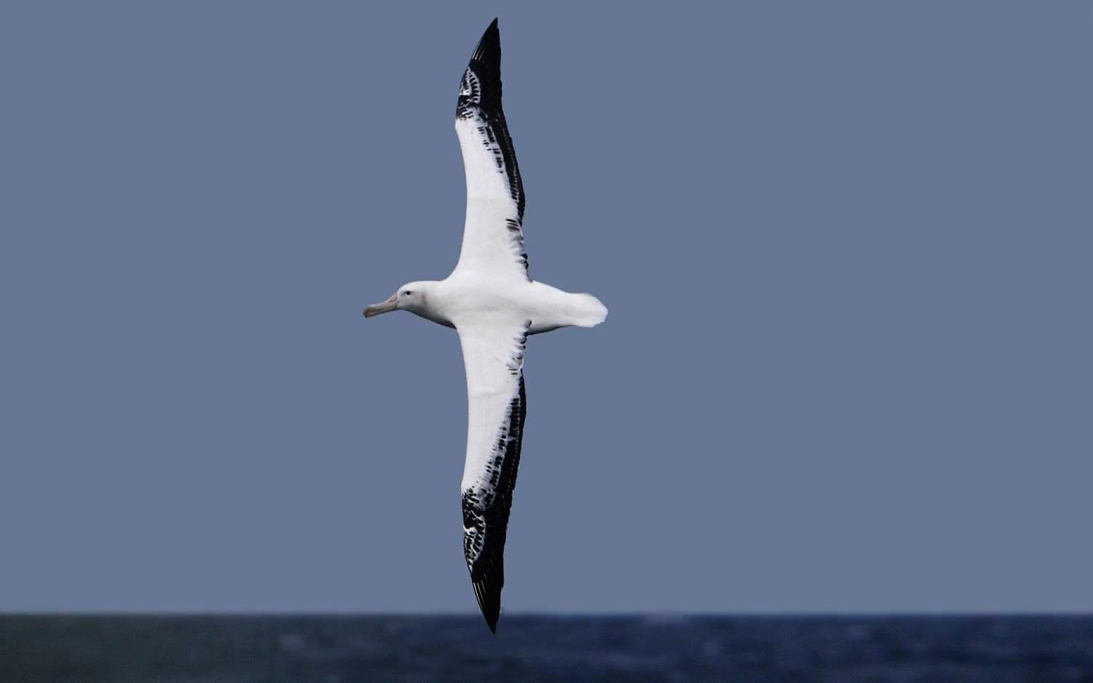
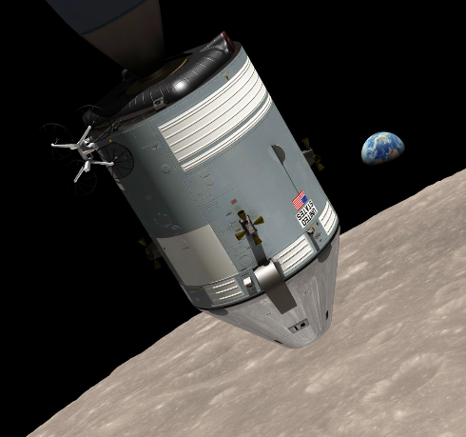
From Newton to Rayleigh: Physics and Dimensionless Terms
Characterizing Orbits and Dynamic-soaring Flight Mechanics
J. Philip Barnes 11 Nov 2016
Notes:
Non-dimensional parameters provide insightful and compact characterization of myriad physical phenomena. One hundred years after its publication, Lord Rayleigh’s “free exponent” method of dimensional analysis remains powerful and relevant, and three centuries after the publication of Principia, Isaac Newton’s gravitation and conic-section orbits continue to play big roles in our lives.
This presentation reviews and renews the derivation and/or application of non-dimensional parameters, including for illustration empirical or theoretical characterization of wing aerodynamic lift, dynamic-soaring flight mechanics, and conic-section orbits. Throughout the presentation we’ll add a few historical notes and describe the interesting physics of the chosen phenomena, as we borrow from the work of Rayleigh and Newton.

Slide 2
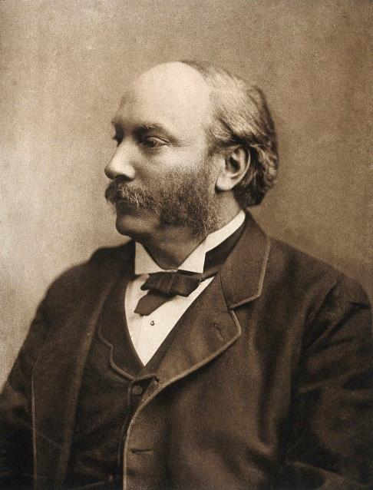
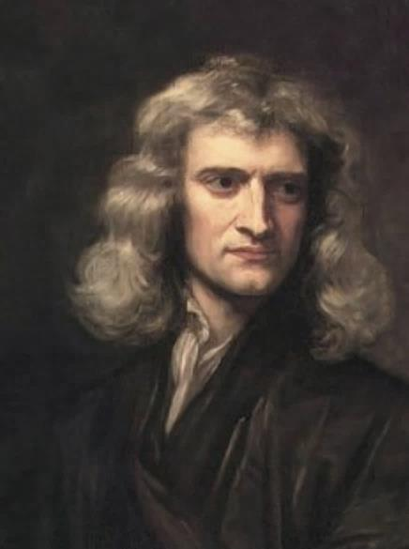
Presentation Contents
Introduction to non-dim. params.
Rayleigh’s “free exponent” method
  Synthesize params. : empirical study
  Application: Wing aerodynamic lift
Newton’s conic-section orbits
  Tangent: Isaac Newton chronology
  Theoretical derivation of params.
  Tangent: Lunar free-return trajectory
Application of Newton’s dynamics
  “By-inspection” params. to add insight
  Applied: Dynamic-soaring trajectory
Wellcome Library, London
Notes:
The presentation describes three methods to derive and/or apply non-dimensional parameters efficiently and insightfully characterizing physical phenomena. These methods can be named “empirical, theoretical, and insightful,” although each has mutual effects of the others. We’ll first take on the hardest, that being Rayleigh’s method of finding empirical exponents, applied for illustration to find the origin of wing lift coefficient. We’ll then coast, in more ways than one, as we review and renew Newton’s conic-section orbits, including study of the lunar free-return trajectory. We’ll finish with an application of insightful terms such as “lift-drag ratio” and “normal load factor” to explain how the wandering albatross uses its dynamic soaring technique to remain aloft indefinitely on shoulder-locked wings. The studies herein borrow heavily from Newton, Rayleigh, or both.

Slide 3

Introduction to Non-dimensional Parameters
Compact characterization of physical phenomena
  Test matrix growth is exponential w/each new variable
Avoid “Mars Lander” mixed and/or ambiguous units
Added insight, i.e., “thrust/weight” or “lift/drag” ratio
Non-dimensional quotient, 2 or more variables, i.e. π ≡ C/D
Another well-known example: Reynolds number ≡ ρvc/μ
  fluid density (ρ), velocity (v), length (c), & viscosity (μ)
Myriad applications (some below included herein):
  Motor-generator torque, speed, & current¹
  Origin of wing aerodynamic lift coefficient
  Conic-orbital position, velocity, and time²
  Gear geometry, mesh loss, & windage³
  Dynamic-soaring flight mechanics⁴
  Heat transfer³, tribology, ...
1 Barnes, J.P., AIAA 2016-4711, Principles of High-efficiency Electric Flight, 2016
2 Barnes, J.P., AAS 87-537, Relating Conic-section Orbital Position, Velocity and Time From Periapsis as Dimensionless Quantities, 1987
3 Barnes, J.P., AGMA 97FTM11, Non-dimensional Characterization of Gear Geometry, Mesh Loss, and Windage (see also Appendix), 1997
4 Barnes, J.P., SAE 2004-01-3088, How Flies the Albatross - the Flight Mechanics of Dynamic Soaring, 2004
Notes:
Non-dimensional parameters offer many benefits, including compact characterization. Consider a test matrix with just two variables, both of which may have non-linear effects. This requires eight test points to characterize, and if necessary modestly extrapolate, the test results. Add a third variable and watch the test matrix explode. Taking advantage of non-dimensional terms, the test matrix can remain comprehensive, but with vastly greater economy.
Dimensionless parameters also help to avoid a “Mars Lander” scenario which suffered from the use of mixed and ambiguous units. Say one team is responsible for the orbital mechanics of the first phase of a trajectory, and another team for the balance. They could safely use mixed units (although we recommend against that) if the teams were to carry and share the non-dimensional orbital parameters at “handoff.”
Perhaps the world’s oldest, well-known dimensionless parameter is “π” representing of course a circle’s circumference-to-diameter ratio. A relatively modern parameter is the Reynolds number, used in fluid dynamics and heat transfer. Myriad applications of non-dimensional parameters include the three studies in this presentation, plus for example gear geometry, mesh loss, and windage. As with orbits, gears continue to play big roles in our lives, centuries after their discovery.

Slide 4
Presentation Contents
Introduction to non-dim. params.
Rayleigh’s “free exponent” method⁵
  Synthesize params. : empirical study
  Application: Wing aerodynamic lift
Newton’s conic-section orbits
  Tangent: Isaac Newton chronology
  Theoretical derivation of params.
  Tangent: Lunar free-return trajectory
Application of Newton’s dynamics
  “By-inspection” params. to add insight
  Applied: Dynamic-soaring trajectory
⁵ Lord Rayleigh, Nature, Vol. 95, p. 66, 1915
Notes:
In this portion of our presentation we conduct an empirical study of wing aerodynamic lift. To best illustrate the method, including its options for “fine tuning,” we imagine knowing nothing of what to expect in the way of non-dimensional parameters characterizing the lift. However, a key feature of the method is the assumption that we do know what dimensional terms should be carried. For wing aerodynamic lift, these of course include at least airspeed, air density, wing planform area, and wing shape.
In our application of the method, we will put full faith in its results, even if it seems to yield initially “bizarre” results. Also, to address what may be perceived as a need for “experience” and/or a priori knowledge to implement the method, we will employ our addition to it which distinguishes “primary” from “auxiliary” variables and empirical exponents. We finish the illustration with a fine tuning operation which yields the well-known definition of lift coefficient.

Slide 5
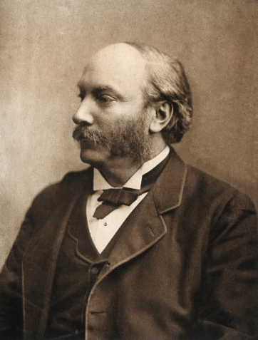
Rayleigh’s “free-exponent” dimensional analysis
Application: Empirical study of wing aerodynamic lift
Assume lift (L) depends on angle of attack (α), sweep (Λ), air density (ρ), airspeed (v), span (b), air viscosity (μ), speed of sound (a), and average chord (c). Angle of attack and sweep are already dimensionless, “embedded” for now into e_{o}.
Solve for the “auxiliary” exponents (x) which, together with “free exponents” (e), obtain the dimensions of lift, and which have a non-singular
matrix representing their units as follows:
Λ
α
c
b
unit | ρ | v | b | μ | a | c | L
Kg | 1 | 0 | 0 | 1 | 0 | 0 | 1
m | -3 | 1 | 1 | -1 | 1 | 1 | 1
s | 0 | -1 | 0 | -1 | -1 | 0 | -2
Notes:
Applying Rayleigh’s “free exponent” method, circa 1915, to the study of aerodynamic lift, we first assume the lift is proportional, by an empirical constant (e_{o}), to a product of dimensional terms, each raised to an empirical exponent (e_{i}) or auxiliary exponent (x_{i}), such that the system product obtains the units of lift.
Our addition to the method outlines the necessary features of the matrix representing the units of the auxiliary variables which, in this example, are air viscosity, speed of sound, and wing average chord. In a system including temperature, or more likely delta temperature, the auxiliary units matrix would have four columns and four rows. Whether the auxiliary units matrix has rank 3 or 4, no two variables therein may share the same units.

Slide 6
Rayleigh’s “free-exponent” dimensional analysis, continued 1
Application: Empirical study of wing aerodynamic lift
To ensure dimensional consistency, arrange all exponents in a set of equations, one for each applicable unit (kg, meter, sec):
kg: ( 1) e₁ + ( 0) e₂ + (0) e₃ + ( 1) x₁ + ( 0) x₂ + (0) x₃ = 1
m: (-3) e₁ + ( 1) e₂ + (1) e₃ + (-1) x₁ + ( 1) x₂ + (1) x₃ = 1
s: ( 0) e₁ + (-1) e₂ + (0) e₃ + (-1) x₁ + (-1) x₂ + (0) x₃ = -2
Re-write as [A] [x] = [B] to solve for auxiliary exponents [x]:
Λ
α
c
1 0 0 x₁ = 1 - e₁
b
-1 1 1 x₂ = 1 + 3 e₁ - e₂ - e₃
Invert [A] and write [x]=[A⁻¹][B]:
-1 -1 0 x₃ = -2 + e₂
x₁ 1 0 0 1 - e₁ 1 - e₁
x₂ = -1 0 -1 1 + 3 e₁ - e₂ - e₃ = 1 + e₁ - e₂
x₃ 2 1 1 -2 + e₂ 1 + e₁ - e₃
Notes:
Here the units table of the previous slide has been represented by a system of equations representing all variables and exponents, with the units of lift represented by the column vector (1, 1, -2) at the upper right-hand side. This system is then converted to matrix form and the auxiliary units matrix (middle-left) is inverted to solve for the auxiliary exponents (x_{i}), represented by the lower-left-hand column.

Slide 7
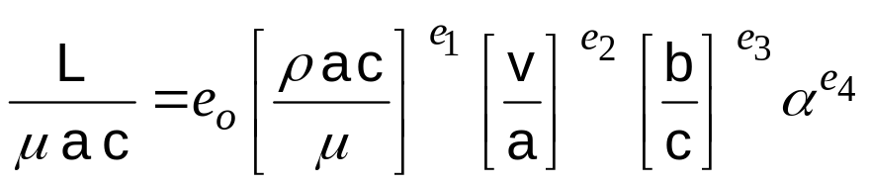
Rayleigh’s “free-exponent” dimensional analysis, continued 2
Application: Empirical study of wing aerodynamic lift
Recall the original assertion:
x₁ 1 - e₁
Recall from the
previous slide:
x₂ = 1 + e₁ - e₂
Λ
α
x₃ 1 + e₁ - e₃
c
Therefore, now re-introducing angle of attack (α), formerly “embedded” in e_{o}
which now “floats” to a new value:
b
Putting full trust in this result, now take test data; vary (ρ, v, μ, α), etc. Predict the exponents e₁ e₂ e₄
We find empirically: L ~ ρ V²α
Notes:
Recalling our original formulation, we apply the results of the previous slide to yield the non-dimensional lift, or “pseudo” lift coefficient, in terms of three non-dimensional groups, the first a “pseudo” Reynolds number, the second representing the Mach number, and the third representing wing aspect ratio (span/average_chord). Also recalling that to maximize our insight into the method we imagine not knowing what to expect, we then take test data, first varying only the first right-hand non-dimensional group, then varying only the second, and so forth.
We next plot the pseudo lift coefficient versus the first non-dimensional group and discover that the empirical exponent (e₁) is quite close to unity. Thus we learn that the lift force (L) is essentially proportional to air density (ρ). We also discover the empirical exponent (e₂) to be near 2.0, whereby the lift force is essentially proportional to the square of airspeed (v). Approximating both empirical exponents (e₁:e₂) as integers, the air viscosity (μ) and speed of sound (a) cancel out. However, the empirical exponents (e_{i}) in practice typically exhibit non-integer values, say for example 0.34 or -0.22. Furthermore, the effects of Mach number and Reynolds number do not entirely cancel out, so we are prompted next to “fine tune” the equation representing the system.

Slide 8
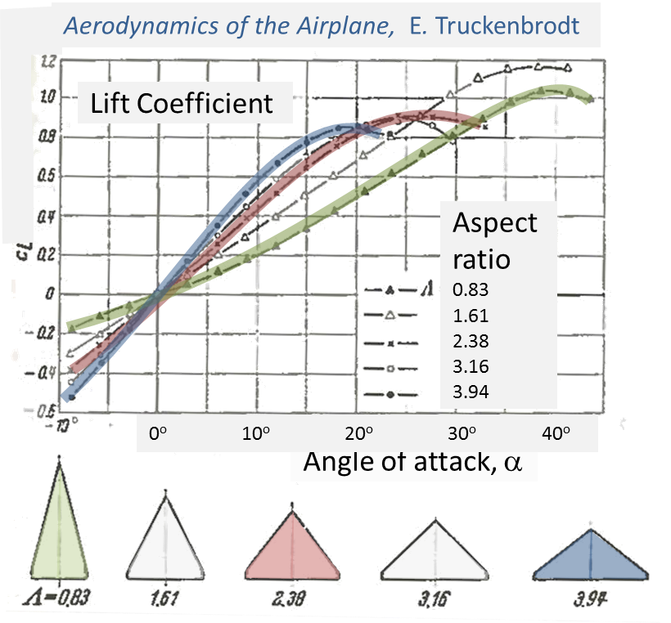
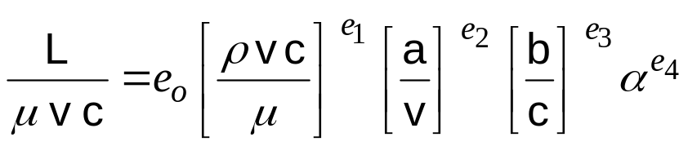
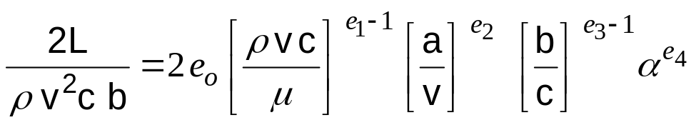
Rayleigh’s “free-exponent” dimensional analysis, continued 3
Application: Empirical study of wing aerodynamic lift
The system previously described is arguably workable, but our measurements reveal lift as proportional to density, wing area, and the square of velocity. Let’s now implement some manipulations at our disposal. We can swap two parameters of the same units, divide the equation by any or all parameters, and multiply any parameter by, for example, (v/v) to split it into two groups, one pre-existing.
Swap (a,v) ; then divide by (1/2) [ρvc/μ] [b/c]:
e₃
Lift Reynolds 1/Mach Aspect AoA
coefficient number number ratio
For Mach<<1, predict the exponent e₂
Notes:
We learned in the previous slide of the near proportionality of lift to air density, angle of attack, and square of airspeed. But our calculations thus far yielded a “pseudo” Reynolds number which we may argue is known from previous studies to be based on airspeed (v), and not the speed of sound (a). Here, we are at liberty to swap every occurrence of (a) with (v) since they share the same units. We are also at liberty to divide both sides of the equation by any or all non-dimensional groups. These operations yield the “fine-tuned” formula at lower left.
Provided the data is taken above a critical Reynolds number, and below a critical Mach number, where in such conditions both non-dimensional parameters have little effect on lift, we discover the empirical exponent (e₁) to be near unity and the exponent (e₂) to be near zero (recall for both cases that any quantity raised to the zero power is unity). The interested reader can take a “cut” at constant angle of attack in the figure at lower right, representing test data, to observe the empirical exponent (e₃) representing the approximate effect of aspect ratio (b/c). To complete the exercise, the empirical factor (e_{o}) can then be determined to represent the linear range of the test data shown.

Slide 9
Presentation Contents
Introduction to non-dim. params.
Rayleigh’s “free exponent” method
  Synthesize params. : empirical study
  Application: Wing aerodynamic lift
Newton’s conic-section orbits
  Tangent: Isaac Newton chronology
  Theoretical derivation of params.
  Tangent: Lunar free-return trajectory
Application of Newton’s dynamics
  “By-inspection” params. to add insight
  Applied: Dynamic-soaring trajectory
Notes:
The previous study represented empirical derivation of non-dimensional parameters. We now turn to the theoretical derivation of such parameters, studying for illustration the conic-section orbits. Whereas Kepler observed the characteristics of elliptical orbits, Newton explained all conic orbits, together with his introduction of the concept of gravity⁸. But before we non-dimensionalize the conic orbits, and explain various reasons to do so, we present a brief chronology of the life of Isaac Newton.

Slide 10

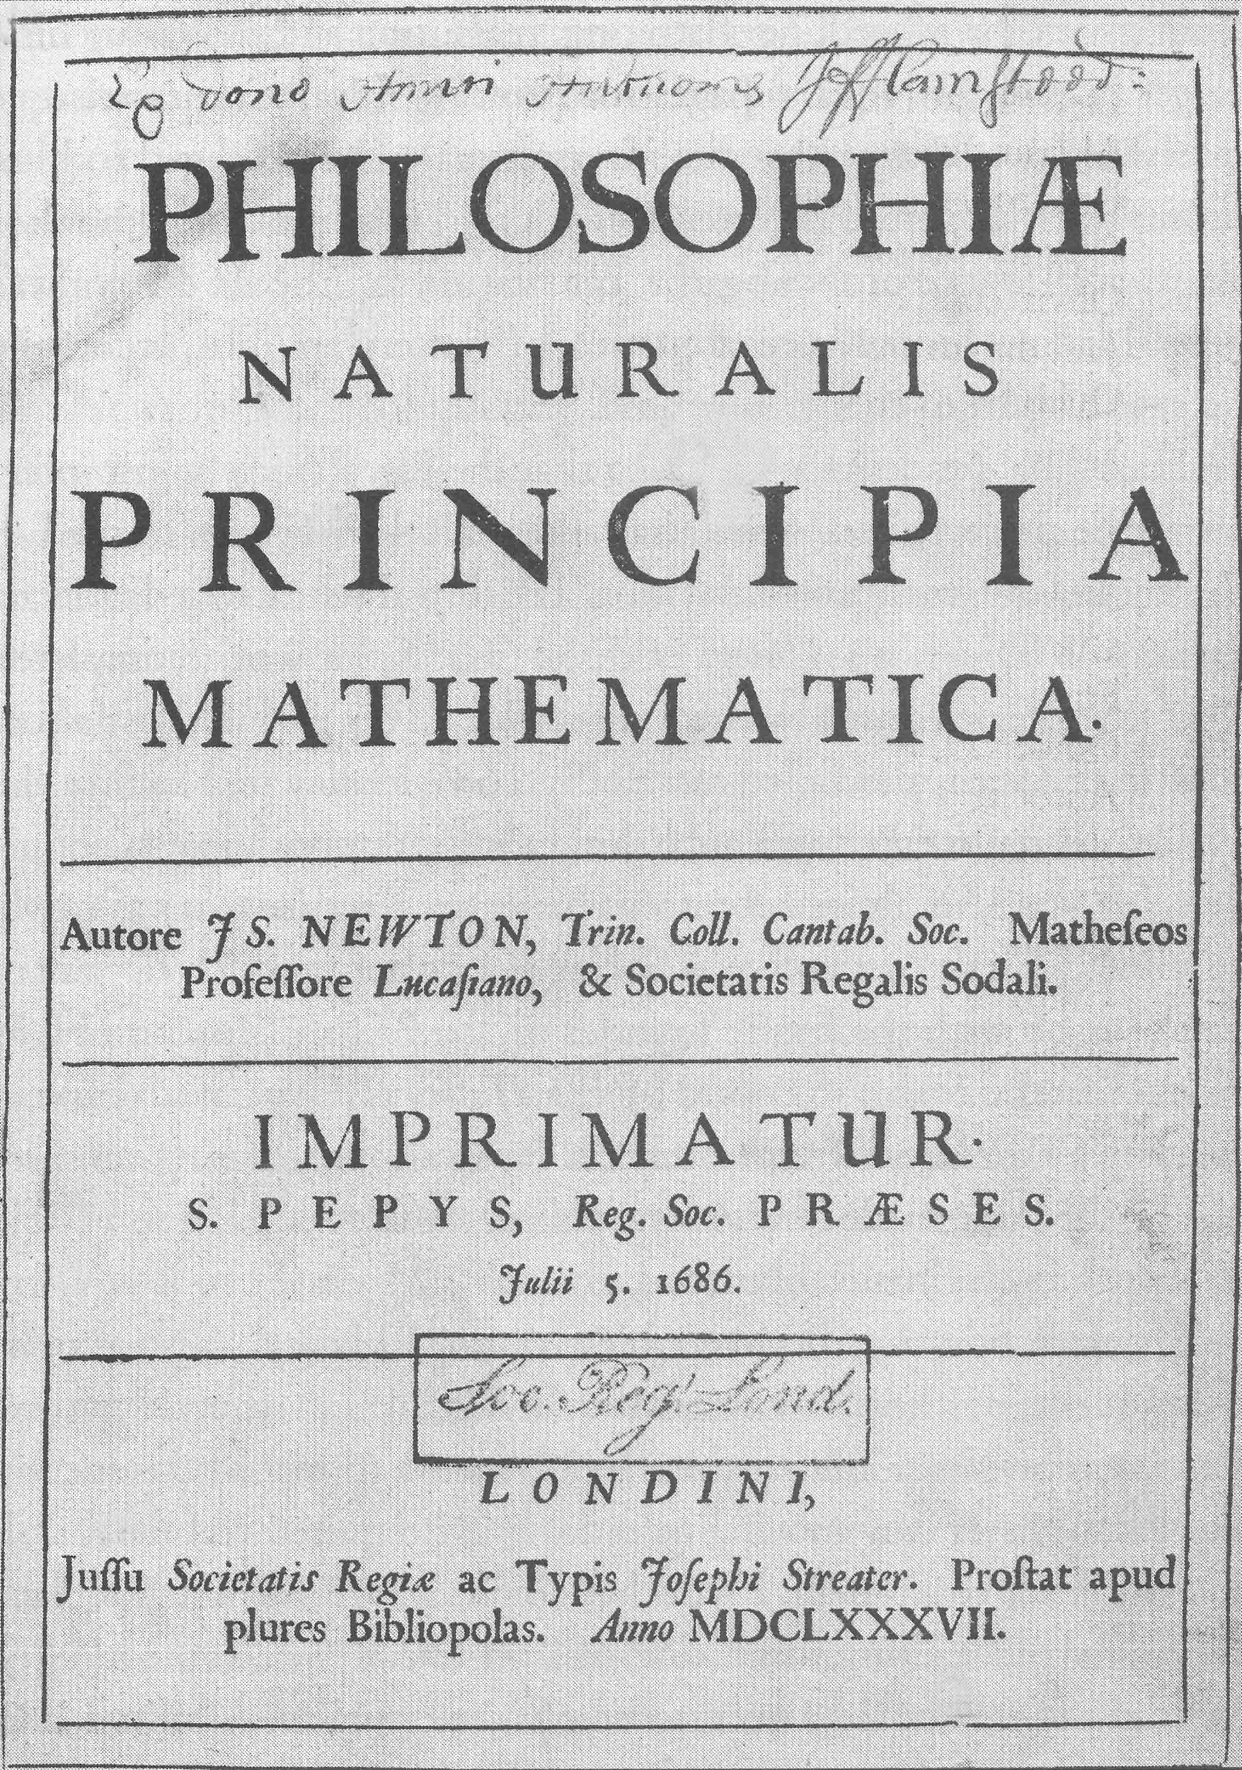
Conic-section orbits: Isaac Newton Chronology
Year Age Development or Event
1665 23 Trinity math degree, avoids plague
1665 23 Invents differential calculus⁶
1666 24 Integral calculus & gravitation
1668 26 Cambridge faculty appointment
1672 30 Elected Royal Society Fellow
1684~ Leibniz publishes his own calculus⁷
1685 43 Sphere point-mass equivalent⁸
1686 44 Principia (all proofs geometric)
1702 60 Optix (1st pub. Newton’s calculus)
1708 66 Knighted
1727 85 Quoted, shortly before death:
“I do not know what I may appear to the world, but to myself I seem to have been only like a boy playing on the seashore, and diverting myself in now and then finding a smoother pebble or a prettier shell than ordinary, while the great ocean of truth lay all undiscovered before me.”
6 Gamow, G., The Great Physicists From Galileo to Einstein, Dover, 1988
7 Jardine, L., Ingenious Pursuits, Building the Scientific Revolution, Anchor, 2000
8 Singer, C., A Short History of Science to the Nineteenth Century, Dover 1997
Notes:
Isaac Newton entered college with little or no knowledge of mathematics, and graduated at age 23 from Trinity as a supreme master of the discipline. Based on his work at Trinity and at home in Lincolnshire, where he retreated to avoid the plague, he invented differential calculus in his first year out of college. The next year he invented integral calculus, and his concept for gravitation. Secretive and socially dysfunctional⁷, Newton kept his calculus to himself, and in publishing his epochal book Principia at the age of 44, employed entirely geometric proofs. Only well after Leibniz independently discovered and published calculus did Newton reveal his own calculus, via his book Optix, at the age of 60. Nevertheless, Newton’s mastery of geometric proofs in Principia, explaining numerous phenomena including conic-orbital shapes, orbital times, and earth-moon effects, remains today arguably unparalleled⁹.
⁹ F.R. Moulton, An Introduction to Celestial Mechanics, Dover, 1970

Slide 11
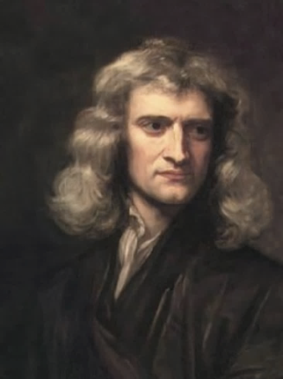
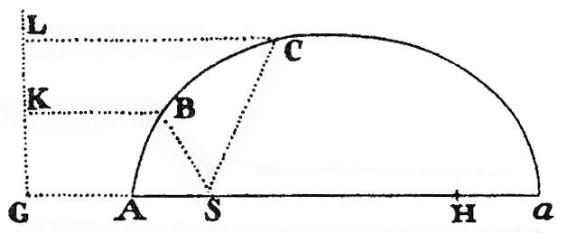
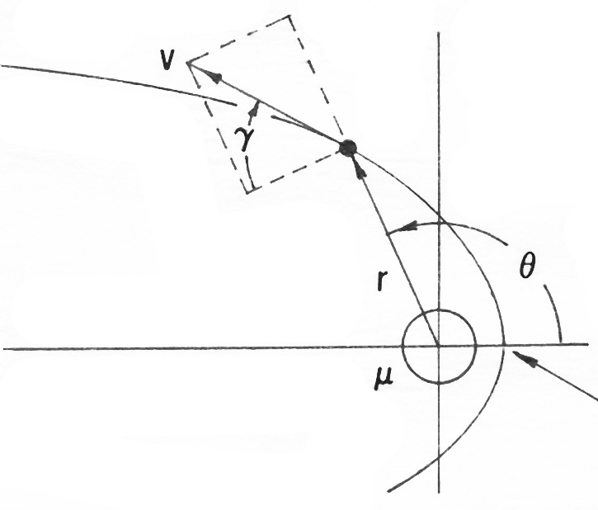
Conic-section orbits: From Principia to the present day
“... if any body is acted upon by a...force that is inversely proportional to the square of the distance...from the center, this body will move in...one of the conics having a focus in the center of forces.”
Newton, Principia, Book 1, Sect. 3, 1686
e≡SB/BK
=SC/CL
Conic section, Principia,
Book 1, Section 4, 1686
Symbols and Definitions
μ Product of central mass (M) & universal gravitational constant (G)
r Radius from the central body center to the satellite
θ True anomaly (angle from closest passage)
v Satellite velocity relative to the central body
γ Flight path angle (see sketch)
h Angular momentum per unit satellite mass
t Time from periapsis (closest passage)
ε Total kinetic & potential energy per unit satellite mass
e Eccentricity of conic section (italic Vs. natural-log base, e)
Notes:
At upper right we reproduce Newton’s sketch of a typical conic section, together with annotations describing its eccentricity (e), which is the radius from its focus to any point on the section, as a fraction of the distance from that same point to a directrix. Newton stated in Principia that any body acted upon solely by a force inversely proportional to the square of the distance from the force center would travel along one of the conics, with the force center residing at the conic-section focus. At lower right we sketch a conic orbit annotated with contemporary nomenclature, and at lower left we list the various orbital quantities.

Slide 12
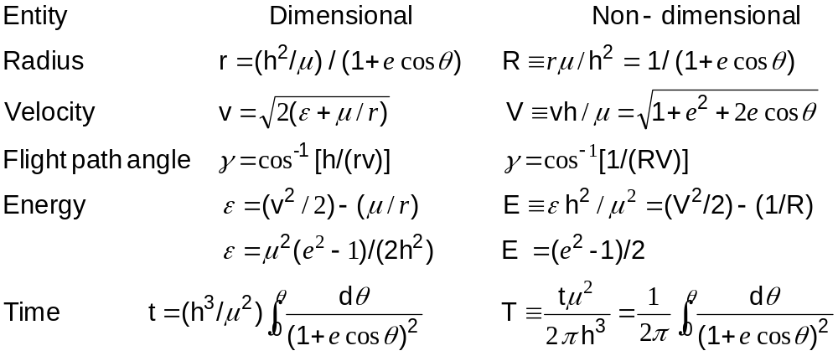
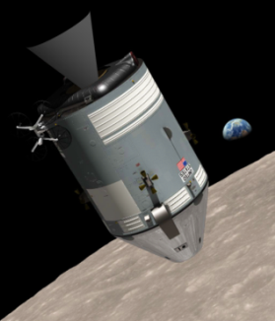
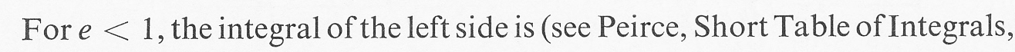
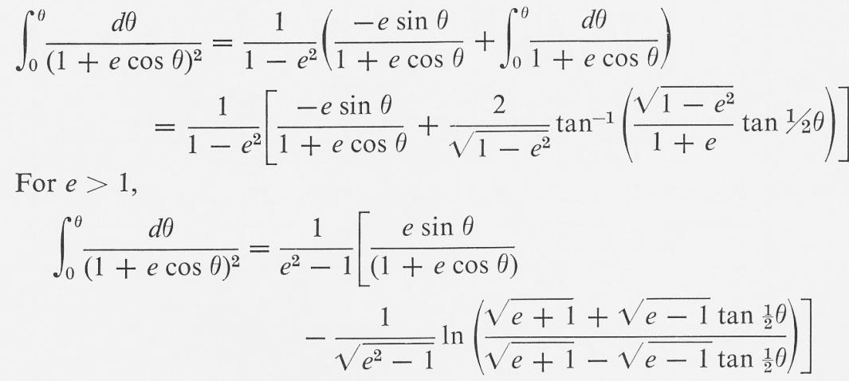
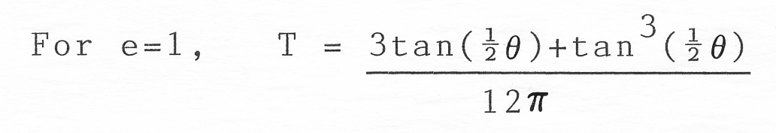
Conic-section orbits: Dimensional & non-dimensional terms
W.T.Thomson, Introduction to Space Dynamics, Dover, 1986, p. 73
T=
[1/(2π)]
[1/(2π)]
[1/(2π)]
e
T=
[1/(2π)]
[1/(2π)]
Notes:
For conic-section orbits, at upper left we show the formulas representing the dimensional quantities. At upper right we show their non-dimensional counterparts, which in most cases are found by inspection, re-arranging to have only the eccentricity (e) and true anomaly (θ) on the right-hand side. Notice that the non-dimensional radius (R) and non-dimensional velocity (V) for a circular orbit (e=0) are unity. To likewise obtain unity for the non-dimensional orbital period of a circular orbit, we arbitrarily divide by (2π) in defining the non-dimensional time (T) from periapsis. Our original paper² had numerically integrated (T), but after the paper was published we learned that (T) can be directly integrated¹⁰. The related formulas are shown at lower left for elliptical and hyperbolic orbits, and at lower right for a parabolic orbit.
¹⁰ Thomson, W.T., Introduction to Space Dynamics, Dover, 1986

Slide 13
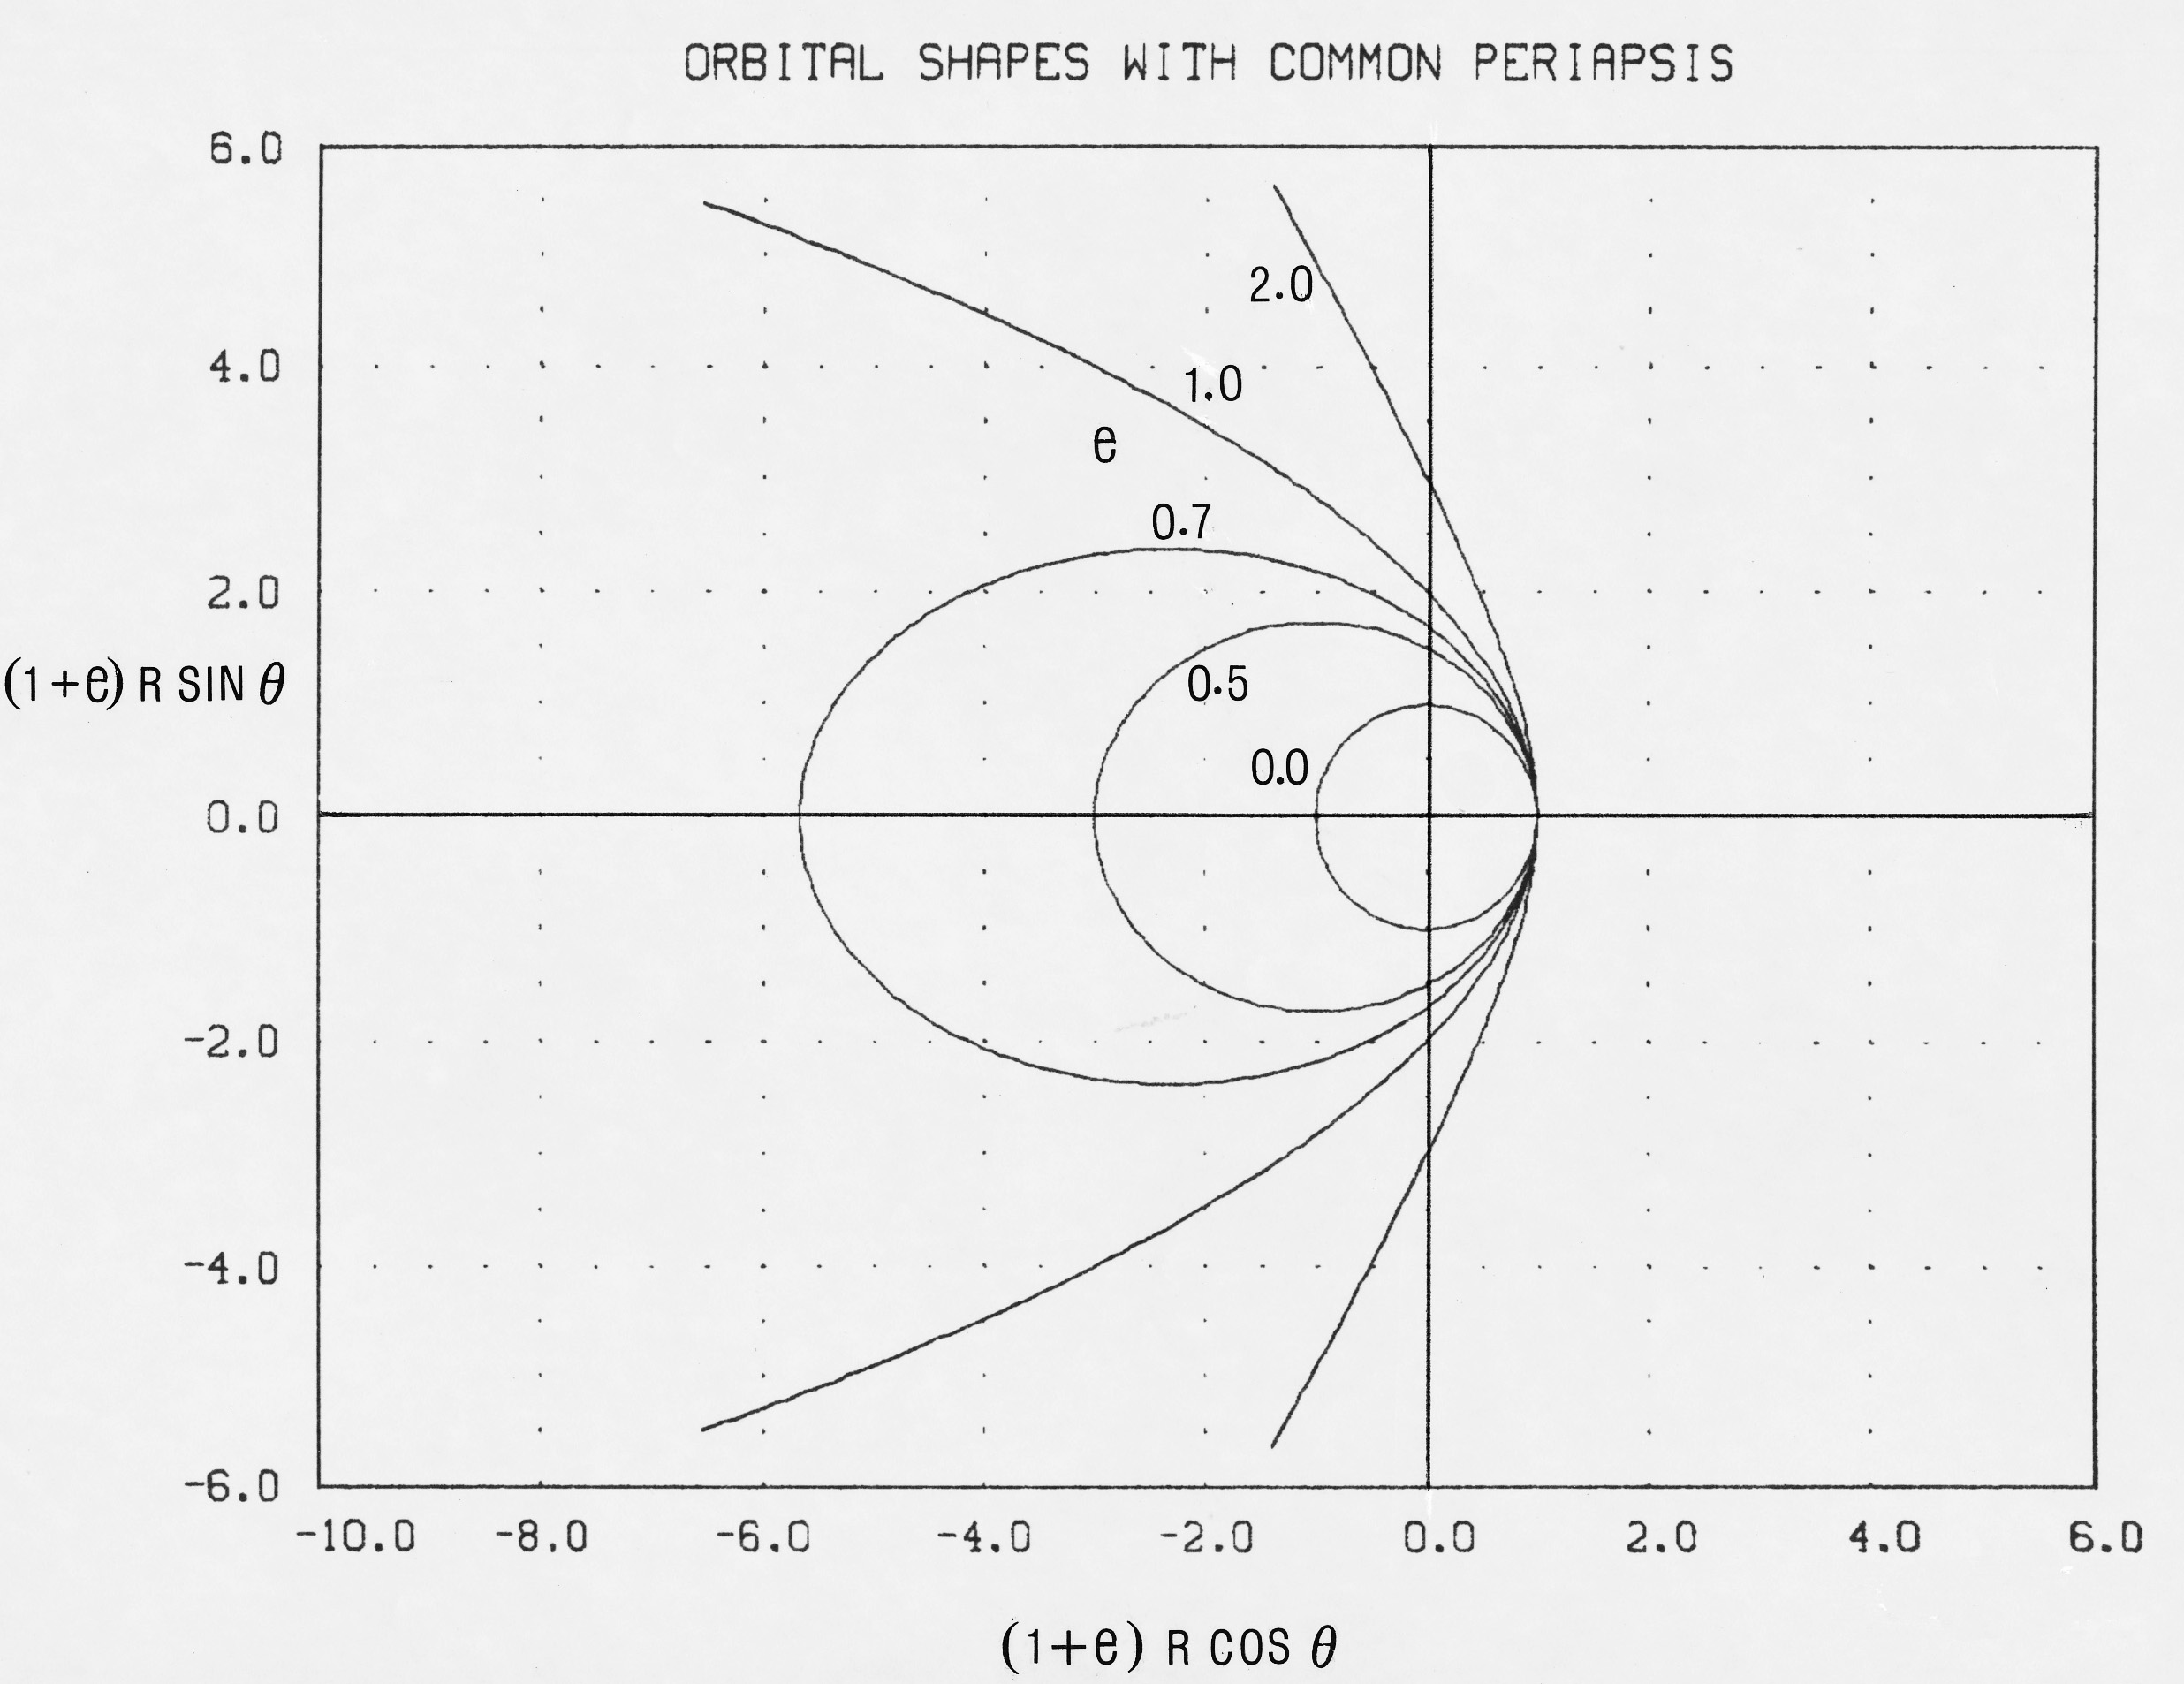
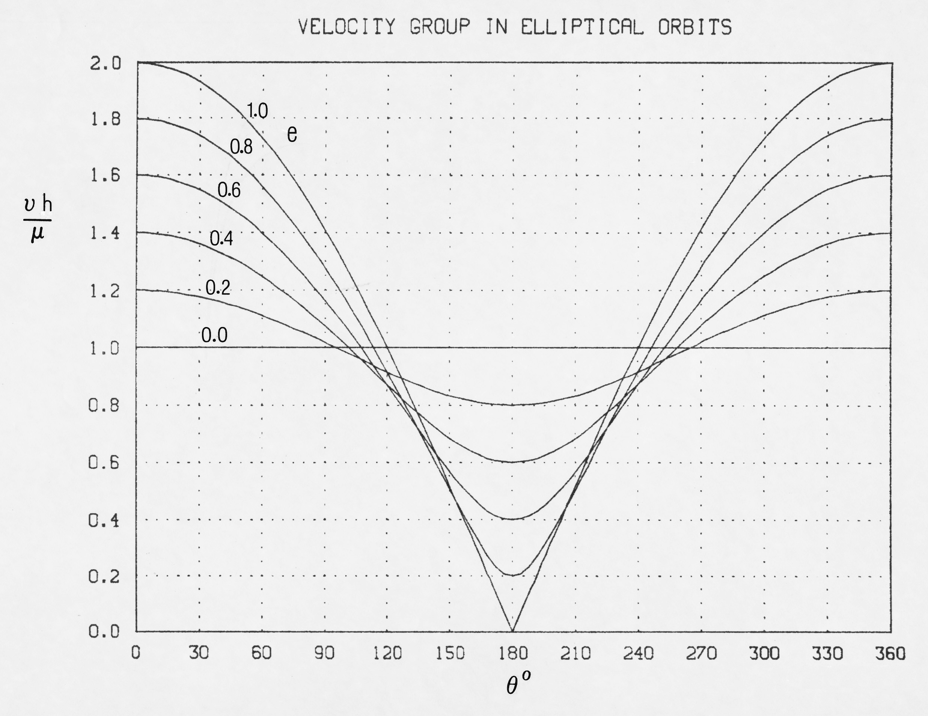
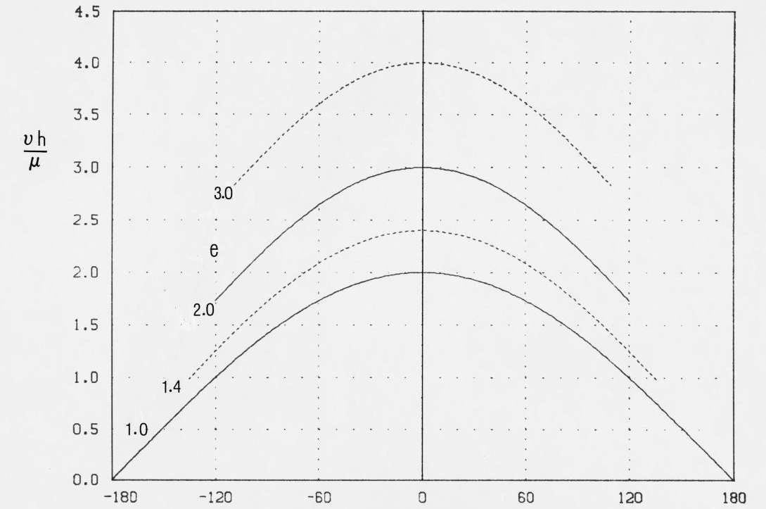
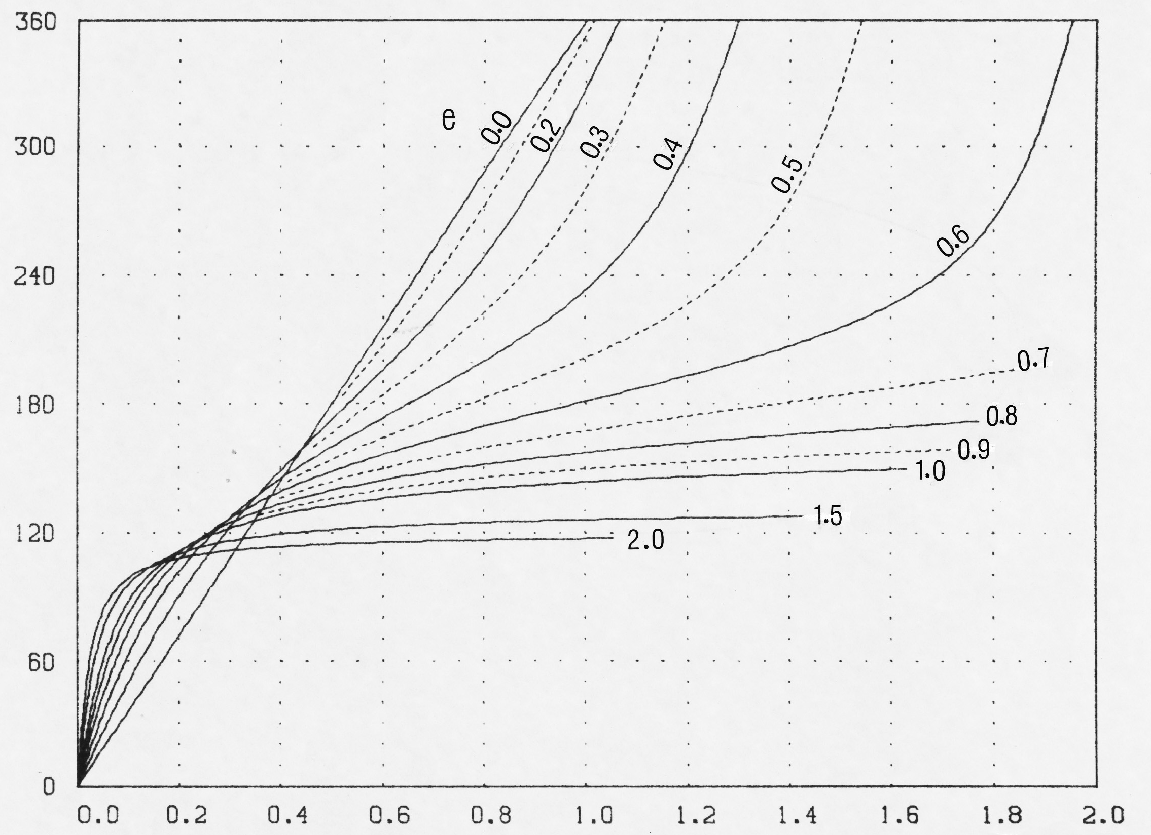
Conic-section orbits: Shape, velocity, and time Vs. position
Non-dim. velocity
elliptical orbits
Conic
section
orbital
shapes
vh/μ
θº
Non-dim. velocity
hyperbolic orbits
Non-dim. time
all conic orbits
vh/μ
θº
Expedited solution of Kepler’s Problem
θº
tμ²/(2πh³)
Notes:
Here we show the non-dimensional shape, velocity, and time from periapsis for conic-section orbits. Again notice that for the circular orbit, the non-dimensional radius, velocity, and period are all unity.
At lower right the non-dimensional time is presented as the independent parameter, although it has been calculated dependent on the eccentricity and true anomaly. This characterization, whether stored as a lookup table or with a curve fit, expedites the iterative solution of Kepler’s Problem, which finds the change in position, given the change in time.

Slide 14

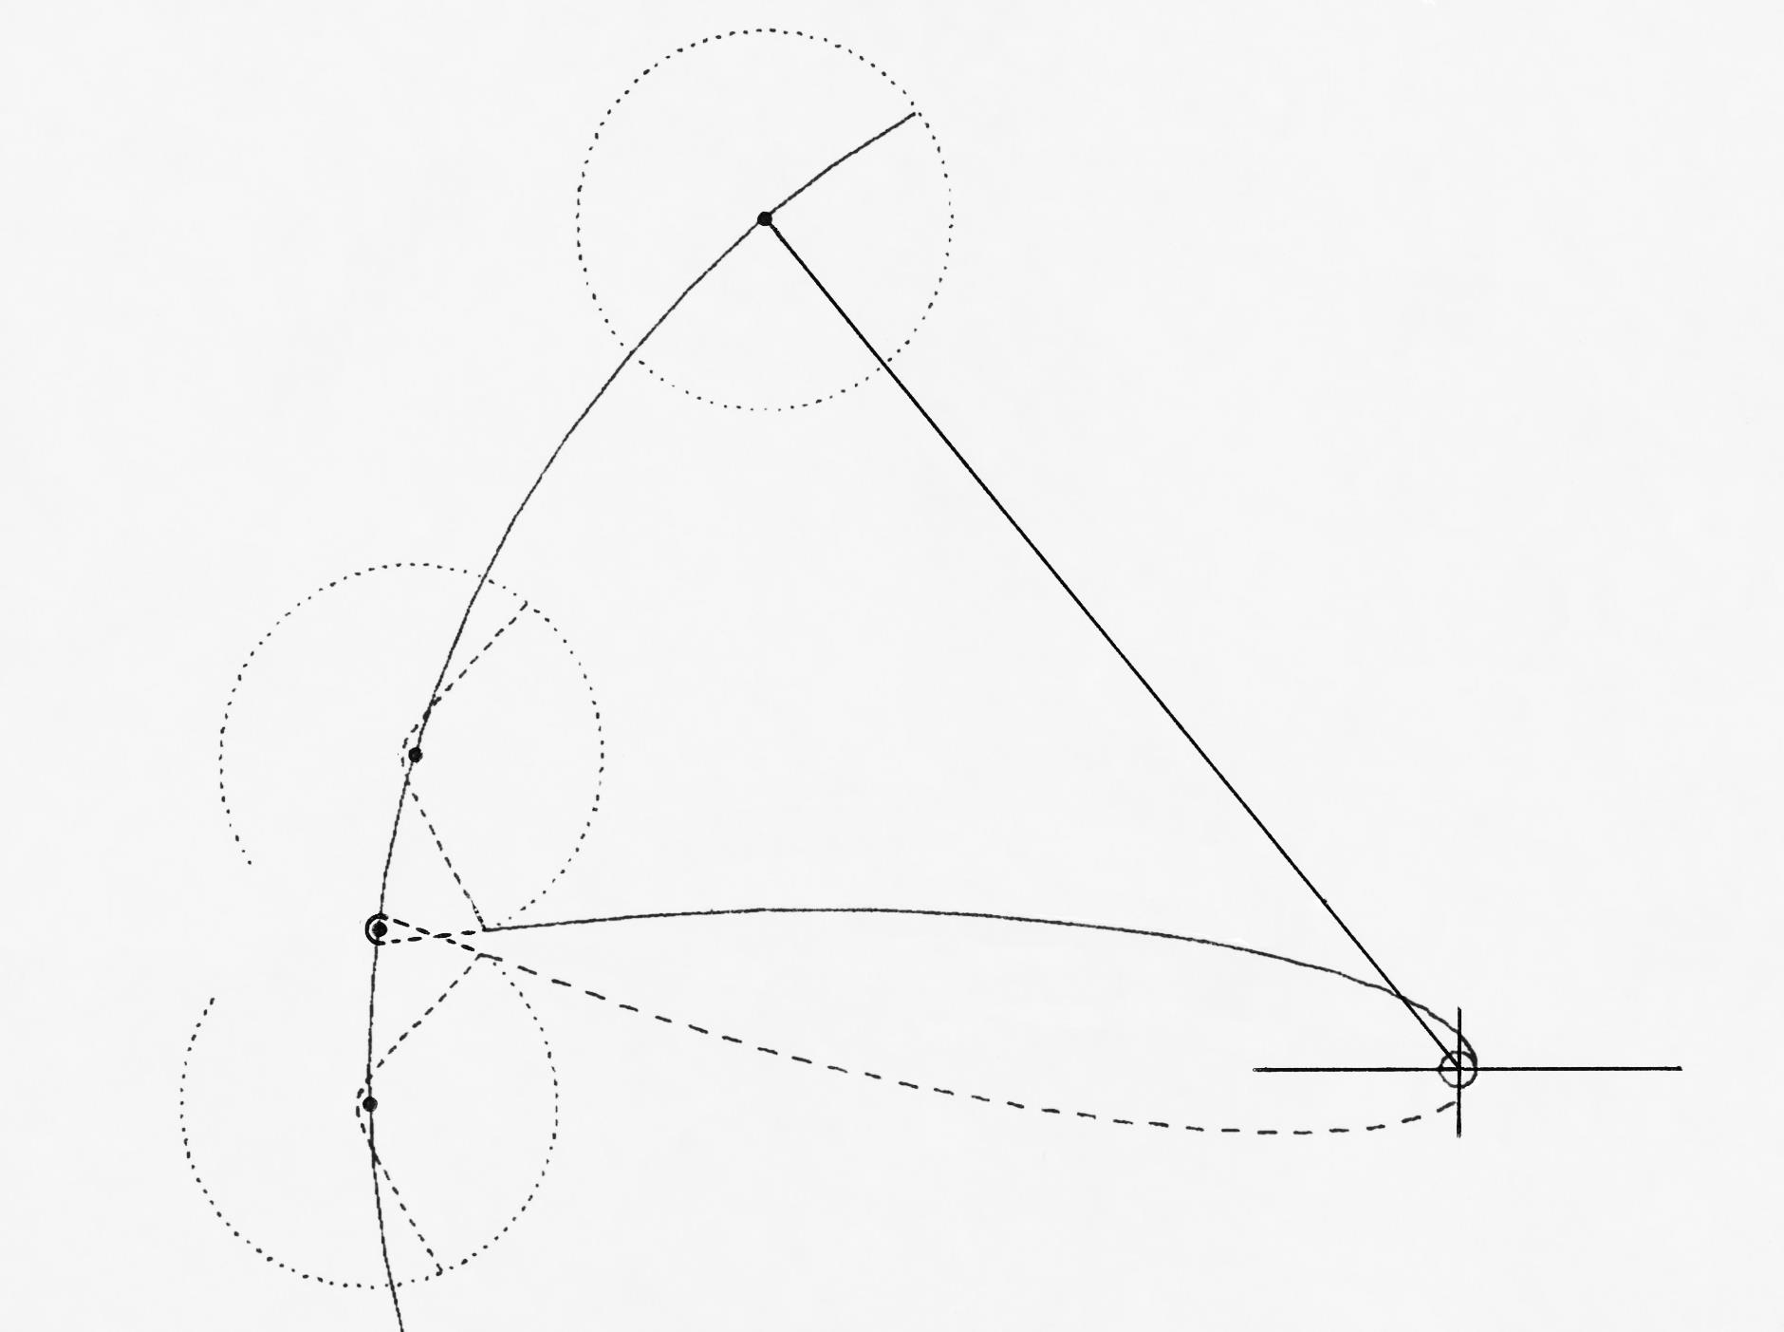
Conic-section orbits: Lunar free-return trajectory, 1 of 2
After translunar injection at point (1) the spacecraft coasts in a highly-elliptical orbit to the lunar sphere of influence at point (2), where the spacecraft enters a hyperbolic trajectory relative to the moon. If the lunar orbit insertion burn at point (3) fails, the lunar free-return trajectory returns the spacecraft to earth with the same as outbound-orbital eccentricity and energy.
16.9-hr from 2:3
Lunar SOI
a
earth-moon radius at TLI
3-hr launch window
300-km park. orbit
6-min TLI burn
2
LOI
Grumman: LM
TRW: LMDE
3
2.58 days to lunar SOI
1
b
4
Hyperbolic passage as
moon travels a : 3 : b
Notes:
Here we apply Newton’s conic-section orbits in the form of a lunar free-return trajectory which, in taking the shape of a distorted but symmetrical figure-8, gives the astronauts a good chance of a safe return home in the event that the lunar-orbit-insertion (LOI) burn at perilune fails to happen. The return trajectory by itself does not guarantee a safe return because of numerous other risks, for example the narrow window of an acceptable earth-atmospheric re-entry angle.
In the diagram above, with the orbital shape shown to scale, the Apollo spacecraft undertakes trans-lunar injection (TLI) at point-1 with a 6-min burn starting from a 300-km parking orbit. The spacecraft then coasts 2.58 days in a high-eccentricity earth orbit to reach the lunar sphere of influence (SOI), where its moon-relative velocity yields a hyperbolic passage. The spacecraft then travels 16.9-hr from SOI entry to lunar-orbit insertion (LOI) with a decelerating burn at perilune (point-3). If this burn fails to happen, the spacecraft enters a free return to earth at point-4 whereby the spacecraft will have undergone a gravitational flyby of the special conditions which do not alter the earth-relative orbital energy of the spacecraft.
The analysis above applies the patched-conic approximation which has numerous opportunities for error accumulation. For example, the earth and moon together rotate about a common center of gravity which resides inside the earth at about ¾ of the earth’s radius. In practice, the mission incorporates several course corrections, typically including one at the point of entry into the lunar SOI. Without such correction, perilune altitude will be much greater than that desired.

Slide 15
Conic-section orbits: Lunar free-return trajectory, 2 of 2
Computer code variable names include what relative to what, at what point, and with what units, if any.
Carry & share non-dimensional counterparts to help avoid “Mars Lander” Imperial vs. metric unit scenario
e_{sm} = 1.69
v_{me2_kms}
v_{se1_kms} = 10.9
V_{se1} = 1.97
v_{sm2_kms}
2
v_{se2_kms} = 0.78
3
e_{se} = 0.972
1
“Failure is not an option”
-Gene Kranz, Apollo 13 Flight Director
Notes:
We conclude this section of our presentation with selected numerical details of the free-return trajectory. This includes our suggestion that all computer-code orbital variables be fully subscripted to indicate what is taken relative to what, at what point, and with what units. For example, the spacecraft earth-relative velocity (km/s) at TLI is named vse1_kms. Its non-dimensional counterpart (Vse1) is also shown.
Why should we take interest in the non-dimensional orbital parameters? First, we can take advantage of a “sanity check” using the orbital non-dimensional characteristics plotted earlier herein. Second, we can preclude another “Mars Lander” failure where Imperial units for velocity were used by one team, and metric units by the other. We infer from the episode that the velocity variables lacked full subscripting. But the non-dimensional parameters have the same numerical value for any consistent units, and these could and arguably should have been shared at orbital-segment “handoff” between teams. In the words of Gene Kranz, Apollo 13 Flight Director, “Failure is not an option.”

Slide 16
Presentation Contents
Introduction to non-dim. params.
Rayleigh’s “free exponent” method
  Synthesize params. : empirical study
  Application: Wing aerodynamic lift
Newton’s conic-section orbits
  Tangent: Isaac Newton chronology
  Theoretical derivation of params.
  Tangent: Lunar free-return trajectory
Application of Newton’s dynamics
  “By-inspection” params. to add insight
  Applied: Dynamic-soaring trajectory
Notes:
No doubt that upon encountering the first “earthrise” seen from moon orbit, the Apollo astronauts gained a profoundly greater appreciation of our blue-planet “spaceship earth.” And with the astronauts now safely returned to earth, we turn in more ways than one to the application of Newton’s physics in Principia, and Rayleigh’s observations in Nature, to explain how the wandering albatross uses dynamic soaring to stay aloft on shoulder-locked wings, circumnavigating Antarctica several times per year. To study the phenomenon, we’ll use non-dimensional parameters which make themselves known “by inspection” for added insight.

Slide 17

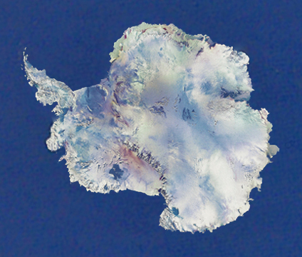
Dynamic Soaring
“The albatross…manages to remain master of its own course, either carried...around the globe or...against the strong winds without a beat of its wings.”
-- Jacques Cousteau
“The albatross can maintain this swooping soaring flight for hours on end without a single wing beat.”
-- David Attenborough
6X / year
Wandering Albatross
Author’s photo, 2007
Notes:
(speaker unroll 3.5-m actual-size photo/poster of a wandering albatross)
This is an actual-size photo of a wandering albatross. Words cannot describe the thrill in seeing this magnificent bird appear from one horizon, circle one’s boat several times, and disappear over the opposite horizon, all without a single wingbeat. That the albatross can do this is well documented, for example by the well-known naturalists David Attenborough and Jacques Cousteau. But only recently have we come to learn most of what we need to know to explain how it does this.
On its maiden flight, the wandering albatross, and its close cousin the royal albatross, has been seen to immediately learn and apply dynamic soaring, disappearing over the horizon. After seven years circumnavigating Antarctica several times per year, the bird navigates with pinpoint accuracy to the island, and in some cases the very spot, where it was hatched. With good fortune and every two years thereafter, it joyfully reunites with a life-long mate to bring forth an albatross chick. In between, the albatross lives in the 20-meter-high howling-wind profile over heaving water in the southern ocean as far as the eye can see. As it gracefully maneuvers well above and among the waves with precise terrain following, whether awake or half asleep, it pulls typically 3-g turns several times per minute. Repeating its dynamic-soaring trajectory, climbing upwind and diving downwind, it regains the energy lost in each case to aerodynamic drag.

Slide 18

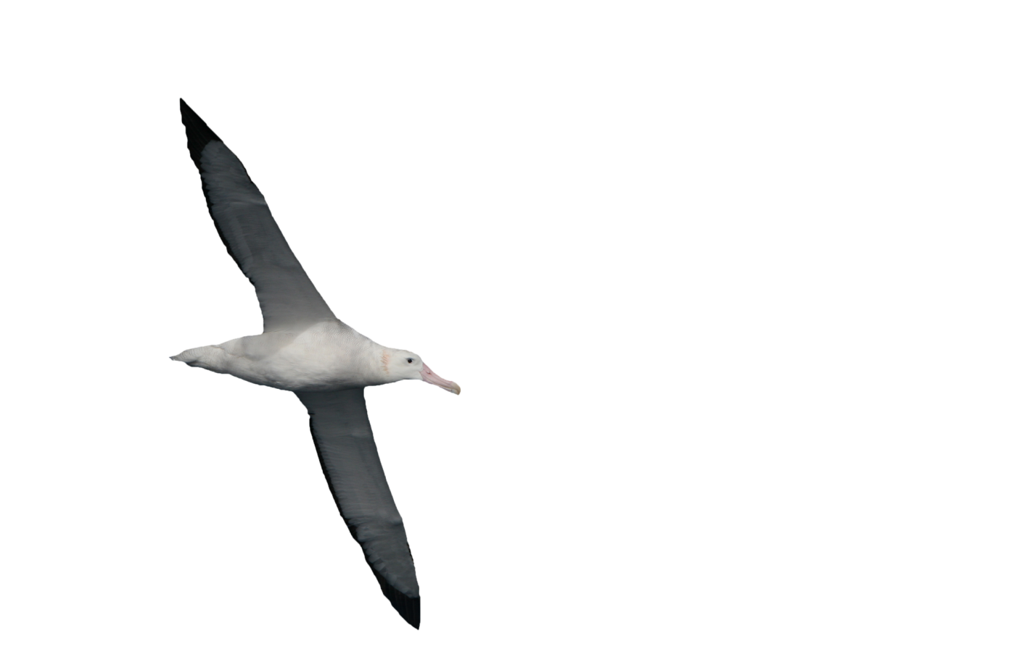
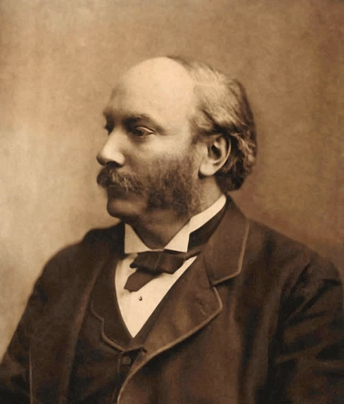
Dynamic Soaring ~ Quantifying Rayleigh’s description
φ
Dynamic Soaring Force Vector (F)
F = m(dw/dt), directed upwind
L
Dynamic Soaring Thrust , T = F∙V
T = m (dV/dt)
= m (dw/dt) (dV/dw)
= m (dw/dt) cosγ cosψ
= m (dw/dz) (dz/dt) cosγ cosψ
= m w’ V sinγ cosγ cosψ
V
D
γ
mw
ψ
T/W = w’ (V/g) sinγ cosγ cosψ
mg
w
“...energy at the disposal of the bird depends on his velocity relatively to the air.” “...it is only necessary...to descend...to leeward, and...ascend...to windward.”
- Rayleigh, The Soaring of Birds, Nature, Vol. 27, Apr. 1883
Wellcomeimages.org
Notes:
Here we show all the forces, including lift, weight, drag, and in particular, the dynamic soaring force which we had postulated in our 2004 SAE paper. As the albatross maneuvers, the dynamic soaring force of magnitude (m dw/dt) remains steadfastly level and pointed directly upwind. Since the wind profile is assumed fixed, only by moving vertically within the wind profile does the albatross experience the rate (dw/dt) and the corresponding dynamic soaring force. During descent, (dw/dt) is negative. Therefore, if the albatross descends downwind the dynamic soaring force vector will in effect point downwind, thus providing thrust. The component of dynamic soaring force aligned with the airspeed vector represents the dynamic soaring thrust. For the dynamic soaring force, Newton would be pleased to see this derivative of his most famous formula from Principia.
Let’s now prove what was previously postulated. To isolate the dynamic soaring thrust we momentarily ignore both weight and drag. Then applying Newton’s Law along the flight path, we find that the dynamic soaring thrust is proportional to the mass (m), wind gradient (w’), airspeed (V), flight path angle (γ), and a “cosine product.” The latter becomes negative when the albatross turns downwind, whereby the dynamic soaring thrust becomes “negative upwind” and “positive downwind.” Note that the wind gradient (w’) does not itself change sign as the rate (dw/dt) changes sign. Thus, in accordance with Lord Rayleigh’s original assertion, the albatross gains energy with both upwind ascent and downwind descent. This represents the first direct quantitative characterization of Lord Rayleigh’s qualitative description of dynamic soaring.

Slide 19
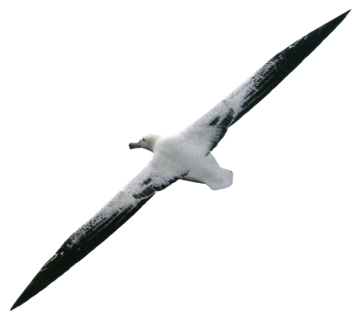
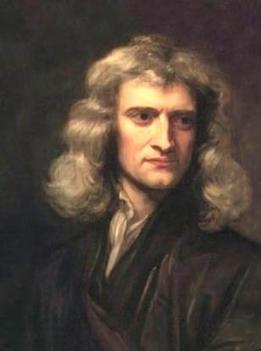
Three orthogonal accelerations ~ Newton’s Principia Applied
“... suppose a polygon ...a body moving with a given velocity along the sides is reflected at each of the angles....the force will be as that velocity ...and the number of reflections jointly.”
Newton, Principia, Book 1, Sect. 2, 1686
γ
Loop
Radius
V
ω
Vcosγ
a
V
γ
v
ψ
Vγ
a=ωv
[Vcosγ]ψ
Turn
Radius
Notes:
A three-dimensional trajectory can be computed by first looking down on the trajectory to fit a local horizontal radius of curvature, and then looking from the side to fit a roller-coaster-loop radius to the motion in a vertical plane. Applying Newton’s Principia, forces directed toward the center of these circles yield the angular rates. The third acceleration is along the flight path itself, and this is determined by dynamic soaring thrust in relation to the drag and the path-aligned weight component.
With variable wing and tail geometry, the albatross has total control over its flight path angle and bank angle or heading. Thus, we can evaluate its dynamic soaring trajectories by scheduling any two such angles to enable progress in a certain direction while following the dynamic soaring rule. The equations of motion then yield all other parameters of the trajectory.

Slide 20
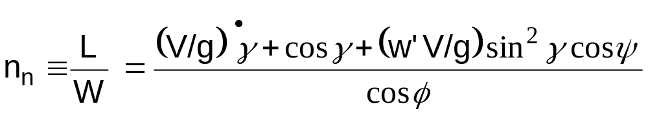
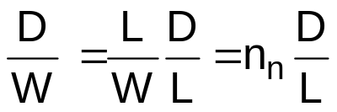
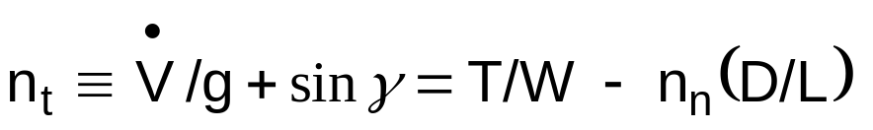
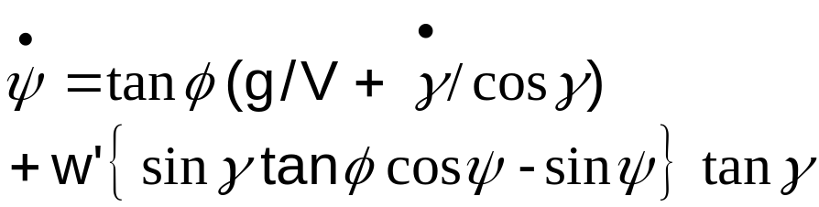

Equations of motion ~ Dynamic soaring trajectory analysis
1
1: Normal load factor
2
Thrust
group
Drag
group
2: Dimensionless drag
3: Tangent. load factor
3
4: Heading rate
5: Lift coefficient
4
6: Drag-to-lift ratio
7: Trajectory
5
C_{L} = n_{n} W / (½ ρ V² S)
6
D/L ≈ (C_{Do} /C_{L} ) + C_{L} /(3A)
Schedule any two angles, say
γ(t) & ψ(t) ; get dγ/dt, dψ/dt
Eqns. yield all other parameters
x = w – V cosγ cosψ downwind
y = V cosγ sinψ crosswind
z = V sinγ vertical
7
Notes:
It is convenient to non-dimensionalize the equations of motion and we begin by relating the drag-to-weight ratio to the product of normal load factor and drag-to-lift ratio. Along the flight path, the vehicle responds not only to gravity, but also to the difference between the non-dimensional thrust and drag groups. With this formulation, we see that the drag is made worse when the bird maneuvers with a load factor (n_{n}) greater than unity. To offset this, nature endowed the albatross with a high-aspect-ratio wing.
It is interesting to see that the motion is entirely determined if we know the flight path angle and its rate, together with the bank angle and airspeed. The trimmed angle of attack then becomes a by-product of the lift coefficient corresponding to the given maneuvering conditions. For a flight simulator with smooth and realistic motion, we have the option of calling for, and numerically integrating, accelerations in gamma and phi. Alternatively, to simulate dynamic soaring, we can schedule gamma and phi with psi to not only follow the dynamic soaring rule (upwind ascent and downwind descent in a positive wind gradient), but also to yield the desired overall direction of motion. We will soon show that the albatross can dynamically soar in any overall direction, including upwind, as observed by the famous naturalist Jacques Cousteau. Given the motion of the bird relative to the “current layer” of air, we can then superimpose any applicable atmospheric motion to obtain the trajectory seen by a stationary observer.

Slide 21
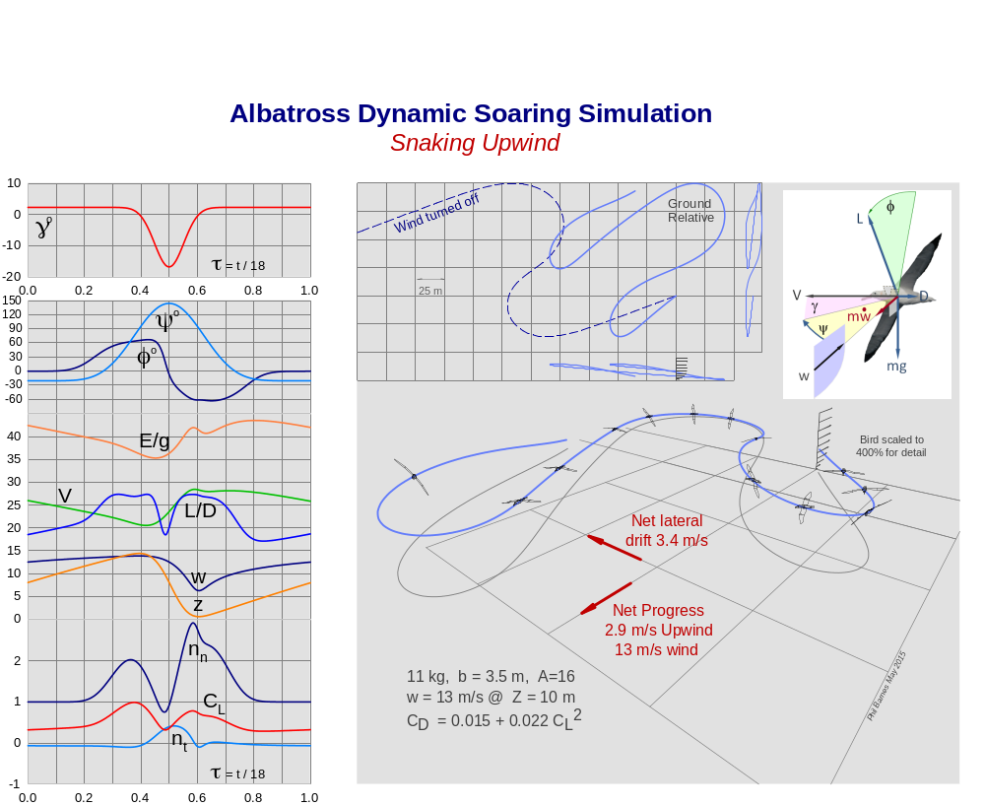
Schedules, γ(t) & ψ(t)
E/g, m
v, m/s
w, m/s
z, m
2.9 m/s net progress
against 13 m/s wind
Notes:
Here we show the details of a trajectory where the albatross makes overall progress upwind without flapping its wings. We chose to schedule the flight path and heading angles versus time, whereby the required bank angles (about 62-deg) have been calculated. Notice that total energy per unit weight (E/g ~ m) is conserved at the end of each 18-sec cycle. Elevation ranges from 1-to-15 meters. Each cycle includes a 2-g and 3-g turn. The tangential load factor (n_{t}), plotted at bottom left, shows by its sign where energy is lost and gained. Overall, the albatross progresses 2.9 m/s upwind against a 13-m/s headwind. Presumably, it can switch to a mirror image maneuver to cancel the overall crosswind drift. A real-time simulation showing various dynamic soaring maneuvers can be run and/or downloaded at the author’s free website, www.HowFliesTheAlbatross.com
“Let not the albatross vanish from the earth on our short watch”
- J. Philip Barnes

Slide 22

About the Author
Phil Barnes has a Master’s Degree in Aerospace Engineering from Cal Poly Pomona. He is a 35-year veteran of air vehicle and subsystems performance analysis at Northrop Grumman, where he presently supports both mature and advanced tactical aircraft programs. Author of several SAE and AIAA technical papers, and often invited to lecture at various universities, Phil is presently leading several Northrop Grumman-sponsored university research projects including wind-tunnel testing and parameterization and visualization of aircraft geometry. Outside of work, Phil is a leading expert on albatross dynamic soaring, and he is pioneering the study of “regen-electric” flight. His work has been characterized by colleagues and university faculty as “landmark” and “inspiring to many.”

