Slide 1
Trigons, Normals, and Quadragons
Vector-based Solutions to the Classic
Problems of Computer Graphics
10 June 2023 update to May 2008 original
J. Philip Barnes
Notes:
A computer graphic (CG) image displays a three-dimensional (3D) object, as realistically as possible, on a 2D computer screen. In this presentation, we will demonstrate 3D geometry math modeling and visualization, including rendering at the individual pixel level. In so doing, we will introduce new alternatives to both classic and contemporary solutions to the classic problems of computer graphics. All of the “alternate” solutions herein are new. Whereas some offer additional insight and complement contemporary methods, others offer either increased computational efficiency or increased rendering accuracy.

Slide 2
Overview
Display a 3D-math-modeled shape on a 2D screen
Presentation Contents
“Flexible-cylinder” geometry grid
Geometry math modeling tools
Vectors ~ history & key operations
Fast world-to-screen transformation
Review/Renew: Z-buffer & Ray-casting
Vector solution : “Point-in-polygon”
Vector solution: Inter-vertex interpolation
“Pyranometer” ambient lighting model
Apply ~ "Render Raptor" & “TrigonoSoar”
Notes:
This chart has no footnotes.

Slide 3
“Flexible Cylinder” Geometry Grid
Computer graphics classic problem 1:
Generate and manage 3D geometry
Arrays and Subscripts
Object (n), Row (i), Col (j),
Vertex (k), Quadragon (m)
y
θ
λ
θ
z
x
λ
Vertex
Normal
Vertex
Quadragon
Notes:
A three-dimensional surface, whether for example a wing, toriod, or sphere, can be mapped as a flexible “distorted cylinder.” To “render” the object as a CG image, we will approximate its surface as an arrangement of “quadragons,” each having ranges of “latitude (λ)” and “longitude (θ),” and each having vertex normal vectors pointing away from the surface.
With a system of arrays and subscripts thereof, we can keep track of quadragons, vertices, and normal vectors. Then, once we find ourselves more deeply involved in our CG calculations, we discover that we’ll need to determine the applicable trigon for each quadragon at hand, whereby the trigon will “inherit” many properties of its “parent.” Toward this end, the “structure" (formerly "type”) declaration of Visual Basic proves invaluable. Herein, our graphics are rendered using only the VB “set pixel color” command. Our geometry definition and vector operations will consistently use the right-hand rule.

Slide 4
Geometry Math-model Building Blocks
1.0
1.0
Pseudo-Cosine
0.8
0.8
m = 2.0 1.0 0.5
0.6
0.6
ε ≡ y / y_{max}
= cos ^{m} (ηπ/2)
ε = sin (η^{m} π)
0.4
0.4
Pseudo-Sine
0.2
η ≡ x / x_{max}
0.2
η
0.0
0.0
0.2
0.4
0.6
0.8
1.0
0.0
0.0
0.2
0.4
0.6
0.8
1.0
1.0
1.0
Varabola
Exponential
0.8
ε = η ^{m}
0.8
_{ε = e}-5η ^{m}
0.6
0.6
0.4
0.4
0.2
0.2
η
0.0
0.0
0.2
0.4
0.6
0.8
1.0
0.0
0.0
0.2
0.4
0.6
0.8
1.0
Notes:
Here we plot several simple but powerful functions which can be used to construct building blocks for the 2D or 3D geometry of streamlined objects. In most cases, these functions have a normalized maximum “length” and/or “height,” each of which can be scaled to model the physical dimension at hand. In addition, these functions incorporate a variable exponent enabling shape adjustment, and more than one function can be added to build shapes of increasing complexity. For example, drawing from the modified trigonometric functions, the “pseudo-sine” with an exponent at or near 0.5 can be used to model the basic half thickness of an airfoil, with maximum “x” representing airfoil chord, and maximum “y” representing airfoil half thickness. Then, an additional smaller term, perhaps using a different function and/or exponent, can model a localized bump.

Slide 5
“TrigonoSoar” Math-modeled 3D Surface
Chord, thickness, twist, etc.
parametric along the spar
from centerline to winglet tip
y
x
z
Notes:
We introduce here “TrigonoSoar,” a math-modeled object to which we will apply our new rendering methods later herein. TrigonoSoar is a blended wing with numerous geometrical parameters (such as backbone, chord, thickness, camber, and washout) modeled parametrically with 2D (y-z-planar) distance along the spar from centerline to winglet tip. Implementations of various modified trigonometric functions for geometry definition are evident in the plan and profile views.

Slide 6
Math-modeled Aircraft
Algebratross
Wandering Albatross
RegenoSoar
Regenerative-soarer
Notes:
Here we illustrate more complex applications of the previously-described geometry building blocks. Both “Algebratross” and “RegenoSoar” are fully math modeled with such tools.
“Algebratross” is a model of the wandering albatross, which uses its 3.5-m wingspan and dynamic soaring technique to remain aloft indefinitely over a waveless sea, without flapping its wings.
Whereas the albatross uses the vertical gradient of horizontal wind speed to remain aloft, the “RegenoSoar” regenerative-soaring aircraft remains aloft, potentially indefinitely at high altitudes, by using its propeller (having symmetrical blade sections) as a turbine to recharge stored energy whenever an updraft is encountered.
As we next progress from “wireframe” to “rendered” computer graphics, we enter the world of “vectors” and “algorithms.”

Slide 7
“RenderRaptor” ~ Wireframe & Flat-Shade
Notes:
"Render Raptor," incorporating all of the methods used herein, has been rendered down to the level of each individual pixel in the draft images shown above. Further enhancements are applied later herein. The only "off-the-shelf" graphics utility is Visual Basic's point-set feature using the pixel coordinates and the specified red, green, and blue light intensity at the pixel. Read on to learn many of the essential processes needed to carry this out.

Slide 8
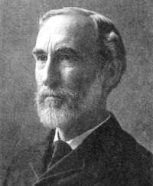
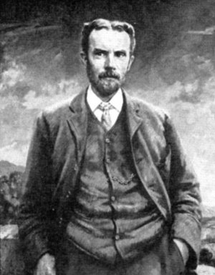
Vectors ~ Origin and Key Operations
y
C
B
j
γ
J. Willard Gibbs
Oliver Heaviside
c
A
k
Unit vectors
a ≡ A / |A|
b ≡ B / |B|
c ≡ C / |C|
cos γ = a b
sin γ = |axb|
i
z
x
Notes:
We are immensely indebted to both Willard Gibbs and Oliver Heaviside, at the very least for their independent invention of vectors, which took place in the 19th century. However, both made many other significant contributions to math and science. Gibbs is perhaps best known for his analysis of available energy in thermodynamic and chemical processes. Heaviside took the original twenty equations of electro-magnetism published by Maxwell, and with the aid of new-found vectors and other powerful tools, condensed “Maxwell’s Equations” into just four.
Armed with this most powerful tool known as “vectors,” our computer graphics methods herein will make good use of the dot product, cross product, tip-to-tail addition, and scaling vector operations.

Slide 9
Fast World-to-Screen Transformation
Computer graphics
Classic Problem 2:
Convert 3D (x,y,z)
to 2D (x,y) screen
1. cosχ = (z_{e}-z_{f}) / R_{ef} ; sinψ = (x_{f} -x_{e}) / (R_{ef} cosχ) ...
2. Rotate globe by angle (ψ) about axis (y-y_{e})
3. Rotate globe by angle (χ) about axis (x-x_{e})
4. Optionally rotate (ζ) for “cockpit-roll” effect
5. Perspective projection yields screen (x, y)_{p}
y-y_{e}
“Viewing
Pyramid”
Base
(screen)
ψ
R_{ef}
“Viewing Globe”
Radius, R_{ef}
p
χ
R_{ef}
f
Focus point
Eye point
e
R_{ef}
f
p
ψ
Any point
ζ
χ
z-z_{e}
x-x_{e}
Notes:
We can imagine a 3D surface as a collection of “points” in space. This "second" classic problem CG is to place a given point (p) on the screen, given the coordinates of the eye point (e), focus point (f), and the point (p) itself. This task is greatly simplified if we imagine the observer to see the world through a hole in the apex of a “viewing pyramid” turned on its side. The viewing pyramid is of course a well-known idea in the world of CG, but our intent here is to apply the viewing pyramid concept with greater efficiency.
Let’s say the viewer initially looks due east, but now intends to focus on some point (f) which resides to the southeast at some different elevation. The observer could “pan” and then “pitch” the pyramid until the point (f) were centered on the “screen” (pyramid base). However, an easier alternative (mathematically) is to leave the viewing pyramid fixed as the “viewing globe” of radius (Ref), centered at (e), is twice rotated for the same result.
Relative to the standard “world-to-screen transformation” methods, this approach requires just two rotations, and no translations. Key to the method is carrying out such rotations about axes passing through the point (e), whereby the rotations operate on the coordinate differences (x-x_{e}, y-y_{e}, z-z_{e}), not the (x,y,z) coordinates themselves. The third rotation is optional for “cockpit roll.”

Slide 10
Polygon Pipeline Optimization (incl. inner surfaces when applicable)
Screen Plane
Polygon Pipeline Filter P. Barnes, 2011
Initialize: No q'gons-in-pyramid ("QiP"=0) ~ partly/fully
Init: “raybox” corners to screen center (if ray-casting)
For each quadragon of each polyhedron:
Get/set vertex model coords., normals, & in/out colors
Model-World (M-W) x'form q'gon vertex coords. only
Test: Will any of 4 vertices project in the screen cone?
OK, World-rotate & screen-project q'gon vertex coords.
Test: q'gon at least partially overlaps the screen ; OK,
M-W transform & World-rotate q'gon vertex normals
Get 4 corners of q'gon bounding box and 2 of pixel-box
Update raybox top-left, low-right corners (if ray-casting)
Get q'gon centroid (z_{c}) ; assess in(out)-facing
Add q’gon as member of “quadragons in pyramid” (QiP)
Screen Cone
Raybox
y
Screen
pixel box
z
x
quadragon
bounding
box
pixel (p)
Z-buffer (E. Catmull / W. Straβer, 1974)
Optimized Implementation by P. Barnes, 2011
Sort QiPs by in(out)-facing and (z_{c})
Initialize: For each pixel (i,j), z_{ref} = - ∞
For each in(out)-facing QiP (q'gon-in-pyramid)
Get pixel box upper-left/lower-right pixel indices
For each pixel (i,j) of the pixel box
Get pixel screen coordinates (x_{p},y_{p})
Test: (p) inside q'gon projection ; OK, interp. (z_{p})
Test at pixel (i,j): z_{p} > z_{ref} ; OK, z_{ref} = z_{p}
Interpolate at (p) ; shade pixel if q'gon is visible
Ray-casting (Arthur Appel, 1968)
Projection-Ray / Z-buffer Hybrid, P. Barnes, 2011
Sort QiPs by (z_{c}) ; Initialize: “hit_index” = -1
For each “screen-raybox” pixel (p); z_{ref} = - ∞
Get pixel sceen x-y ; Cast eye-to-pixel ray
For each QiP, test: 2D overlap box includes (p)
OK, test: point (p) is inside QiP projection
OK, interpolate (z_{p}) on QiP ; Test: z_{p} > z_{ref}
OK, hit_index = QiP_index ; z_{ref} = z_{p}
At hit, interpolate ; shade pixel if q'gon is visible
Notes:
Here we provide concise summaries of the well-known “Z-buffer” and "Ray-casting" rendering algorithms, supplemented with a suggested "polygon-pipeline filter" generally applicable to either method. The filter includes the "screen-cone criterion" to avoid many unnecessary operations. Along the way, we highlight in red those aspects of the algorithm which will make use of the newer methods herein. Specifically the pixel shading operation includes the "pyranometer ambient lighting foundation" described later herein.
With z-buffering, for every polygon fully or partially displayed on the screen, we must test every applicable pixel. In working our way from entire objects down to the pixel level, we first take the opportunity to avoid the myriad calculations for any object having a “bounding box” that doesn’t overlap the screen. The same exclusion test is applied to quadragons, ultimately yielding an applicable “pixel box,” within which we then test for “point in polygon.” Upon passing all tests, we are ready to interpolate key properties (i.e., z-coordinate), at the pixel (p), given the properties at the three vertices of the applicable trigon for the quadragon at hand. Finally, we compute the diffuse and specular reflections at the pixel and assign a pixel color.
Whereas z-buffering visits each polygon, ray casting visits each pixel. But either method encounters the classic problems of "point in polygon" and "inter-vertex interpolation." We next propose efficient, vector-based solutions thereof.

Slide 11
Vector determination of "point-in-polygon"
Computer graphics classic problem 3:
Given 2D coordinates of vertices and point (P), determine if (P) resides inside
y
Define:
E_{i} Edge vector, vertex(i)-to-next(i+1)
P_{i} Point vector, vertex(i)-to-point (P)
z Unit vector out of the page
Observe:
(P) inside: E₁ x P₁ points out of the page
(P) outside: E₁ x P₁ points into the page
Therefore:
Point (P) is outside if, for any vertex (i),
( E_{i} x P_{i} ) ● k < 0
3
E₂
E₃
P
2
P₁
E₁
P
1
x
Postulate: Applies to any convex polygon
Notes:
The classic solutions to the classic “Point-in-Polygon” problem often take a cumbersome algebraic form, or a trigonometric form which requires computations at all three or four vertices. The contemporary solution makes use of barycentric coordinates (BC), deeming the point (p) as “outside” upon finding any barycentric coordinate to be negative. The present vector-based alternative, having equal computational efficiency to the BC method, deems the point (p) outside if a simple vector operation for any polygon edge vector yields a negative result. We postulate that the vector-based method is applicable to any convex polygon.

Slide 12
Inter-vertex Interpolation ~ Vector Solution
Computer graphics classic problem 4:
Given geometry & optics at the vertices, interpolate the values thereof at point (p)
y
3
Classic method: “scan line” (comp. intensive)
Contemporary method: Barycentric Coords.
Complementary Alternative : Vectors
4
2
p
Apply vector tip-to-tail addition & scaling
Solve for & store two “position parameters”
R_{o4} = R_{o1} + R₁₄ = R_{o1} + α R_{1p}
= R_{o2} + R₂₄ = R_{o2} + β R₂₃
1
o
x
Equate R_{o4} (Δx) & (Δy) to get α, β
Finally, interpolate at (p):
z_{p} = z₁ + [z₂ + β (z₃-z₂) -z₁] / α
Postulate: To interpolate on a quadragon (non-planar), average z_{p} based on four possible trigons
Notes:
For polygon sorting, shading, and related operations, we need to interpolate between trigon vertices to determine the properties at a point (p) within the trigon. Relative to the traditional “scan-line” method, which must compute various distances, our new vector-based solution computes various differences. Only the latter avoid computationally-intensive square-root operations.
The figure above illustrates the vector approach to obtain any property (such as z-coordinate or light intensity) at the point (p), given that same property at each of the three vertices of the trigon. With the aid of tip-to-tail vector addition and scaling, the method solves “ahead of time” two simultaneous equations to yield two “location parameters” (α,β) which apply to the point (p) for the applicable trigon.
Those familiar with the contemporary approach (barycentric coordinates) will note both similarities to, and differences from, the formulas shown above. Although the BC method is perhaps more elegant, the vector-based method provides additional insight and illustrates the unity of mathematics, whereby totally different methods yield the same result.

Slide 13
“Pyranometer Model” of Ambient Lighting
Computer graphics classic problem 5:
Model ambient light before illumination
Classic lighting model: Uniform ambient
Then add illumination
Problem:
“Grey silhouette” until lights are added
Poor foundation of total reflection model
Idea:
Vary ambient reflection with orientation
~ good foundation before illumination
Implementation:
pyranometer measures "skydome" light
- Rotated on it side ~ half the intensity
- Inverted ~ zero intensity (@ albedo=0)
Sun shade
pyranometer disk sees
only the sky "dome"
Define:
pyranometer tilt angle (τ)
Ground albedo (α)
Ambient Reflectance
ρ = 1 - τ/π + α τ/π
Notes:
We have now arrived at the point where we are ready to “shade the pixel.” The established shading models, including some which are quite complex, often begin with “uniform ambient” light intensity before illuminating the scene with one or more lights. However, such modeling depends on the individual lights for surface definition. Prior to light-source illumination, the uniform ambient model applies a uniform “shade of gray” to the object on the screen. Since our objective is to accurately simulate all reflections acting together, it appears that “uniform ambient” modeling lays a poor foundation for subsequent illumination.
Thus, here we intentionally delay illumination until a more satisfactory ambient lighting model is in place. In so doing, we introduce the scientific instrument known as a “pyranometer,” used to measure the intensity of diffuse skylight. The pyranometer, kept shielded from the sun, would register half the normal intensity if turned on its side (assuming for the moment a ground albedo of zero). If inverted, the pyranometer would register zero light intensity, again assuming zero ground albedo.
For our “pyranometer” ambient lighting model, we imagine each quadragon (or local point therein) to be a tiny pyranometer. If the local normal vector points “up,” the pixel will reflect the maximum ambient light intensity. Ground albedo is adjustable in the model, which although quite simple, nonetheless represents a major improvement over fixed ambient lighting. This is apparent in the next slide, where we render “TrigonoSoar” with only ambient light. Note that such ambient light reflection will, and should, remain the same regardless of the position of lights, once such lights are added.

Slide 14
TrigonoSoar ~ All Methods Herein Applied
Uniform Ambient
Ground
Albedo = 0.0
“pyranometer”
Ambient Model
Ground
Albedo = 0.5
Notes:
At top left, we clearly see the failure of "uniform ambient" lighting for a "cloudy-day" scenario. Even when the sun is hidden from view by uniform cloud cover, a three-dimensional object will exhibit surface definition based only on ambient light. Yet no such definition appears with the uniform ambient model.
But at lower left, we apply the pyranometer ambient lighting model, again with no point lighting yet applied. Surface definition is immediately apparent. At the right, we show the effects of different levels of reflection of light from the ground.
With the pyranometer ambient lighting model now applied, the next step of adding one or more point light sources can only yield better results.

Slide 15
"Render Raptor" ~ Math-modeled Aircraft

Slide 16
Summary ~ Trigons, Normals, and Quadragons
New Solutions: computer graphics classic problems
Complementary, faster, or better, with added insight
World-to-screen transformation ~ just two rotations
"Screen-cone" world-to-screen exclusion criterion
Point-in-polygon ~ vector-based alternative
Interpolation at point (p) ~ vector-based alternative
“Pyranometer” ambient-lighting model foundation

Slide 17
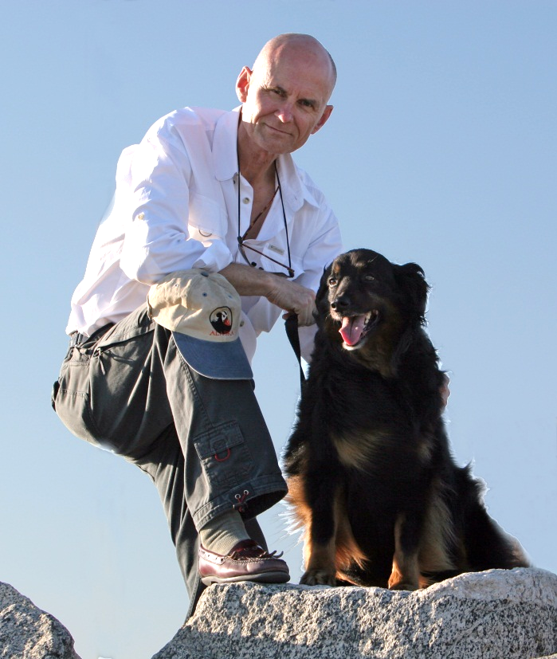
About the Author
Phil Barnes has a Bachelor’s Degree in Mechanical Engineering from the University of Arizona and a Master’s Degree in Aerospace Engineering from Cal Poly Pomona. He has 32-years of experience in performance analysis and computer modeling of aerospace vehicles, engines, and subsystems, primarily at Northrop Grumman. He has authored SAE technical papers on aerodynamics, dynamic soaring, and regenerative soaring. This latest presentation brings together Phil’s knowledge and passions for computer graphics, and geometry math modeling.

