Slide 1
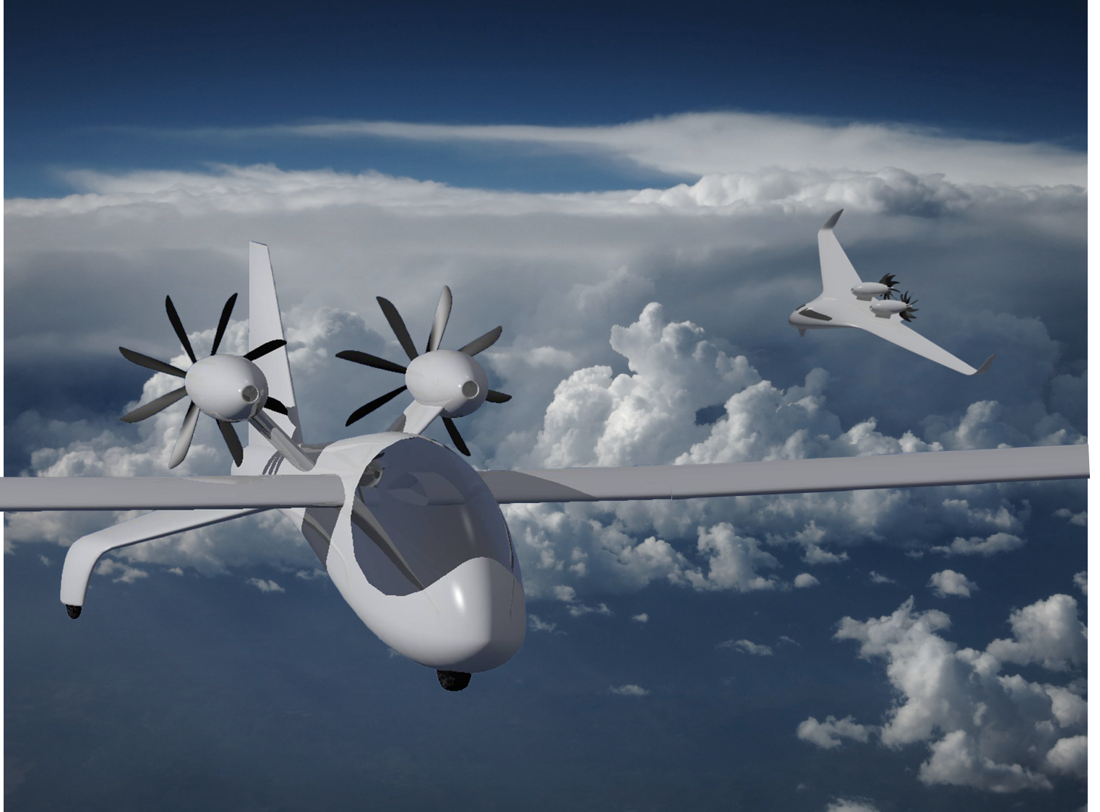
Principles of High-efficiency Electric Flight
J. Philip Barnes, Senior Technical Fellow
Pelican Aero Group
01 Nov, 2020
Animated slides ~ F5
+ “View ~ Notes Page”
Notes:
Electric flight has recently made its debut, with personal aircraft flying an hour or more. It’s only a matter of time before the gravimetric and volumetric energy densities of batteries, whether chemical, mechanical, nano-tech or nuclear, increase to enable more passengers, range, and endurance. As we wait for that inevitable development, we should strive for the highest efficiencies of electric-flight components and systems.
This presentation introduces new and fundamental characterizations of permanent-magnet motor-generator performance, electrical architecture optimization at full power, DC power conditioning for cruise and regeneration, dual-role propeller and aerial wind turbine subsonic and transonic aerodynamics, and vehicle performance. Our computational platform is the no-nonsense programming language of EXCEL/Visual Basic; free copies of any or all modules are available upon request.
Many of the key concepts and methods are the fruit of the author’s collaboration with engineering students working capstone projects. The learning was bi-directional. All materials are freely posted at the author’s site www.HowFliesTheAlbatross.com, the main charter of which is to prevent or delay the extinction of the wandering albatross. A second and much broader charter is to promote awareness of other threats to our natural world, which many distinguished scientists have projected will no longer exist as we know it by 2050, when the total weight of plastic at sea will exceed that of all marine life and when human population will have added three billion. Already today, humans and domestic animals take up the vast majority of the world’s total vertebrate animal mass, with wild creatures falling fast as we warm the globe, chop down forrests, and rake the seafloor. Hopefully, our progress with green transportation will at least delay what seems inevitable. The reader is invited to check out NetFlix’s new documentary “David Attenborough – A Life on Our Planet,” and for interesting related and informative reading, the book “Sapiens.”

Slide 2
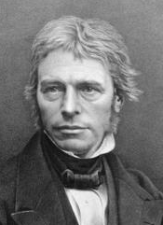
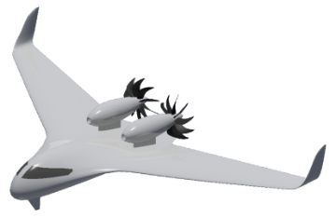
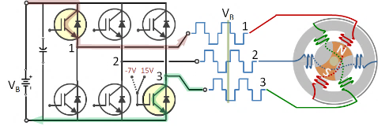
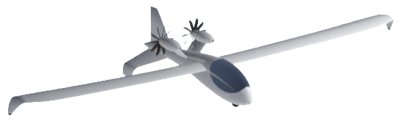
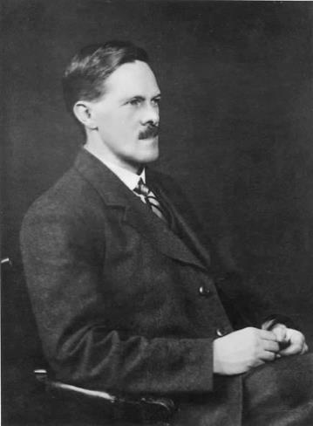
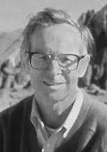
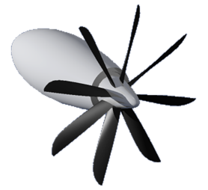
Presentation Contents
Motor-Gen
Faraday
Speed
Sweep
Optimize
full power
Hybrid option
Regen
DC-DC
cruise
Regen
MacCready
by permission, MaryEvans.com
Glauert
Windprop
Notes:
Introduction
Along the way in our presentation, we’ll visit with three visionaries. Michael Faraday invented the world’s first electric motor. Herman Glauert, propeller and wing aero guru of the 1930’s, was father of the airborne wind turbine. Paul MacCready, world-first in human-powered flight, originated the regenerative-electric flight concept. We’ll proceed directly to electrical machines, full-power optimization, and efficient electrical-power conditioning, including regeneration. We’ll then couple the electrical power system with one or more high-efficiency aero rotors, introduce regenerative electric flight, review/renew air-vehicle performance, and apply blade and wing sweep to increase flight speed. We’ll then finish up introducing and suggesting an architecture for hybrid-electric flight.

Slide 3
Presentation Contents
Motor-Gen
Faraday
Speed
Sweep
Optimize
full power
Hybrid option
Regen
DC-DC
cruise
Regen
MacCready
by permission, MaryEvans.com
Glauert
Windprop

Slide 4
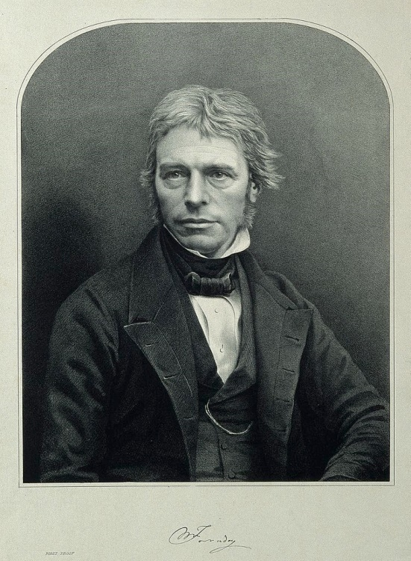
Michael Faraday, inventor of the world’s first electric motor, 1821
- Little formal training
- “...one of the greatest scientific
discoverers of all time”
- Earnest Rutherford
- 3 portraits in Einstein’s office:
Newton, Maxwell, Faraday
by permission, Wellcome Library, London
Notes:
Michael Faraday, pioneer of electrochemistry and inventor in 1821 of the world’s first electric motor, had little formal education. Faraday became one of the greatest scientific discoverers of all time, according to Earnest Rutherford. Albert Einstein posted on the wall of his study three images: Isaac Newton, James Maxwell, and Michael Faraday. Later herein we name our high-speed all-electric aircraft concept “Faraday First” in his honor.

Slide 5
Motor-generator Principles
Change to generator mode:
Same direction of rotation
Same sign of EMF
Same ratio, k = EMF/speed
Same ratio, torque/current
Torque & current reversed
τ
B
N turns
ω
ε_{m}
i
i
B
ε_{b}
τ
τω = ε_{m} i
ε_{m}= k ω
τ = k i
N turns
ω
Motoring
ε_{m}
i
Motoring mode:
“weaker than battery” gen.
EMF proportional to RPM
Torque propor. to current
i
B
ε_{b}
Generating
Notes:
Let's now characterize the performance of electrical machines with the ubiquitous feature of permanent-magnet or otherwise fixed-magnetic-field strength (B). The machine shown here came well after Michael Faraday, but it is derived from his vision. We’ll begin with a "classical" brushed machine which more readily reveals the principles which also apply to brushless machines.
First and foremost, the force on an electrical charge crossing a magnetic field is orthogonal to both the field and the charge velocity. With motor operation, longitudinal motion of charge within each copper loop yields torque, and circumferential motion yields an increase of voltage (the potential energy per unit charge) in the form of an electro-motive force, or EMF. (The interested reader is invited to test these assertions). Second, any motor can be a generator and vice-versa. As the motor spins faster, with torque proportional to current (except for torque loss), its linearly-rising EMF eventually matches the battery voltage, whereby current vanishes. Torque also vanishes, except for parasitic effects.
If the machine now is run (actually driven) at further increasing speed, and/or if battery voltage is somehow reduced, the machine becomes a generator, with an EMF exceeding that of the battery. However, rotation direction, EMF proportionality to speed, and torque proportionality to current remain the same as with a motor, but with both torque and current now changing sign. These continuities are essential to ground-electric-vehicle regenerative braking and “regenerative-electric flight.”
Regardless of operating mode, the three formulas shown characterize the basic operation of the machine, whether it is brushed, or brushless and combined with an inverter-rectifier, as discussed next.

Slide 6
Presentation Contents
Motor-Gen
Faraday
Speed
Sweep
Optimize
full power
Hybrid option
Regen
DC-DC
cruise
Regen
MacCready
by permission, MaryEvans.com
Glauert
Windprop

Slide 7
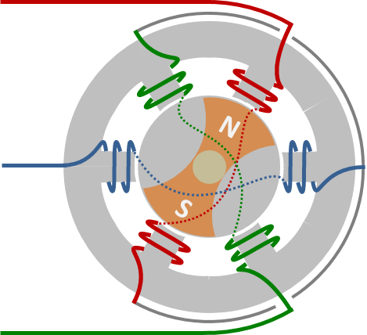
BLDC Mot-Gen. & inverter-rectifier: Ideal System efficiency
ε_{m}= k ω
R
“Equivalent brushed” machine
Inverter-
Rectifier
τ
τ = k i - λ
i
M-G
ε_{b}
ω
R ≡ lumped resistance
Motor eff., η ≡ τω / (ε_{b} i) ; η_{ideal} = k i ω / (ε_{b} i) = k ω / ε_{b}
Regen eff. , η ≡ ε_{b} i /(τω) ; η_{ideal} = ε_{b} i / (k i ω) = ε_{b} / (k ω)
Notes:
The brushless motor-generator as a system with its inverter-rectifier has the same two-wire interface with the battery and follows the same principles as a classical DC brushed machine, in that the generated EMF is proportional by the “EMF constant” (k) to rotational speed, and the torque is proportional by that same constant to current.*
Motoring system ideal (lossless) efficiency is given by the ratio of motor-output shaft power (product of torque and rotational speed) to battery “electromotive” power (product of battery EMF and current). Here, for our lossless system battery resistance is ignored. Using the classical formulas previously introduced, ideal motoring system efficiency reduces to the motor-to-battery EMF ratio (kω/ε_{b}), identical to a corresponding speed ratio, ω/(ε_{b}/k). Thus, system motoring ideal efficiency is simply proportional to rotational speed. Similarly, system generating ideal efficiency is the inverse of this speed ratio. We next show test data which confirms these predictions throughout the regions where losses are a small fraction of useful power.
* The EMF constant (k) has units of Volts/(rad/s), and it also represents the torque constant of the same numerical value with units of N-m/Amp. Such constant is inversely proportional to the popular voltage constant “K_{v}” having units of RPM/Volt.

Slide 8
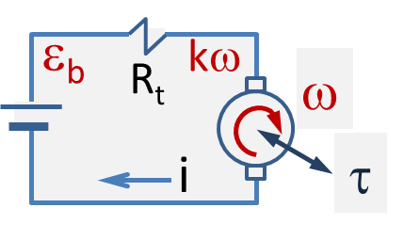
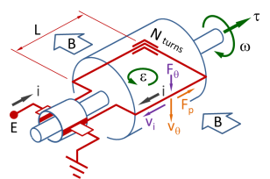
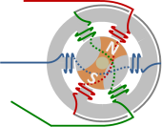
Theory & data: Non-dim. speed, torque, current, efficiency
Ideal gen. η = 1/ν
Ideal motor η = ν ≡ kω/ε_{b}
Efficiency curves are asymptotic to ideal, except where parasitic losses dominate
Notes:
Here we have non-dimensionalized test data from two different machines, one a motor and the other a generator, although a single machine would exhibit largely the same behavior. Plotted versus a non-dimensional rotational speed (speed ratio, or EMF ratio), which we designate “nu,” are the motoring and generating efficiencies, non-dimensional torque, and non-dimensional current. Notice that motoring behavior is bounded by a triangle with two sides of length unity. In the lower-right region of the figure, both torque and current change sign for generator operation.
As predicted earlier with our simplified, ideal system model, motoring efficiency is proportional to rotational speed. This trend is matched by test data, except near unity speed ratio where the motor EMF approaches that of the battery, and where power losses ultimately overshadow useful power. At unity speed ratio, the motor-generator EMF opposes and matches that of the battery, whereby current is zero and efficiency for an ideal system “instantly” falls to zero. In practice, the efficiency reaches a peak penetrating into the upper-right corner of a triangle as indicated by the red arrow.
At upper right, generating efficiency test data exhibits our earlier-predicted inverse proportionality to speed as rotational speed increases beyond unity speed ratio. As with motoring, improved generating efficiency would entail greater penetration into the “triangle” apex.

Slide 9
Non-dimensional characterization of P-M mot.-gen. performance
E_{m}
Dimensional Terms
E ≡ Voltage
ε ≡ Electromotive force (Volts)
i_{m} ≡ motor Amps = (ε_{b}−kω)/R_{e}
k ≡ EMF constant,
N-m/A or Volts/(rad/s)
K _{v} ≡ Motor const., RPM/Volt
note: K_{v} = 30/(πk)
m = motors per batt. = i_{b} /i_{m}
R_{m} ≡ 2-phase resistance, Ohm
R_{e} ≡ “either-path” resistance
= mR_{b} + R_{m}
τ ≡ Torque, N-m
≡ Torque loss, N-m
ω ≡ Rotational speed, rad/s
E_{b}
i_{b}
MOTOR
i > 0 ; τ > 0
GEN.
i < 0 ; τ < 0
R_{b}
i_{m}
R_{m}
k ω
ε_{b}
ω
Efficiencies
Motoring: ν < 1 - λR_{e}/(kε_{b}):
System motoring efficiency,
η_{s} ≡ (τω) / (ε_{b}i_{m}) “either path”
= [τR_{e} /(kε_{b})] [kω/ε_{b}] / [i_{m}R_{e}/ε_{b}]
= (1−ν−ψ) ν / (1−ν)
with maximum efficiency:
η_{opt} = 1 + ψ − 2ψ^{0.5}
@ ν_{opt} = 1 − ψ^{0.5}
Generating: ν > 1
System generating efficiency,
η_{s} ≡ (ε_{b} i_{m}) / (τ ω)
= (ν − 1) / [ν (ν −1 + ψ)]
with maximum efficiency:
η_{opt} = 1 / [1 + ψ + 2ψ^{0.5}]
@ ν_{opt} = 1 + ψ^{0.5}
τ = k i_{m}−λ
Non-dimensional Terms
Speed: ν ≡ kω/ε_{b} = RPM/(K_{v}ε_{b})
Current: i_{m} R_{e} /ε_{b} = 1−ν
Torque: τ R_{e} /(kε_{b}) = 1 – ν – ψ
Torque loss: ψ ≡ λR_{e} /(k ε_{b})
Current ,
i_{m} R_{e} /ε_{b}
ψ
1
0
1
0
η_{s}
Sys. Motoring
Efficiency
Torque,
τ R_{e} / (kε_{b})
0 1
0 1
ν ≡ kω/ε_{b}
ν ≡ kω/ε_{b}
Notes:
The simplified circuit shown above is the basis of our non-dimensional characterization of P-M machine performance where a battery powers one or more motors in parallel. At upper left are the basic parameters including “battery” (or power source) EMF (ε_{b}), system “either-path” resistance (R_{e}), motor EMF constant (k), and “modeled-as-fixed” torque loss (λ). In the absence of test data, we estimate the fixed torque loss to be a small fraction (say, 0.005) of the ideal stall or “locked-rotor” torque (k i = k ε_{b} /R_{e}) at zero rotational speed (ω). The next slide relates peak efficiency to the non-dimensional torque loss, in accordance with the equations of this slide.
Above, at the center, are the non-dimensional terms representing speed, motor-generator current, torque, and torque loss. If data characterizing the machine is available, we compute the non-dimensional torque loss (ψ), from its constituents. Otherwise we estimate it. We’ll soon show how this system enables compact characterization of test data representing machine or system performance. We’ll then focus on operating the system at its rated full power and at its peak system efficiency.

Slide 10
Motor-gen. max. efficiency Vs. Specific Torque Loss
Notes:
This plot relates peak motoring and generating efficiencies to the non-dimensional torque loss. For a model aircraft motor, a representative peak efficiency is 75%. For a sport-electric aircraft, such may be 93%. If we have a super-conducting machine, motor resistance will approach zero, but other torque losses, such as those for magnetics, windage, and bearings, will perhaps remain largely unchanged.

Slide 11
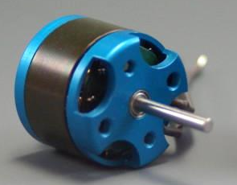
Brushless motor data condensation & theory validation
Test data: D. Lundström,
AIAA 2010-483
All data by the present method
Speed ratio, k ω/ε_{b}
Notes:
Here, at lower right, we condense a comprehensive, non-dimensional mapping of the performance of an “Mfly” model-aircraft brushless-DC motor. As with the brushed-DC machine, the efficiency is initially proportional to non-dimensional rotational speed (or speed ratio), then quickly falling to zero at unity speed ratio. Both non-dimensional torque and current are linear with non-dimensional speed, falling to zero at unity speed ratio. The test data, taken by grad student (now Dr.) David Lundström, represents the power-supply voltage, torque, speed, and current for a wide variety of propellers driven at static conditions.
Naturally, we are interested in operating near peak efficiency if conditions allow, but they often do not. Furthermore, the data above pertains to shop power (fixed voltage supply) and thus isolated motor operation, whereby “battery” resistance is zero in our simplified circuit model. If the motor is instead integrated with a finite battery, battery resistance usually overshadows that of the motor, and we discover that the optimum EMF constant (k) for an integrated motor differs vastly from that for an isolated motor.

Slide 12


“Six-pack” inverter-rectifier ("inverting" for motoring)
V_{B}
1
1
N
2
2
-7V 15V
3
S
V_{B}
3
Inverter converts 2-wire DC to 3-wire "AC“
Alternating transistor “diagonal pairs”
Commutation toggles two phases 0-to-V_{B}
Relatively low frequency at full power
Notes:
The “brushless-DC” machine is today ubiquitous, in part due to its capability of operating at far-higher voltage than a brushed machine. Here we investigate its operation as a motor and as a generator. A basic understanding of brushless motor control turns out to be a prerequisite thereof. Therefore, we first study motor control with the familiar “six-pack” inverter which, as we shall show, also serves as a rectifier passively enabling regeneration. This ingenious device, now around for several decades, in effect converts two-wire DC to 3-wire AC. Upper-lower “diagonal pairs” of transistors are alternately operated in effect as switches to connect one phase to battery voltage and a second phase to ground. The remaining phase “floats” until it is immediately put to use in the subsequent 60-deg-segment commutation. Thus, the magnetic field and rotor together spin around with the resulting electronic commutation.
Later herein we discuss a grossly-inefficient method (namely main-current pulse-width-modulation, or PWM, used in typical speed controls for present-contemporary model-aircraft) of “throttling down” to cruise power by “chopping” the commutation waveforms shown above. As we will show, a far-more efficient application of PWM is to control the voltage gain of a DC-DC voltage converter. But in lieu of using DC-DC conversion to throttle down, a model aircraft or UAV with today’s typical electronic speed control could easily double its endurance or range by alternately climbing at full power and gliding, power off.

Slide 13

Inverter-rectifier ("inverter" for motoring mode) ~ Snapshots
V_{B}
V_{B}
1
1
V_{B}
1
V_{B}
1
2
2
2
2
3
3
3
3
"Upper" switch pairs diagonally with a lower switch
Two phases are operating; one phase is "floating"
V_{B}
V_{B}
1
1
V_{B}
1
V_{B}
1
2
2
2
2
3
3
3
3
Notes:
The sketches above show the six-pack inverter in operation for various snapshots in time. With the battery and motor-generator connected to the inverter, current enters (red path) the upper switch and leaves (blue path) via the lower switch.
“Floating” phases also appear in each of the commutation waveforms shown above. Since “schematically-vertical” transistor pair operation must be avoided to preclude a short circuit, a short time gap (not shown here) with none of the transistors energized is necessarily included in each commutation cycle.

Slide 14
Six-pack inverter-rectifier (rectification for regeneration)
Snapshot
ε₁ - ε₃ > ε_{B}
1
1
ε_{B}
2
2
Diodes provide
"free" regen!
3
3
When motor-gen ΔEMF exceeds batt. EMF
Six-pack rectifies 3-wire AC into 2-wire DC
Battery recharged through flyback diodes
IGBTs unidirectional, ignore commutation
Current to battery!
Notes:
Under conditions where the generated EMF is greater than the battery EMF (as, for example, with DC-DC “boost” of generated voltage) the inverter will serve as a rectifier and, together with the motor-gen, deliver in effect DC current with minor ripple to the battery. Such regeneration occurs via the transistor flyback diodes which impose small loss of about 0.7V with today’s transistors. An insulated-gate bi-polar transistor (iGBT) conducts unidirectionally, so the above waveforms apply with or without commutation.

Slide 15
Presentation Contents
Motor-Gen
Faraday
Speed
Sweep
Optimize
full power
Hybrid option
Regen
DC-DC
cruise
Regen
MacCready
by permission, MaryEvans.com
Glauert
Windprop

Slide 16
Full-power optimization: voltage, current, & voltage const.
Task: Apply non-dim. model to solve for optimal battery EMF & motor (K_{v}) given (m) motors per battery, per-motor resist. (R_{m}), shaft torque (τ) & speed (ω), and effects of battery EMF & scale on battery resistance (R_{b})
Approach: Notice both (ν, η_{s}) will be about 0.9 for the optimal system Also note peak efficiency is uniquely set by the non-dim torque loss (ψ)
Optimum
[τ, ω, R_{e} ] fixes the
optimal [ i_{m}, ε_{b}, K_{v} ]
Mutual effects call for iterative sol’n:
1) Current: i_{m} R_{e} = ε_{b} (1-ν)
2) Power: τ ω = η_{s} ε_{b} i_{m}
Combine equations (1,2):
Equate ε_{b} for operating current
Equate i_{m} for operating Voltage
Corresponding Voltage const.
R_{e} = R_{e} (m, ε_{b} , τω)
R_{m} = R_{m} (τω)
η_{opt} = η_{opt} (ψ)
ψ = ψ (k, R_{e} , ε_{b} ,λ)
k = k (ν, ε_{b} , ω)
K_{v} = 30 / (π k)
Notes:
Let’s now apply the method to optimize the full-power system performance with (m) motors per battery or other voltage source. For now we assume that propeller torque (τ) and speed (ω) are known. We first write and combine the formulas for per-motor current and power, the former including “either path” resistance (R_{e}). We then recall that peak system efficiency (η_{s}), say 0.9, corresponds to a unique speed ratio (ν), also about 0.9. Thus a given combination of shaft power (τω) and either-path resistance (R_{e}) calls for a unique optimal battery EMF and current. And, given the desired operating speed (ω), the optimal motor voltage constant (K_{v}) is now set. If the “battery” is “infinite,” or otherwise exhibiting a fixed supply voltage, the “battery” resistance is set to zero, giving an optimal system (“battery” EMF, per-motor current, and motor-gen K_{v}) entirely different from that with a finite battery. These scenarios represent an integrated versus isolated motor.
Alas, most of these parameters have mutual effects, so an iterative solution is required. Before we turn to that, let’s study representative properties of brushless “outrunner” motors. These characteristics provide guidance for initial guesses, and a “sanity check” on our results.

Slide 17
Trend, motor resistance (two phases in series)
Indoor
Giant scale
other source
Full scale
Notes:
Recall that the basic circuit of an “isolated-motor” (fixed “shop” Voltage) has motor terminal Voltage working against the permanent-magnet motor-generator EMF to drive current through the two active phases of the machine. This log-log plot shows the trend of UAV-sized brushless outrunner motor two-phase resistance versus sustained motor shaft power (distinguishing shaft power from electrical power with a subscript). For this motor architecture, our extrapolation to sailplane scale gives a two-phase-series motor resistance (R_{m}) on the order of 10 milliOhms.

Slide 18
Motor k_{v} trend
Indoor
Giant scale
other source
Full scale
Notes:
Here we show the trend of motor voltage constant (K_{v}) versus shaft power. The data has been grouped by a characteristic dimension represented by the square root of the product of motor cylinder length (L) and diameter (D). Often the ratio L/D is near unity, whereby this characteristic dimension readily represents the “size” of the motor.

Slide 19
Motor RPM trend
Giant scale
Indoor
other
source
Full scale
Notes:
The plot above trends motor RPM with shaft power. A model-scale motor may spin a noisy propeller at 13000 RPM, but a sport-electric aircraft motor might spin at 2500 RPM. Here we note that all of the trends studied exhibit considerable scatter, and such trends are limited to the specific motor architecture represented by this data. Soon to become available are “transverse-flux” motors which, at full scale, may deliver high torque while spinning at only 1000 RPM to drive a quiet eight-blade propeller without the need for a gearbox.

Slide 20
Motor weight trend
Full scale
Giant scale
Indoor
Notes:
This trend of brushless outrunner motor weight versus shaft power exhibits considerably less scatter than our other trends. Again, however, different architectures can be expected to diverge from the trend, particularly where it has been extrapolated to full scale.

Slide 21
Algorithm (VB pseudo-code) solving for optimal full power
‘ Declare constants, i.e. pirad, mOhm/Ohm, Watts/kW, etc...
‘ Input motor torque (tau_Nm), loss (Lam_Nm), RPM, resistance (Rm_mO)
‘ Input battery cell properties, EMFc_V, Rc_mO, # parallel strings (Np)
‘ Input number (motors) per battery, “margin” to left of nu at max eta
‘
psi = 0.01: Rb_mO = Rm_mO ‘ first estimates
Re_mO = motors * Rb_mO + Rm_mO ‘ either-side resistance
For i = 1 To 10 ‘ iteration counter
nu = (1 - margin) * (1 - Sqr(psi)) ‘ speed ratio
etas = nu * (1 - psi / (1 - nu)) ‘ system max efficiency
EMFb_V = _ ‘ updated battery EMF
Sqr((Re_mO / mOhmOhm) _
* tau_Nm * om_rads / (etas * (1 - nu)))
Ns = EMFb_V / EMFc_V ‘ number of series cells
Rb_mO = Rc_mO * Ns / Np ‘ battery resistance, mOhm
Re_mO = motors * Rb_mO + Rm_mO ‘ either-path resist., mOhm
psi = Lam_Nm * (Re_mO / mOhmOhm) _ ‘ specific torque loss
/ (k_NmA * EMFb_V)
im_A = Sqr(tau_Nm * om_rads _ ‘ motor current, Amps
* (1 - nu) / ((Re_mO / mOhmOhm) * etas))
k_NmA = nu * EMFb_V / om_rads ‘ motor EMF const., N-m/Amp
Next i
‘ Auxiliary results:
Kv_RPMV = 30 / (pirad * k_NmA) ‘ motor volt const., RPM/V
etas
Notes:
Here we show the “pseudo-code” of an EXCEL/VB macro which solves iteratively for optimal battery EMF and motor voltage constant given the number of motors per battery and per-motor shaft power and rotational speed. The predict-correct method works with the non-dimensional speed, torque, and current to solve for the number of battery cells in series, given the user input number of parallel strings. If the motor uses constant-voltage shop power, an infinite battery (R_{b}=0) is modeled.
System (“either-path” with multiple motors per battery) resistance includes that of the battery, comparable to that of the motor at model-aircraft scale. At full scale, motor resistance becomes relatively small, whereby the solution for optimal isolated-motor conditions will vary considerably from that for the optimal battery-integrated motor or set of parallel motors.
Notice that all dimensional variables have units appended to the variable name. This helps avoid a Mars Lander situation where velocity “V” was handed off as (ft/s) by one orbital-mechanics team to another reasonably assuming (m/s). Appending units to the variable names significantly expedites code de-bugging and increases the probability of a good “first run” for the calculation.

Slide 22
Presentation Contents
Motor-Gen
Faraday
Speed
Sweep
Optimize
full power
Hybrid option
Regen
DC-DC
cruise
Regen
MacCready
by permission, MaryEvans.com
Glauert
Windprop

Slide 23
Cruise efficiency penalty when “chopping” the main current
Commutation, δ = 1.0
Low-frequency, full power
Negligible chopping loss
Pulse-width mod., δ ≈ 0.15
Hi-frequency chop, cruise
Chopping loss ~ 3%
| τ
| | δτ
Motor losses (windage, bearings, ...) persist, PWM “off”
Motor torque loss magnified by duty cycle inverse (1/δ)
Loss due to main-current PWM far exceeds chop loss
Notes:
Up to this point we have focused on optimal performance at full power. We now focus on power conditioning at cruise, where power is roughly one fifth of that for climb. At full power, commutation is a relatively low-frequency switching which matches phase operation to rotor position. With model aircraft and UAVs, a typical-contemporary electronic speed control (ESC) “chops” the commutation waveform to reduce power for cruise. Chopping of the main current entails relatively high-frequency PWM superimposed on the commutation square wave as shown.
ESC losses associated with PWM are set by the product of switching cycle energy loss and switching frequency. Such loss is largely unaffected by duty cycle (the fraction of “on” time during PWM), and may be roughly 3% at cruise. But ESC chopping loss is quite small in comparison to another loss imposed by main-current PWM, that of persistence of motor parasitic losses during the “off” portion of each PWM cycle. This is a classic systems engineering case where two high-efficiency components (ESC & motor) often operate together with unsatisfactory system efficiency, as quantified next.

Slide 24
PWM duty cycle at cruise power
Motor torque
Efficiency
Full
power
Load torque
Cruise
% RPM
0 20 40 60 80 100
Cruise power ~ 20% of full power (car or aircraft, climb)
Cruise torque ~ 50% of full power ; 15% of motor torque
PWM duty cycle ~ 0.15 to match motor & load torques
Notes:
Whether we are interested in a ground electric vehicle or electric aircraft, the power for cruise is a fraction of full power. A car might consume 100 kW climbing a mountain highway at 100 km/hr, but it needs only about 20 kW to cruise at the same speed on level ground. Whereas an EV may keep the same speed, reducing torque 80% for cruise, an electric aircraft reduces both speed and torque.
Here we plot versus speed the efficiency and torque, showing the match of motor and load at full power. In this example, when we now reduce the speed for cruise, the motor’s available torque is about seven times that required for cruise. Recall that for a P-M machine, torque is proportional to current. Thus, if we use pulse-width modulation (PWM) to “chop” the main current, the PWM duty cycle will be about 15% to match motor and load at cruise.
Notice also that the efficiency of the motor at the reduced RPM is only 58%, and that is only when energized. De-energized between power pulses for the larger fraction of the PWM cycle, the motor continues to sustain windage, bearing, and magnetic losses, thus doing “negative work” on the system.

Slide 25
PWM efficiency: Theory and test data
PWM Efficiency, η_{PWM}
Climb
* AIAA 2010-483
ψ = 0.015
ν = 0.6 - 0.9 est.
Cruise
Data
Theory
η_{pwm} = (1 - ν - ψ/δ) / (1 - ν - ψ)
50% loss at cruise if PWM is applied to main current
Notes:
Here we compare our approximate model of PWM efficiency to test data taken by Dr. Lundström. Although the theory departs from the data at ultra-low duty cycle, the fact remains that PWM losses, including chopping, approach 50% at cruise duty cycle. This “PWM efficiency” becomes a factor on the energized-motor efficiency of 58% at cruise in the previous slide. Thus as we mentioned earlier herein, a model aircraft or UAV incorporating a typical-contemporary ESC can double its range or endurance by never “throttling back,” instead alternately climbing at full power and then gliding, power off, with a “zig-zag” flight path.
It would appear that this phenomenon was well known to Toyota in the 1990’s, and this led them to reject main-current PWM in favor of “DC-DC converter” technology for their Toyota Prius. In a DC-DC converter, PWM finds a happy home, indeed proving essential, by operating on an auxiliary current at a transistor gate to control converter voltage “boost or buck” (gain). This we discuss next.

Slide 26








DC-DC buck converter for cruise, boost converter for regen
δτ |−−τ−−|
Trans. gate PWM
δ ≡ duty cycle ; τ ≡ period
PULSE-WIDTH MODULATION
CRUISE VIA BUCK CONVERTER
REGEN VIA BOOST CONVERTER
Transistor
i_{M}
ε_{M}
i_{B}
V_{M}
V_{B}
ε_{B}
L
L
C
ε_{B}
M-G
M-G
C₁
PWM
C₂
PWM
CRUISE: M-G voltage < batt.
”buck” ≡ V_{M} / ε_{B} = δ
REGEN: Boost M-G EMF > batt.
“boost” ≡ V_{B} / ε_{M} = 1/(1-δ)
Either device adds minor ripple overall
Notes:
Having optimized our system at full power, and recalling that the power for cruise is only a fraction thereof, we now efficiently “throttle down” for cruise by reducing the apparent EMF of the battery. Here, motor terminal voltage (V_{M}) is optimally reduced by an amount which retains the optimal non-dimensional speed (ν ≡ kω/v_{M}~ 0.9). Such voltage reduction is provided by a DC-DC buck converter, where the duty cycle (δ) of PWM applied at the transistor gate equates to the voltage “buck” (β ≡ v_{M}/ε_{B}). And, since we previously showed that we should not cycle the main current on/off, the capacitor (c₁) serves as a cyclic reservoir of charge thereof. Given the high frequency of PWM, the converter adds only minor ripple to the main current. Neglecting losses, output current is doubled if output voltage is halved. Such discontinuity may raise an eyebrow among those of us regularly applying continuity of fluid flow.
Now turning to regeneration, where due to relatively-low rotational speed the generator EMF is well below that of the battery, we must “boost” the apparent EMF of the generator to exceed the battery EMF and drive current into the battery. Here, the counterpart to the buck converter is the boost converter, for which the voltage boost is given by 1/(1-δ). Again, the device adds only minor ripple to the main current.

Slide 27
DC-DC Voltage buck or boost for cruise or regeneration
Given optimal full-power (k, ε_{b}), buck/boost Voltage via DC-DC converter to satisfy cruise or regen torque (τ) and speed (ω)
Solve for “buck-boost” Voltage ratio, β ≡ E_{m} /E_{b} where we define:
“actual current” factor, α_{DC} ≡ 1/η_{DC} motor ; α_{DC} ≡ η_{DC} regen
E_{b} = ε_{b} - i_{b}R_{b}
E_{m} = βE_{b} = kω + i_{m}R_{m}
Note β=1.0 at full power
β
R_{b}
R_{m}
i_{m}
i_{m}
ε_{m}= k ω
Next slide example:
1st opt. full-power ε_{b} : K_{v}
2nd “buck” battery, cruise
3rd “boost” M-G to regen
ε_{b}
i_{b} = βm i_{m}α_{DC}
ω
τ = k i_{m}−λ
Quadratic Eqn; Motor: negative root ; Generator: positive root
Notes:
We now insert the DC-DC converter into our electric-flight system with the purpose of efficient power conditioning in cruise or regeneration. First, the converter is assumed bypassed or otherwise ignored at full power, and otherwise operated to boost or buck motor-generator terminal voltage. Moving up along each side of the circuit above to assess the two terminal Voltages of the DC-DC converter, we solve for the converter Voltage ratio, designated (β), in terms of the cruise shaft power and earlier-solved, full-power battery EMF & motor voltage constant. We define a DC-DC converter “actual” (α_{DC}) factor on battery current to account for the small (3%) power loss of the converter.
Recalling that with regeneration both current and torque are negative, experimenting with the hypothesis that the formula above can also solve for regeneration conditions leads to a sign change for the root of the quadratic-equation characterizing the circuit.
We next apply all of the methods herein to (1) optimize the system of a sport-electric flyer at full power, (2) buck the battery apparent EMF at cruise, and (3) boost the motor-generator apparent EMF for regeneration. This is outlined in the next chart.

Slide 28
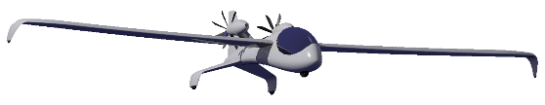
Optimal full power + DC-DC conversion for cruise & regen
FULL POWER, OPTIMIZED
Companion to slide 53
DC-DC
Efficiency ~ 71-86% by operating mode
Notes:
Here we show the results of our EXCEL application of the theory to Coulomb Keeper, extended after full-power optimization to add DC-DC conversion for efficient power conditioning at both cruise and regen. Since our model approximates a fixed torque loss, motoring or generating efficiencies for cruise or regen are somewhat reduced since the fixed torque loss represents a larger fraction of the shaft torque. However, battery efficiencies thereof are increased at reduced battery current. With the aid of DC-DC conversion at all power levels below full power (climb), electrical power efficiency is held between acceptable and good (71-86%). System efficiency (52-64%) then includes the losses of the windprop. We now turn to propeller and airborne wind turbine aerodynamics which represent “half” of our electric-flight system.

Slide 29
Presentation Contents
Motor-Gen
Faraday
Speed
Sweep
Optimize
full power
Hybrid option
Regen
DC-DC
cruise
Regen
MacCready
by permission, MaryEvans.com
Glauert
Windprop

Slide 30
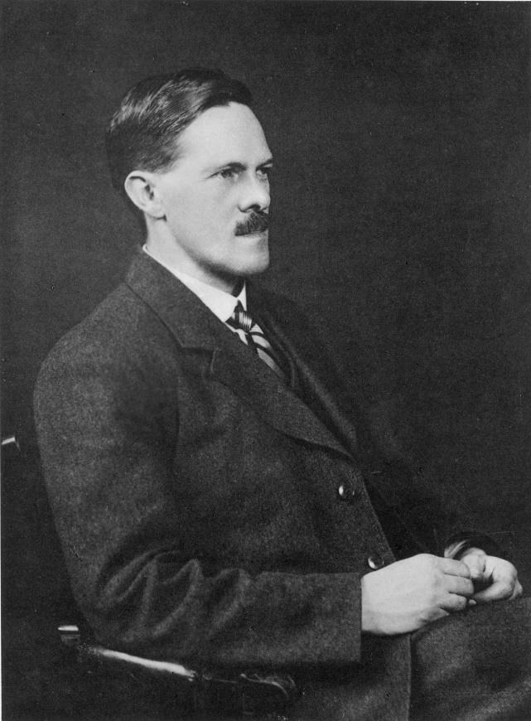
Meet Hermann Glauert
Pioneer, prop. & heli. aero
Thin-airfoil integral solution
Lift, any wing chord & twist
Prandtl-Glauert transform
Ridge-lift soaring analysis
Helicopter figure of merit
Father, aerial wind turbine
by permission, MaryEvans.com
Notes:
Hermann Glauert, a brilliant British aerodynamicist, was the guru of propeller and helicopter aerodynamic theory in the 1930’s. Also expert in wing aerodynamics, he solved the thin-airfoil problem, calculated the lift distribution of any unswept wing with arbitrary distribution of chord and twist, and independently conceived what is now called the Prandtl-Glauert Rule for transonic flow. In his classic 1926 text, he introduced an interesting ridge-lift analysis applicable to our “regen” which is described later herein. Glauert also pioneered the theory of the airborne wind turbine.

Slide 31
Task and Diagram: Glauert’s Blade-Element Method
All parameters are non-dimensional, except (c,h)
h
c_{D}
c_{L}
c
V_{p}+V_{ix}
ζ
W
πR/J - V_{iθ}
α
φ
β
Notes:
Here we show the velocity diagram and outline the problem to be solved by Glauert’s blade-element method. The velocity diagram, working exclusively with non-dimensional parameters, shows the profile velocity (Vp) and effective relative wind (W), including induced velocities. Also shown are the effective relative wind angle (φ), blade angle of attack (α), airfoil zero-lift angle (ζ) above the chord line, and lift and drag coefficients.
The eight parameters in the diagram have mutual effects. In particular, we highlight the core of Glauert’s method, represented by the dependence of induced axial velocity on thrust loading, and the dependence of induced circumferential velocity on the torque loading.

Slide 32
Windprop Blade Angle and Operational Mode
Increase RPM ~15%
Peak prop. efficiency
Positive torque
r tanβ = R tan β_{tip}
α = 0, hub-to-tip
~ torque-free
Decrease RPM ~15%
Peak turb. efficiency
Negative torque
Propeller
Pinwheel
reference
Turbine
L
β
β
β
v_{o}
v_{o}
v_{o}
-L
ω r
ω r
ω r
w
w
w
Define: “Speed ratio,” σ ≡ v / [ ωR tanβ_{tip} ], similar to advance ratio (J), but immediately revealing the mode:
σ < 1 prop., σ = 1 pinwheeling, σ > 1 airborne turbine
Notes:
Pitch at a given radial station is the streamwise length, for one rotor revolution, of the helical wake vortex which we imagine traced by a stream of dye emerging from the trailing edge of the blade at that radial position. With low blade pitch, the helical wake remains relatively close to the rotor. With high blade pitch, the helical wake moves quickly downwind. In general, pitch varies with radial station, but if we employ symmetric sections and special twist (r tan β = R tan β_{tip}) for radially-uniform pitch, then every blade section has zero angle of attack from hub to tip at what we will name the pinwheeling condition (where ωr tanβ = v_{o} ; thus, r tan β = constant). Here, the rotor operates almost torque-free, as if a garden pinwheel in the wind. If we now increase the rotational speed about 15% while holding constant airspeed (v_{o}), the blades efficiently develop lift, thrust, and torque as a propeller. Reducing rotational speed about 15% below pinwheeling, the blades develop negative values thereof, as an efficient aerial wind turbine.
We are thus led to define a new term, the “speed ratio” (σ), which not only applies to both propeller and turbine operation, but which also highlights pinwheeling where such speed ratio is unity. Although speed ratio has some similarity to a propeller’s “advance ratio” (J), only (σ) at once identifies the windprop operating mode: propeller, pinwheel, or aerial turbine .

Slide 33
Presentation Contents
Motor-Gen
Faraday
Speed
Sweep
Optimize
full power
Hybrid option
Regen
DC-DC
cruise
Regen
MacCready
by permission, MaryEvans.com
Glauert
Windprop

Slide 34
Propeller blade - comprehensive velocity diagram
w₂
Blade section
Looking outboard,
Blade at 3 o’clock
Helical wake
vortex sheet
ω r – 2v_{iθ}
v₁
Glauert: inflow is irrotational
Axial velocity locally conserved
Final swirl imparted suddenly
Wake-induced velocity (v_{i})
Glauert: 2v_{iθ} at "rotor out"
Absolute velocity (v) increased
Relative wind (w) is decreased
Immediate static pressure rise
Chord line
v₂
Axial
wind
β
v_{ix}
v₁ ≡ v∞+v_{ix}
v_{iθ}
v_{i}
φ
Zero-lift line
Rotational wind
w_{θ} ≡ ω r - v_{iθ}
ζ
Relative
wind w₁
α
v₁
Notes:
Here we show a comprehensive velocity diagram for the section of a propeller blade, looking outboard with the blade at 3-o’clock and with the rotation vector pointed forward. The inflow velocity (V₁) is purely axial, including the wake-induced axial velocity (V_{ix}) representing upstream acceleration. Furthermore, the axial velocity is conserved in the immediate neighborhood of the rotor, but there is additional acceleration downstream. Relative to the blade are the inlet and outlet “wind” vectors (W), with the trailing vortex helical wake nominally anchored to the quarter chord position and, arguably, leaving the blade aligned with the chord line. As with a wing, the wake induces a velocity (V_{i}) largely normal to the chord line, with induced velocity components (V_{ix}:V_{iθ}). As noted by Glauert, and as reflected in the velocity diagram, the flow leaving the trailing edge "sees" the effects of the immediate swirl imparted by all the blades, whereby the effective rotational wind (W_{θ}) is shorter than that of the leading edge. Relative to an observer fixed to the aircraft, the conservation of axial velocity and sudden-imparted rotational flow are seen by examining the “absolute velocity” vectors (V₁ and V₂).
The reduction of relative wind (W) through the rotor yields a sudden increase in pressure just downstream of the rotor. Assuming incompressible flow, Bernoulli’s Equation relates the pressure rise to the change in the square of the circumferential relative wind. Each induced-velocity component (V_{ix}:V_{iθ}) reduces the angle of attack (α). For clarity, these components are shown larger than actual. The Wright Brothers, inventors of the first practical aerial propeller theory, called the induced axial velocity “throwdown” and the induced circumferential velocity, which they likely detected with downwind streamers, as “negative tangential.”*
* Carroll & Carroll, J. Aircraft, Vol. 42, No. 1, Jan-Feb 2005

Slide 35
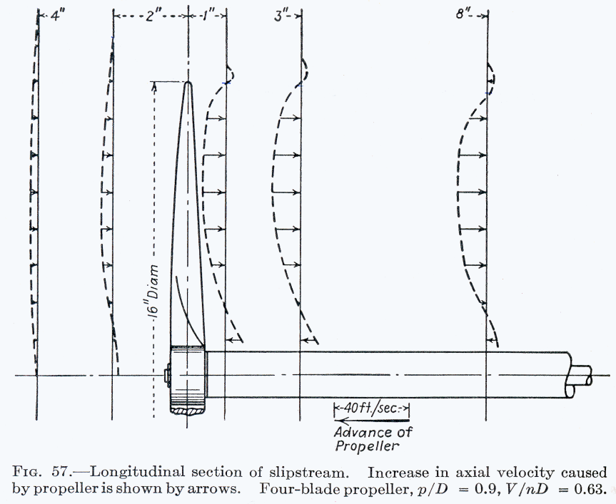
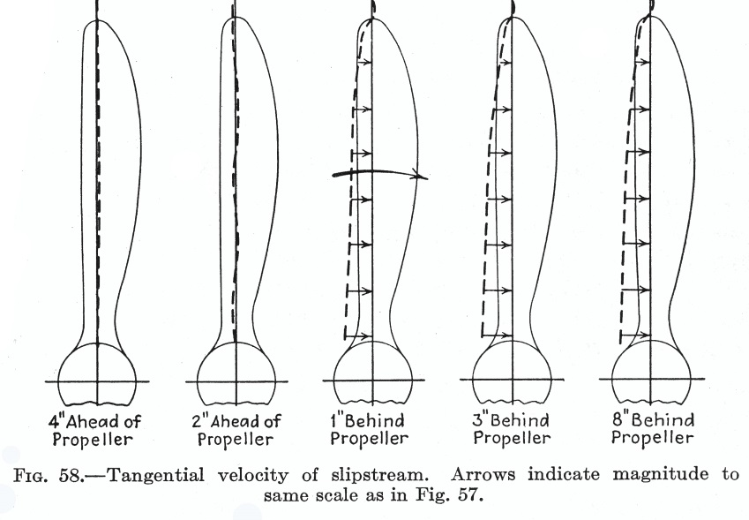
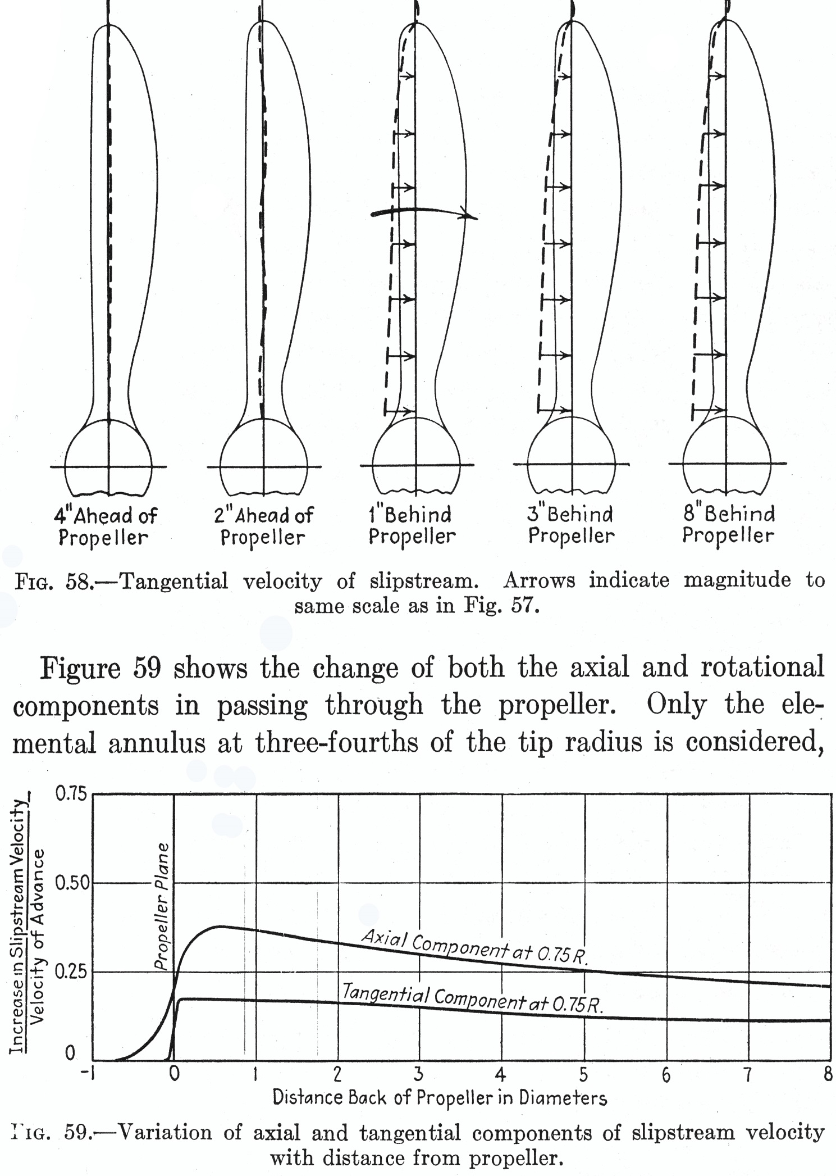
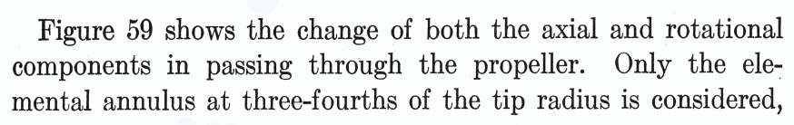
Test data validates Glauert's description of induced velocity
Gradual buildup
Immediate swirl
F.E. Weick, Aircraft Propeller Design, McGraw-Hill, p. 102-103
Notes:
In his classic 1926 text, Glauert reviewed the actuator disk model originated by Rankine around the time of the American Civil War. One key phenomenon to emerge from the actuator disk model of a propeller is the gradual increase of velocity approaching and leaving the propeller. This is substantiated by test data shown here, where for this set of conditions, the slipstream attains its final velocity less than one diameter downstream.
Another key phenomenon, as perhaps first described by Albert Betz, with further elaboration by Glauert, is the sudden and final swirl immediately imparted to the flow at the propeller. This also is substantiated by the test data shown above.

Slide 36
Duplicating Glauert’s sample calculation (Durand’s book)
R
R
R
Glauert’s
example*
Glauert applied
(previous slide)
BEM interpretation validated
First hint of optimistic thrust
Induced
velocities
Lifting-line BEM hybrid
* Aerodynamic Theory, W.F. Durand, Dover, 1963, Vol. iV, p. 174-175, 239-240
Notes:
Here we validate our interpretation of BEM by duplicating Glauert’s example from his classic “Propellers” section of Volume iV from Durand’s Aerodynamic Theory. At the top are blade chord and blade angle. At the bottom are the thrust loading and induced velocities. The symbols represent Glauert’s calculations and the dashed curves represent our interpretation of his method. For reference, we add the solid curves representing the hybrid method herein, and these give the first hint that BEM overpredicts the thrust loading.

Slide 37
Lifting-Line Method ~ Overview
Refs: SAE 975559
SAE 1999-01-1581
ζ
α
α+ζ
Tangent-flow boundary cond.
Equiv. flat-plate airfoil
ΣV_{i}∙u
Sum induced velocities aligned with unit vector u (normal to wind W)
due to all bound and helix vortices ; Get G(R)
W
ΔΓ
N
u
…
V
G≡Γ/(v∞R)
ΔΓ
2
ΔΓ
All non-dim.
except Γ v∞ R
1
W
Lifting Line (or path)
φ
πR/J
N Horseshoe vortices
N downwash nodes
N x N Linear system
β+ζ
Notes:
To bypass BEM’s limitations and also to accommodate sweep, transonic, and cascade effects, we have hybridized BEM with our lifting line method, numerically integrating helical wake effects. In the diagram above, we nest several horseshoe vortices along the lifting line at quarter chord, with each vortex ultimately taking the shape of a helix which is discretized into linear filaments which, in accordance with the Biot-Savart Law, induce a velocity at each downwash node. The method numerically integrates, for every bound and trailing vortex filament of every blade, the component of induced velocity aligned with a unit vector which is directed normal to the undisturbed wind at the downwash node, the latter nominally at ¾-chord, but which as described later herein, is shifted forward for cascade effects, and aft for transonic effects. The solution for bound vortex strength applies a boundary condition where the flow must be parallel to the equivalent-plate airfoil at the downwash node. Hybridization of our lifting-line method with BEM simply applies Glauert’s formulas for induced velocities, as the lifting line method solves for dT/dR and dQ/dR.

Slide 38
Lifting-Line Method ~ Nested loops with axial flow
p q
For i = 1 to N ‘ downwash node
For j = 1 to N ‘ horseshoe vortex
Fij = 0 ‘ initial. influence
For k = 1 to B ‘ blade
For L = 1 to S ‘ upwind segment
ΔFij = …. ; Fij = Fij + ΔFij
Next L
For m = j to N ‘ bound segment
ΔFij = …. ; Fij = Fij + ΔFij
Next m
For n = 1 to S ‘ downwind seg.
ΔFij = …. ; Fij = Fij + ΔFij
Next n
Next k
Next j
Next i
. .
ΔΓ
N
…
ΔΓ
2
ΔΓ
. .
1
q p
Select one “master blade”
Declare & calc. arrays for:
Downwash node coords.
Downwash unit vectors (u)
Vortex segment ends (p,q)
D’wash bound. cond. (κ)
Solve [F][ΔG]=[κ]
For i = 1 to N
Gi = 0 ‘ initial.
For j = 1 to i
Gi = Gi + ΔGj
Next j
Next i
c_{L} : Streamwise sol’n
c_{D} : 2D sweep theory
Notes:
This sketch shows greater detail for lifting-line modeling of a propeller. Nested loops accommodate the bound and trailing helical vortices of each horseshoe and each blade. This approach is limited to symmetric flow. If the rotor is inclined to the flow, the number of simultaneous equations is factored by the number of blades, and the blade loading will then vary blade-to-blade.

Slide 39
Lifting-Line validation, case 1
Low-speed propeller, β₇₅ = 45º ; J = 2.03, NACA ARR L6E22
BEM+EBE outperforms Lifting-Line for this example
Notes:
This chart compares to test data the blade loads computed by BEM+EBE and our lifting-line method. In this example BEM+EBE happens to comes closest to the test data, representing a three-blade propeller with a spinner, all at the operating conditions shown.

Slide 40
Fixed-pitch windprop efficiency comparison, B=8 Vs. B=2
1.0
Efficiency
8
8
0.8
2
2
0.6
η
Propeller
fv / (τω)
Turbine
τω / (fv)
0.4
0.2
Speed Ratio, σ ≡ v_{o} / (ωR tan β_{tip})
0.0
0.5
0.6
0.7
0.8
0.9
1.0
1.1
1.2
1.3
1.4
1.5
1.6
1.7
1.8
1.0
0.9
B=8 : High pitch, low RPM
0.8
CLIMB
0.7
Similar peak efficiencies
8 blades: hi-pitch, slow, quiet
Same thrust & diameter,
symmetric airfoil sections
R tanβ = const. = tan β_{tip}
0.6
0.5
F ≡ Force
coefficient =
f / (½ ρ_{ο}v_{o}² πR ²)
0.4
B=2 : Low pitch, high RPM
0.3
CRUISE
0.2
EFFICIENT
REGEN
0.1
CAPACITY
REGEN
0.0
-0.1
PINWHEEL
B=2
-0.2
8
-0.3
Speed Ratio, σ ≡ v_{o} / (ωR tan β_{tip})
-0.4
0.5
0.6
0.7
0.8
0.9
1.0
1.1
1.2
1.3
1.4
1.5
1.6
1.7
1.8
Notes:
Given symmetrical sections and the hub-to-tip uniformity of the pinwheeling condition, it should be no surprise to learn that increasing or decreasing rotational speed on either side of pinwheeling yields similar peak efficiencies for propeller and airborne wind turbine operation. What may come as a surprise is the very-small drag of pinwheeling, explained by recognizing that here the force on each section is directed roughly perpendicular to the freestream, thus having little effect on vehicle drag.
Let’s now compare the characteristics of two windprops of the same thrust and diameter, one spinning slowly with eight high-pitch blades, the other spinning fast with two low-pitch blades. In each case we will use the previously-described symmetrical sections and twist for uniform pitch. Versus speed ratio, we find that both windprops exhibit peak efficiencies over 85% for both propeller and turbine operating regimes. The eight-blade, high-pitch rotor will be much quieter than its two-blade counterpart. Also, with its reduced tip Mach number, a multi-blade, high-pitch rotor enables higher airspeed (this comparison is at low airspeed).
A companion plot shows the force coefficient (F) versus speed ratio (σ). As expected, the force is positive for propeller operation and negative for turbine operation. Since RPM is dramatically reduced for regeneration, the corresponding force and power are much lower than those for climb.

Slide 41
Windprop aero performance – Cruise
Sym. sections ; B = 8 ; (r/R) tanβ = tan 31º
σ = 0.84 ; η = 0.883
Notes:
This is the input and output of a comprehensive model of propeller or wind-turbine aerodynamic performance, programmed with Visual Basic, and graphically displayed in EXCEL (free, as all else, at my website). The model numerically integrates the effects of the helical wakes and “hybridizes” those results with Glauert’s application of the momentum principle to relate the induced velocities to thrust and torque loading.
Blade geometry is rapidly and smoothly characterized with just 3-to-5 input points, cubic-spline interpolation with independent control of the full range of spline-end conditions, and an optional elliptical envelope applied to the blade chord outboard of any user-specified radial station.
The model, detailed and validated with test data in my related SAE and AIAA technical papers, outputs thrust and torque loading, Glauert’s “section efficiency” (ideally radially constant), induced velocities, and lift and drag coefficients. The ten-blade propeller studied here for a speed ratio 16% below pinwheeling operates at 88% efficiency.

Slide 42
Windprop aero performance – Regen
Sym. sections ; (r/R) tanβ = tan 31º
σ = 1.13 ; η = 0.888
Signs change with turbine operation
Notes:
We now operate the same rotor as an airborne wind turbine, whereby a speed ratio of 13% above pinwheeling is selected for high efficiency. As we might expect, we see a change of sign in thrust, induced velocities, and lift coefficient. But as might not be expected by some readers, the rotor exhibits almost 89% efficiency, slightly better than that of the propeller. Toggling between this and the previous chart reveals the effects of changing operational mode.

Slide 43
Presentation Contents
Motor-Gen
Faraday
Speed
Sweep
Optimize
full power
Hybrid option
Regen
DC-DC
cruise
Regen
MacCready
by permission, MaryEvans.com
Glauert
Windprop

Slide 44

Meet Paul MacCready
First human-powered aircraft
Solar-powered, ground & air
Pterodactyl flapper & glider
Regen-elec. soar concept, ‘98
- “considered with caution”
courtesy of Tyler MacCready
Notes:
The visionary American engineer Paul MacCready brought us the first human-powered flight. He was also pioneer in the technology of ground electric vehicles, solar-powered flight, and paleo-aero engineering. In his seminal paper of 1998, MacCready introduced "with caution" the concept of what we have termed regenerative electric soaring. Although in his paper MacCready did not offer a specific configuration, he did imagine and describe a complete flight of a "regen." Much of this presentation attempts to demonstrate the feasibility of MacCready’s regen concept.

Slide 45
Presentation Contents
Motor-Gen
Faraday
Speed
Sweep
Optimize
full power
Hybrid option
Regen
DC-DC
cruise
Regen
MacCready
by permission, MaryEvans.com
Glauert
Windprop

Slide 46
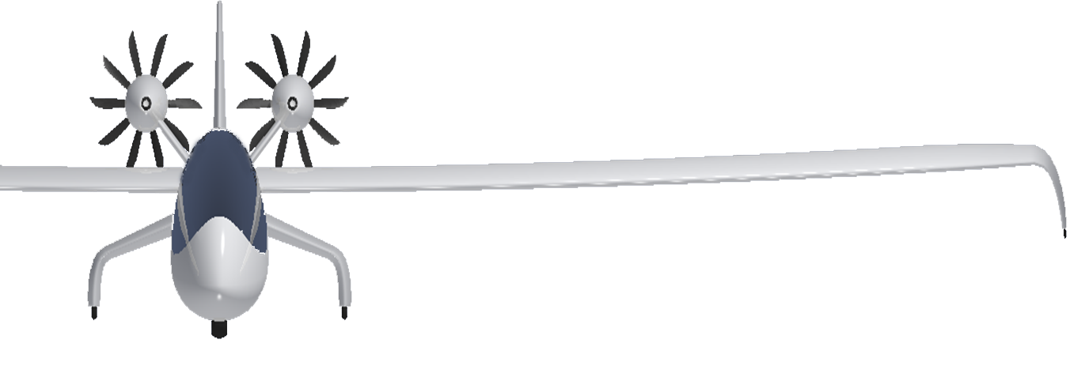
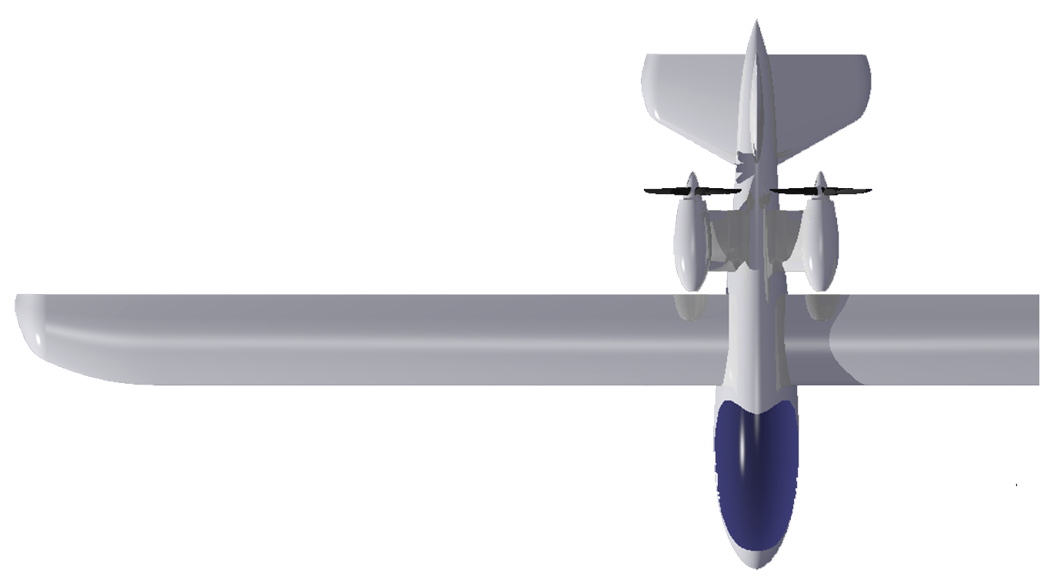
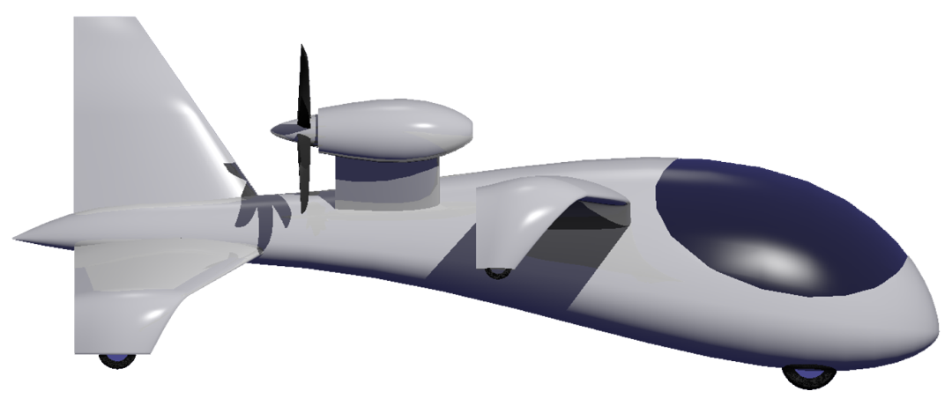
Introducing Coulomb Keeper regen-electric soarer
Counter rotors
Symmetric flow
Zero net torque
10-blade rotors
Low RPM, quiet,
Limited diameter
Ground handling
No assistance req'd
Winglet tip wheels
Pusher Config., laminar flow, no helix upset
Pod-air-cooled
MG & PE
Notes:
Here we introduce Coulomb Keeper, a “regen” named for its frugality in earning and spending electrical charge, and designed to realize the visions of Glauert and MacCready. The pusher windprops eliminate interference of helical wakes with the airframe. Rotor diameter is constrained by design to incorporate Glauert’s “many blades” and, with the aid of high pitch, reduce both RPM and noise. Inverted winglets with wheels preclude the need for ground-handling assistants. Symmetric sections enable efficient propeller operation in climb and cruise, and efficient wind turbine operation in ridge lift, thermals, steepened final descent, and perhaps even windy-day recharge on the field with a safety perimeter. With this set of ideal conditions of weather and geography, the “holy grail” of repeated flights powered entirely by the wind may come within our reach.

Slide 47
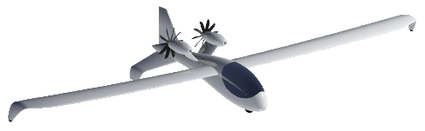
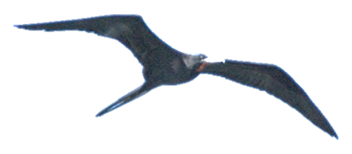
Thermal Updraft Contours
Elevation, z_{o} ~ m
1ºC warmer-air column
20-minute lifetime
~ solar power x 10
U ~ m/s
1
2
3
Total Energy
= Kinetic
+ Potential
4
Total Energy
= Kinetic
+ Potential
+ Stored
Notes:
The representative thermal shown above, including contours of local updraft velocity (u,m/s), has a diameter of 200-m at its base and 1-km diameter at its top where the elevation is perhaps 4-km. A thermal is aptly named, since its air temperature is typically 1ºC higher than that of the surrounding air.
The peak-updraft core of 5-m/s resides at an elevation of 1000-m. Optimally positioned relative to (58-m from) the core, a regen aircraft with a still-air sink rate of 1.7-m/s, including the effects of regeneration, would be carried aloft at 2.0-m/s by a 3.7-m/s updraft. At the top of the thermal, updraft velocity falls to zero. The lifetime of the thermal is consistent with the time consumed by climbing fraction of its height.

Slide 48
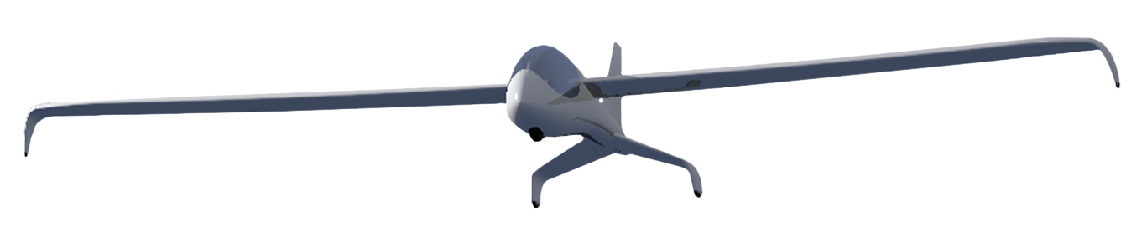
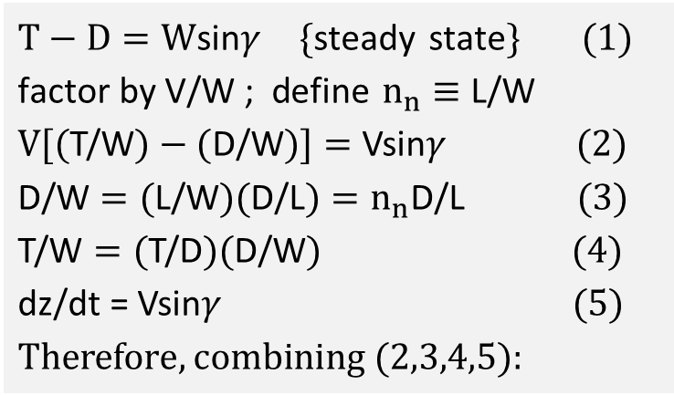

Steady-state climb or sink, any orientation, in still air
V
L= n_{n} W
T-D
φ
γ
γ
$$T−D=W\text{sin}γ \{\text{steady} \text{state}\} (1) \\ \text{factor} \text{by} \text{V}\text{/}\text{W}\text{ ; }\text{define} n_{n}≡\text{L}\text{/}\text{W} \\ V[(\text{T}\text{/}\text{W})−(\text{D}\text{/}\text{W})]=\text{Vsin}γ (2) \\ \text{D}\text{/}\text{W}=(\text{L}\text{/}\text{W})(\text{D}\text{/}\text{L})=n_{n}\text{D}\text{/}\text{L} (3) \\ \text{T}\text{/}\text{W}=(\text{T}\text{/}\text{D})(\text{D}\text{/}\text{W}) (4) \\ \text{dz}\text{/}\text{dt}\text{ = }\text{Vsin}γ (5) \\ Therefore, combining (2,3,4,5):$$
W
Frigate Bird
  T/D=0 (no thrust)
  sink rate (-dz/dt) = n_{n} (D/L)V
Frigate Bird and Regen
  sink increases with g-load (n_{n})
  sink increases with airspeed (V)
$$\text{dz}\text{/}\text{dt}=n_{n}\left(\text{D}\text{/}\text{L}\right) V [(\text{T}\text{/}\text{D})−1]$$
Notes:
This sketch shows the forces acting on an aircraft in still air and in steady-state cruise, climb, or descent, wings level or banked, whether along a linear or curved trajectory. Thus the only constraints for the present analysis are the still-air and steady-state conditions. In the diagram with the flight path angle (γ) and wings banked at the angle (φ), the lift vector (L) is normal to the airspeed vector (V). The lift has the value (n_{n}W), where (W) designates weight and (n_{n}) the normal load factor. Note that flight path angle (γ), taken relative to the local air mass, will be negative if the aircraft sinks therein. After “normalizing” the various forces in terms of dimensionless ratios, we find that the steady-state, still-air climb rate (dz/dt), regardless of vehicle orientation, is given by the product of the still-air “clean sink rate” [n_{n}(D/L)V] and a “propulsive group” [(T/D)-1]. Note for regeneration that the thrust/drag rato (T/D) is negative. In referring to a “clean” sink rate, we apply a thrust-drag accounting rule that assumes all propulsion elements are removed when calculating drag (D), and that any drag increments (trim, interference, etc.) due to propulsion system integration have been treated as thrust penalties when we declare the “installed” thrust (T).
A sailplane or soaring bird has (T/D=0), whereby the still-air climb rate is of course negative. Sink or climb performance is degraded as load factor (n_{n}) is increased, since (L/D) evaluated at the lift coefficient under load. Thus, turning “twice increases” the drag, and we learn from the wandering albatross to employ a high-aspect-ratio wing to mitigate this effect.
Before applying these results to a complex scenario, we first apply them to a simple, historical scenario: The Wright 1902 glider soaring in ridge lift.

Slide 49
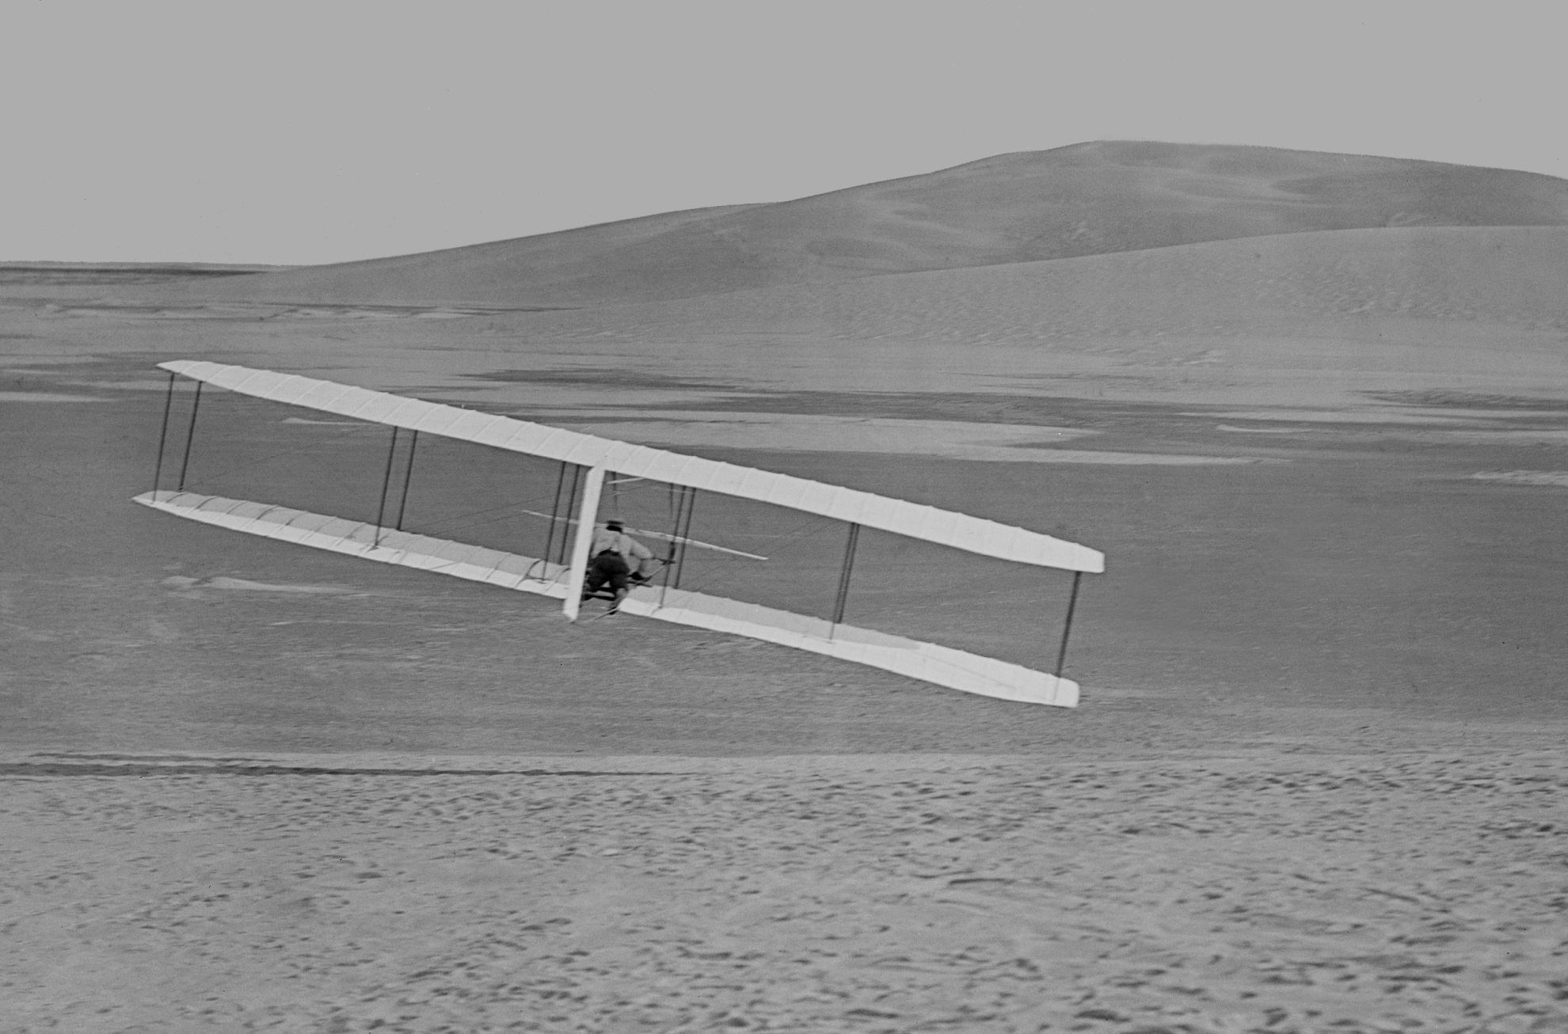
Wilbur Wright ridge soaring in 1902 at Kill Devil Hills, N.C.
Wright 1902 glider
Wing warping
Coupled rudder
1000 flights
Glider: -05% margin
Flyer: -25% margin
Notes:
The Wright Brothers’ 1902 glider, making about 1000 flights, was the world's first practical aircraft, independently controllable about all three axes, and enjoying reasonably-coordinated turns. This glider was marginally unstable (5%) in pitch, but generally manageable. For their 1903 Wright Flyer, the brothers installed a relatively-heavy propulsion system well aft of the c.g., finding themselves quite lucky to get two successful flights before the aircraft was destroyed. As it was, the aircraft parked in the sand was destroyed by tumbling in a gust of wind. But had there been no such gust, the aircraft would likely have soon been severely damaged by an inevitable hard landing on account of its severely tail-heavy condition. The unflyable nature of the 1903 aircraft would be “rediscovered” precisely 100 years later, in spite of our e-mailed cautionary advice, in an attempt to launch and fly a stubbornly-exact replica.

Slide 50
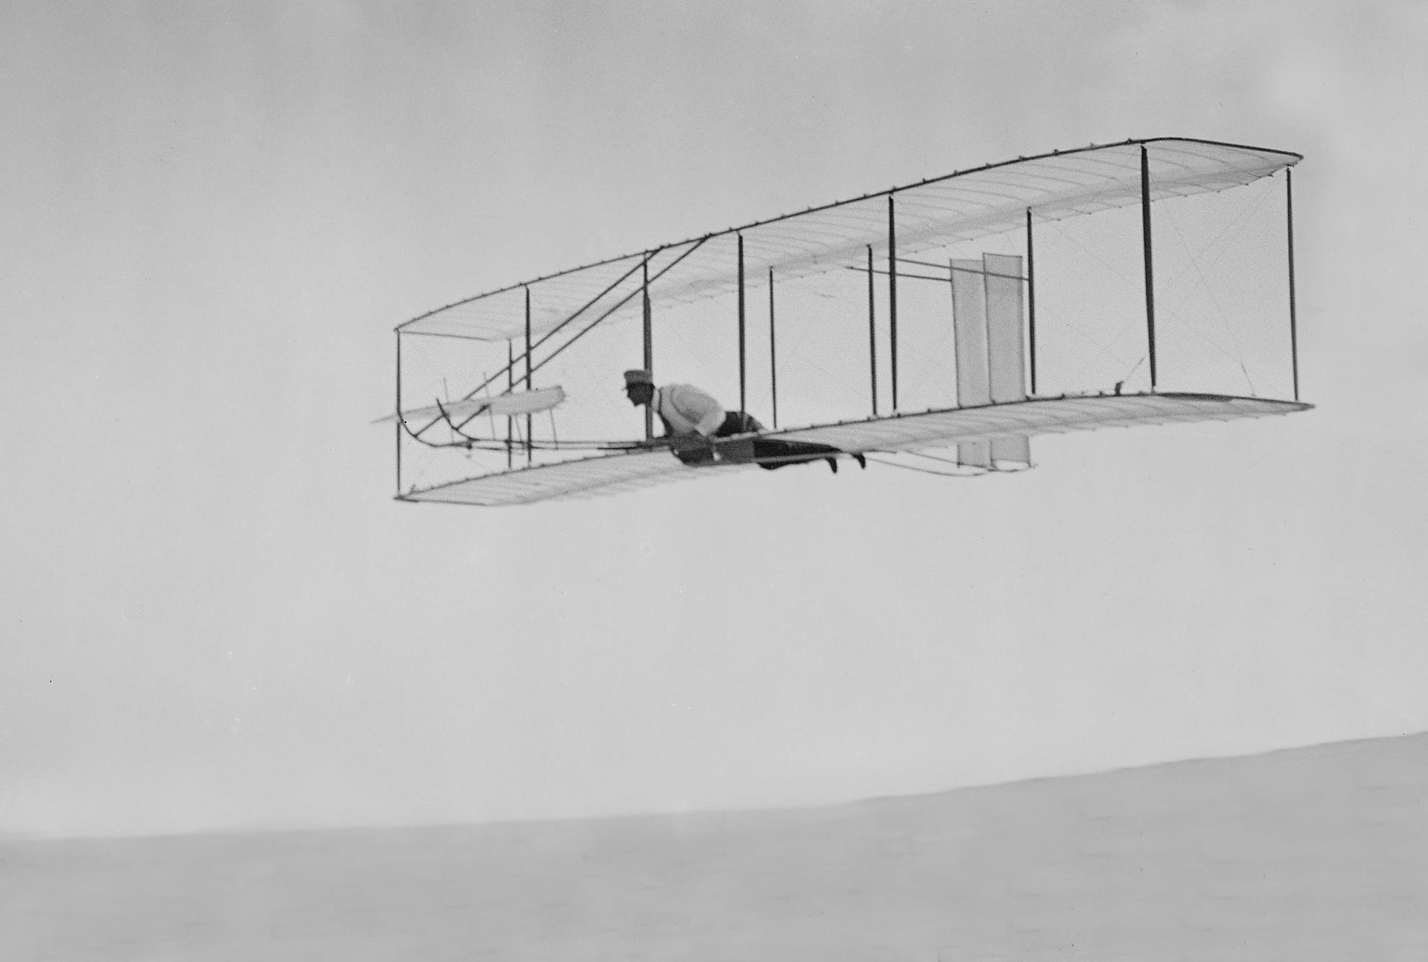
Ridge soaring: 1902 Wright Glider at Kill Devil Hills, N.C.
Over 1000 flights
-5% static margin
Orville:
"The machine flew beautifully...and...
when the proper angle of incidence
was obtained, seemed to soar"
γ
L
u
γ
D
v
W
Ridge-soaring power = Dv = (D/L) (L/W) W (v/u) u
= tanγ cosγ W (1/sinγ) u = Wu
Notes:
The Wright Brothers wisely selected the sand dunes of the Outer Banks of North Carolina for their flight tests. On a windy day, the dunes would provide an updraft to reduce ground speed and to enable slope soaring, should conditions permit. But more important, the sand cushioned the inevitable hard landings.
In the photo and sketch above we solve for the power provided by the ridge-soaring updraft, and this is given by the product of drag and airspeed, equivalent to the product of weight and updraft velocity. We next apply this to a more complex scenario where we are interested in what we have termed “total climb rate” (dz_{t}/dt), or the rate of change of total kinetic, potential, and stored energy per unit weight.

Slide 51
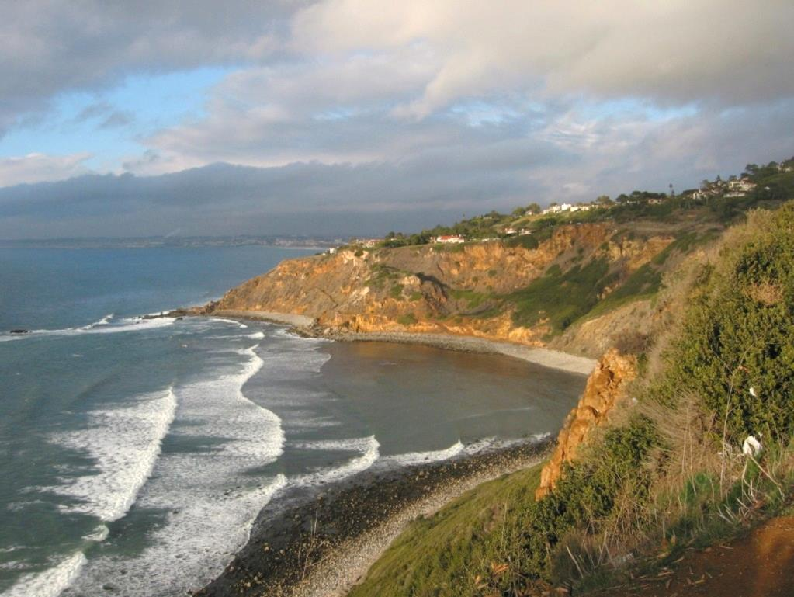
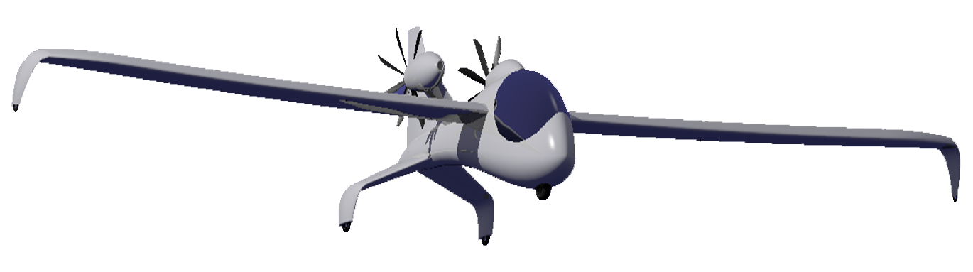
Regenerating in ridge lift
Mode RPM
Climb 1300
Cruise 1100
Pinwheel 700
Regen 400
Notes:
In the graphic above, a “regen” in ridge lift uses its “windprops” as airborne wind turbines to recharge the battery. The twin, fixed-geometry rotors with symmetric sections incorporate high pitch and rotate relatively slowly, particularly during regeneration. If the aircraft is both aerodynamically efficient and equipped with the capability for efficient regeneration, taking advantage of that capability when encountering various forms of updraft will increase flight endurance. In the limiting case of special conditions depending on local geography and/or weather and state of charge at the beginning of final descent, a regen could further regenerate during descent and land with a full charge. On the ground, the regen might further top off its battery with the aircraft safely cordoned off and its windprop operating as a turbine on a windy day. We thus imagine at least the notion of a self-contained flight powered entirely by vertical and horizontal winds.

Slide 52


Regen-electric-flight Equation
“Total climb,” ż_{t} defined:
Steady-state rate of change,
total potential, kinetic, and
stored energy / total weight
Typical T/D
Climb: 5.1
Cruise: 1.0
Pinwheel: -0.1
Regen: -1.8
“Clean”
sink rate
Power Group
Updraft
“Total
Climb”
“Total Sink”
Ridge, u ~ 2.4 m/s
Thermal, u ~ 3.7 m/s
Define “Exchange ratio,” ε
= η_{sys} (~ 0.6), turbine mode
= 1/η_{sys} (~ 1.6), prop mode
System = elec.+ windprop(s)
Steep final descent
Ground wind charge
Notes:
This slide introduces our regen-electric-flight equation, where we show a regen storing energy in ridge lift, and where we study the rate of change of total kinetic, potential, and stored energy. Dividing this total by vehicle weight yields what we name total climb rate, designated “Zt dot.” This begins with updraft (u), and we then subtract the total sink rate obtained from the product of clean sink rate and a power group representing the windprop effect, including a term which we name the exchange ratio, “epsilon.” The exchange ratio is defined as the combined electrical and windprop system efficiency in turbine mode, or the inverse thereof in propeller mode. The derivation of the formula is found in our SAE paper “Flight Without Fuel.”
For the ridge-lift scenario shown here, the updraft matches the sink rate including regeneration, whereby the aircraft pumps energy into the battery, gaining total energy, as it flies along the ridge with constant kinetic and potential energy. The formula for total-climb readily reveals that a “regen” should have high L/D, low wing loading (low airspeed, V), and high system efficiency.

Slide 53
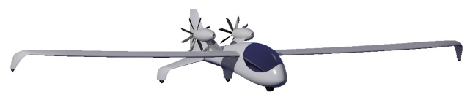
Coulomb Keeper
Point Performance
Companion to slide 28
Notes:
This table, for the benefit of those interested in greater detail, summarizes the flight conditions, shaft power, electrical power, climb rate, total climb, and numerous other parameters for, column-by-column, cruise, climb, regen in ridge lift, regen in a thermal, and regen for steep descent. See also slide 75 for electrical-power details.
Key parameters of interest are highlighted with boxes, including the comparison of windprop shaft power. Notice that the power to cruise is about one fourth the power to climb. We keep this in mind when we later study power conditioning.

Slide 54
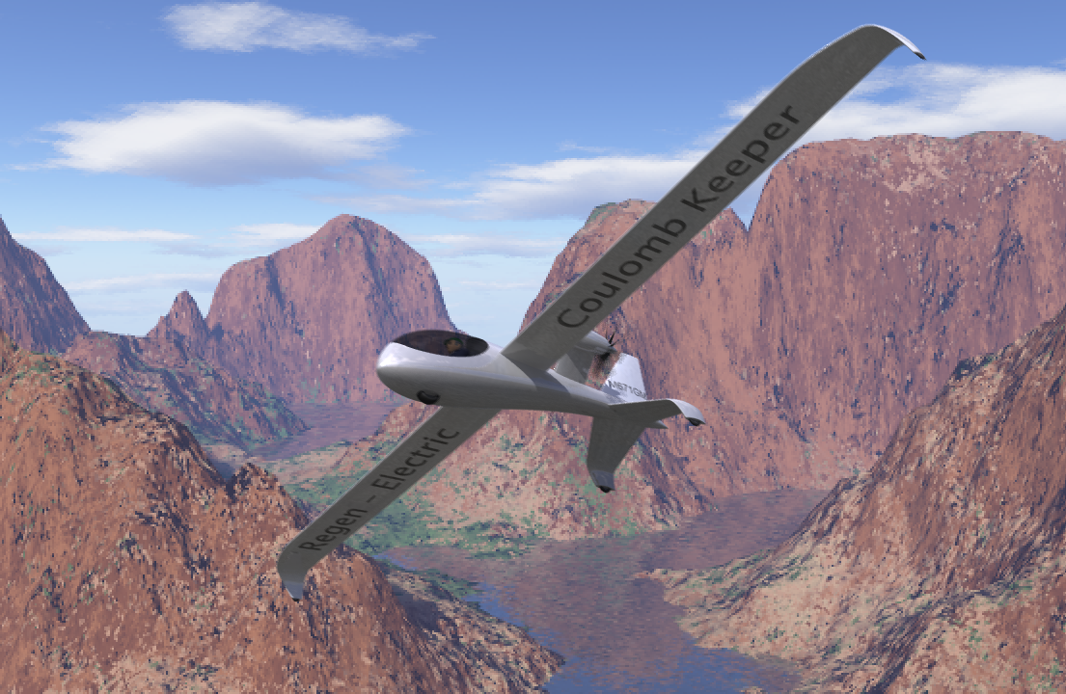
Coulomb Keeper Flight Simulation
Model by J. Philip Barnes / Animation: Mario Merino
posted at www.HowFliesTheAlbatross.com
Notes:
We next show a short simulation of Coulomb Keeper in various flight modes. The geometric model, fully math modeled by the author with Python equations in the free and highly-capable computer-graphics tool Blender (www.Blender.org), was animated by computer-graphics artist Mario Merino.

Slide 55
Presentation Contents
Motor-Gen
Faraday
Speed
Sweep
Optimize
full power
Hybrid option
Regen
DC-DC
cruise
Regen
MacCready
by permission, MaryEvans.com
Glauert
Windprop

Slide 56
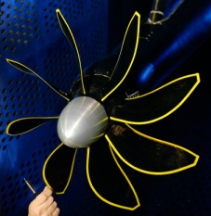
Propfan: Hybrid Lifting-Line compared to high-speed test data
NASA SR-7A propfan, Mach 0.80 ; β₇₅ = 60.2º ; J = 3.09, NASA TM 89917
NASA TM 89917
L-Line
r/R
r/R
Excellent results for Lifting Line with no adjustments to operating conditions
Notes:
This last example of the lifting line method applied to transonic flow models the NASA SR-7A propfan. As with the previous examples, the “windwise” distance between the lifting and downwash lines is factored by our normalized-empirical Prandtl-Glauert airfoil-lift-slope correction (slide 94), with both Mach number and thickness taken normal to the spar. Also as before, cascade effects shift the downwash line forward near the hub.
The calculation exhibits an excellent match to the test data representing thrust. However, our calculated efficiency (not annotated above) is about 10 points below the test data. Nevertheless, the original NASA reports, as well as follow-on AIAA papers, had to uniformly reduce the blade angle 4-deg to get a reasonable match between calculated and measured thrust. Here no such adjustments have been applied.

Slide 57
Presentation Contents
Motor-Gen
Faraday
Speed
Sweep
Optimize
full power
Hybrid option
Regen
DC-DC
cruise
Regen
MacCready
by permission, MaryEvans.com
Glauert
Windprop

Slide 58
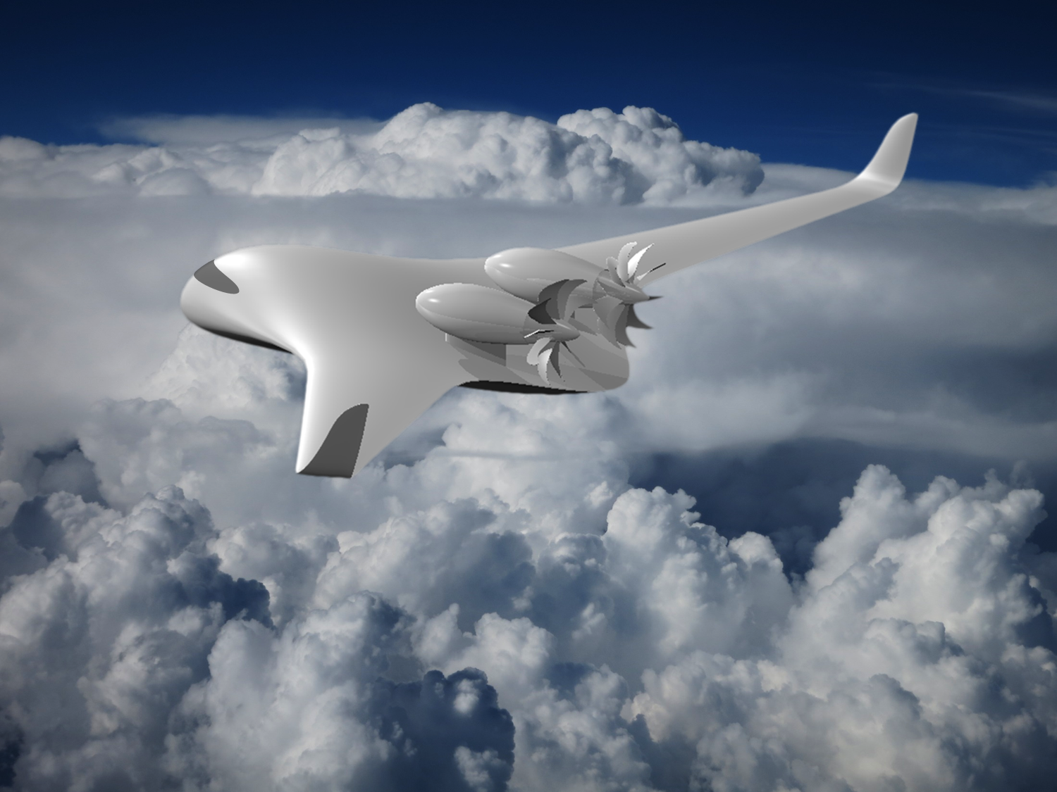
Methods applied: “Faraday First” all-elec. or hybrid-elec.
Mach 0.70
71% efficiency
10 swept blades:
- reduced diameter
- reduced RPM
- reduced noise
Notes:
Now we apply the present method to suggest the aerodynamic design of a propfan suitable for the fast aircraft depicted above. Each of two rotors would have ten swept blades to reduce diameter, RPM, and noise for a given thrust. The formula at the right matches total thrust and drag at cruise.
The geometry of Faraday First is fully characterized with equations in the Python programming window of the open-source computer-graphics software freely available at (www.Blender.org). To preserve the irrotational flow upstream of the rotors, we have adopted a pusher configuration.

Slide 59
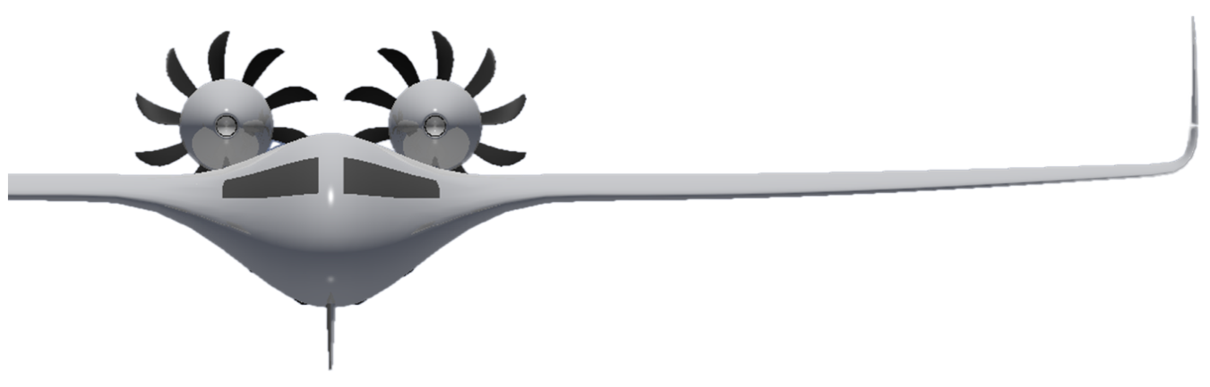
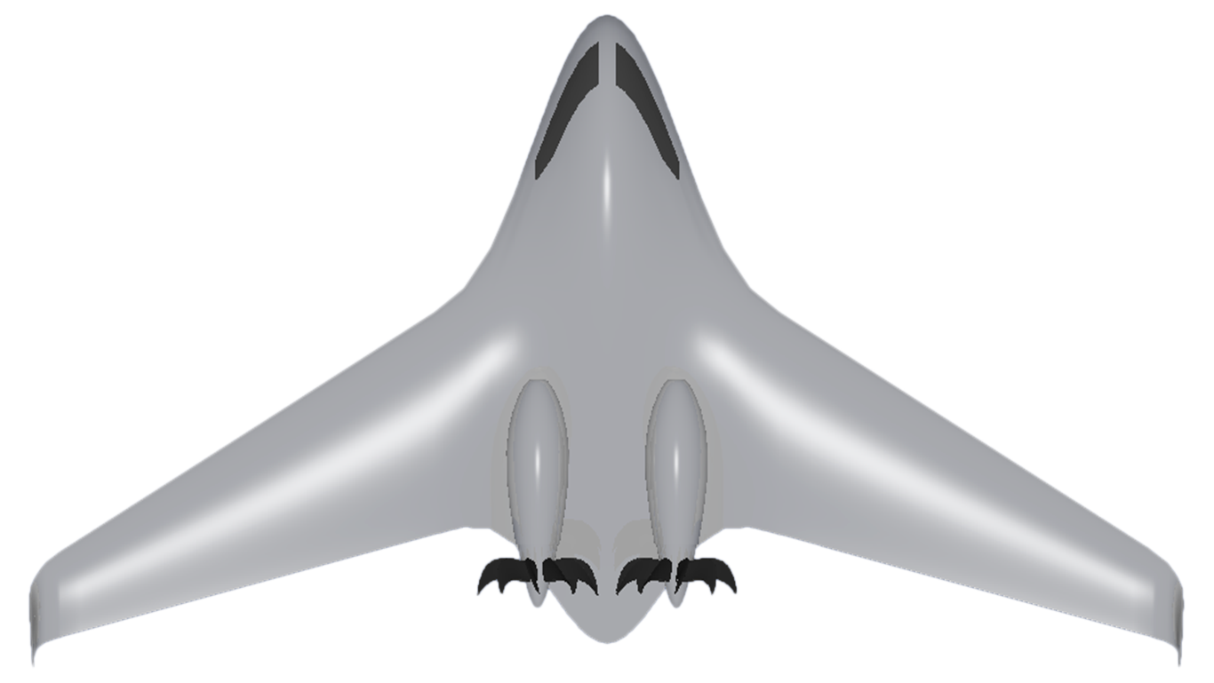
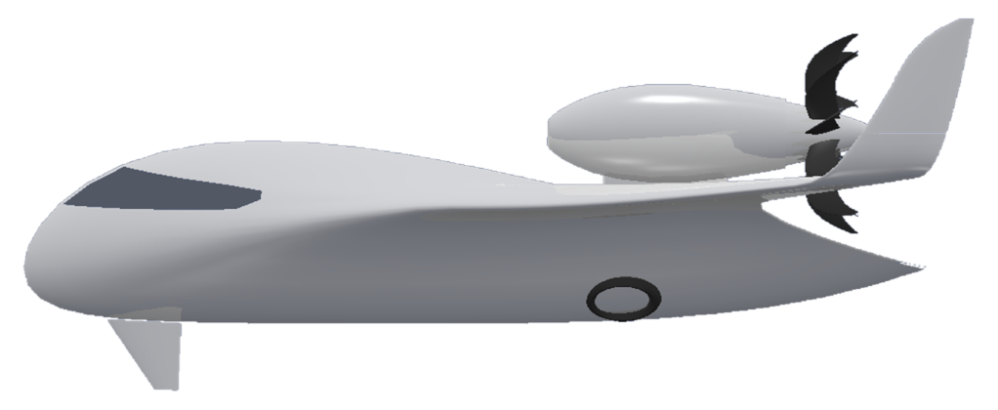
Introducing Faraday First: 10-x today’s batt. Specific energy
10-blade rotors
Low RPM & noise
Notionally First all-elec.
aircraft to fly > M 0.70
Ventral canard
Assists turning
Enhances safety
Notes:
Here we introduce Faraday First, taking advantage of future “battery” specific energy and notionally first to fly all-electric at 0.75 Mach number. Alternatively, the aircraft may employ a hybrid architecture. As with Coulomb Keeper, the rotors employ symmetric sections and many blades to reduce not only diameter and noise, but also in this case to reduce rotor-tip Mach number. Also again, a pusher configuration is adopted to eliminate helical-wake upset of laminar flow. Pylon trailing-edge blowing might be employed to mitigate pylon-wake effects. Although Faraday First was originally envisioned to implement a unique method of swept-wing flight control based on symmetric or differential winglet toe-out, with a ventral canard to prevent adverse yaw, subsequent analysis of lift distribution with winglets deflected showed that winglet differential toe-out could supplement, but not replace, conventional flight control. Thus we may imagine that Faraday First also incorporates elevons and ailerons, although they are not shown, in our video shown next to give the general idea of high-speed all-electric flight.

Slide 60
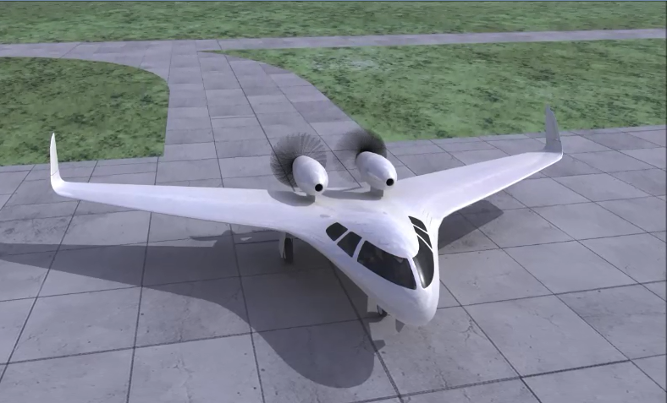
Faraday First Flight Simulation
Model by J. Philip Barnes / Animation: Mario Merino
posted at www.HowFliesTheAlbatross.com

Slide 61
Presentation Contents
Motor-Gen
Faraday
Speed
Sweep
Optimize
full power
Hybrid option
Regen
DC-DC
cruise
Regen
MacCready
by permission, MaryEvans.com
Glauert
Windprop

Slide 62
Notional high-efficiency hybrid-electric architecture with regen.
STARTUP
TAKEOFF & CLIMB
DC-DC
DC-DC
M-G
M-G
Batt.
ELEC.
LOAD
Batt.
ELEC.
LOAD
ENG.
ENG.
Mot-gen.
batt. kW
~ 4X eng.
shaft kW
O’RUN.
CLUTCH
misc
misc
SM
SM
CRUISE & RE-CHARGE
REGEN DESCENT
DC-DC
DC-DC
M-G
M-G
Batt.
ELEC.
LOAD
Batt.
ELEC.
LOAD
ENG.
ENG.
hi-eff. eng.
cruise and
re-charge
Eng. 0-rpm
Restart on
Approach
misc
misc
SM
SM
Notes:
As we await inevitable breakthroughs in battery specific energy (energy/weight), specific power (power/weight), and energy density (energy/volume), hybrid-electric architectures will take to the skies, particularly for “several-passenger” aircraft. In this slide we introduce a notional high-efficiency hybrid-electric flight architecture, borrowing from a Collins Aerospace concept, but introducing significant differences.
In using only one motor generator, the system avoids the “middle-man” effect suffered by converting shaft power to electrical power and then back again with two electrical machines, one driven by the engine and the other driving the propeller. Also, since we showed that the power to climb is about five times the power to cruise, the so-called “cruise engine” is sized only to power the propeller in cruise with simultaneous re-charge of the relatively-large battery which, with the motor in climb, supplements the engine with four times the engine power. The small cruise engine and relatively large battery constitute the core of the Collins concept. And as noted by Collins, the cruise engine always operates near peak efficiency, whereas today’s all-fuel-based approach suffers reduced efficiency upon “throttle down” to cruise, where roughly-constant parasitic losses consume a larger fraction of total engine power.
Features unique to our proposed variant of the Collins architecture include overrunning clutches to enable two simultaneous shaft power inputs and ensuring that neither starter motor nor engine parasitic losses are sustained during regen in final descent with the engine shut down (re-started for approach). DC-DC converters in the circuit control current levels and directions.
The above is only a schematic; how to efficiently and aerodynamically package the rotor, gearbox, cruise engine, and motor-generator clearly presents a challenge. In particular, the engine may “want to“ spin perhaps 50 times faster than the propeller. If the rotor has many blades, as we suggest, it will have a large hub providing a starting point for component frontal area.

Slide 63
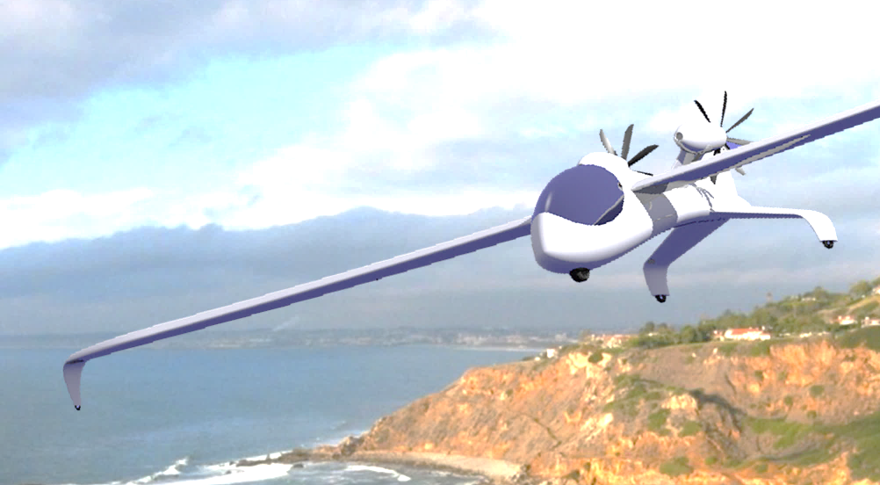
Summary – Principles of High-efficiency Electric Flight
New, non-dim. modeling of P-M machine performance
Full-power optimization of voltage & motor-gen constant
DC-DC converter for efficient cruise & regen power regime
Glauert/MacCready: “Fathers” of “windprop” dual-role rotor
Propeller: Lifting line works well subsonic, & transonic swept
Windprop: similar efficiency for propeller & turbine modes
Quiet & efficient: “many” blades, high pitch, spinning slowly
Select a high-torque/low-speed motor-gen to avoid gearbox
Coulomb Keeper : Regen.-electric wind-powered floater
Faraday First : notionally first all-electric to fly Mach 0.7+
Regen-electric flight is coming soon to an airport near you!

Slide 64
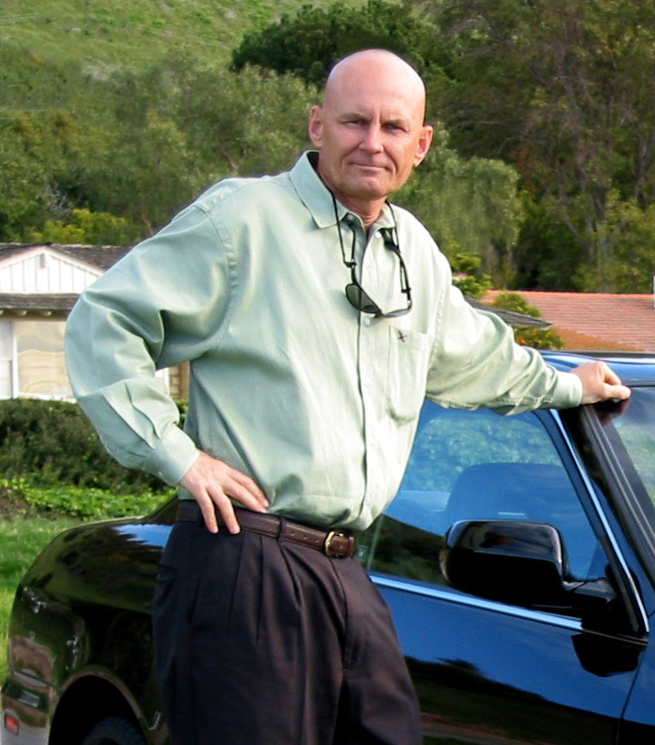
About the Author
J. Philip Barnes has a Master’s Degree in Aero Engineering from Cal Poly Pomona and BSME from the University of Arizona. He is a 40-year “veteran” of air vehicle, propulsion, and subsystems performance modeling at Northrop Grumman. Phil’s analysis and SAE paper explaining how the wandering albatross uses dynamic soaring to remain aloft on shoulder-locked wings was named “landmark” by noted aerodynamicist Bruce Carmichael. Phil was recently nominated by former Aviation Week editor Bill Sweetman, colleagues, and Phil’s academic network to deliver the AIAA 2020 von Karmán Lecture. He is now pioneering the science of regenerative electric flight, and his presentations thereof have been named “inspiring to many.” Author of diverse technical papers, Phil has delivered invited, travel-paid lectures at Cal Poly, USC, UIUC, OSU, and the University of Dayton. He was named 2014 Outstanding Aero Engineering Alum at Cal Poly Pomona, where he presented “Future Flight: Learning From the Birds” to an audience of 200 graduates, family, and faculty. Phil is a recipient of SAE’s Lloyd Withrow Excellent Speaking Award and AIAA’s 2016 Gohardani Aerospace Presentation Award. Phil’s work is freely posted at his website www.HowFliesTheAlbatross.com.

