Slide 1
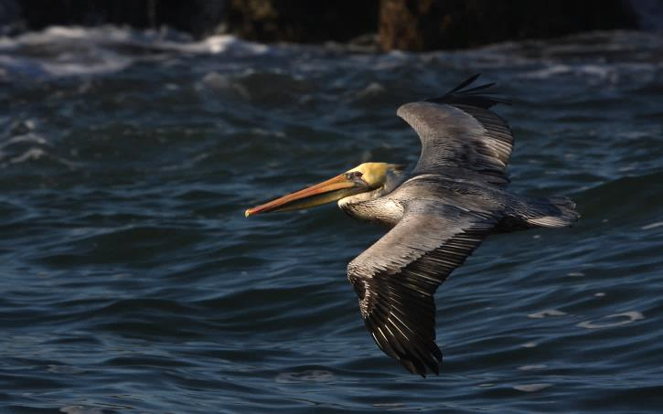
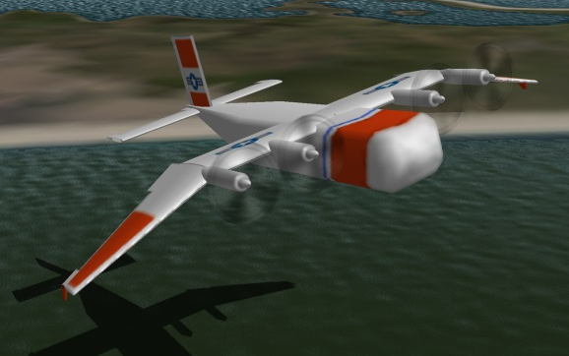
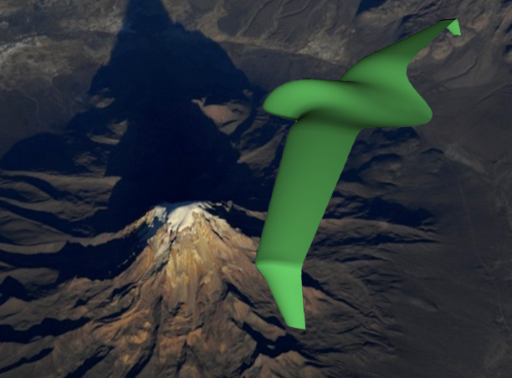
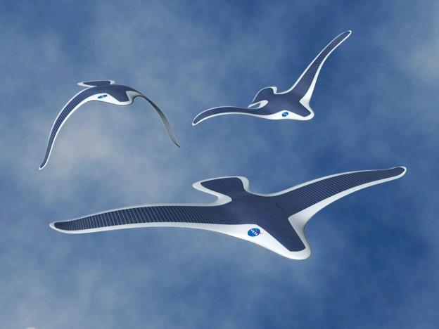
Future Flight: Learning From the Birds
Cal Poly Pomona Outstanding Engineering Alum 2014 Presentation
J.Philip Barnes 07 June / 19 Dec update 2014
Animated Presentation
Use slideshow F5 key
Also View "Notes Page"
All photos & graphics are by the author except where noted and used by permission
Notes:
This “bio/green aero engineering” presentation will draw from several disciplines, including photography, paleontology, ornithology, aerodynamics, and flight mechanics, to facilitate a broad look at just some of the things the birds can do, and how we might apply some of those skills in future aircraft. The intent of the presentation is to increase our awareness of amazing natural aerial world, so that we may take greater interest in emulating and protecting it.
Although the birds have enjoyed millions of years of evolutionary perfection of their skills, in many cases we can emulate one or more of those skills in an aircraft, no matter how primitive our aircraft may appear in comparison. Although we can duplicate neither the egg nor the instinctively-expert flying creature to emerge and develop from it, we can duplicate to a useful extent capabilities like aerial autonomy, sensing, and configuring or maneuvering for enhanced flight efficiency. Indeed, for the special case of regenerative electric flight, our aircraft can be “one up” on the birds, to quote from Paul MacCready, with the ability to rapidly store energy extracted from atmospheric motion.

Slide 2
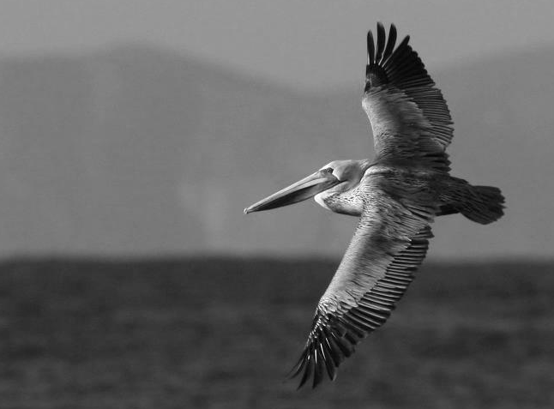
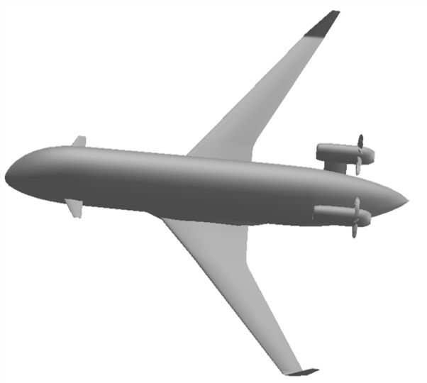
Presentation Contents
What the birds can do
* emulated for future aircraft
Formation flight
* Ground effect
Terrain following
* Wing morphing
Flying submarines
* Finger feathers
Aerial trekking
Sensors
* Energy regeneration
Payload & range
Extreme environment
* Dynamic soaring
Notes:
Our study topics will include formation flight, ground effect, payload and range, extreme environment, sensors, energy regeneration, and dynamic soaring. Wherever we show an asterisk, we will offer up a future aircraft application of the capability under study.

Slide 3
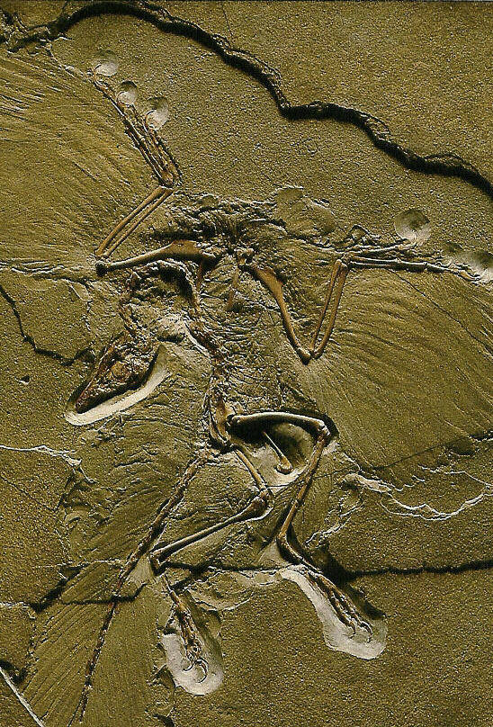
Bird Evolution
Archaeopteryx
150 Million Yr.
Pteranodon
9-m wingspan
200-65 Million yr.
Little finger
Wandering
Albatross
3.5-m span
Osteodontornis
55-5 million yr.
6-m wingspan
Shared sky
Notes:
Archaeopteryx is among the fossil evidence that birds evolved from dinosaurs about 150 million years ago. Already well evolved by then was the Pteranodon, neither bird nor dinosaur, which appears to have used dynamic soaring, the art of intelligent maneuvering to extract energy from the wind gradient to remain aloft without wing flapping. Just one of many other interesting aspects of Pteranodon is its “hand,” with the thumb widely separate from the middle fingers, and with the little finger evolving and growing to become the main spar.
We may be surprised to learn that so-called “modern birds” shared the ocean skies with Pteranodon. One such bird was the ancestor of a large and early albatross named Osteodontornis. Today, the Wandering albatross is the world's largest bird, and it carries on the tradition of dynamic soaring.
Restore lighting, blacken screen, and unroll / display 12-foot life-size albatross poster....

Slide 4
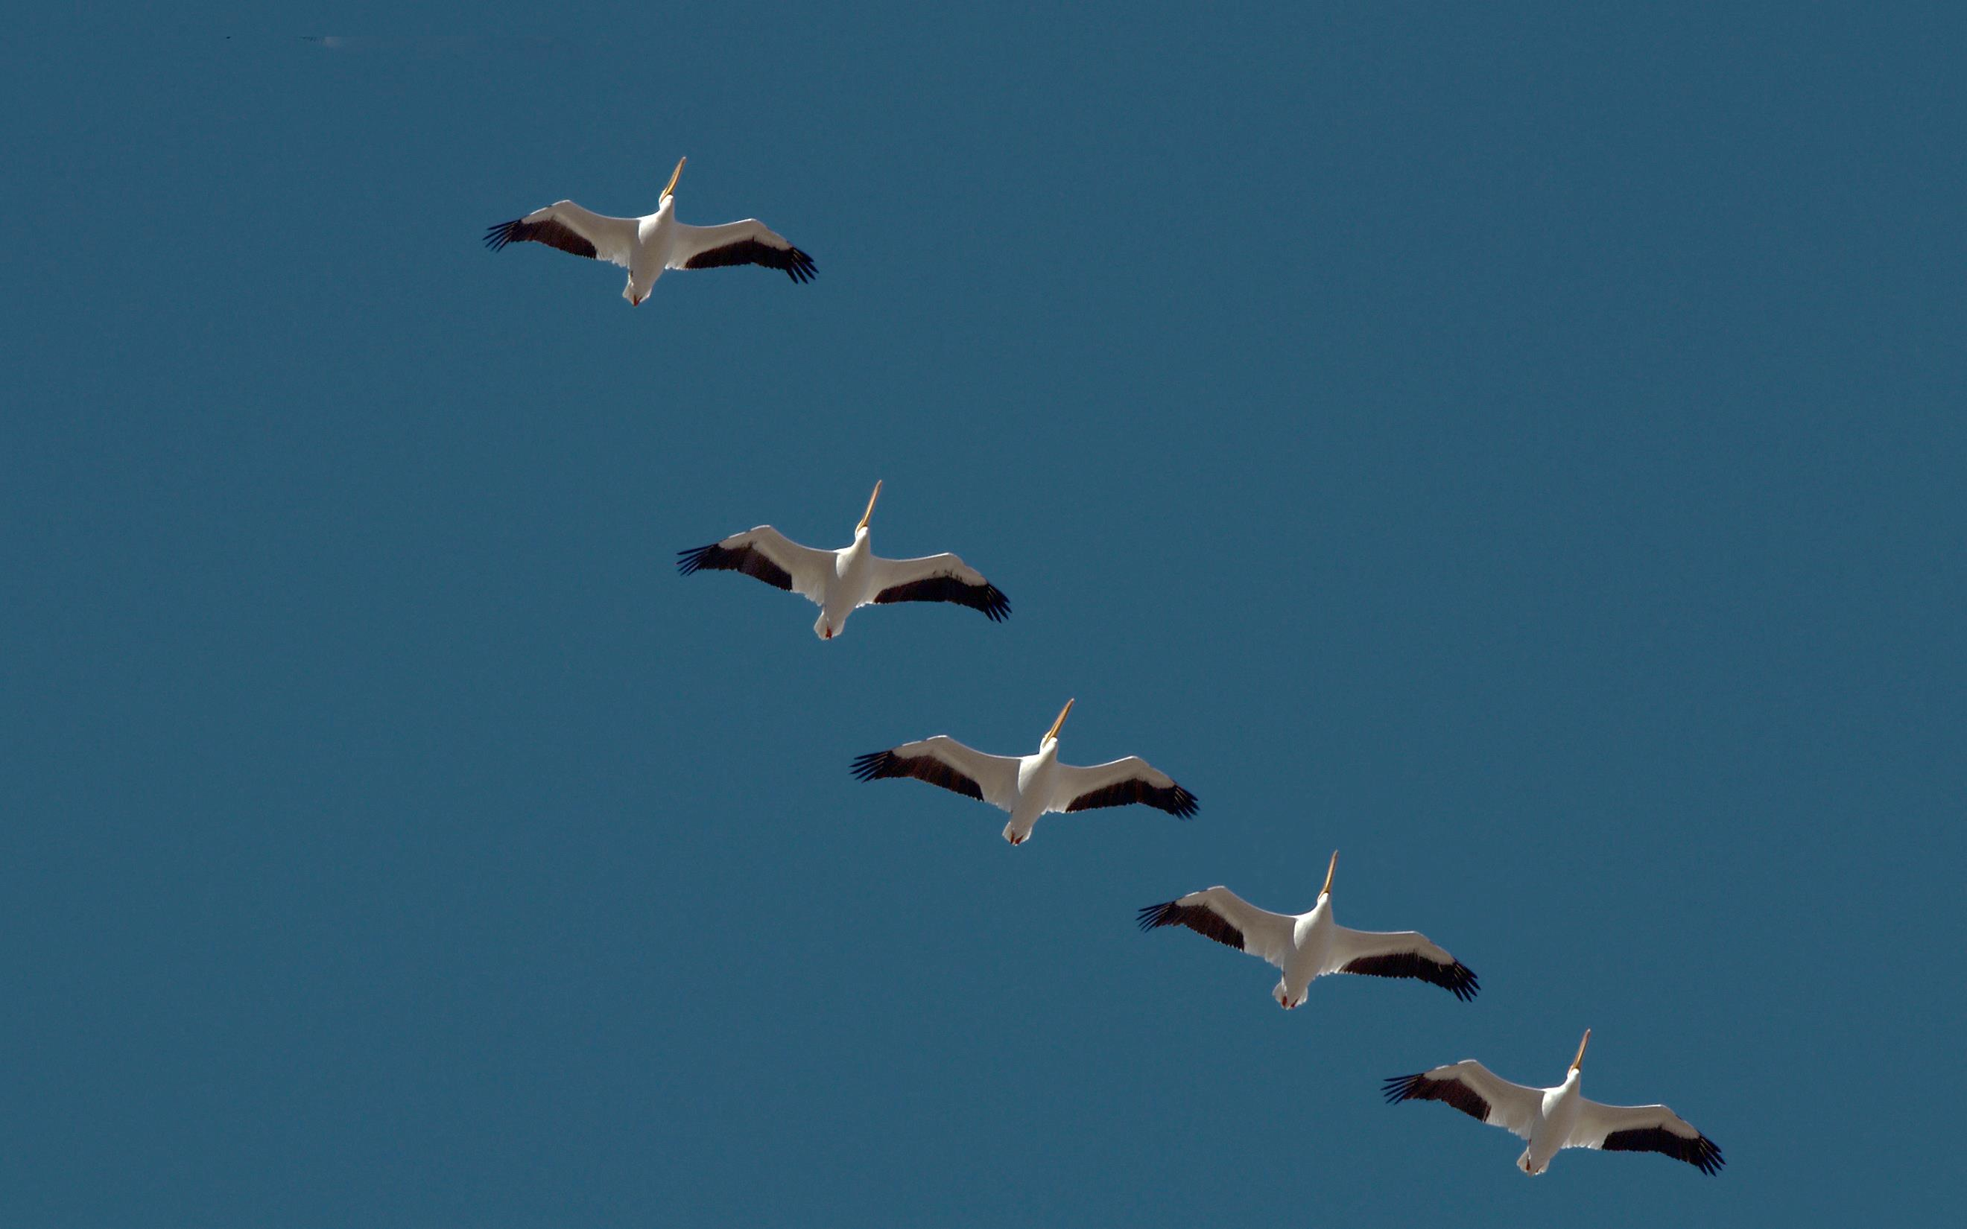
Formation Flight
10% reduced drag (followers)
2% reduced drag (leader)
"I could feel my wingman
coming up behind me."
- Les King, jet pilot
White Pelican migration,
Cibola Nature Preserve,
Colorado River
Notes:
It was quite a thrill to see this formation of White pelicans migrating over the Cibola Nature Preserve at the California-Arizona border. The lead bird and only one side of a V-shaped formation were captured in this photo. All of the followers enjoy a drag reduction of about 10%. Before we explain how this could be, let’s ask if the lead bird in formation is working harder or easier than it would in isolated flight.
To answer this question, let’s model the lift of any bird with a horseshoe vortex. Such is reasonably characterized as a “tornado” which we know to “induce” velocities around its core. In the photo above, any point “outside” of the horseshoe vortex experiences an upwash, and such makes for easier flight at that point. With one or more followers providing modest upwash outside of their horseshoe vortices, the lead bird actually enjoys about 1-2% enhanced L/D relative to flight in isolation.
Jet pilot Les King describes well the effect of a “wingman” joining up with the “lead bird.” Notice also that any point residing “inside” the horseshoe vortex will experience downwash. This leads to our next topic, ground effect.

Slide 5
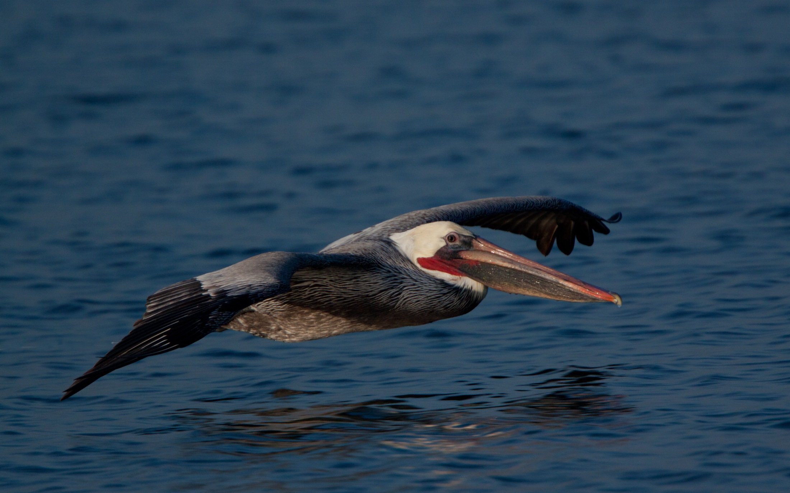
Ground Effect
mirror-image-induced velocities
xxx
Upwash due to mirror image trailing vortices
30% reduced drag
Upwash &
pitch down moment
Airspeed reduced by bound vortex
Inverted mirror image
- courtesy of Albert Betz
Notes:
Here a Brown pelican flies in ground effect, the latter characterized by flight proximate to the ground or water within a distance representing a fraction, say less than half, of the wingspan. As shown to us around the time of WWI by the famous aerodynamicist Albert Betz, ground effect can be modeled with an imaginary mirror image aircraft under the ground or water. The two aircraft then experience mutual, identical, and generally favorable effects.
The upper bird or aircraft flies largely within the upwash generated by the trailing portions of the inverted horseshoe vortex of the image bird. This provides a substantial and mutual reduction of drag. What is perhaps less known about ground effect is the slight reduction of airspeed induced by the bound vortex of either bird upon the other. As a consequence, an aircraft in a takeoff roll in quiescent air with flaps down (and thus with its mirror image developing inverted lift) will register an airspeed which is less than its groundspeed. The speed difference will be most pronounced at takeoff rotation.
An additional and subtle effect of the bound portion of the image vortex is the upwash and resultant nose-down moment at the empennage.

Slide 6
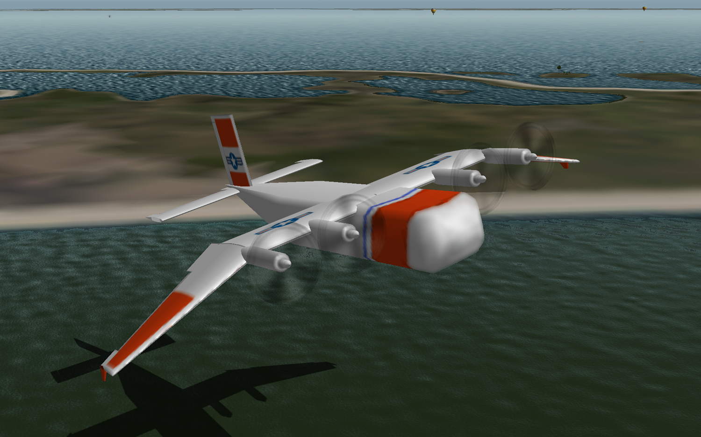
xxx
Boeing Pelican Advanced Transport
www.X-Plane.org
Notes:
Learning from the Brown pelican is this Boeing future transport flying in ground effect, appropriately named the Pelican. The image is provided courtesy of the X-Plane flight simulator community. The aircraft emulates the pelican in more ways than one, with the wingtips bent toward the water to enhance the ground effect.

Slide 7
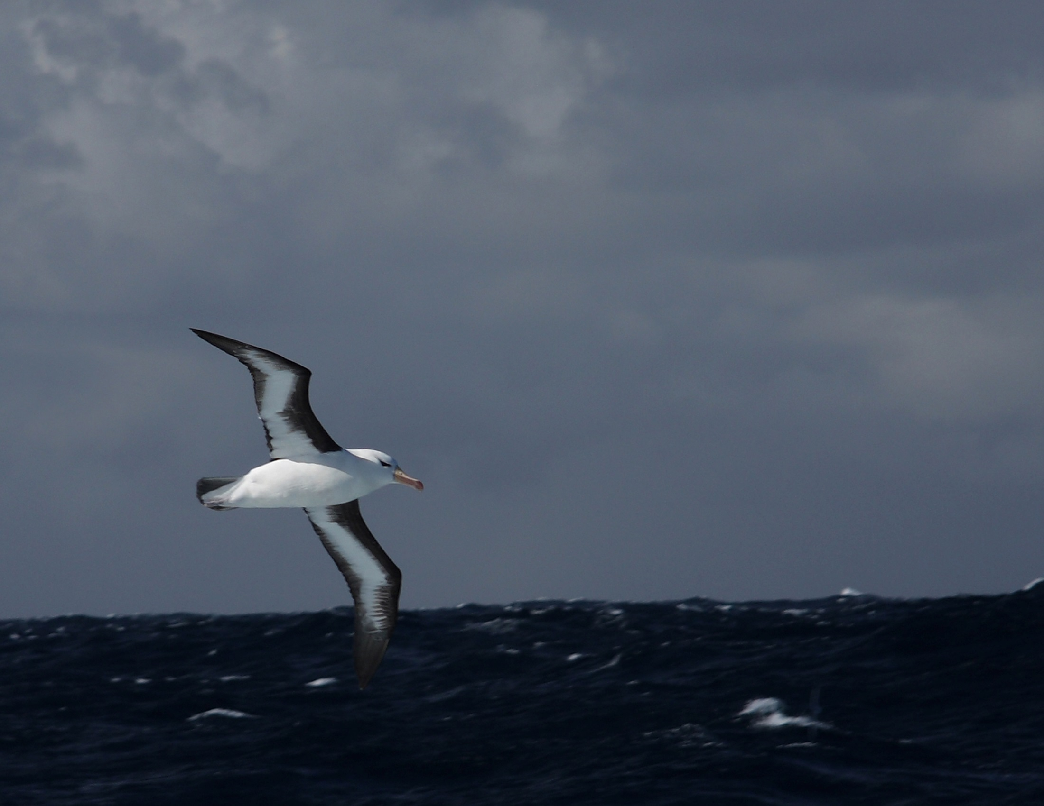
Terrain Following
Black-browed Albatross
Drake Passage
Precise terrain following
Half asleep between waves
3-g maneuver every 12-sec
Shoulder-locked wings
Notes:
Birds are adept at terrain following. Indeed, this Black-browed albatross can ply the waves while half asleep, according to the well-known naturalist David Attenborough. As we shall show later, the albatross effortlessly conducts a 3-g maneuver every 12 seconds or so, its wingtip occasionally skimming the water. The albatross lives the vast majority of its life in the 20-meter layer of air over waves extending as far as the eye can see. Although terrain following is the typical condition, the albatross does not need waves to implement its dynamic soaring technique which keeps it aloft continuously on shoulder-locked wings. We will return to the topic of dynamic soaring later herein.

Slide 8
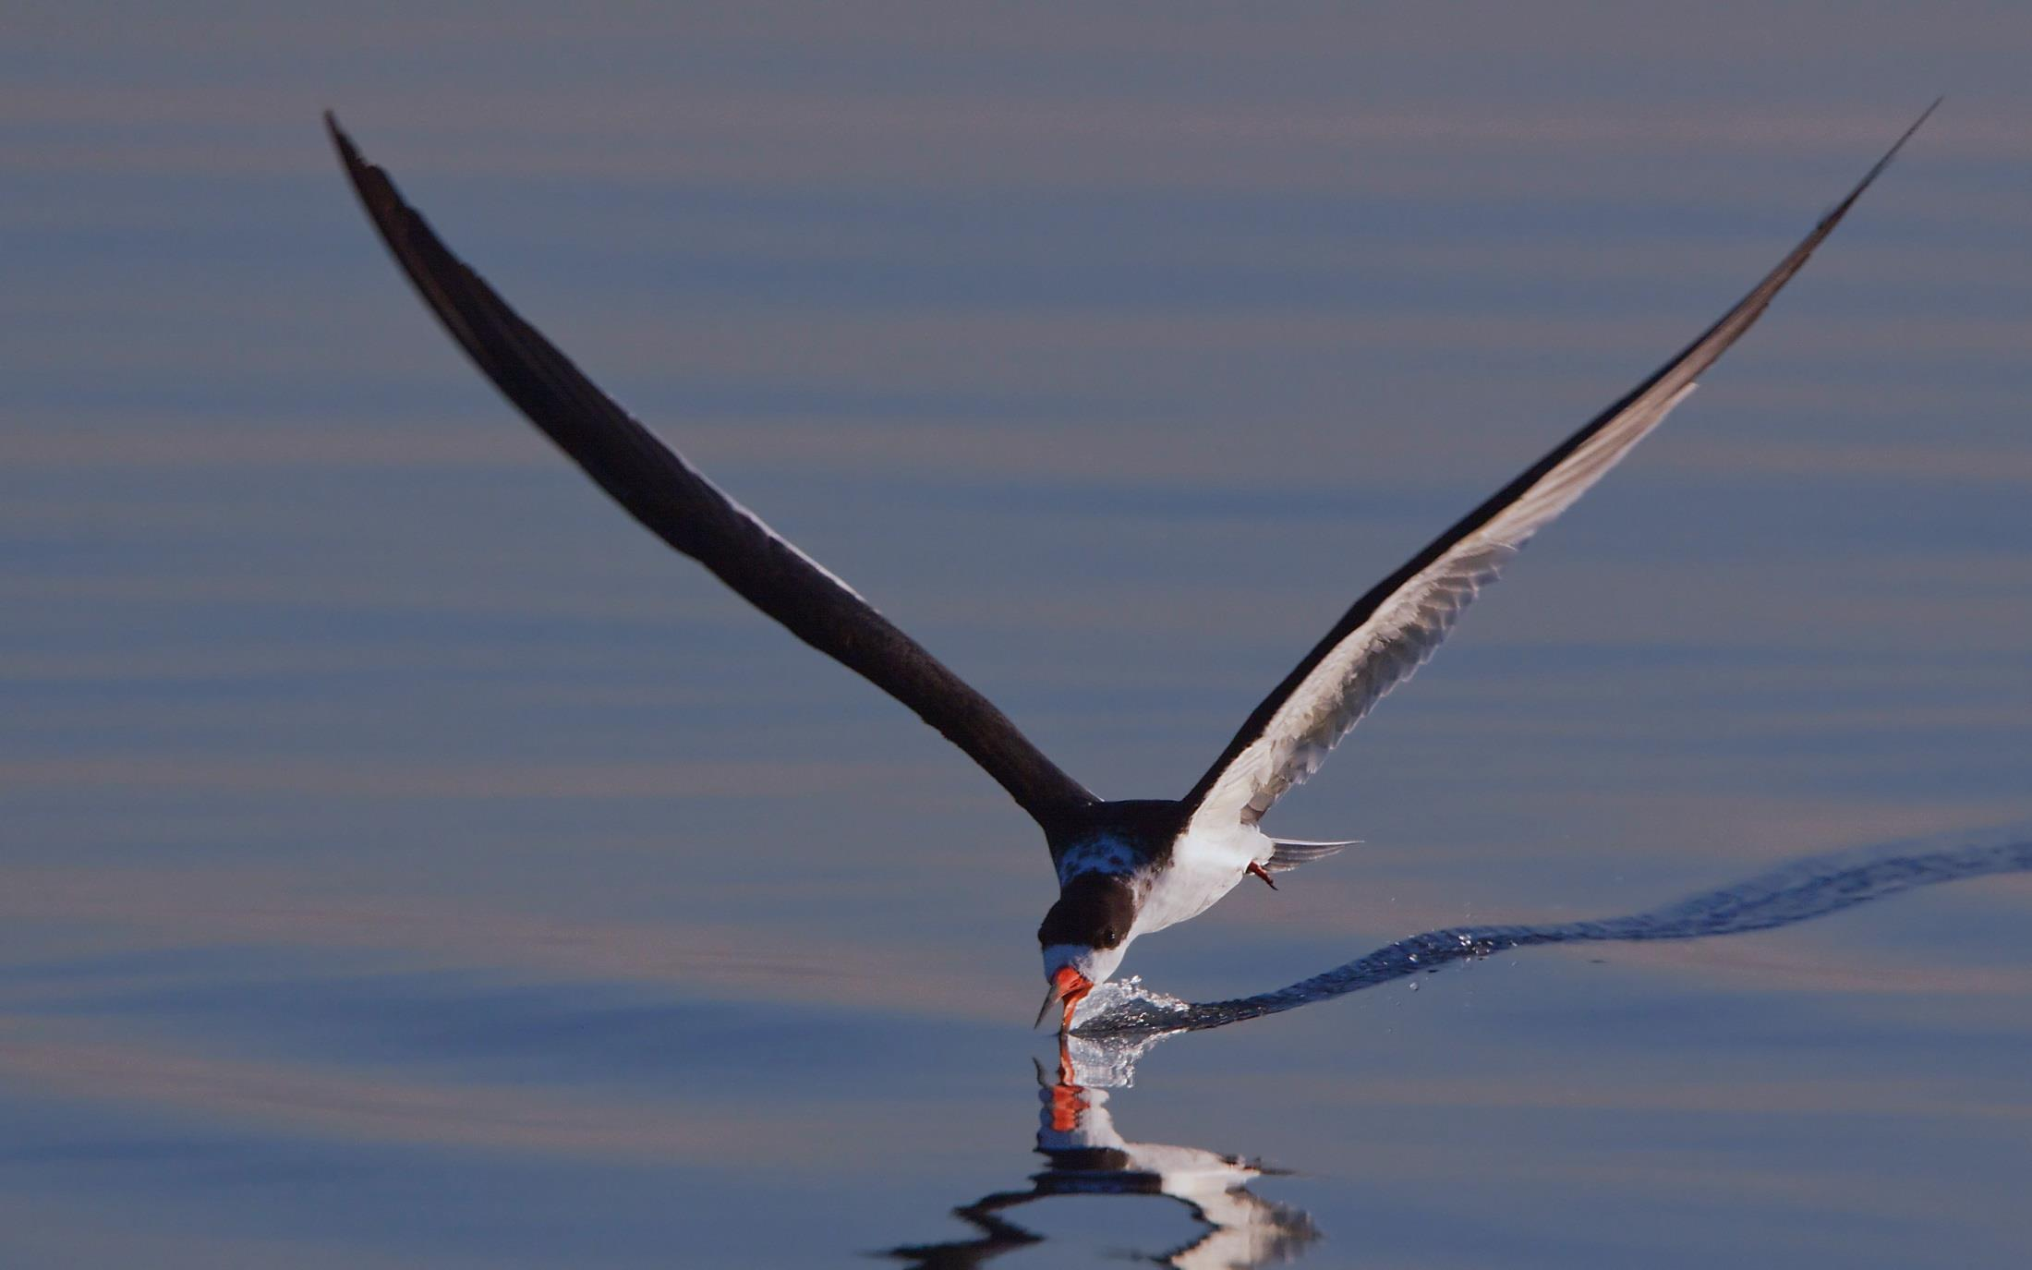
xxx
Terrain Following
Black Skimmer
Precise positioning,
wings flapping over
smooth or rough water
Notes:
Whereas the Black-browed albatross deftly controls the position of its body among the heaving waves, the Black skimmer precisely holds a small fraction of its beak in the water, with or without heaving waves. While flapping its wings, the skimmer holds its lower mandible just beneath the surface to catch fish. The lower mandible has an opening in the back to allow the water to flow through with minimal drag impact. When a fish is encountered, the head and beak together snap down and backward to absorb the impact.

Slide 9
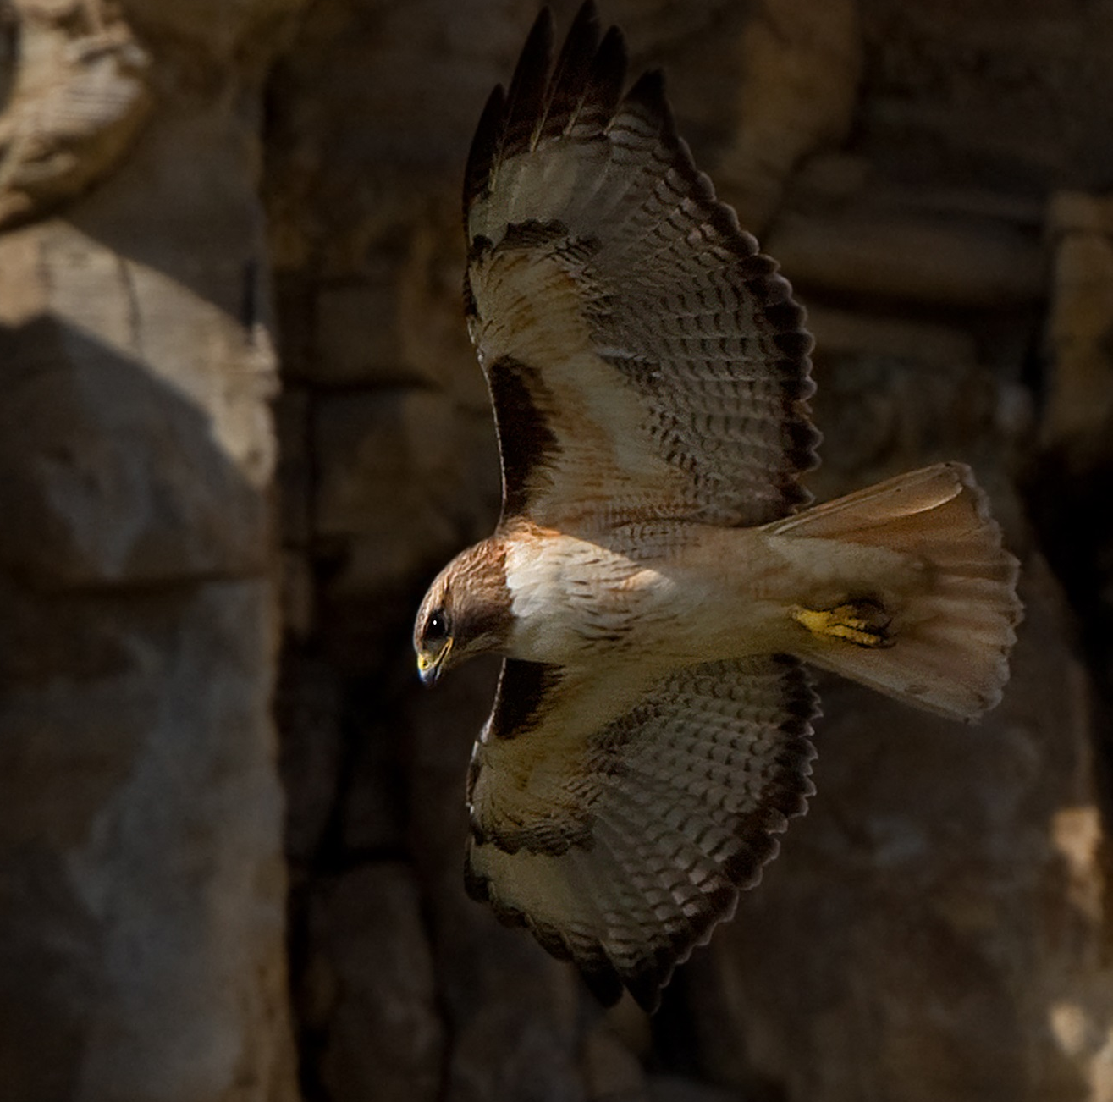
xxx
Morphing Wing
Red-tailed hawk
Fold for speed
Sweep to maneuver
Notes:
The Red-tailed hawk is a master of the morphing wing, as seen in the high-speed dive captured in the photo at left. With such high speed, and with the background soon to appear, photographic success even with dynamic autofocus would have been highly unlikely. Only one shot within a rapid burst was found to be in focus using a telephoto lens with fixed manual focus.
When the hawk is gliding (photo at right), the wings are extended and largely unswept, yielding a statically-stable configuration trimmed with tail reflex or “decalage” relative to the “equivalent flat plate” of the wing. But when the hawk closes in on its prey, the wings are swept forward, yielding both increased maneuverability and a statically-unstable configuration requiring active pitch control with a dynamic tail which is held trailing-edge down to balance out the forward sweep.

Slide 10
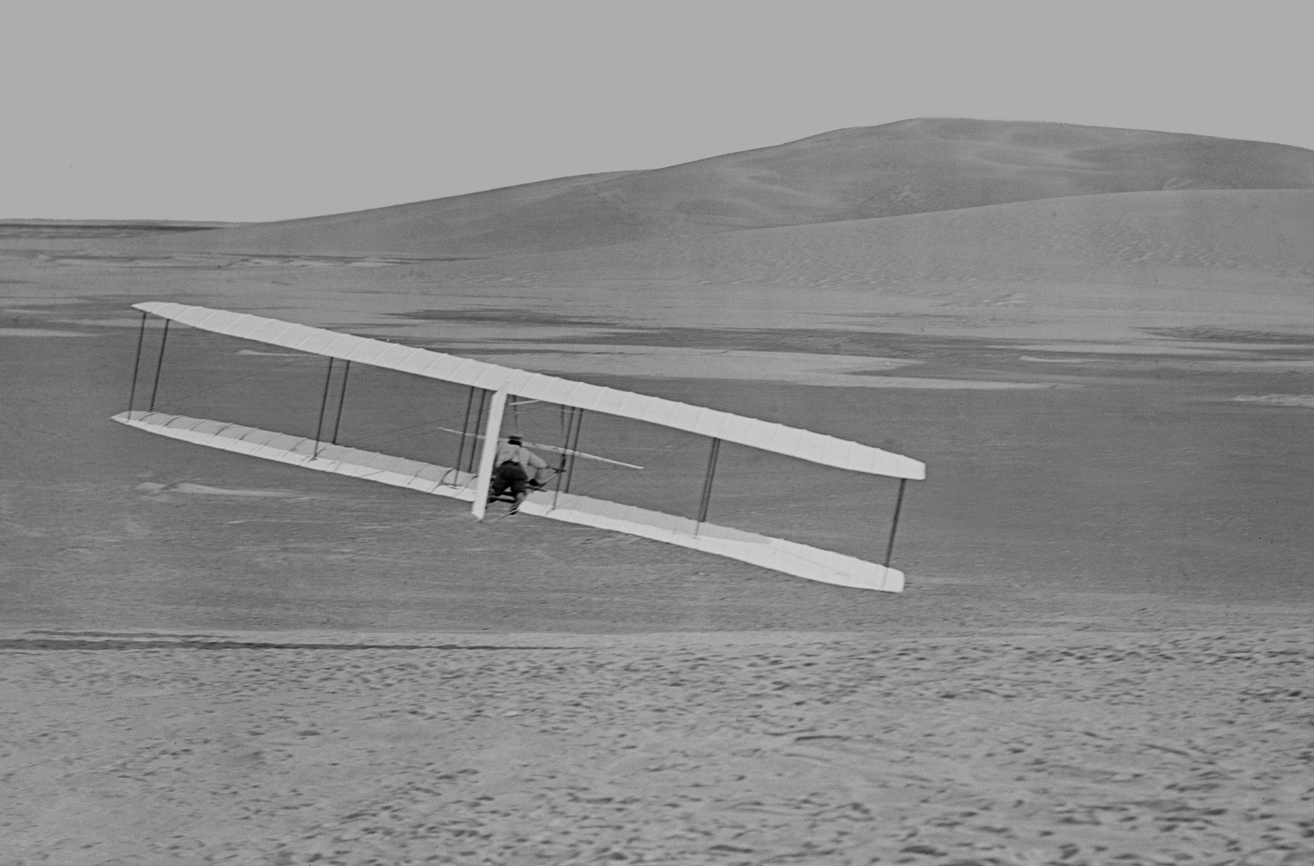
Morphing Wing
xxx
Wright 1902 glider
Wing warping
Coupled rudder
1000 flights
Glider: -05% margin
Flyer: -25% margin
Notes:
The Wright Brothers were first to apply the morphing wing to an aircraft with their wing-warping method. Their 1902 glider, making about 1000 flights, was the world's first practical aircraft, independently controllable about all three axes, and enjoying reasonably-coordinated turns. This glider was marginally unstable, but generally manageable. But for their 1903 Wright Flyer, the brothers added a relatively heavy propulsion system well aft of the c.g., finding themselves quite lucky to get two successful flights before the aircraft was destroyed. As it was, the aircraft parked in the sand was destroyed by tumbling in a gust of wind. But had there been no such gust, the aircraft would likely have soon been severely damaged by an inevitable hard landing on account of its severely tail-heavy condition. The unflyable nature of the 1903 aircraft would be “rediscovered” precisely 100 years later, in spite of our cautionary advice, in an attempt to launch a stubbornly-exact replica.

Slide 11
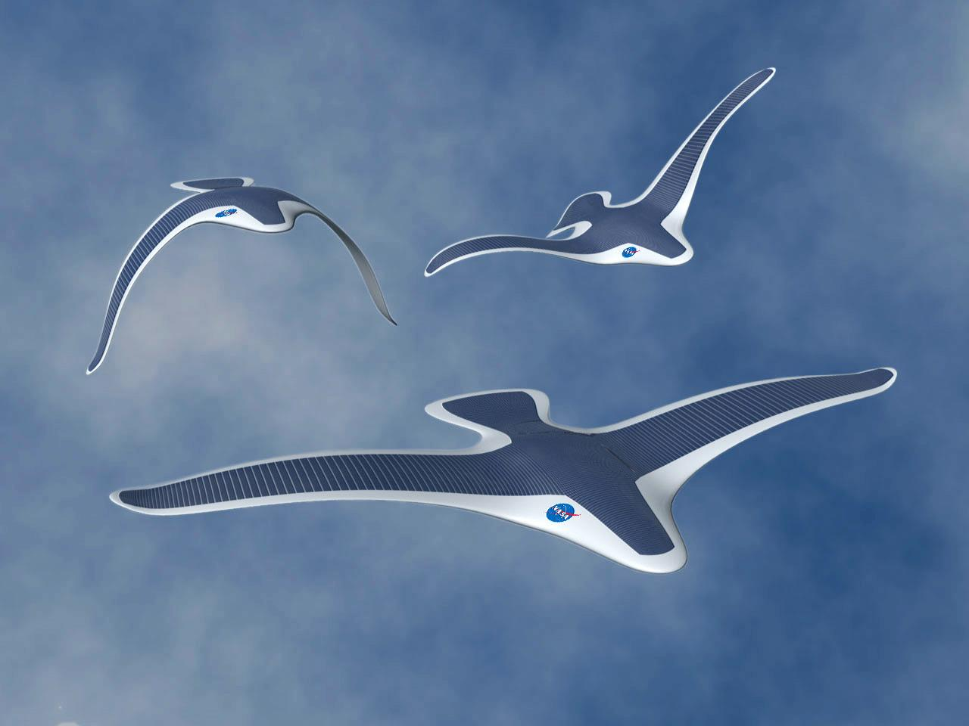
Wing Morphing
Integrated structure, power, and propulsion
www.morpheus.umd.edu
Notes:
Here we see more than just wing morphing in a system studied by the Morpheus Lab. This conceptual aircraft would integrate structure, power, and autonomy with flapping-wing propulsion and asymmetric morphing for roll control.

Slide 12
xxx
Flying
Submarines
Grebe
Cormorant
Webbed-foot propulsion
Loon
Merganser
Notes:
We can reasonably refer to these diving birds (clockwise from upper left: grebe, cormorant, merganser, and loon), among others, as flying submarines. Masters of the air, they are also able to go beneath the water surface and outmaneuver fish in their own element, this after the fish have enjoyed perhaps twice as many million years to evolve and perfect their own underwater maneuvering skills. This class of submariner birds, using webbed feet for underwater propulsion with the wings tightly folded, is capable of surprising speed underwater. Furthermore, some diving birds are capable of reaching considerable depths approaching perhaps 20 meters.

Slide 13
Flying Submarines
xxx
Underwater flapping
Booby
Puffin
Notes:
The Nazca booby and Atlantic puffin are just two of many bird species which, also masters of both air and water, catch fish by propelling themselves underwater with flapping wings.

Slide 14
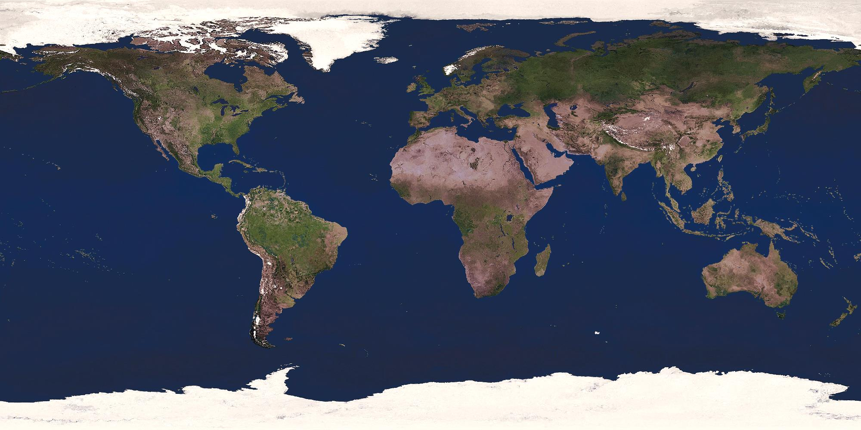
xxx
Aerial Trekking
Thunderstorm
updraft risk
Navigation
10-mi accuracy
Sun position
North star
magnetite
Alaska to
Argentina
Notes:
Ducks and hawks annually migrate over a land route from Alaska to Argentina. Research suggests that the birds appear to use the sun’s position during the day, the North star’s position at night, and/or perhaps magnetic-field sensing to navigate with great accuracy.
One of the dangers along the way is the risk of being rapidly swept upward into the top of a thundercloud where the bird would freeze to death at temperatures near -40ºF / -40ºC.

Slide 15
Aerial Trekking
Arctic Tern
Pole-to-pole
Round trip
exceeds earth circumference
Notes:
In its annual round trip between the Arctic and Antarctica, the Arctic tern travels a distance greater than the earth's circumference. One migration route, perhaps among others around the globe, includes periodic resting places along the curving coastlines of the Americas.

Slide 16
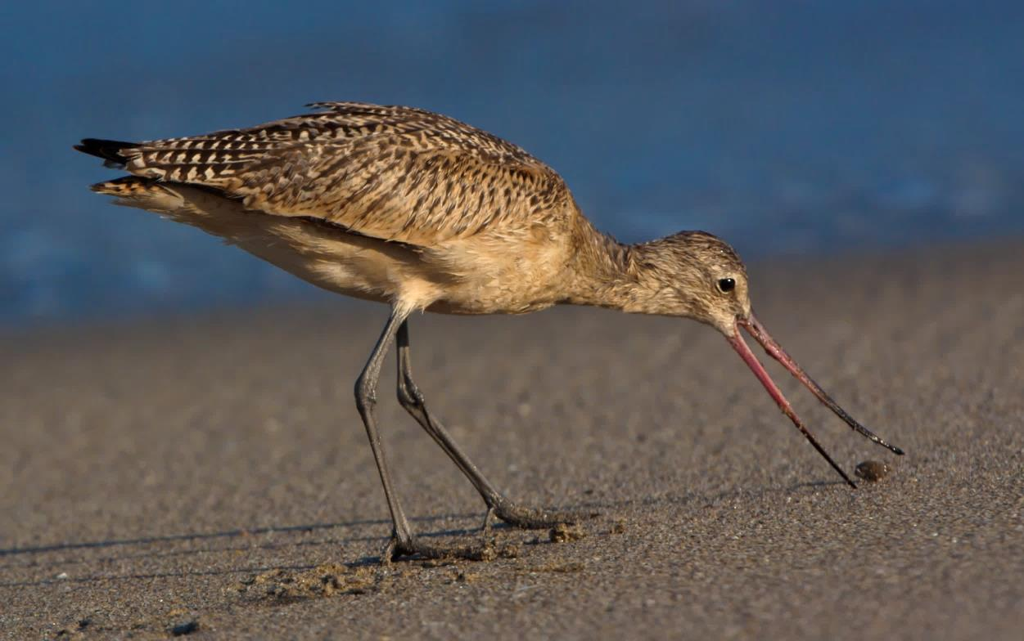
xxx
Payload & Range
Godwit
Add 100% body-weight
7300-miles non-stop,
Alaska to New Zealand*
* Wired, Mike Lemanski
Notes:
The godwit adds 100% body weight in preparation for what appears to be a 7300-mile, non-stop migration between Alaska and New Zealand. Researchers tagging birds at staging points note that many of the birds appear significantly underweight when the flock decides to leave. Given the statistical variations in departure weight, one can imagine that a few of the birds, after nearly completing an epic journey, glide exhausted down to the water within sight of the shore.
It is reasonable to suspect that in lieu of a non-stop flight the godwits might use their superior navigational skills to stop at selected islands residing more or less along this route, including Midway, Pacific equatorial islands, and/or the New Hebrides. But further tagging research would be needed to test this hypothesis. With or without such stops, the distances over water remain vast, and we may reasonably suspect the godwit is not equipped for waterborne landing or takeoff.
This slide in our original presentation to about 150 Cal Poly Pomona Aero Engineering graduates, family members, and faculty showed the southern end of the godwit’s migration at New Guinea. The audience was too polite, or too focused on engineering at the expense of geography, to point out to the author that New Zealand is southeast of Australia, as shown with the corrected arrow.

Slide 17
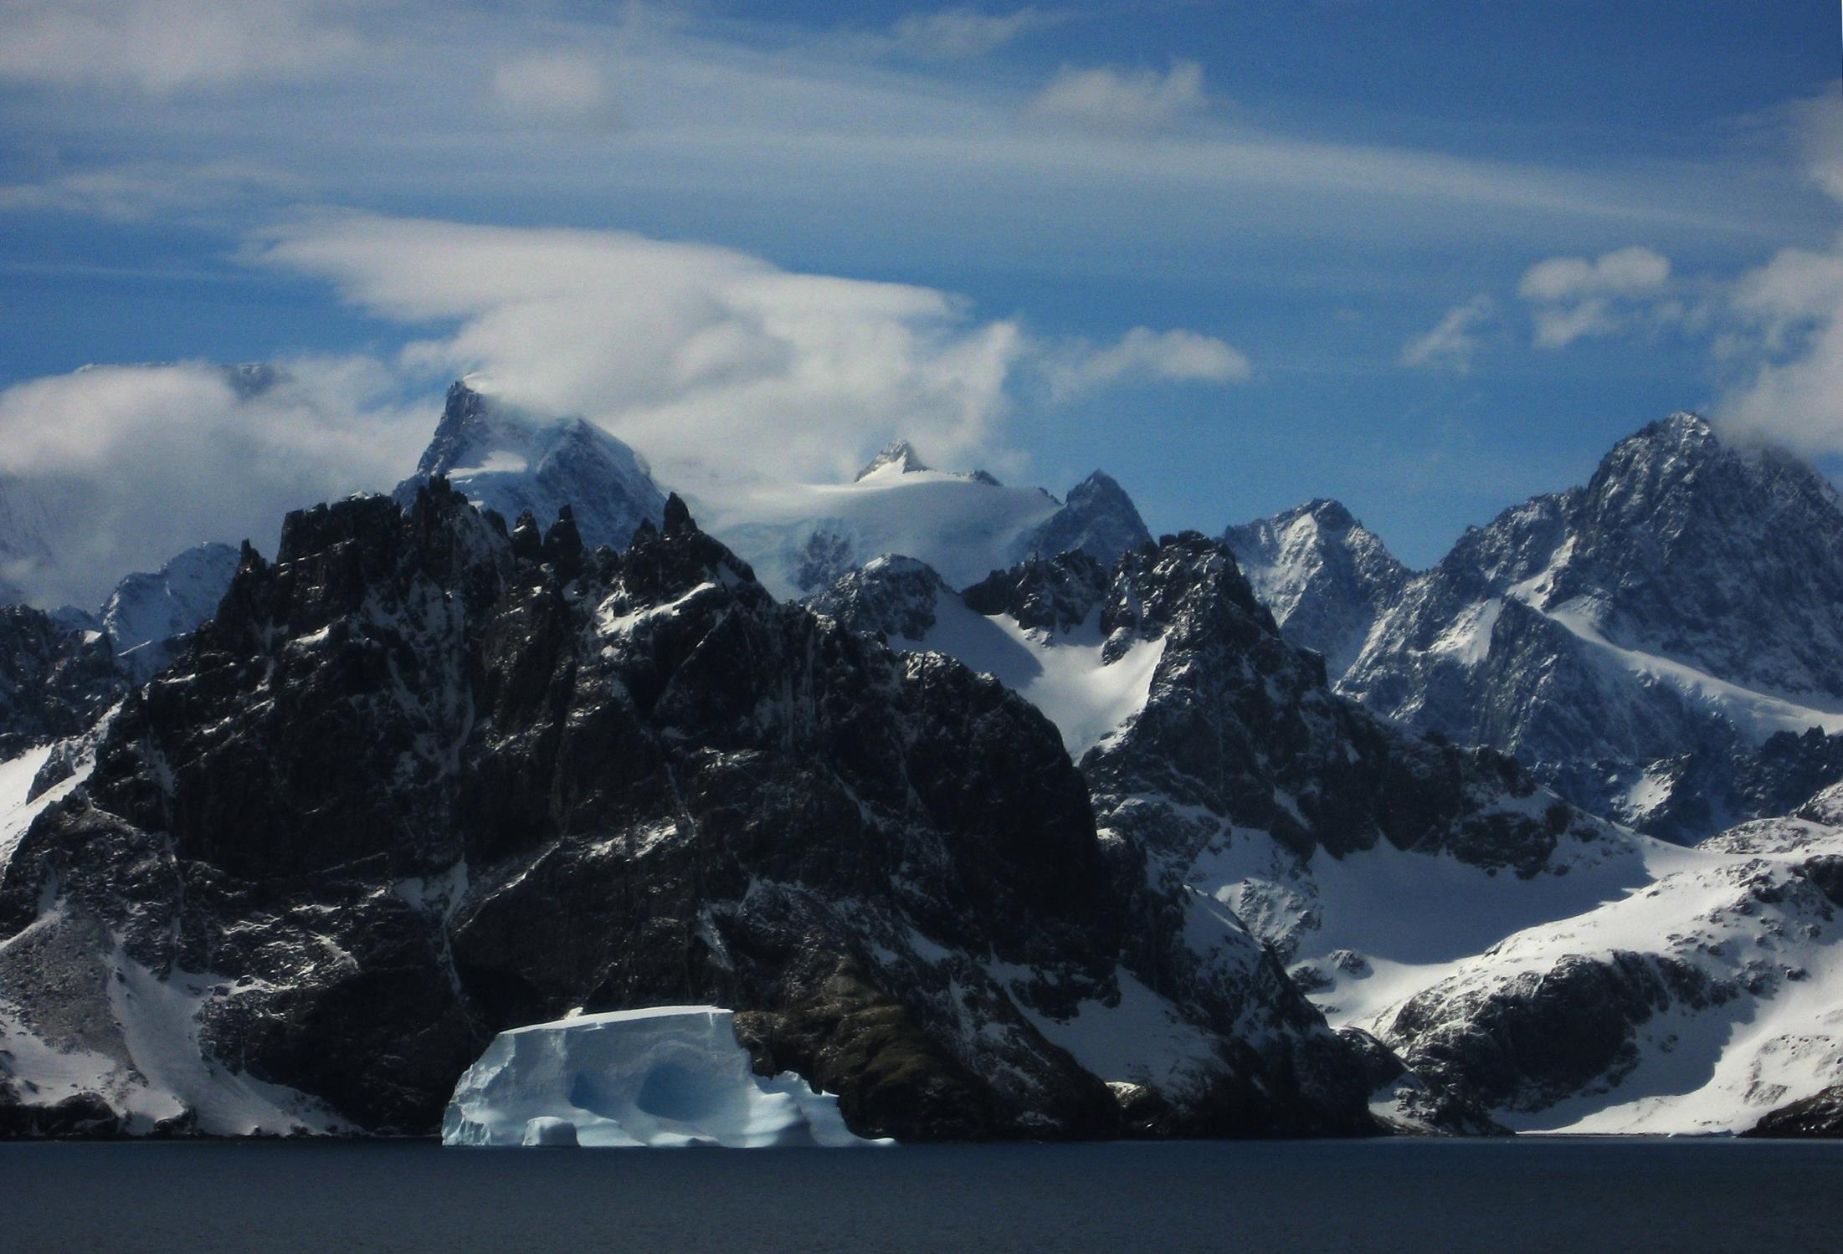
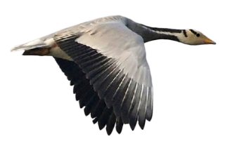
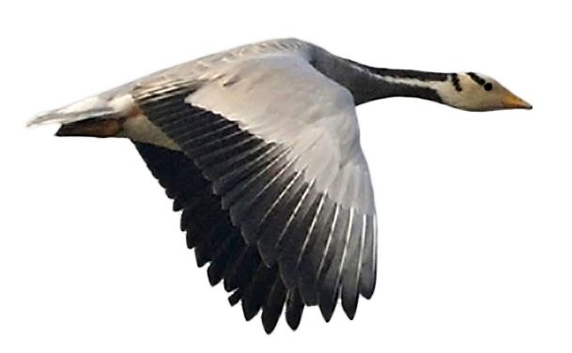
Extreme Environment
Bar-headed goose
Himalayan crossing
7 days at 29500 ft
-40ºF/-40ºC
Composite photos
Background: author
Bar-headed goose:
Lip Kee Yap @ Flickr
Notes:
The Bar-headed goose is specially equipped for sustained, high-altitude flight where the air is quite thin and cold at perhaps -40ºC. Formations of bar-headed geese have been reported by commercial aircraft pilots passing by at 29500 ft. Naturally, getting a close-up photo of such flight would be a challenge, at least because the goose flies much slower than the minimum airspeed of an aircraft at such altitude. Accordingly, we have taken the liberty of preparing a composite photo* to illustrate the amazing capability of this species of goose.
* South Georgia Island photo "stretched" by the author
Bar-headed goose courtesy of Mr. Lip Kee Yap @ Flickr

Slide 18
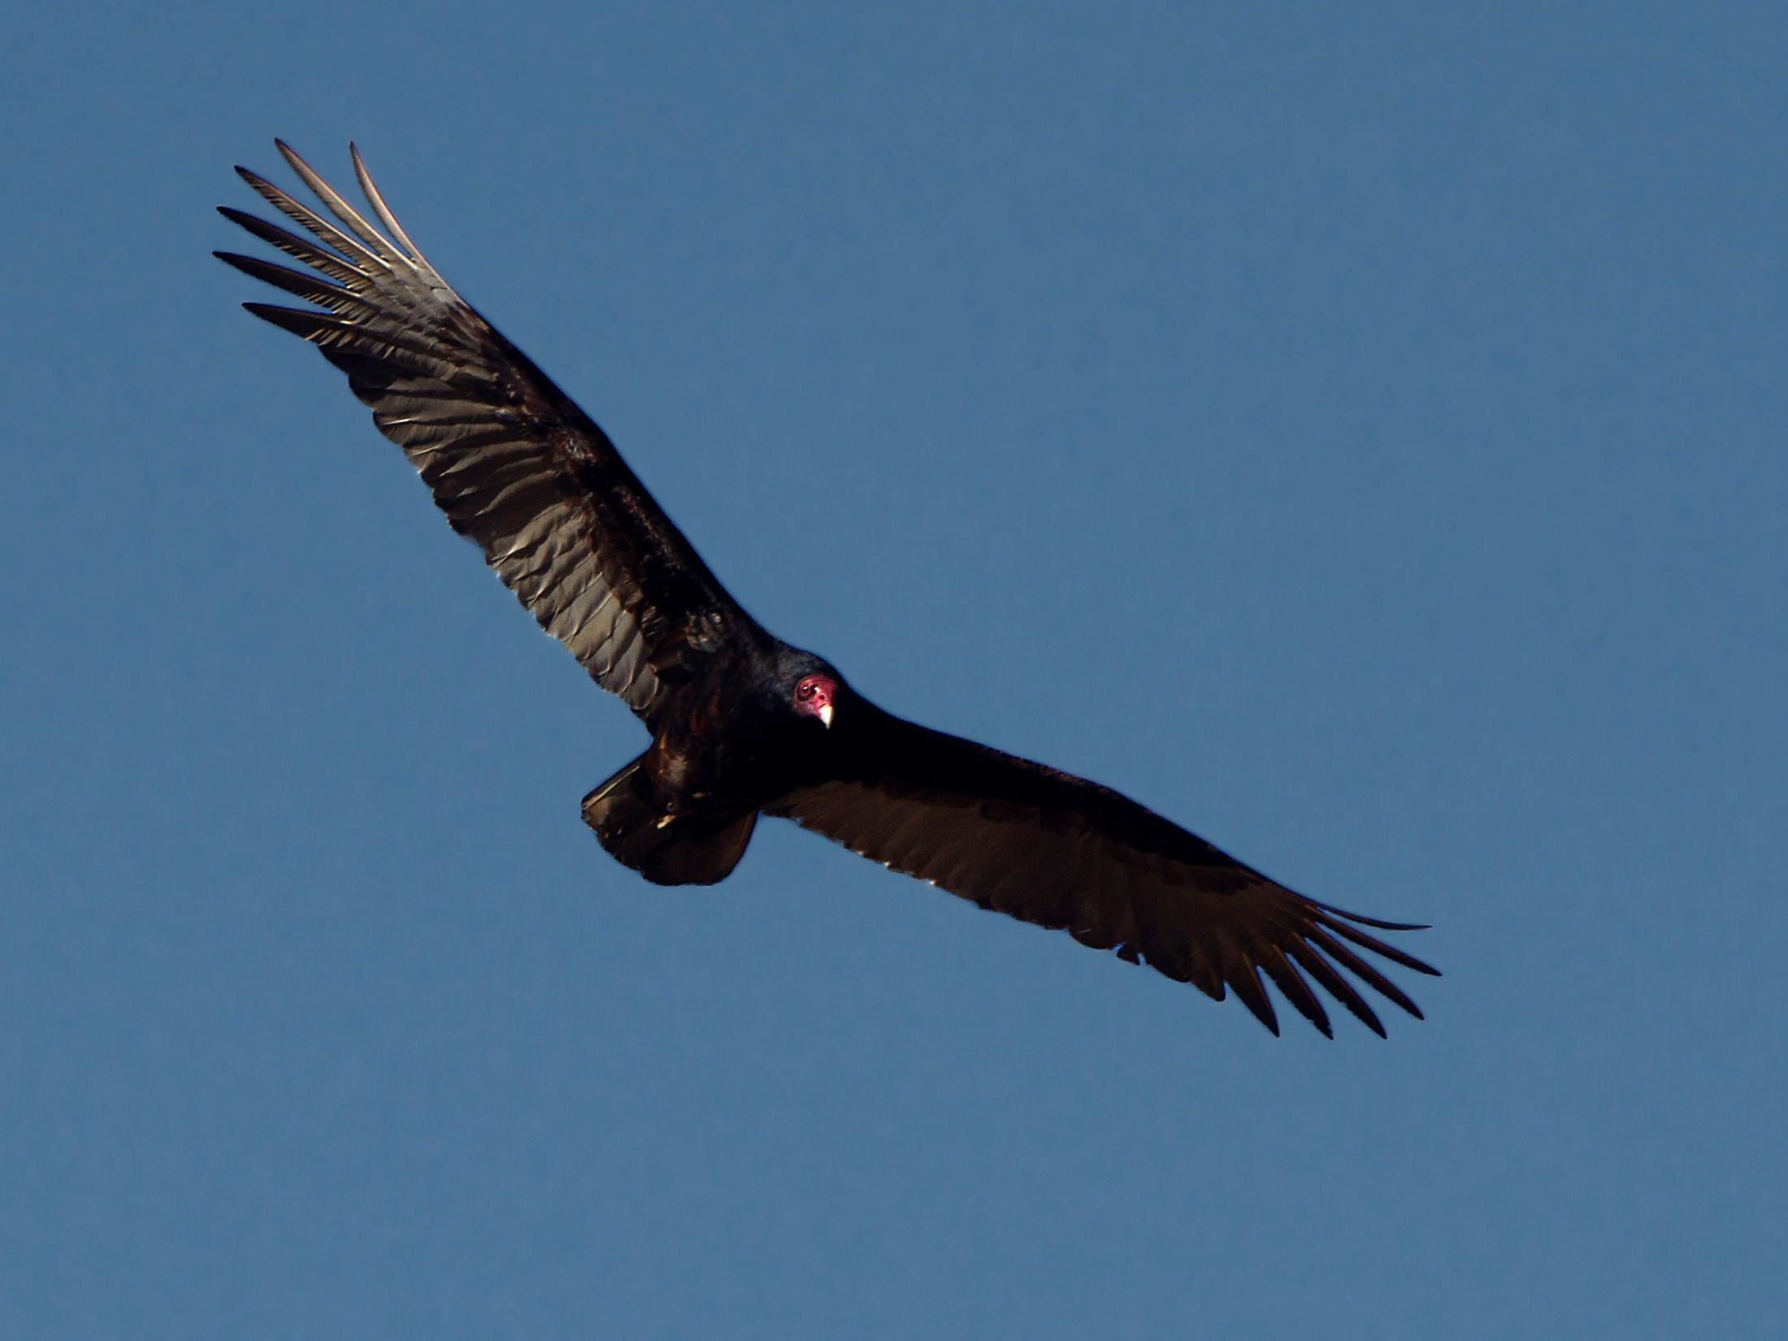
Sensors (smell)
Turkey Vulture, first on the scene
from miles away
Notes:
The Turkey vulture is often first on the scene of a carcass, detected by the bird from miles away with its extraordinary sense of smell. Perhaps an autonomous aircraft could mimic this capability with a "sniffer" to detect one or more chemical agents and transmit the information representing what has been sensed and where.

Slide 19
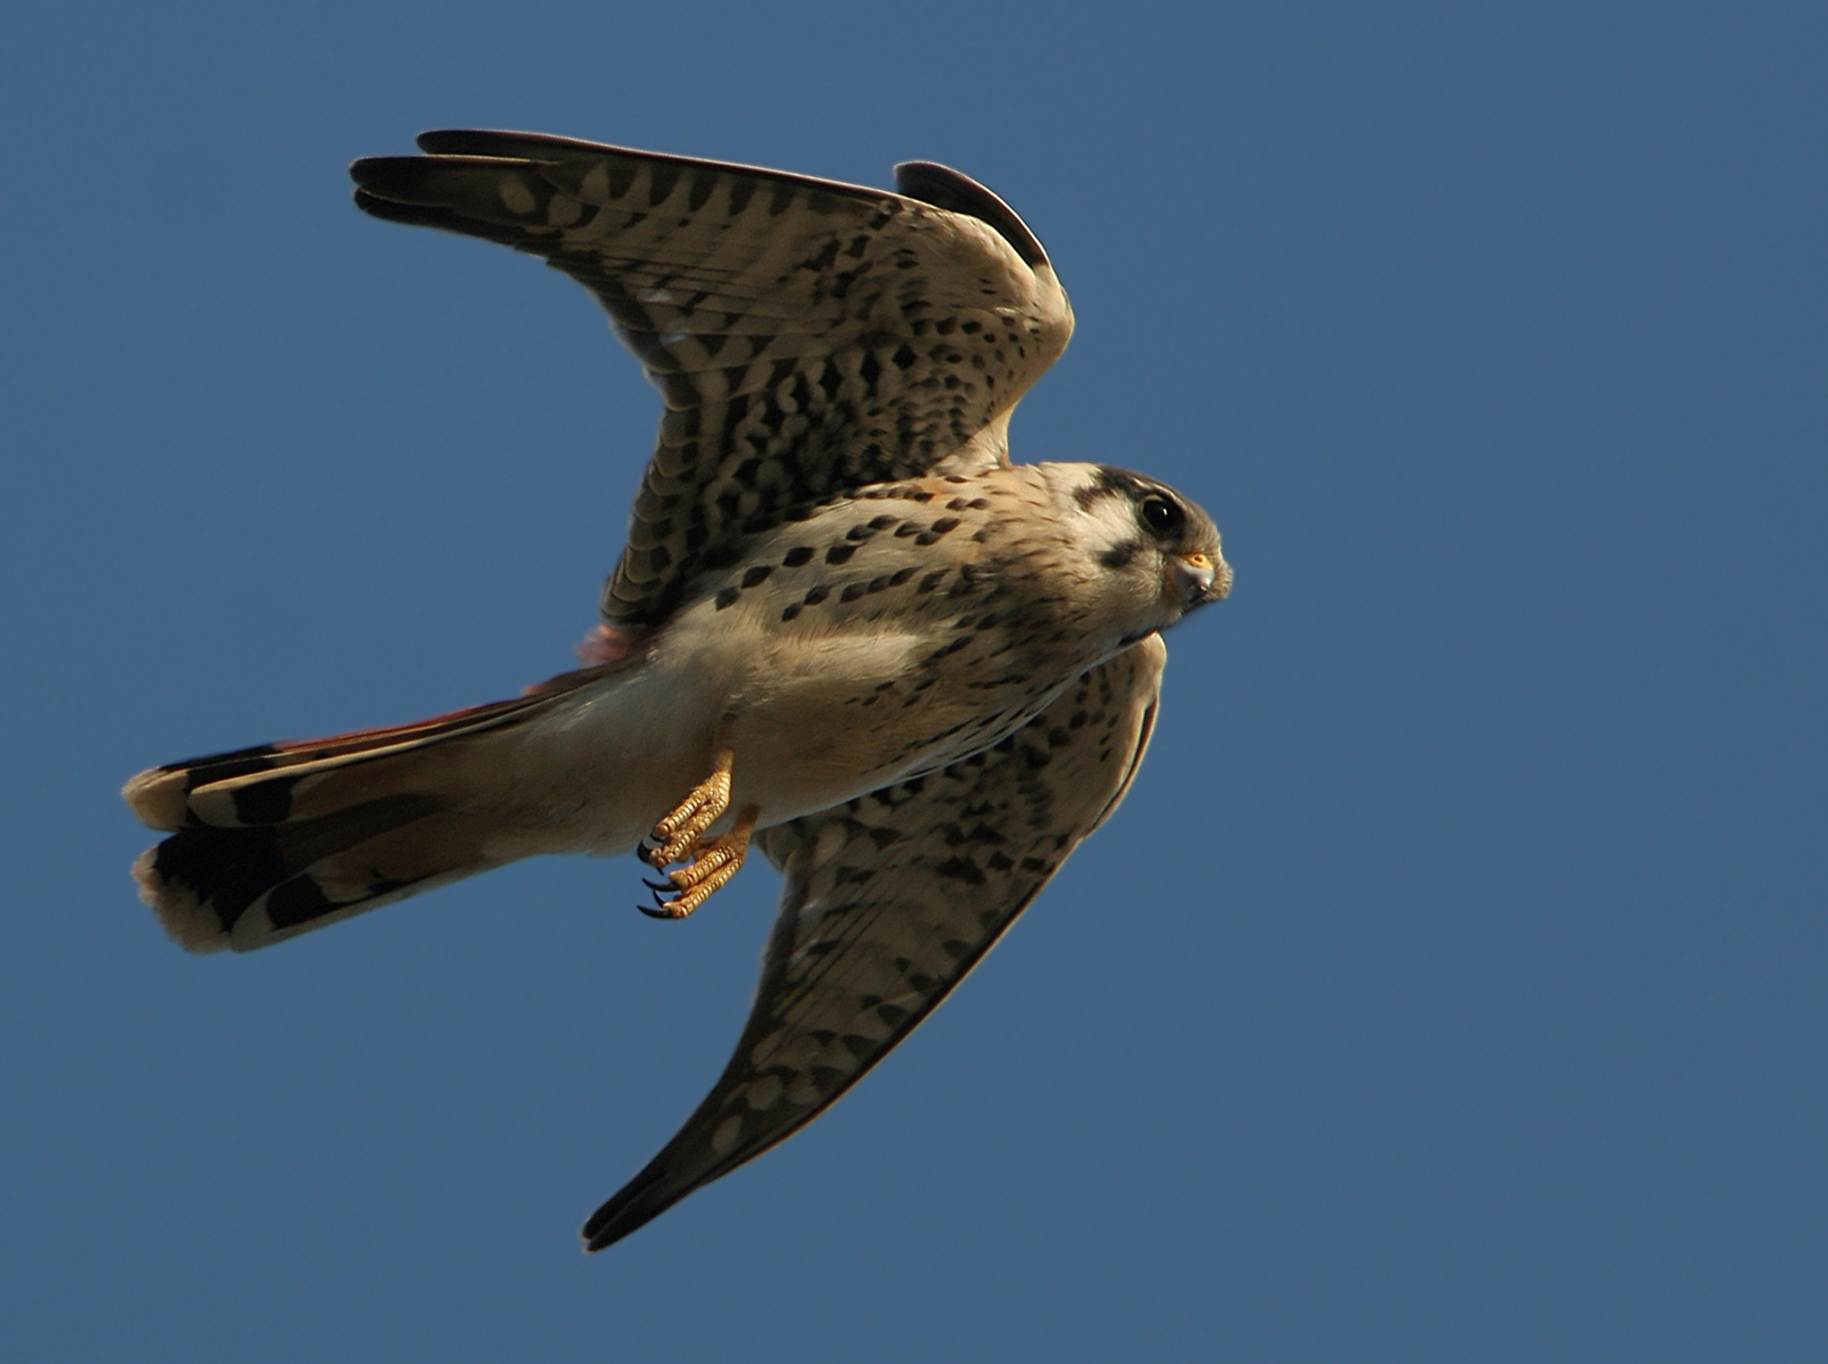
Sensors (infrared vision)
Kestrel
Nocturnal infrared detection of field mouse urine track
Notes:
The Kestrel catches field mice in the dark with the aid of its infrared vision. The field mice give away their presence with urine which, unfortunately for them, is revealed by infrared radiation. The kestrel also hunts during the day, as was this bird, photographed hovering at the edge of a cliff.

Slide 20
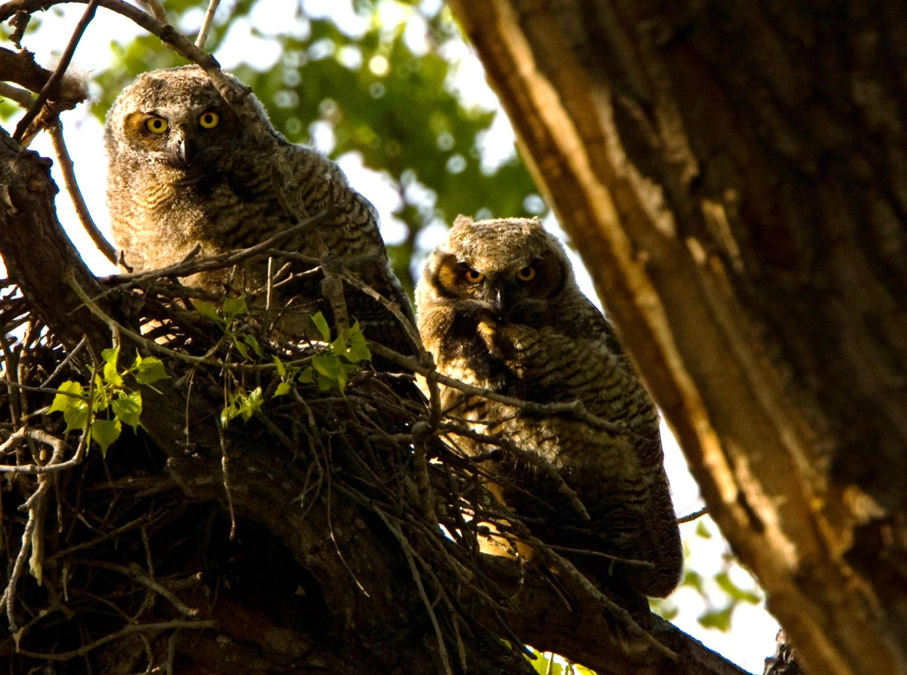
Sensors (hearing)
Eye-ear “dishes”
Ear asymmetry
3D Stereo hearing
Stealth feathers
Pounce in the dark
Notes:
These Grey owls, as well as all other owls, have large "dishes" around the eyes, but such dishes are not there to support vision. Instead, these dishes capture and concentrate sound for the ears which are positioned asymmetrically to enable "3D stereo" hearing. The owl’s eyes cannot rotate in their sockets, so the owl must turn its head, up to 180-deg, to change its line of sight. But when focusing on its prey at night, it is not focusing its eyes; it is focusing its ears. With its extraordinary hearing, the owl can capture its prey in complete darkness, arguably with its eyes closed. The owl also has evolved a special “stealth” treatment of its feathers to largely eliminate the sound of its flight. Not long after these young owls were photographed, they grew to be capable night raptors.

Slide 21
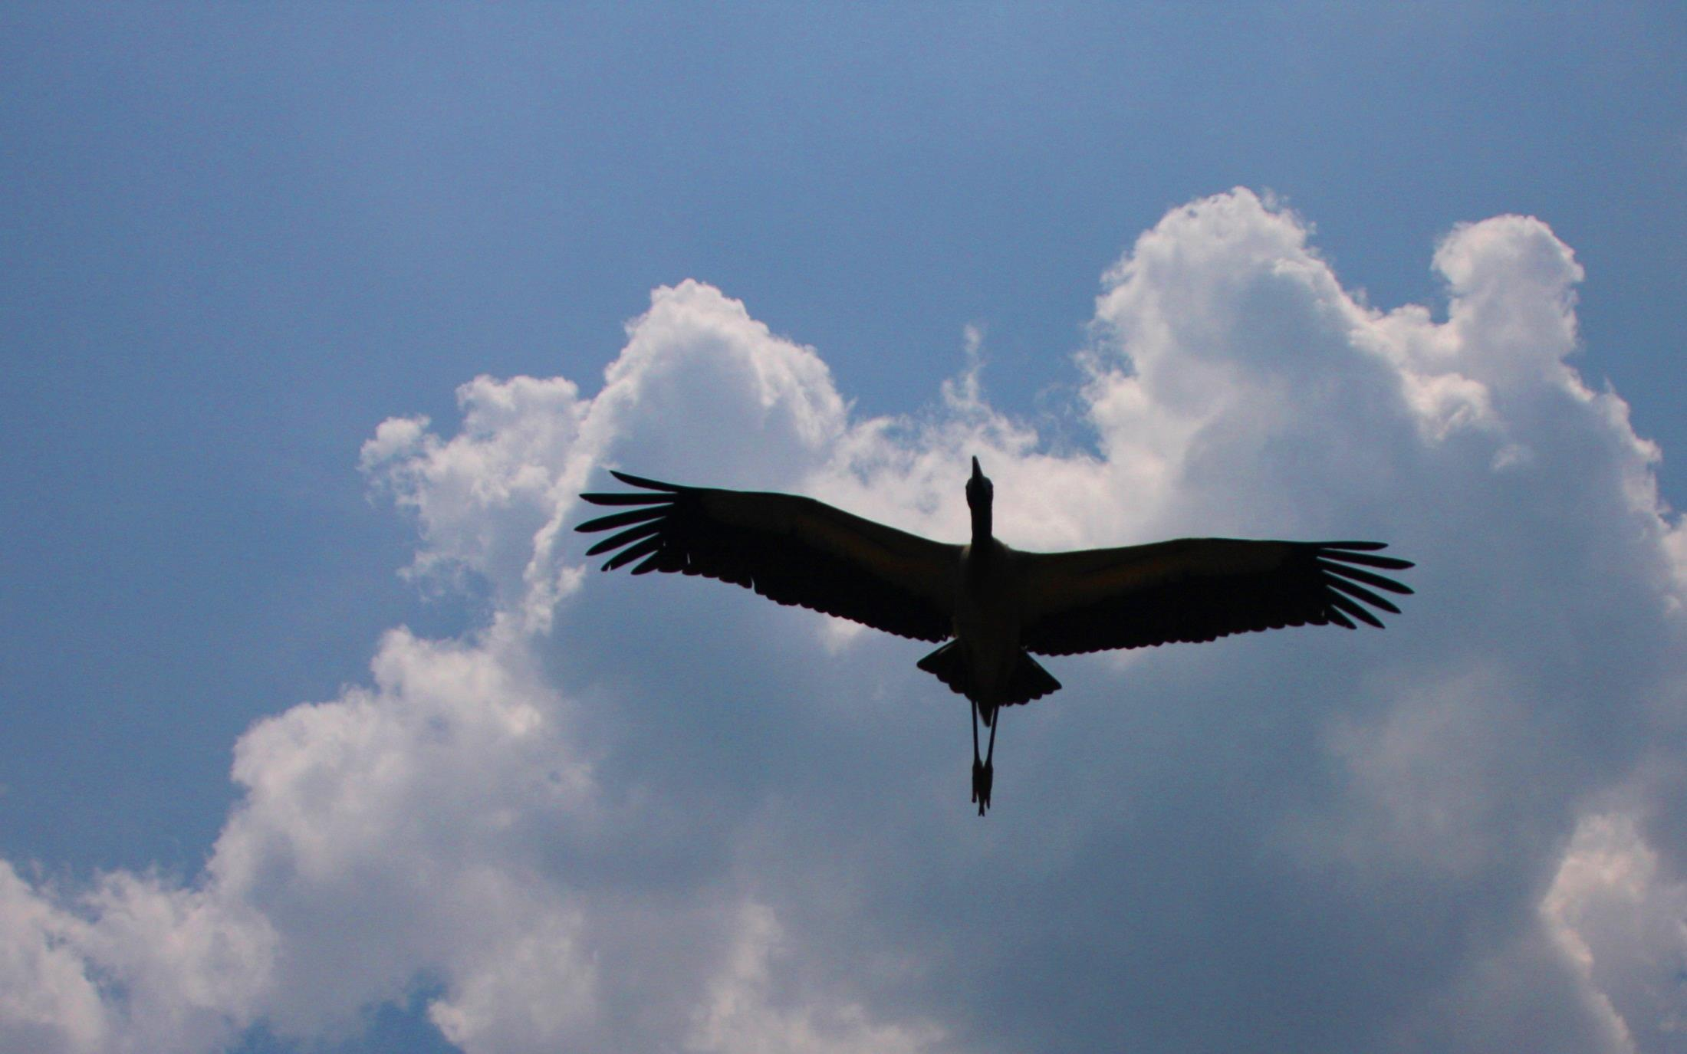
xxx
Finger Feathers
Enhanced L/D
Fine-tuned maneuvers
Variable feather incidence
Notes:
Many soaring birds, such as this Wood Stork, have finger feathers which would appear to be adjustable, symmetrically or differentially, for efficient and/or maneuvering flight. The forward-most finger feathers typically are "washed out" by about 30º relative to the wing chord. It would appear that the finger feathers have somewhat of a "winglet" effect, but with quite different geometry.

Slide 22
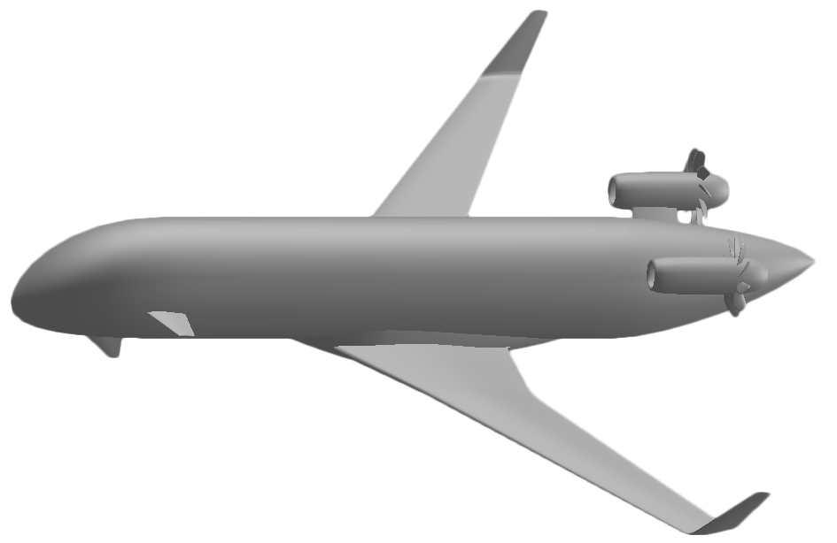
Finger Feathers
Future transport with variable winglet "toe" for pitch and roll
Notes:
Here we offer a notional emulation of bird finger feathers for a future aircraft with a swept wing and reduced empennage. The approach would vary the "toe out" of winglets, with or without symmetry, for pitch and/or roll. Further study would address the question of how to ensure both safe and favorable yaw response to differential toe out.
The particular concept shown, actively stabilized in yaw with a ventral canard, would also notionally have floating canards which are activated only for selected conditions such as assisting the “toed-out” winglets for takeoff rotation, gust rejection, or supplementary control of pitch. Active stabilization of both pitch and yaw is commonly practiced by many bird species, and such enhances flight efficiency and maneuverability.

Slide 23
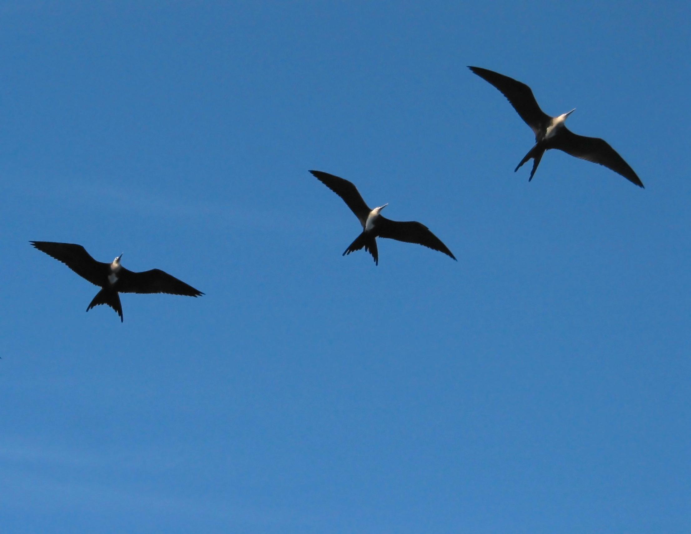
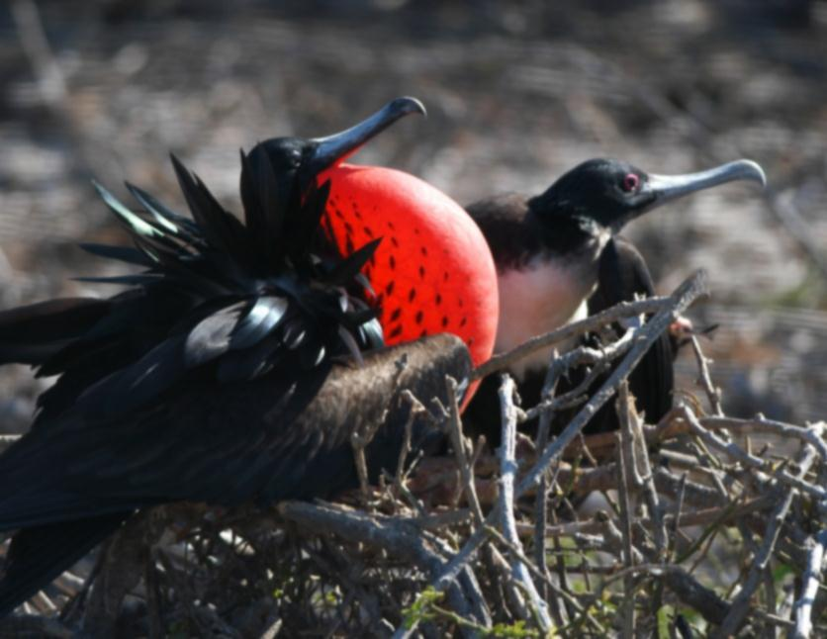
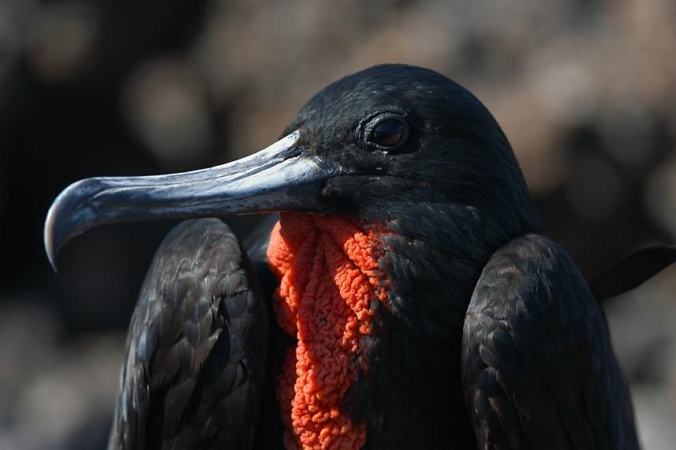
Energy regeneration
Flight sustained by atmos. vertical motion
Thermal day & night up to 2800 m
Lowest wing loading of any bird
Energy rate sensor ~ air temp, air press.?
No H₂O contact ; feed like Pteranodon
- Great Frigate Bird
30-year lifespan
Sortie radius to 1800 km
Sortie duration up to 4 days
Data:
Henri Weimerskirch,
et.al. Nature Jan 2003
Photography:
Phil Barnes
Notes:
The Great Frigate Bird is our role model for a "regen" aircraft. Prevalent in tropical areas such as Baja California and the Galapagos Islands, the Frigate Bird has many capabilities which our regen shall attempt to emulate. These include self-contained takeoff, emergency thrust on demand, and flight sustained often or overall by vertical motion of the atmosphere. We must also follow the example of the Frigate Bird by incorporating an "energy rate sensor" so that we can recognize and capitalize on lift while minimizing exposure to sink. Perhaps the Frigate Bird senses the slight differences in air temperature which mark rising or sinking air. Perhaps it can sense changes in barometric pressure. But whatever its energy-rate-sensing method, the Frigate Bird soars day and night on thermals* at altitudes up to 2.8 km, largely on shoulder-locked wings, traveling great distances in a sortie which may last several days.
Like the albatross, the Frigate Bird soars for long periods over water as far as the eye can see. But of the two, only the Frigate Bird can never land on the water, due to its permeable plumage. Thus the Frigate Bird feeds mostly by following waterborne predators and plucking scraps from the surface.
* H. Weimerskirch, et.al., Frigate Birds Ride High on Thermals, Nature, Jan 2003
M. Allen, Autonomous Soaring for Improved Endurance of a Small Uninhabited Air Vehicle, AiAA 2005-1025

Slide 24
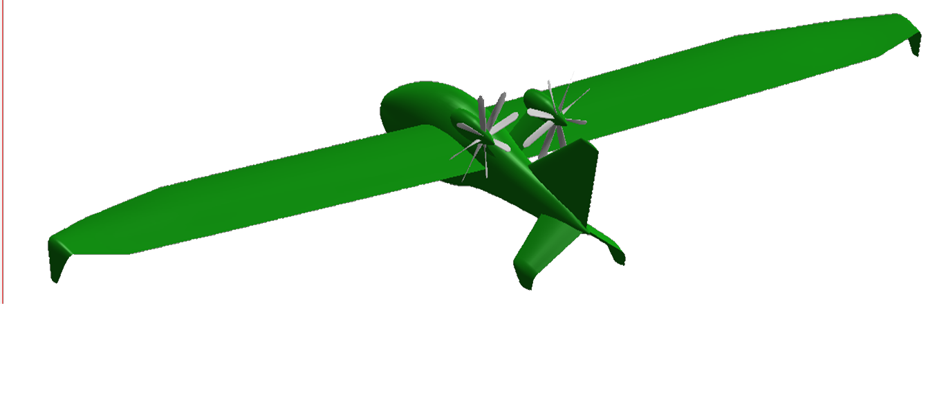
“Regen” : Regenerative-electric Flight
Enhanced range & time
Steep descent option
Landing thrust reversal
Ground wind recharge
Features & Enablers
Thermal / ridge lift
High L/D, low sink
Sym. rotor airfoils
DC boost converter
Propel. ~ high RPM
Turbine ~ low RPM
“Clean”
sink rate
Windprop
Effect
Updraft
ε ≡ “Exchange Ratio,” as applicable:
turbine system efficiency ~71%
1 / propeller system efficiency
0 for pinwheeling (no exchange)
“Total
Climb”
“Total Sink”
Notes:
Like a soaring bird, this “regen,” or regenerative electric aircraft, extracts energy from vertical atmospheric motion. But whereas the soaring bird simply maintains its potential energy, the regen goes a step further to gain internal energy. Regeneration is possible when the updraft exceeds the regen’s clean sink rate, where “clean” represents the “windprop” system removed.
With the regeneration capability, the aircraft enjoys increased range, endurance, steep descent where necessary, ground-roll thrust reversal, and ground recharge in the wind. Apart from uplift, key enablers for the regen include high lift-to-drag ratio, low wing loading, and symmetric rotor airfoils which can be shown to offer similar peak efficiency for both operational modes. An additional key enabler is a DC boost converter, borrowed from ground EV regenerative-braking technology to enable efficient bi-directional control of electrical power.
The system-level formula at lower left, applicable for any operational mode including pinwheeling, relates the updraft velocity (u), "clean sink rate“ (windprop removed), and system bi-directional efficiency to the rate of change (dz_{t}/dt) of total specific kinetic, potential, and battery-stored energy. This formula, also applicable for cruising or maneuvering at load factor (n_{n}) and corresponding lift/drag ratio (L/D), reveals the requirements for efficient aerodynamics, powertrain efficiency, and low wing loading.

Slide 25
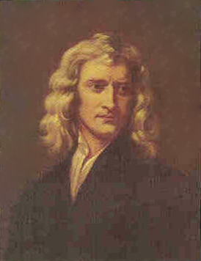
Dynamic Soaring ~ Force Diagram
Dynamic Soaring Force Vector (F)
= m(dw/dt), directed upwind
φ
L
Dynamic Soaring Thrust , T = F∙V
Isolate dynamic soaring thrust
(ignore weight & drag for now)
T = m dV/dt
= m (dV/dw) (dw/dt)
= m cosγ cosψ (dw/dt)
= m cosγ cosψ (dw/dz) (dz/dt)
= m cosγ cosψ w’ V sinγ
Isaac Newton
V
D
γ
mw
ψ
mg
w
Thrust proportional to airspeed, wind gradient, climb angle, and airspeed-to-wind “alignment”
Notes:
Whereas the “regen” extracts energy from vertical wind in the form of thermals or ridge lift, the wandering albatross uses its dynamic soaring technique to extract energy from the vertical gradient of horizontal wind. In the graphic above we show the albatross at an arbitrary orientation, with all the forces, including in particular the dynamic soaring force. This vector, of magnitude [m(dw/dt)], remains steadfastly level and pointed directly upwind. The component of that force aligned with the airspeed vector constitutes dynamic soaring thrust.
Since the wind profile is fixed, only by moving vertically within the wind profile does the albatross experience the rate (dw/dt) and the resulting dynamic soaring thrust. To quantify the thrust, we momentarily ignore both weight and drag. Then applying Newton’s Law along the flight path, we find that the dynamic soaring thrust is proportional to the mass (m), wind gradient (w’), airspeed (V), flight path angle (γ), and a “cosine product.” The latter becomes negative when the albatross turns downwind, whereby the dynamic soaring thrust remains positive if the albatross descends downwind ( where sin γ < 0).
For the albatross, the dynamic soaring thrust has the same effect as a “strap-on jet pack,” with thrust varying throughout each dynamic soaring cycle. It would appear that nature’s jet engine has been around for 50 million years.

Slide 26
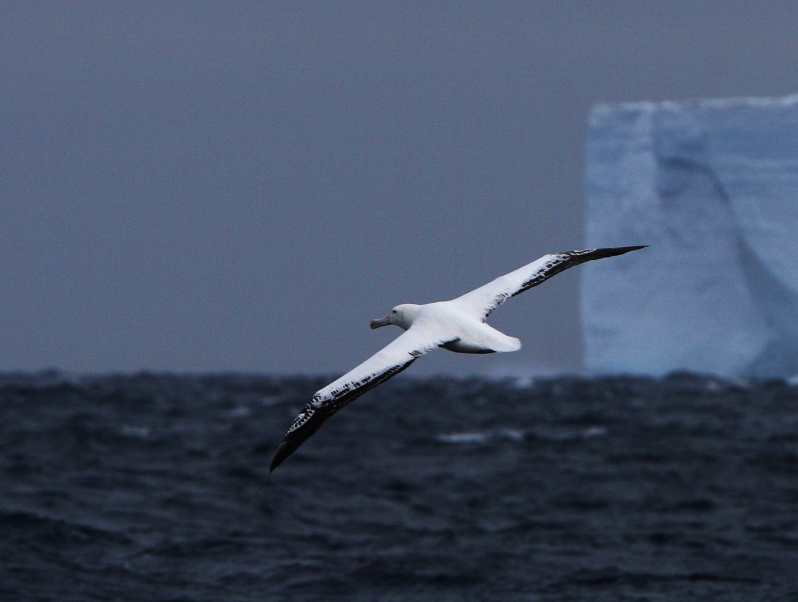
Dynamic Soaring
Wandering albatross
Sustained maneuvering flight on shoulder-locked wings over a waveless sea, extracting energy from the 20-m boundary layer, climbing upwind, diving downwind
4X / year
"I hadn't been expecting to see my first albatross ... But in an abrupt clearing of the mist ... there it was, drifting low over the ragged seas. Enormous and powerful, effortless as sleep, it crossed our wake and then was gone ... I was left with an enchanted sense that I had received a gift."
- Graeme Gibson, The Bedside Book of Birds
Dynamic
Soaring
Simulation
Microsoft
Graphics
Module
Notes:
It was the author's privilege to witness a lengthy performance by this Wandering albatross in between our ship and an iceberg. The thrill of seeing a wandering albatross in flight can only be approximated with words, such as those at lower right by Graeme Gibson. On shoulder-locked wings, the wandering albatross uses its dynamic soaring technique, repeatedly ascending upwind and diving downwind in the 20-meter wind boundary layer to remain aloft, as long as it chooses, without a single wing beat. The albatross can make net progress in any direction, including directly upwind, with dynamic soaring.
Occasionally catching a wave for ridge lift, but not needing the waves for dynamic soaring, the albatross typically conducts a downwind spiral maneuver high above the waves, leaving them far behind as it circumnavigates Antarctica perhaps four times per year. Every two years, it navigates with pinpoint accuracy to the island of its maiden flight where, with good fortune, it rejoins its life-long mate. A mature wandering albatross, reaching with luck 80 years, will have "greyed" by replacing most of its black feathers with white. The albatross in the photo is relatively young.
Our interactive, real-time simulation of the albatross' repertoire of dynamic soaring maneuvers was originally prepared for, and hosted on, Windows XP. To run the simulation on newer platforms, the legacy graphics module MSVBVM50.DLL must installed with the utility or otherwise copied to the windows/system32 directory (this will not conflict with newer graphics modules). After installing the graphics module, run the simulation: moving ~ ... ~ ok ~ fly.

Slide 27
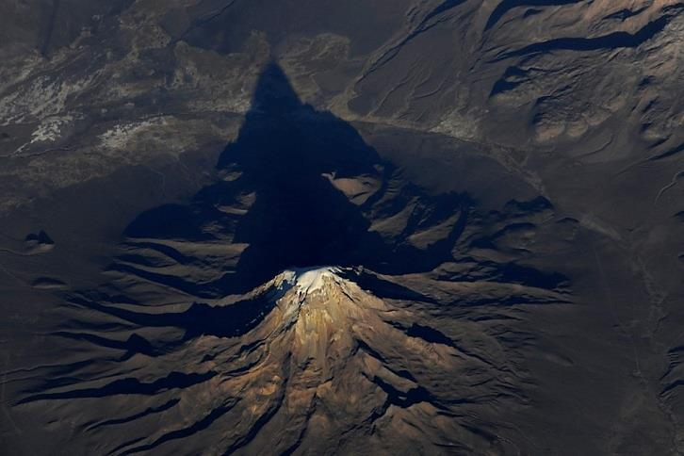
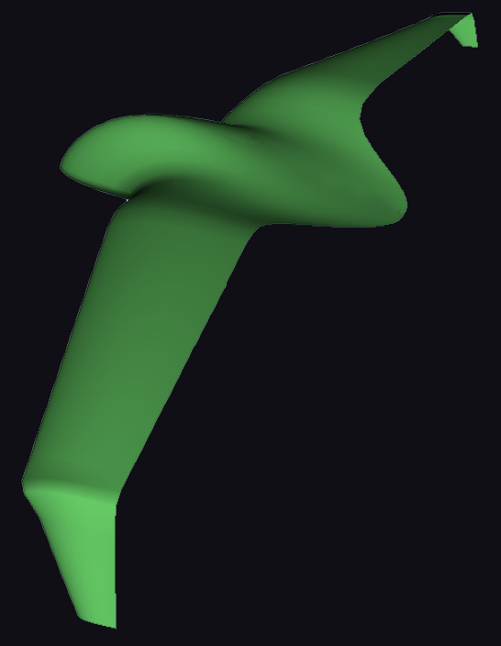
“Dynasóar” - Dynamic soaring in the jet stream
Dynamic soaring thrust (T), Aircraft mass (m)
“zoom climbing” wings level at an angle (γ),
Airspeed (V) and wind gradient (w'=dw/dz)
Headed upwind
T = m (dw/dt) cos γ
= m (dw/dz) (dz/dt) cos γ
= m w' V sin γ cos γ > D
Divide by weight, W=mg:
T/W = T/(mg) > D/W = (D/L) (L/W)
w' (V/g) sin γ cos γ > (D/L) cos γ
w' (V/g) (L/D) sin γ > 1
Dynamic soaring "must haves"
Threshold wind gradient, w'
D.S. Rule: w' sin γ cos ψ > 0
High speed, V (high wing load)
High L/D (lift-to-drag ratio)
Notes:
The question is often asked, "Can an aircraft do dynamic soaring?" Although someday soon a sleek autonomous aircraft may soar like an albatross over the southern ocean, wind gradients over land are much less than those enjoyed by the albatross. But the Jetstream exhibits consistent wind gradients at 11-km altitude. A fast dynamic soaring aircraft (or “dynasóar” – note the difference in spelling from “dinosaur”) equipped with airspeed and altitude sensors to determine total energy may find the Jetstream wind gradient sufficient to emulate the albatross’ perpetual soaring flight.
The fundamental equation of dynamic soaring is derived above, where the dynamic soaring thrust (T) must overcome the drag (D). High aerodynamic efficiency is needed to ensure that such energy gain balances or exceeds the energy lost to drag in the two necessary cross-wind turns of each cycle.
One of the many extraordinary aspects of dynamic soaring is its favoritism for high weight (actually wing loading), a result of its demand for high velocity. Indeed, a given successful dynamic soaring aircraft can be rendered unsuccessful by reducing its weight below a certain threshold. The weight of the wandering albatross, in relation to its wingspan and wing area, has been optimized over 50 million years to best enable wind-profile penetration without preventing running-and-flapping takeoff from the water.

Slide 28
Dynamic soaring in the jet stream
Notes:
Continuing here our assessment of the possibility of terrestrial dynamic soaring, we restrict ourselves to flight over flat terrain, as the albatross can maintain its total energy overall over a flat, waveless sea. In the Jetstream we find a highly-repeatable wind gradient, based on the data shown above. This may be sufficient to support the dynamic soaring of a fast and sleek aircraft. Based on the dynamic soaring equation, and assuming similar L/D and climb and dive angles, the “dynasόar” basically shares with the albatross the product of wind gradient and airspeed.
Of course, a “dynasόar” must avoid outright the commercial transport cruising altitude band, and it must at all altitudes have reliable collision-avoidance autonomy. Fortunately, a 1-km band for dynamic soaring is available at an altitude near 8.5 km. An additional, and thinner, band is available at higher altitude, but in this region, where the wind gradient is negative, the familiar dynamic soaring rule is reversed, whereby the aircraft will descend into the wind and climb with the wind.

Slide 29
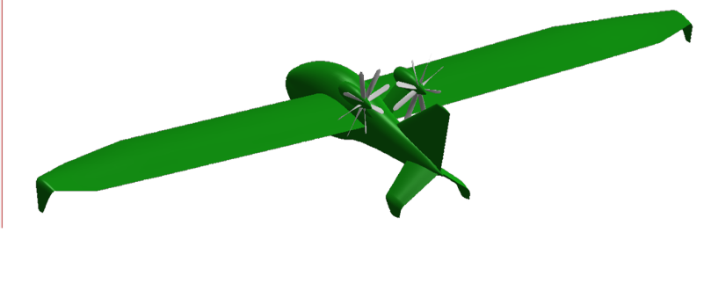
Wrap-up, Future Flight: Learning From The Birds
We saw some of what the birds can do
We showed future aircraft applications
Suggested reading:
The Life of Birds (David Attenborough)
Global Birding (National Geographic)
Atlas of Bird Migration (Random House)
This free presentation and others:
www.HowFliesTheAlbatross.com
Parting thoughts:
Birds have graced our blue planet for 100 million years
Modern humans have been here only 0.1 million years
Let not birds (or gorillas) go extinct on our account
Green engineers (hopefully you) will be key

Slide 30
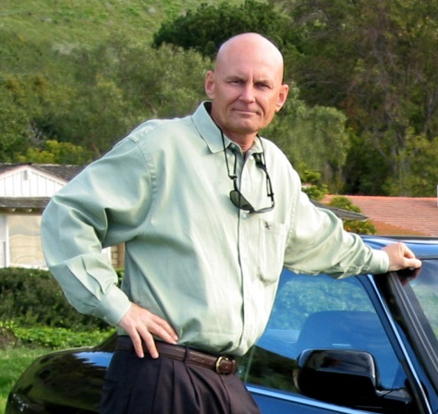
J. Philip Barnes
Cal Poly Pomona Outstanding Engineering Alum
07 June 2014
Phil Barnes is from Tucson Arizona, where he obtained his Bachelor’s degree in mechanical engineering from the University of Arizona. Phil joined Pratt & Whitney in Florida, contributing to the design and analysis of the F-100 engine powering the F-15 and F-16 fighter aircraft.
In 1981, Phil Joined Northrop to support the F-20 program. In 1988, he earned a Master of Engineering Degree from Cal Poly Pomona, with a young Dr. Ali Ahmadi as one of the professors. Phil authored, for his Master’s Degree project, a new method and AIAA paper on characterizing Keplerian orbital mechanics.
Obtaining a Master’s degree became a catalyst, not only for enhanced skills at work, but also for personal research at home. At work, after completing a study influencing the design of the YF-23 Advanced Tactical Fighter, Phil presented a 2-day SAE seminar on aircraft auxiliary and emergency power. At home, he wrote his first SAE technical paper: “Math Modeling of Airfoil Geometry and Aerodynamics.” This was followed by an SAE paper on 3D wing aerodynamics, and an AGMA paper on gear geometry, mesh loss, and windage. Following another SAE paper, on propellers, Phil was awarded SAE’s Lloyd Withrow Excellence in Oral Presentation Award.
For Northrop Grumman’s 2003 Centennial of Flight celebration, Phil prepared a technical paper explaining how the wandering albatross uses dynamic soaring to remain aloft on shoulder-locked wings over a waveless sea. Phil’s real-time simulation of the albatross conducting dynamic-soaring maneuvers is part of today’s presentation herein:
Future Flight: Learning From the Birds
Whereas the Wandering Albatross exploits horizontal atmospheric motion, the Frigate Bird exploits vertical atmospheric motion, both sensing and managing its “total energy state.” Phil’s latest research is focused on emulating the Frigate Bird by implementing regenerative electric flight, where a dual-role propeller/wind turbine extracts and stores energy in thermals, wave lift, and final descent.
Recently, AIAA invited and sponsored Phil’s travel to Dayton Ohio to present an AIAA Distinguished Lecture on the German Jets of WWII. Phil’s technical papers, presentations, and ideas reside in the public domain, by intent, at his website:
www.HowFliesTheAlbatross.com

