Slide 1
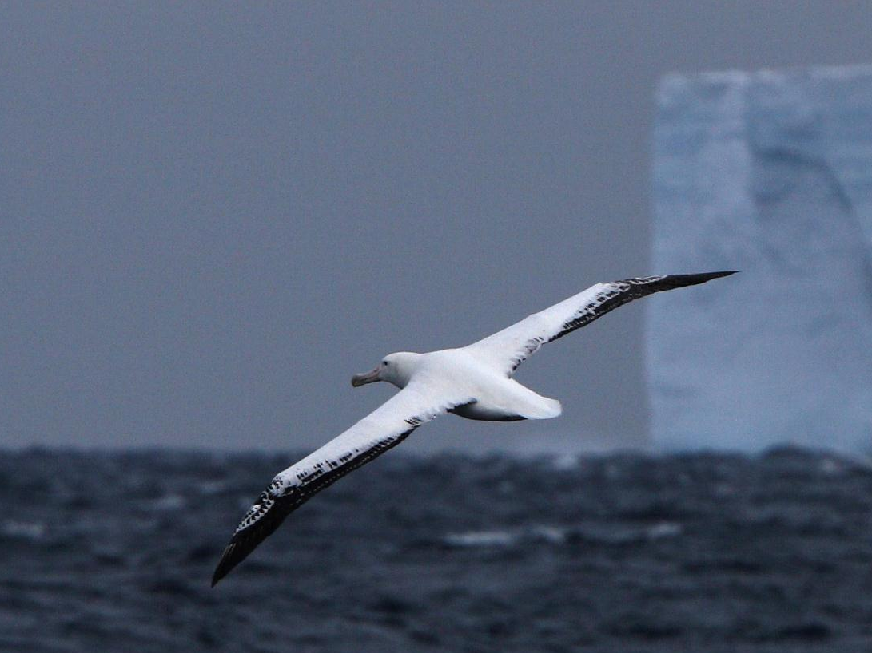
How Flies the Albatross
The Flight Mechanics of Dynamic Soaring
J. Philip Barnes 15 Sept. 2020 Update / Nov 2004 Original
Animated charts (F5 key)
also “view ~ notes pages”
Notes:
It is my pleasure to share the discovery of how the albatross uses its dynamic soaring technique to remain aloft indefinitely on shoulder-locked wings over a waveless sea. Of course the albatross often catches a free ride along the front of a wave, just like the pelicans here in southern California, but waves travel much slower than the wind, and as we will show, the albatross travels overall downwind faster than the wind. Indeed, the albatross circumnavigates Antarctica several times per year, in as little as 46-days per trip. Only with dynamic soaring can the albatross fly so fast and far.
Our presentation, “How Flies the Albatross ~ the Flight Mechanics of Dynamic Soaring,” draws from several disciplines, including aerospace engineering, physics, mathematics, computer graphics, paleontology, photography, and even a little poetry, to observe what the albatross does, and understand how it does it, hoping that we’ll take greater interest in halting its slide to extinction.

Slide 2
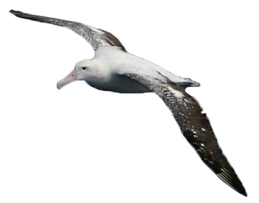
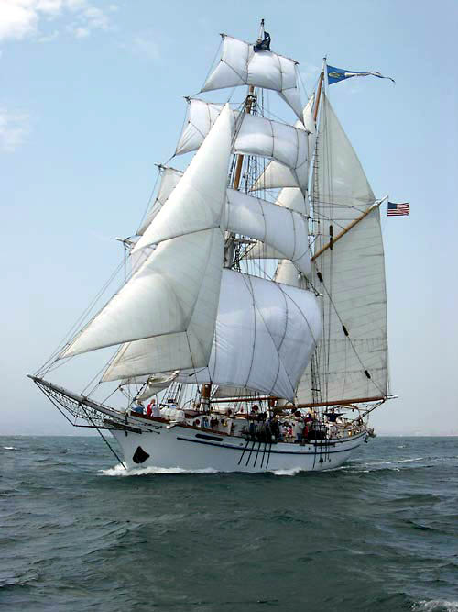
From The Rhyme of the Ancient Mariner ~ Part the First
And a good south wind sprung up behind;
And the Albatross did follow,
And every day, for food or play,
Came to the mariners’ hollo!
- Samuel Taylor Coleridge
Notes:
In “The Rhyme of the Ancient Mariner,” the sailor shot the albatross with his crossbow, believing the bird was responsible for the ice-cold storm. This was unfortunate for both because, as the story goes, the albatross was “the bird that made the wind to blow.” Consequently, the ship drifted into the doldrums, and the crew perished from thirst.
Today we are still shooting the albatross, in a manner of speaking, but our crossbows take the form of long-line fishing fleets, predators introduced to the remote islands where the albatross breeds, and more recently, floating plastic at sea. Although the albatross has graced our blue planet for 50 million years, we so-called “modern” humans appeared only recently, about 0.1-million years ago. Yet within just the last 0.0001-million years, many albatross species have lost half of their population on account of us.

Slide 3
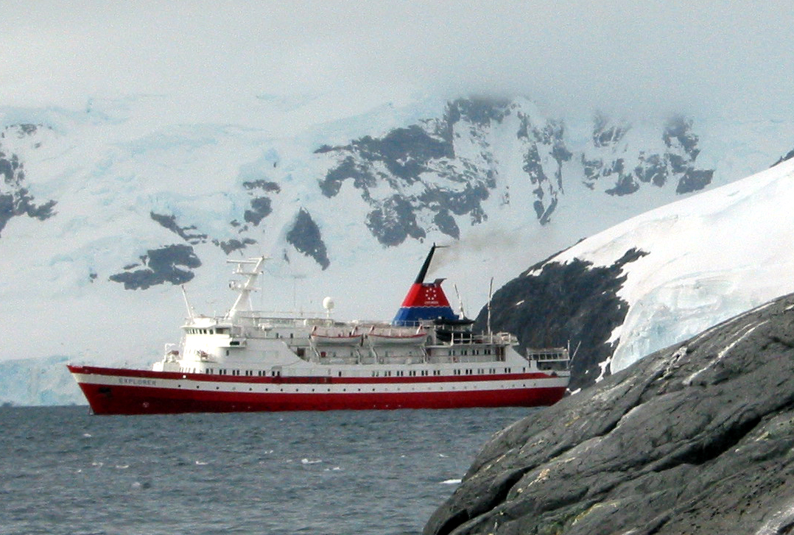
Right-sized expedition ship
Notes:
A great way to experience the albatross in action, together with other fascinating wildlife and breath-taking scenery, is to travel to Antarctica with an extension to South Georgia. Such a three-week trip is best taken in northern-hemisphere wintertime on a small ship accommodating 100-200 passengers. Anything smaller can make for one or two difficult Drake Passages; anything larger cannot anchor close enough to safely dispatch zodiacs enabling land exploration on foot. Travelers will likely board in Ushuaia, Argentina. Visit expeditions.com for a representative example of trip cost and details. Our presentation herein somewhat randomly inserts the author’s personal photos to help describe the world of the albatross.

Slide 4
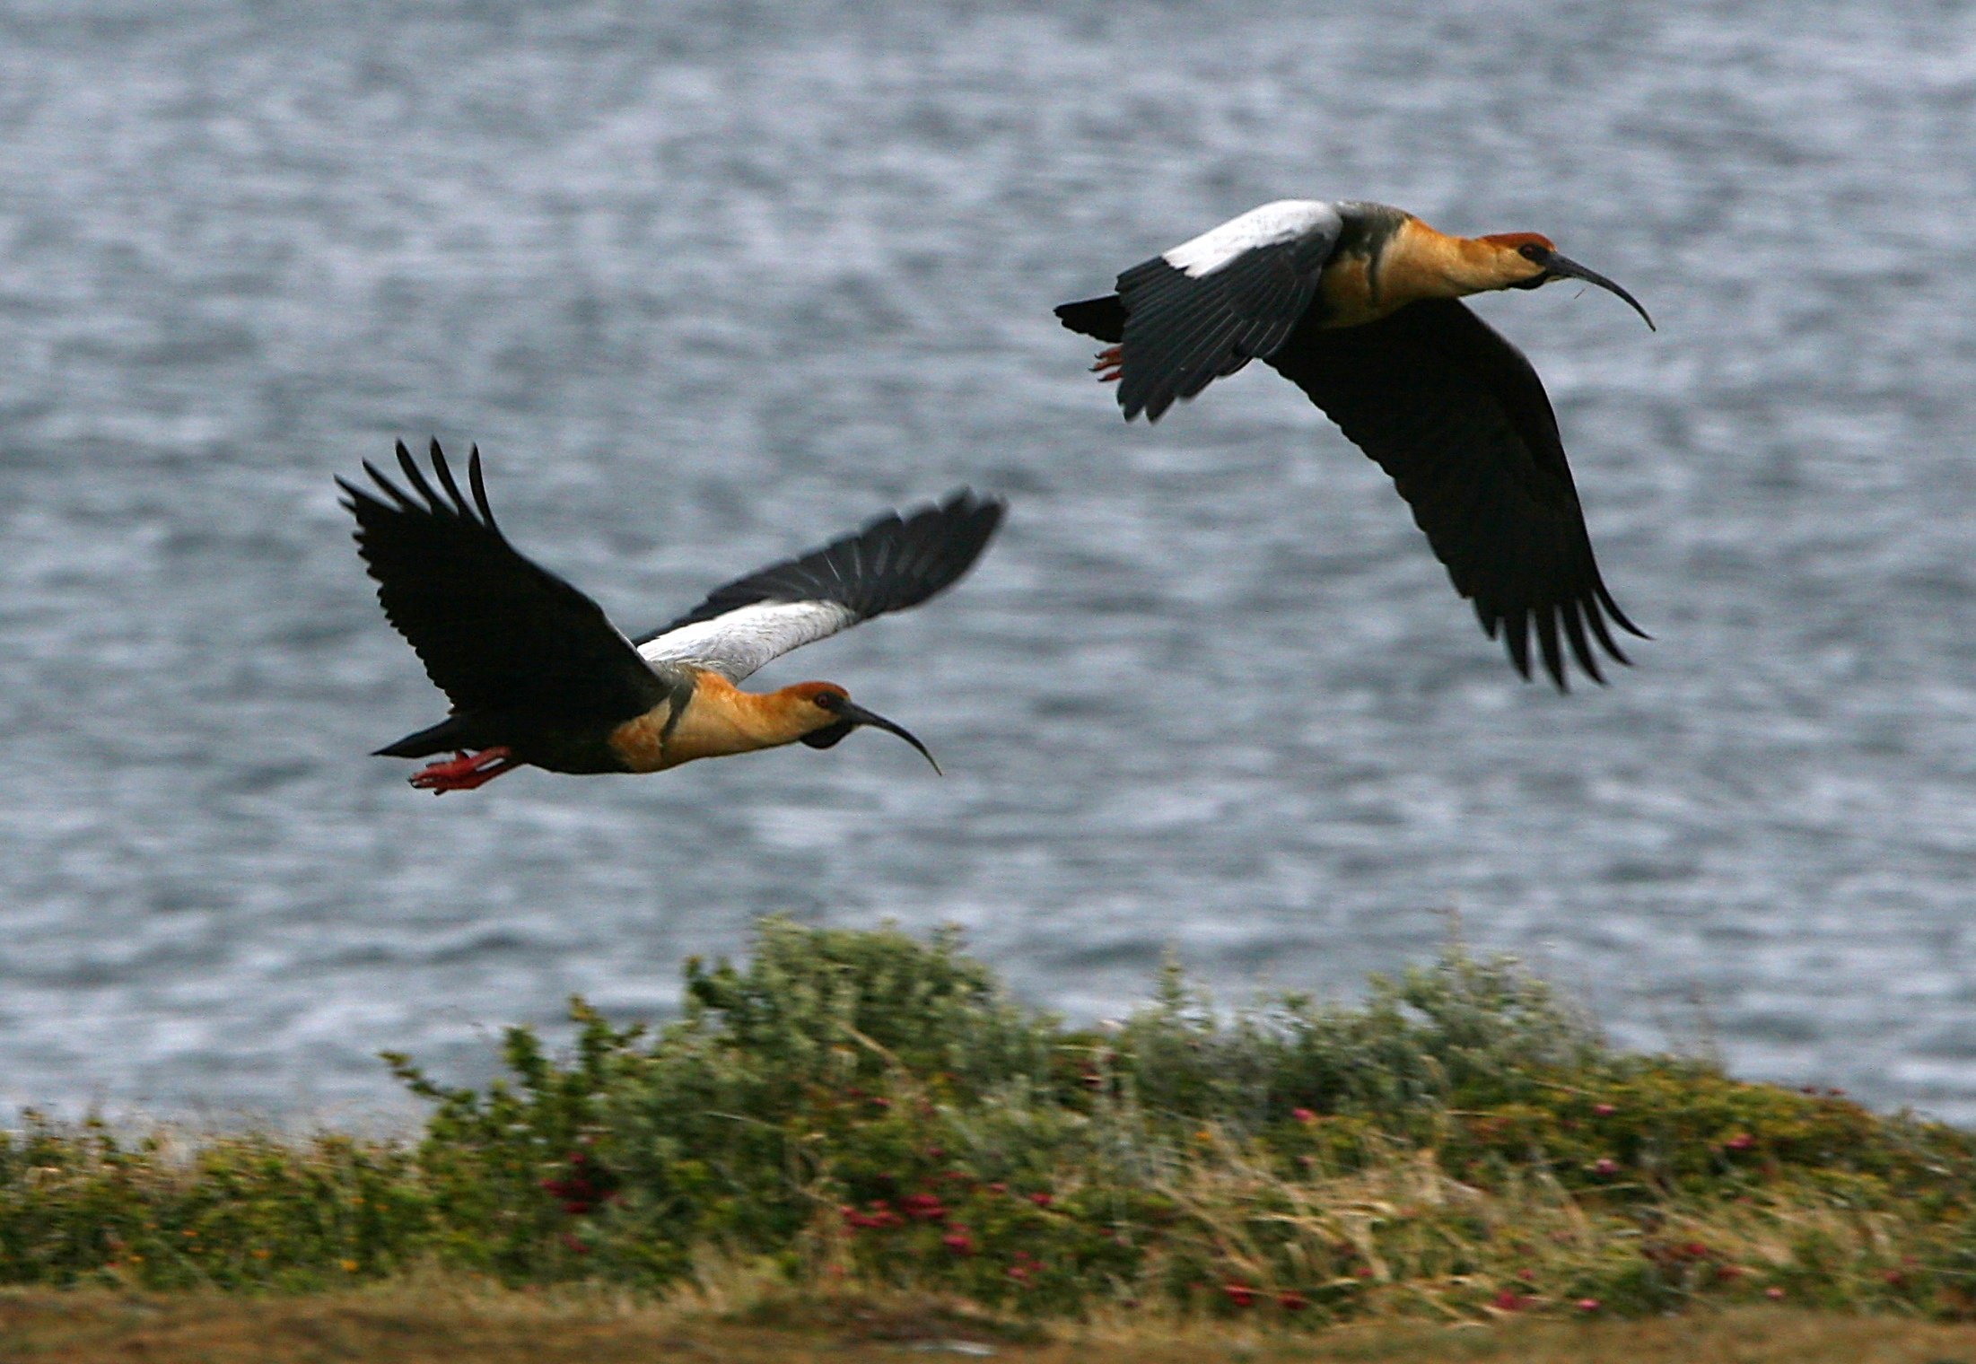
Black-faced Ibis, Ushuaia, Argentina

Slide 5
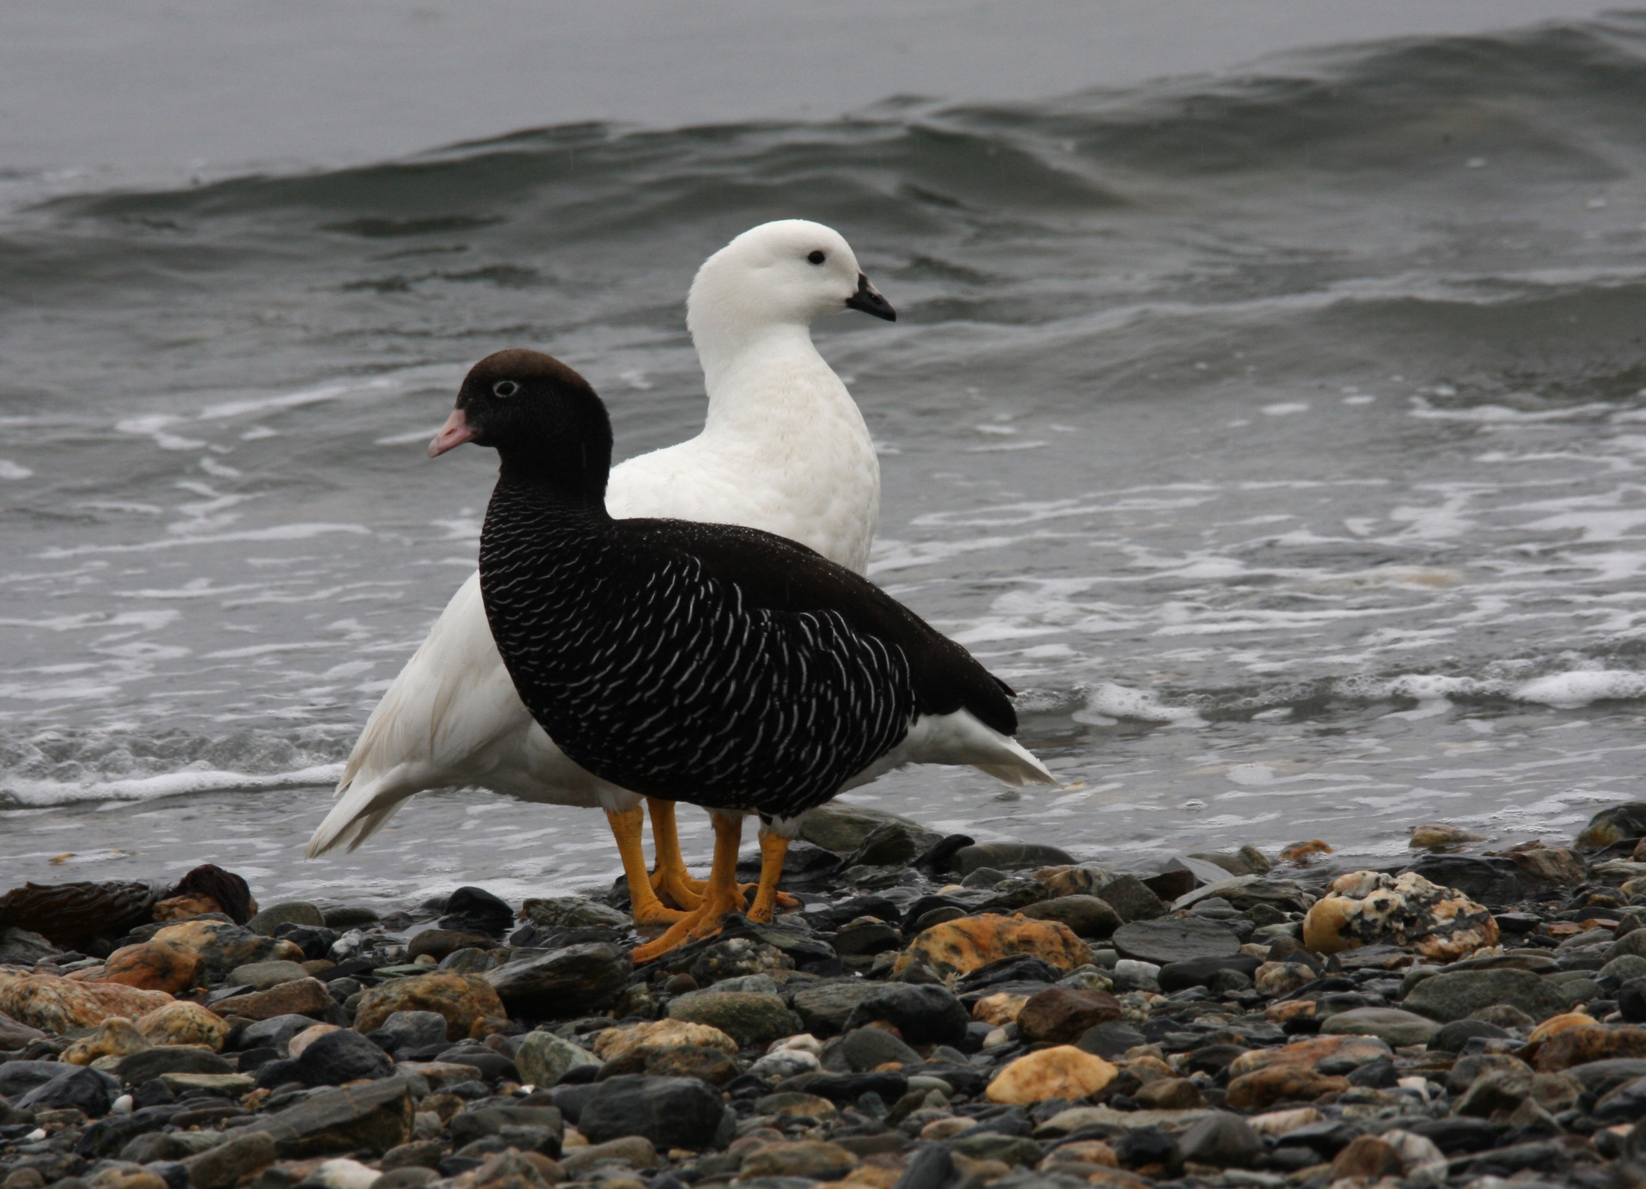
Snow Geese, Ushuaia, Argentina

Slide 6
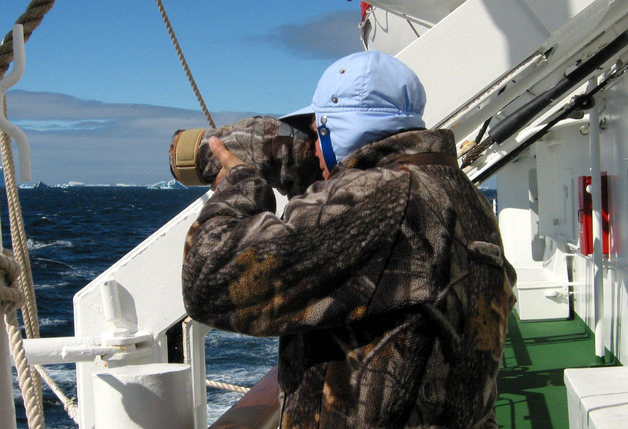
In freezing, howling wind, 2-hand-entry mit allows sustained, gloves-free oper.

Slide 7
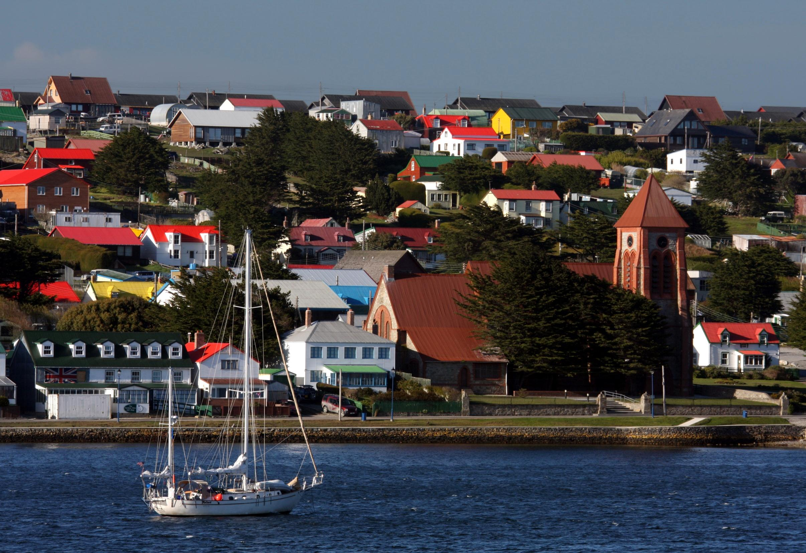
Port of Stanley, Falkland Islands

Slide 8
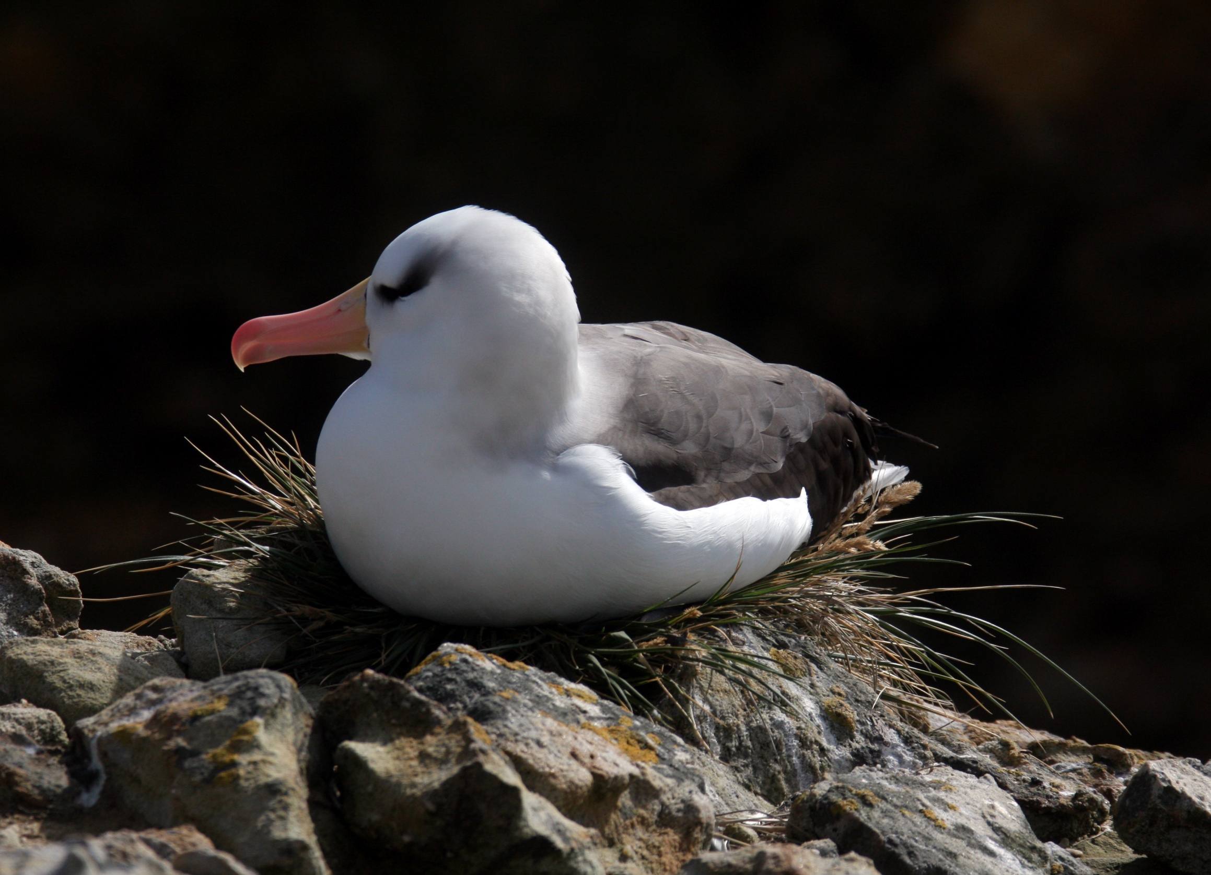
Black-browed Albatross nesting in a cliff outside Port Stanley, Falkland Islands
Royal Albatross

Slide 9
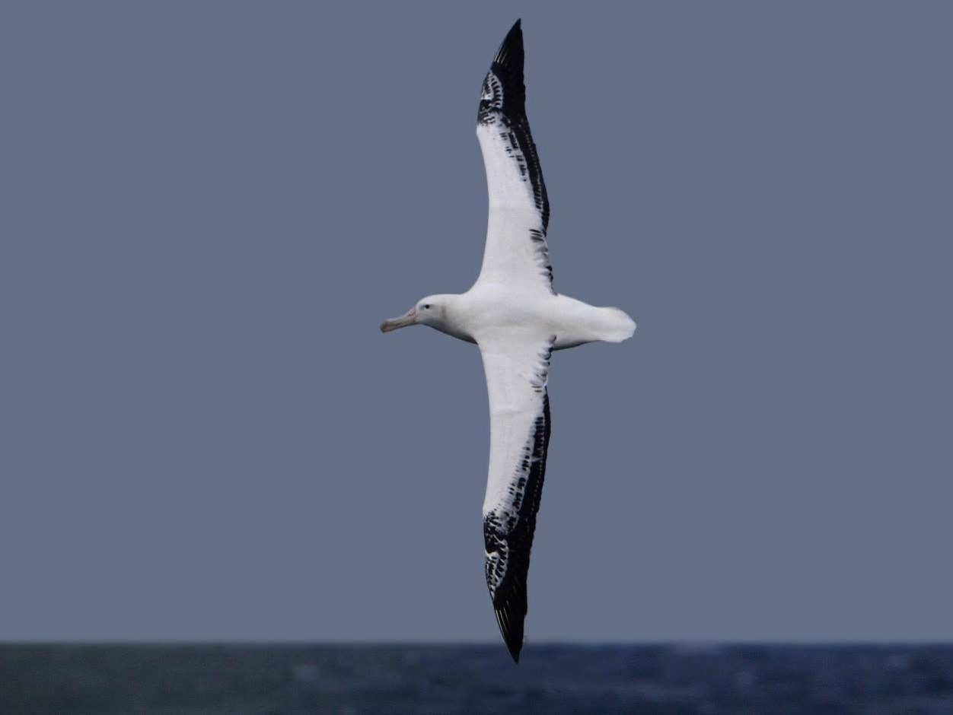
“The albatross can maintain this swooping soaring flight for hours on end without a single wing beat.” - David Attenborough
Noted Naturalists’ Observations
“The albatross … manages to remain
master of its ... course, ...carried ...
around the globe or...making way
against the strong winds without a
beat of its wings.”- Jacques Cousteau
Notes:
Well-known naturalists, including David Attenborough and Jacques Cousteau, have observed and documented how the albatross appears to defy the laws of physics in remaining aloft indefinitely without flapping its wings. In this presentation, we will show how the albatross does these things while adhering, as we must, to the laws of physics.

Slide 10
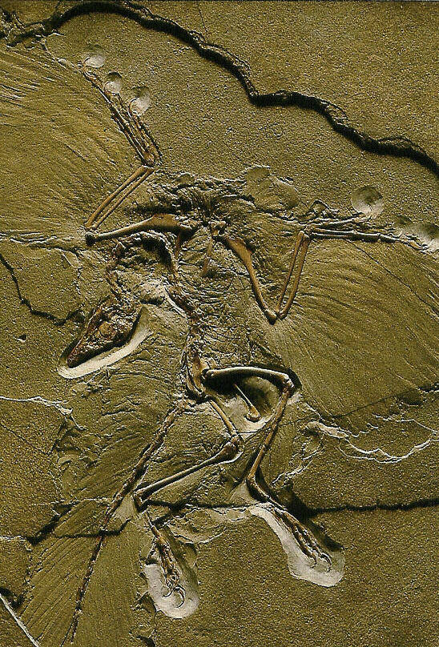
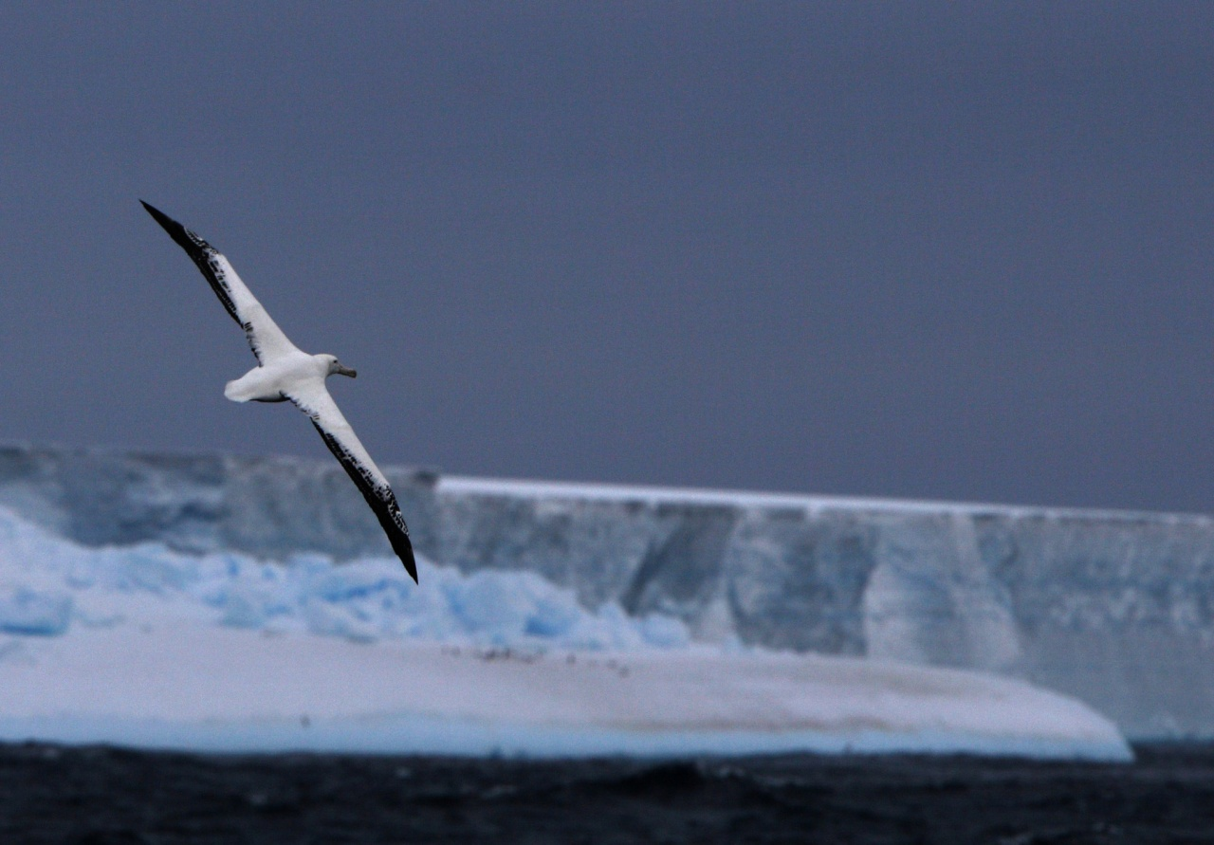
Evolution and Dynamic Soaring
Archaeopteryx
150 Million Yr.
Pteranodon
9-m wingspan
200-65 Million yr.
Wandering
Albatross
3.5-m span
Osteodontornis
55-5 million yr.
6-m wingspan
Notes:
Archaeopteryx was the feathered bird-dinosaur which lived 150 million years ago. Probably unable to sustain flapping flight, Archaeopteryx may have used its feathered wings to enable a gliding attack on its prey, and/or to enhance its running speed by developing flapping thrust (1). With evolutionary time, wing area and wingspan increased to the point of going airborne from a running start.
Evolving to flight along an entirely different path, one without feathers, was the Pteranodon flying “reptile” with up to 9-m wingspan. Among many of its fascinating features is the evolution of its little finger to become the main spar of its wing. With fossils often found far out at sea, and with chest muscles likely too small to sustain flapping, Pteranodon may have originated dynamic soaring,
By 100 million years ago, birds looked much as they do today (2). An early albatross of 6-m wingspan, named Osteodontornis, lived between 55 and 5 million years ago. Even before the arrival of Osteodontornis, modern birds shared ocean skies with Pteranodon (4).
Today, 13 species of albatross grace our blue planet and carry forth the ancient skill of dynamic soaring. The Wandering albatross, the main subject of our study herein, has a 3.5-m wingspan, the largest of any bird living today.
(1) Phillip Burgers & Luis Chiappe, “The Wing of Archaeopteryx as a Primary Thrust Generator,”
Nature, Vol. 399, 1999, p. 60
(2) Joel Carl Welty, “The Life of Birds,” Alfred A. Knopf, 1962, p. 483
(3) Adrian Desmond, “The Hot-blooded Dinosaurs,” Dial Press, 1976, p. 170-183
(4) Richard P. Hilton, “Dinosaurs and Other Mesozoic Reptiles of Calif.,” 2003, UCLA Press, p. 70

Slide 11
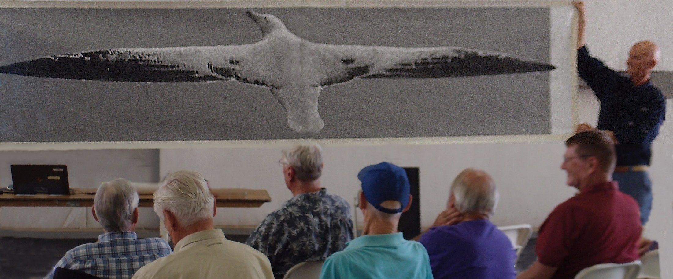
Life-size poster of wandering albatross with 3.5-m wingspan
Notes:
Courtesy of Kinko’s is this life-size poster of a wandering albatross, with the poster held by the author and an audience volunteer. The photo has been scaled to show a 3.5-m wingspan.

Slide 12
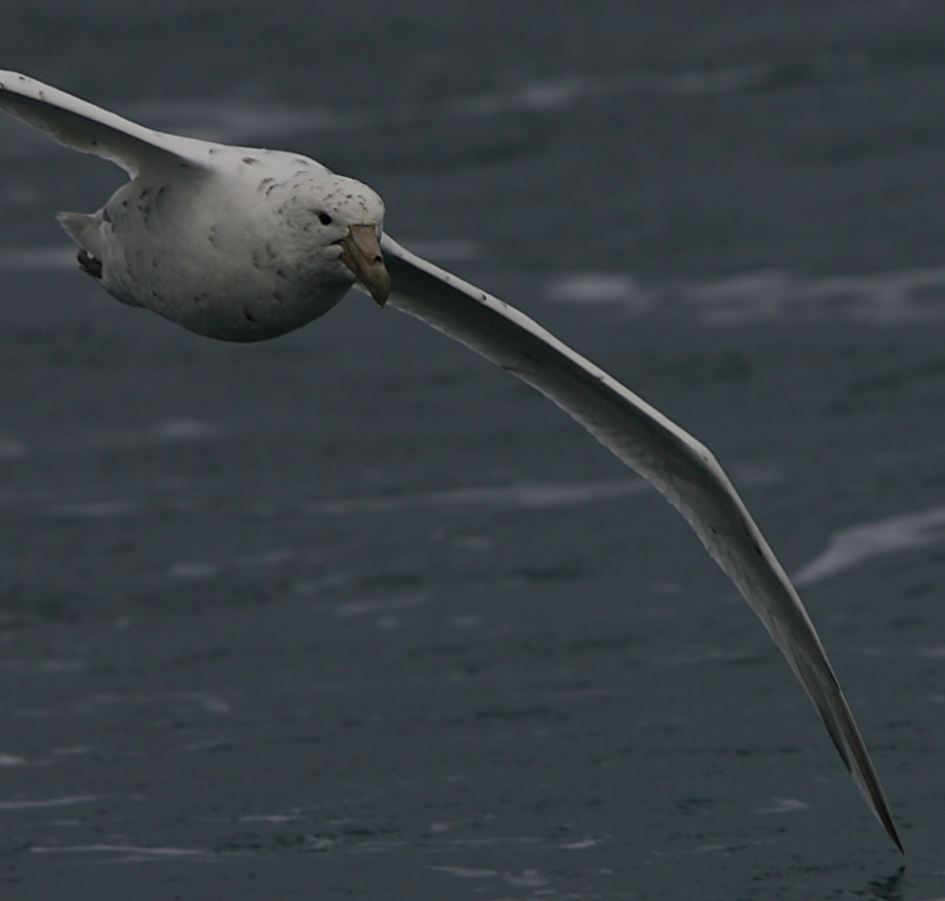
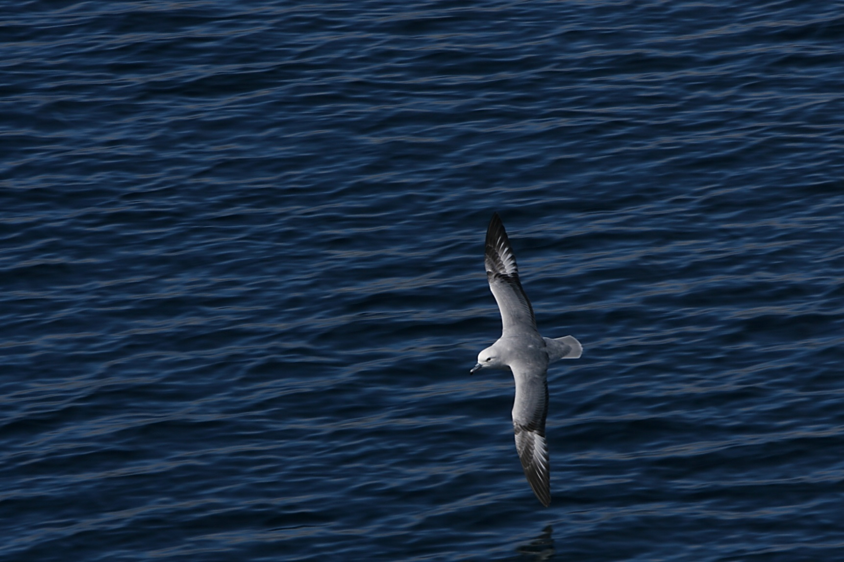
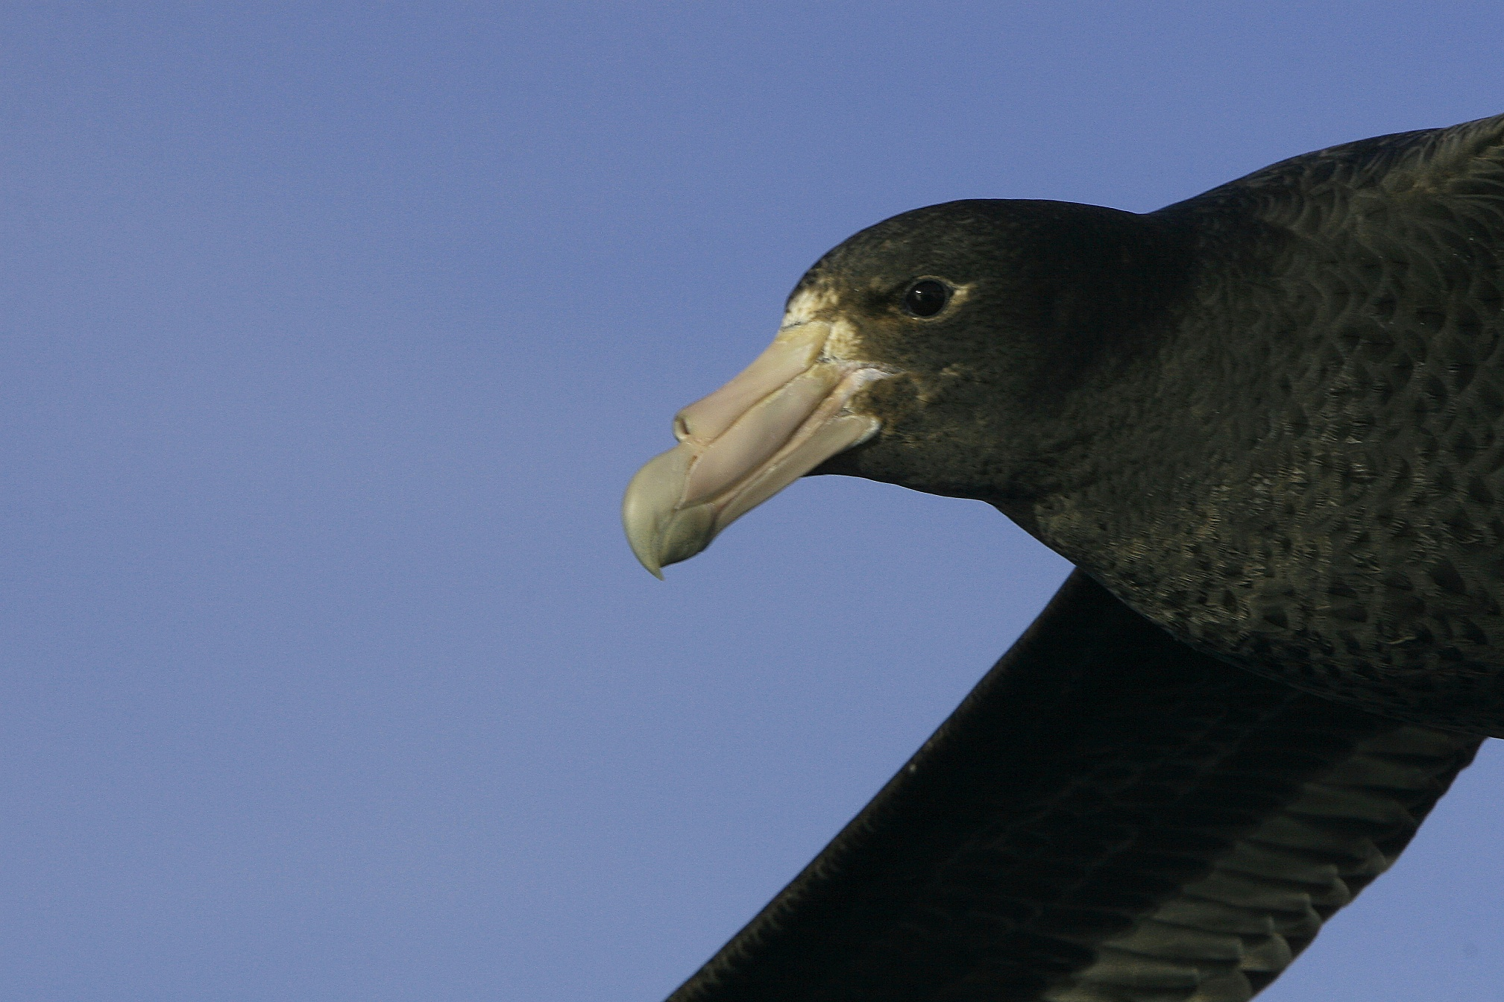
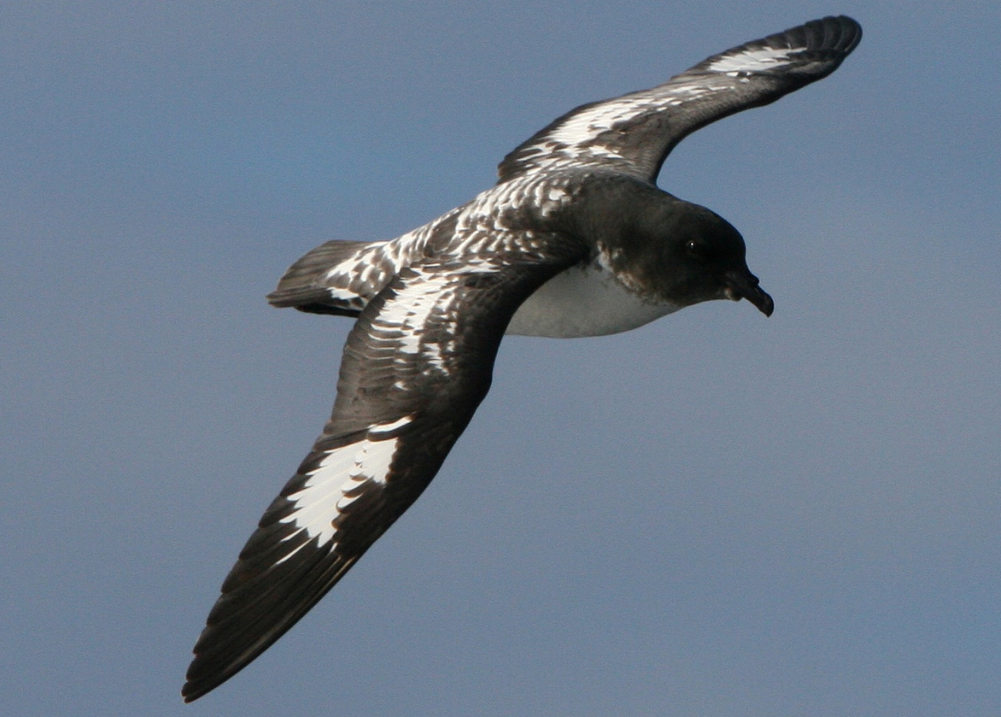
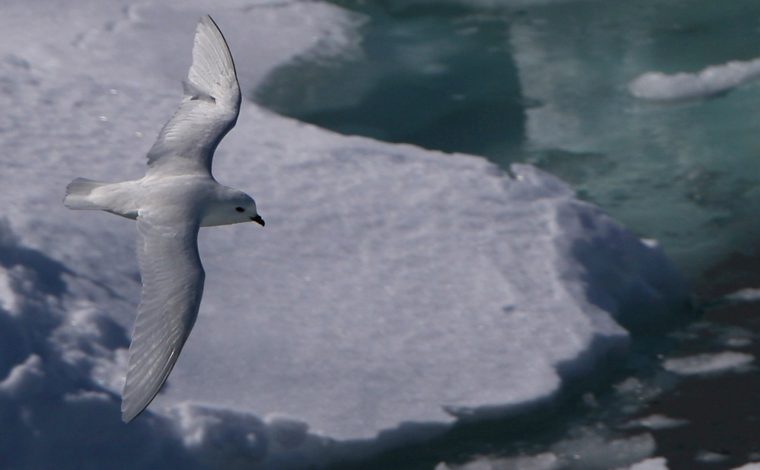
Giant Petrel
Southern
Fulmar
Giant Petrel
White Morph
“Tubenoses”
Drink saltwater
Nasal excretion
Snow Petrel
Painted Petrel
Notes:
Other seabirds join the albatross in dynamic soaring, except when the wind falls below a threshold. The giant petrel, particularly its rare “white morph,” can easily be mistaken for an albatross at a distance. The “tubenose” seabird family, including the albatross, petrels, and fulmars, de-salinate ingested sea water, excreting the salt from their tubenose.

Slide 13
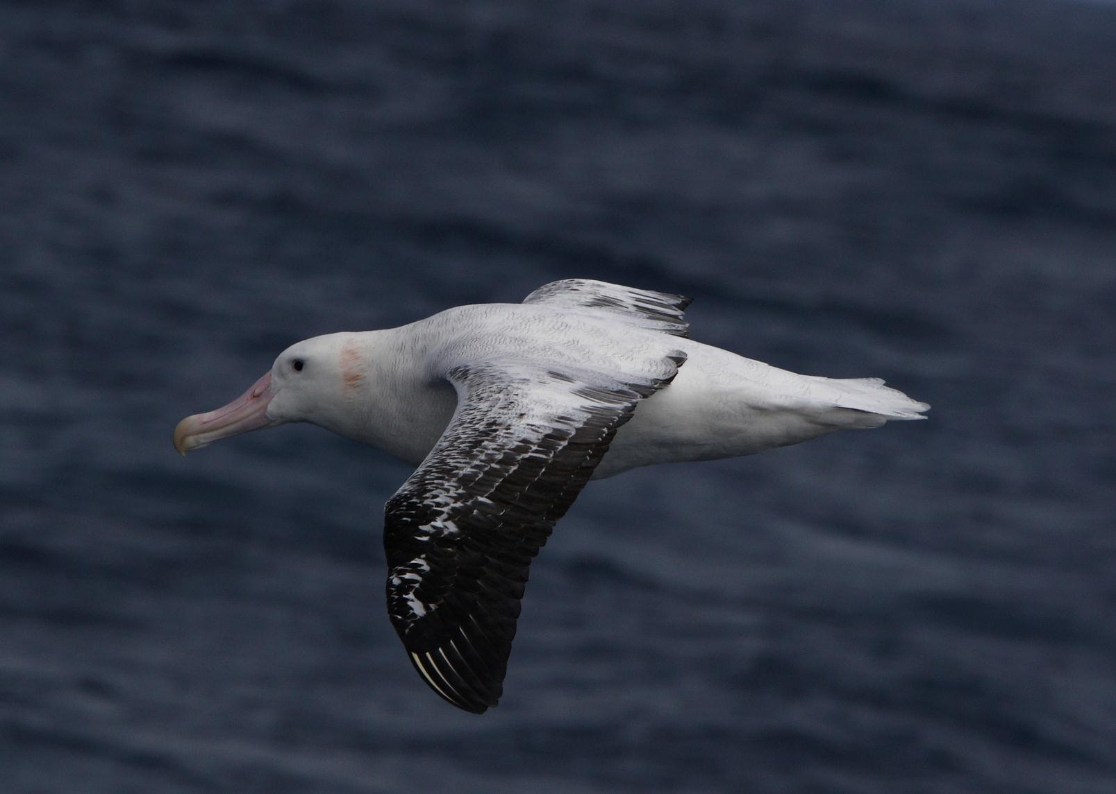
Wandering Albatross
Notes:
The wandering albatross can be distinguished from its royal albatross cousin by a pink patch on the side of its head. Both species otherwise look alike and can have the same wingspan.

Slide 14
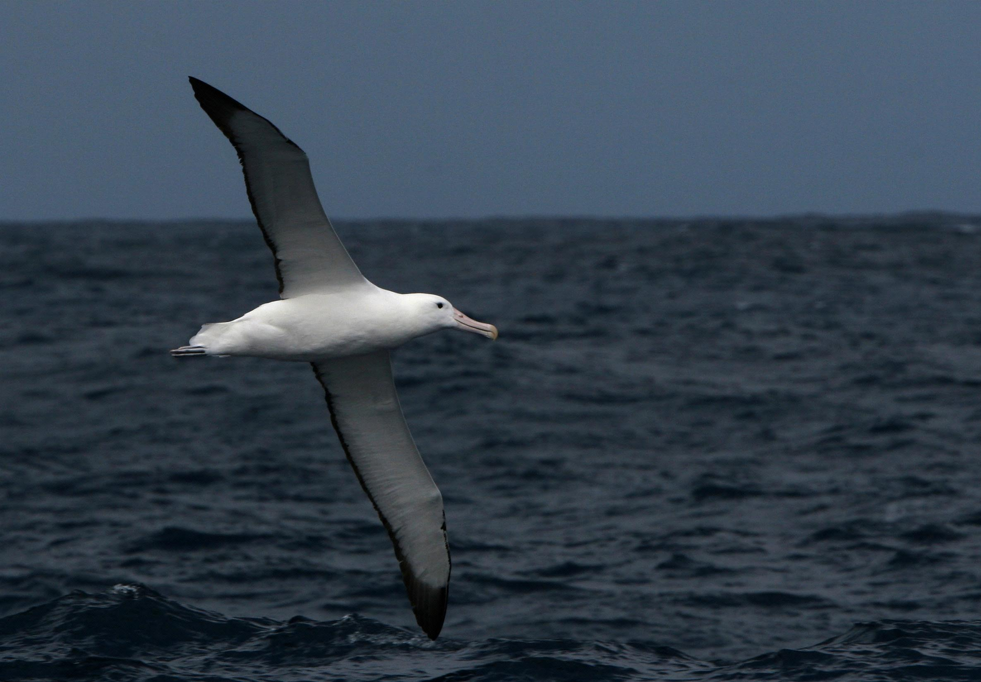
Royal Albatross
Notes:
This is a royal albatross, photographed in the Drake Passage. Most of our in-flight bird photos herein were captured with a Canon EOS single-lens-reflex camera and 400 DO super-telephoto lens with a drop-in polarizing filter.

Slide 15
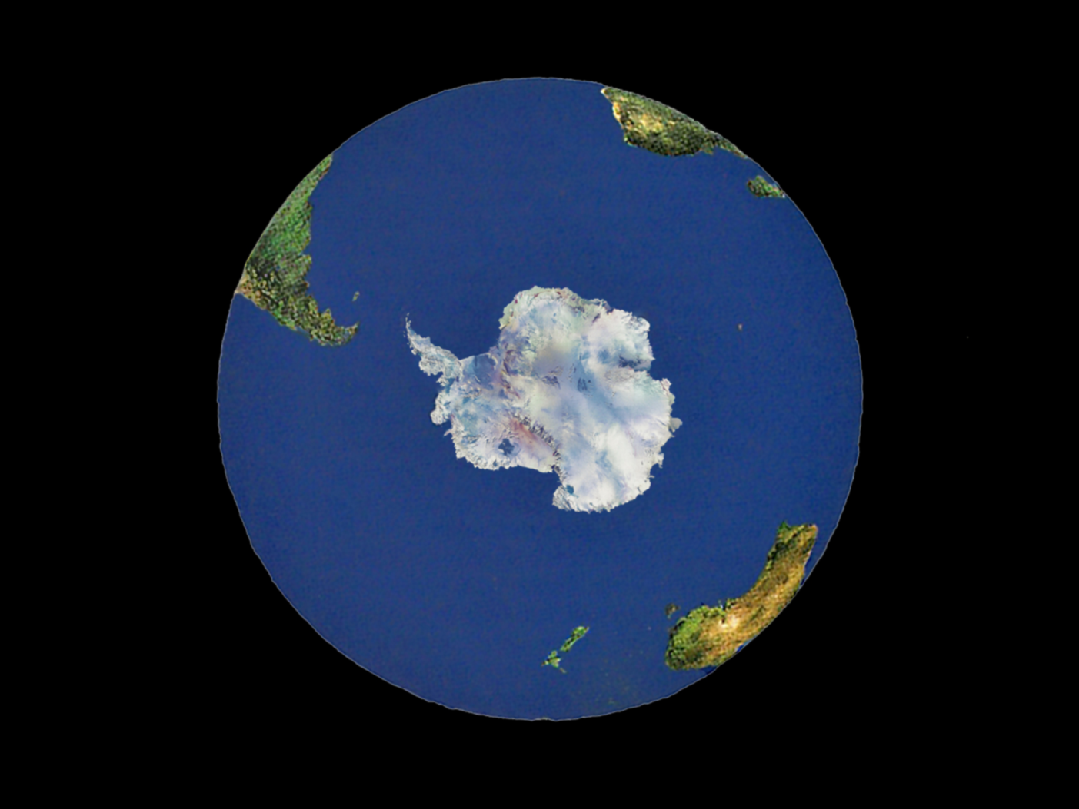
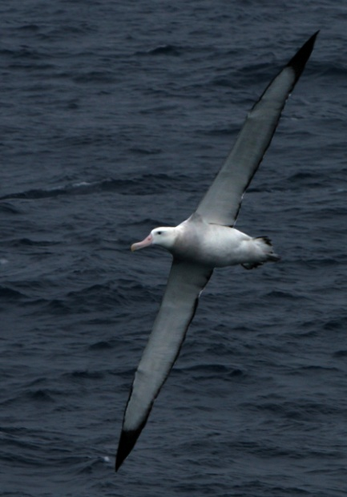
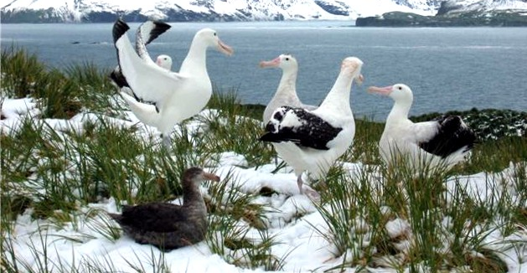
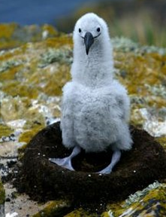
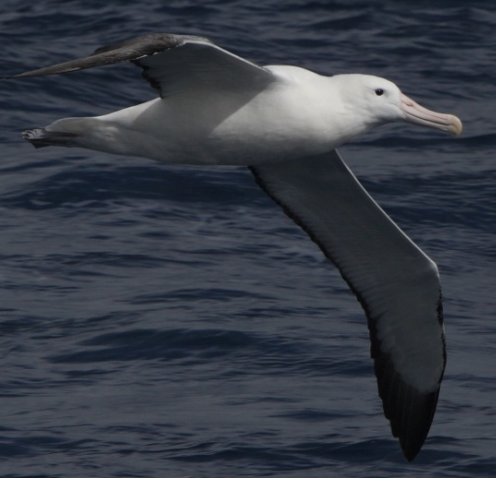
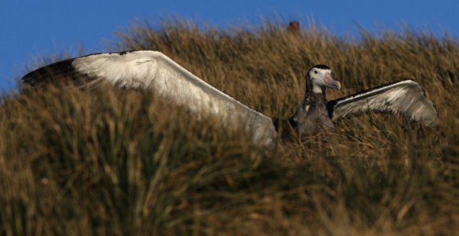
Antarctic Circumpolar
Current
Air & water
60-yr Life span
Life-long mate
Pinpoint
Navigation
Shoulder Lock
1500 km/day
Sleep on
the wing
1-Chick every 2-yrs
Breeding Site Islands
Notes:
Here’s an interesting view, looking “up” at our spaceship Earth. The thin line around the globe, here a graphical artifact, closely represents the combined thickness of our ocean and atmosphere. Thus the so-called “biosphere” is really more of a thin and fragile shell or veil; thus the urgency of protecting it.
Throughout the year, the Antarctic Circumpolar Current, or ACC, sweeps around the continent, accompanied by a consistent howling and freezing wind, and on occasion hosting the largest waves on the planet. The northern and southern fronts of the ACC are marked by sharp changes in water temperature, salinity, and concentrations of phytoplankton and zooplankton.
Roughly speaking, the wandering albatross rides the wind above the ACC, although it wanders considerably farther north or south. The albatross uses its dynamic soaring technique to travel perhaps 1500 km/day, and according to David Attenborough, often does so half asleep on the wing. That would include effortless terrain following over a heaving sea, and as we shall show later, pulling a 3-g turn every 10-seconds.
As an adult, every other year the albatross navigates with pinpoint accuracy to the island where it was hatched and, with good fortune, meets or greets its life-long mate to raise a single chick. Initially, the chick has full-time supervision by one parent, but then for just over a year, the chick is left alone and fed every 5 days as each parent returns separately from a 10-day excursion. Then the chick is totally abandoned, and driven by hunger, it lifts off and quickly learns or instinctively implements dynamic soaring. On their maiden flight, many albatross fledglings have been seen to disappear over the horizon to begin their first decade totally at sea.
Try locating New Zealand and South Georgia in the satellite photo above.

Slide 16
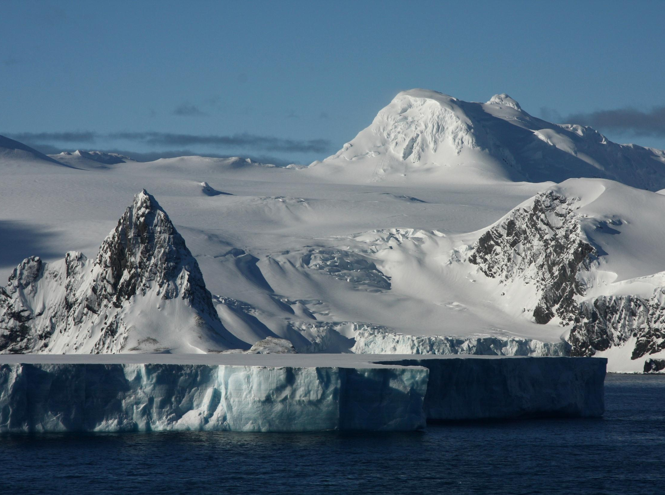
Elephant Island

Slide 17
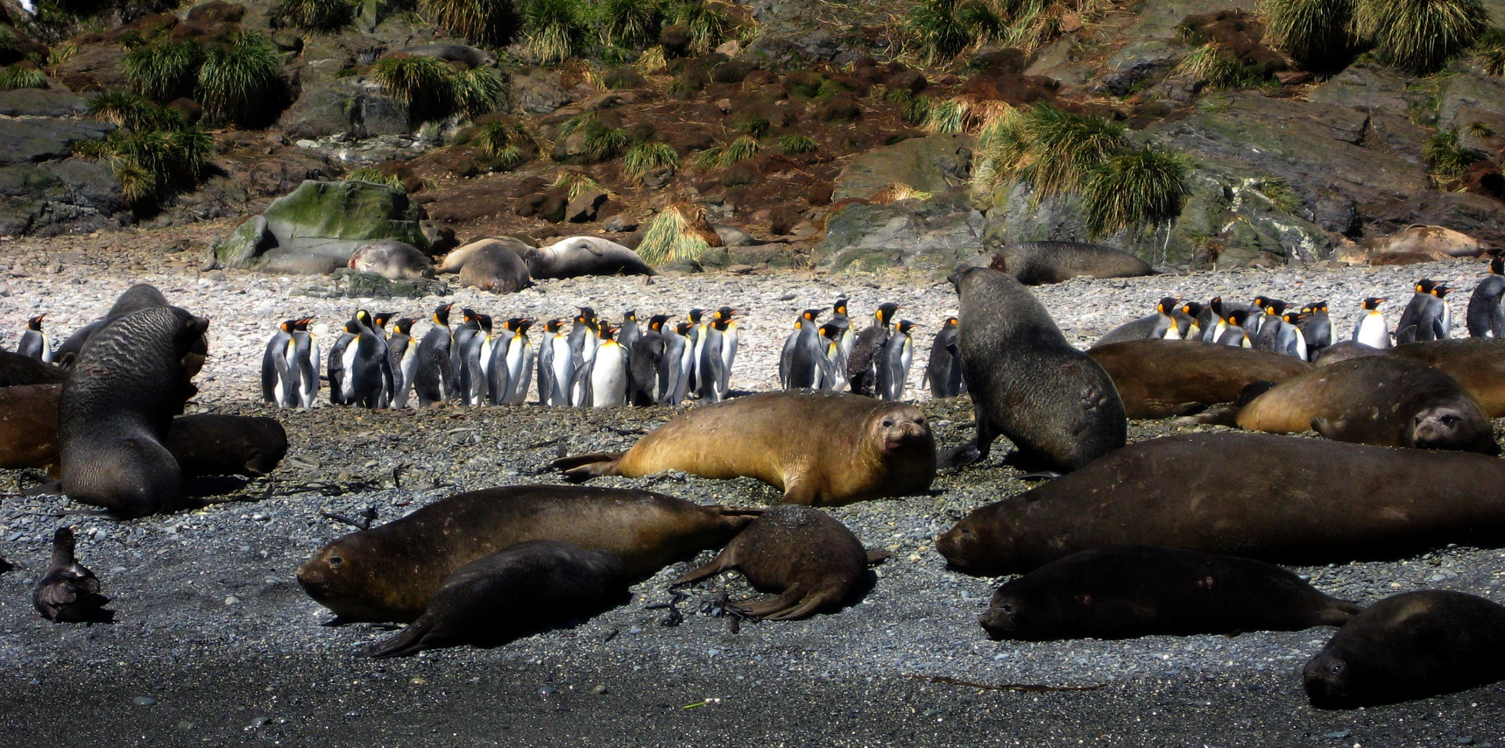
Approaching by zodiac

Slide 18
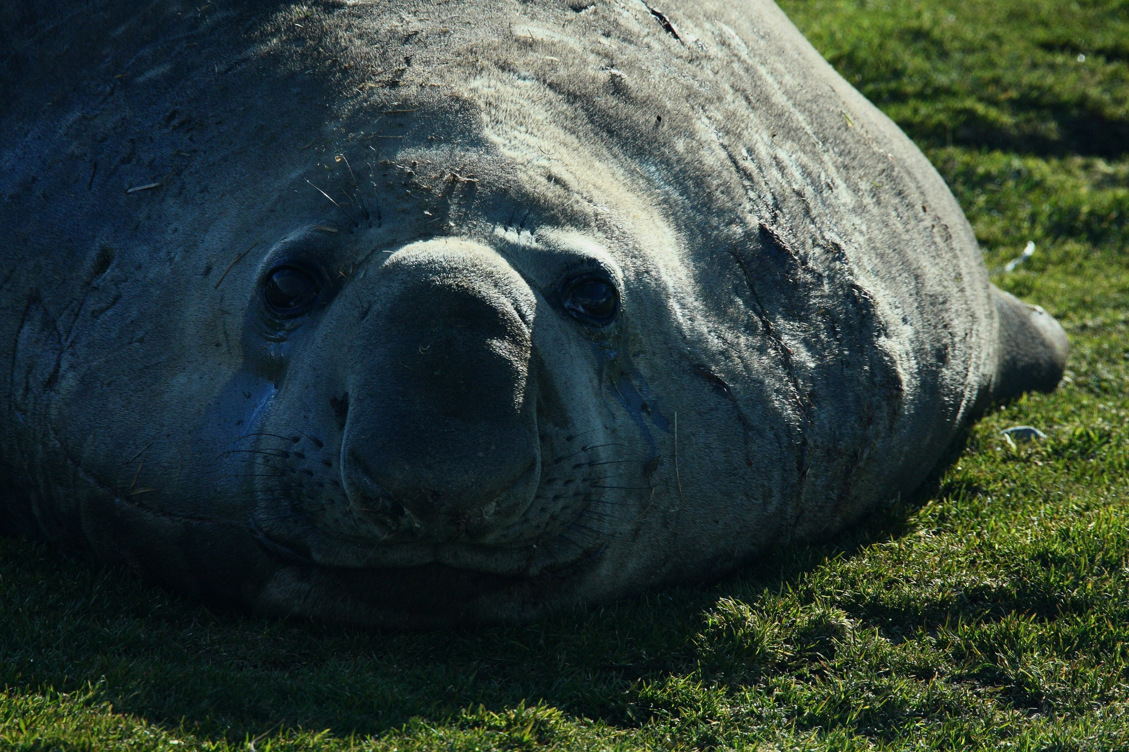
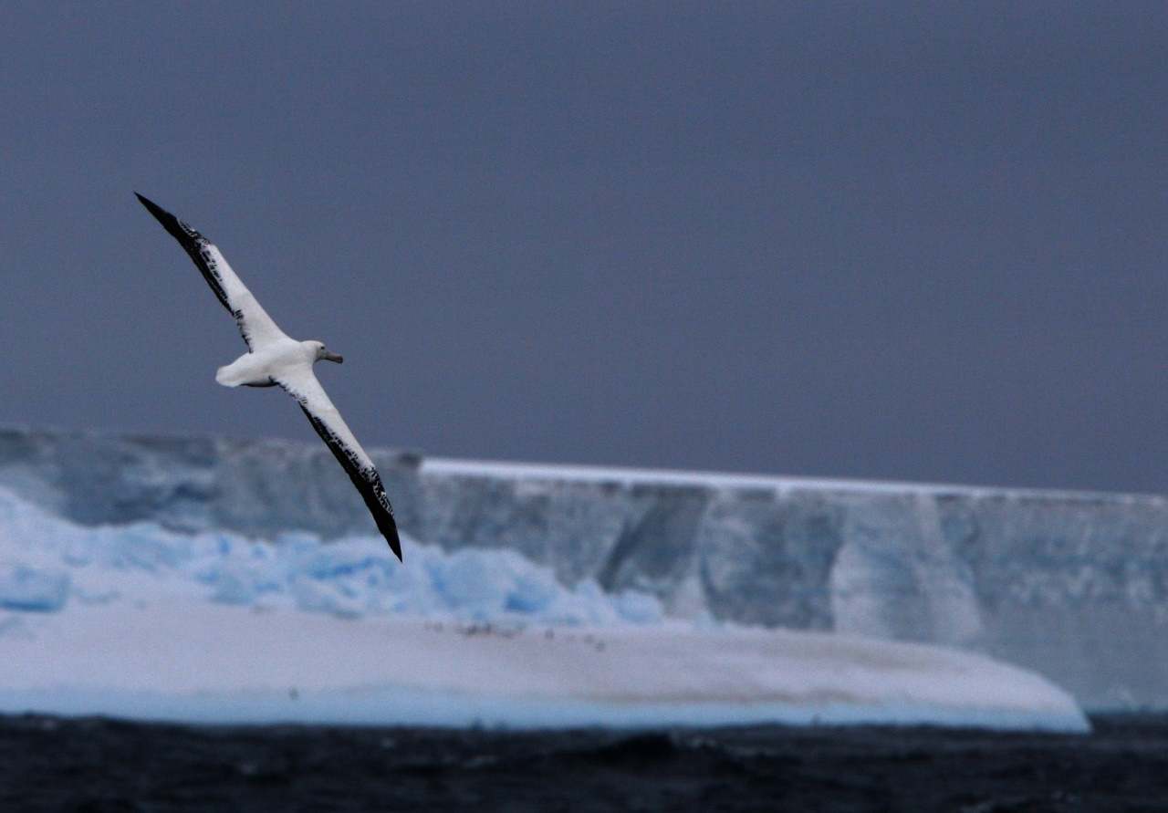
Elephant seal, weighing up to 5 tons, diving to a depth of 1-mile
Notes:
This is a young elephant seal. The adult male can grow to five tons, but the female “only” to one ton. Scientists studying and publishing on such seals have adopted a two-word descriptor (not mentioned here) for a young male sneaking up on a female as the dominant male is distracted.

Slide 19
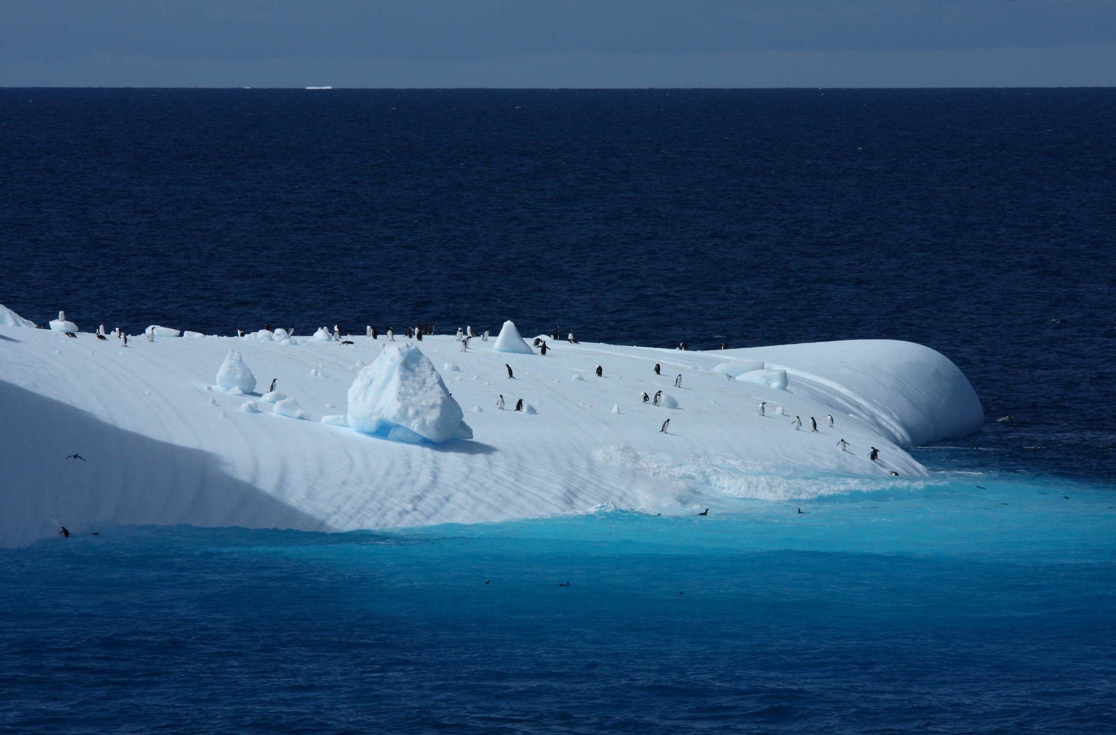
Penguins enjoy a well-worn iceberg near South Georgia

Slide 20
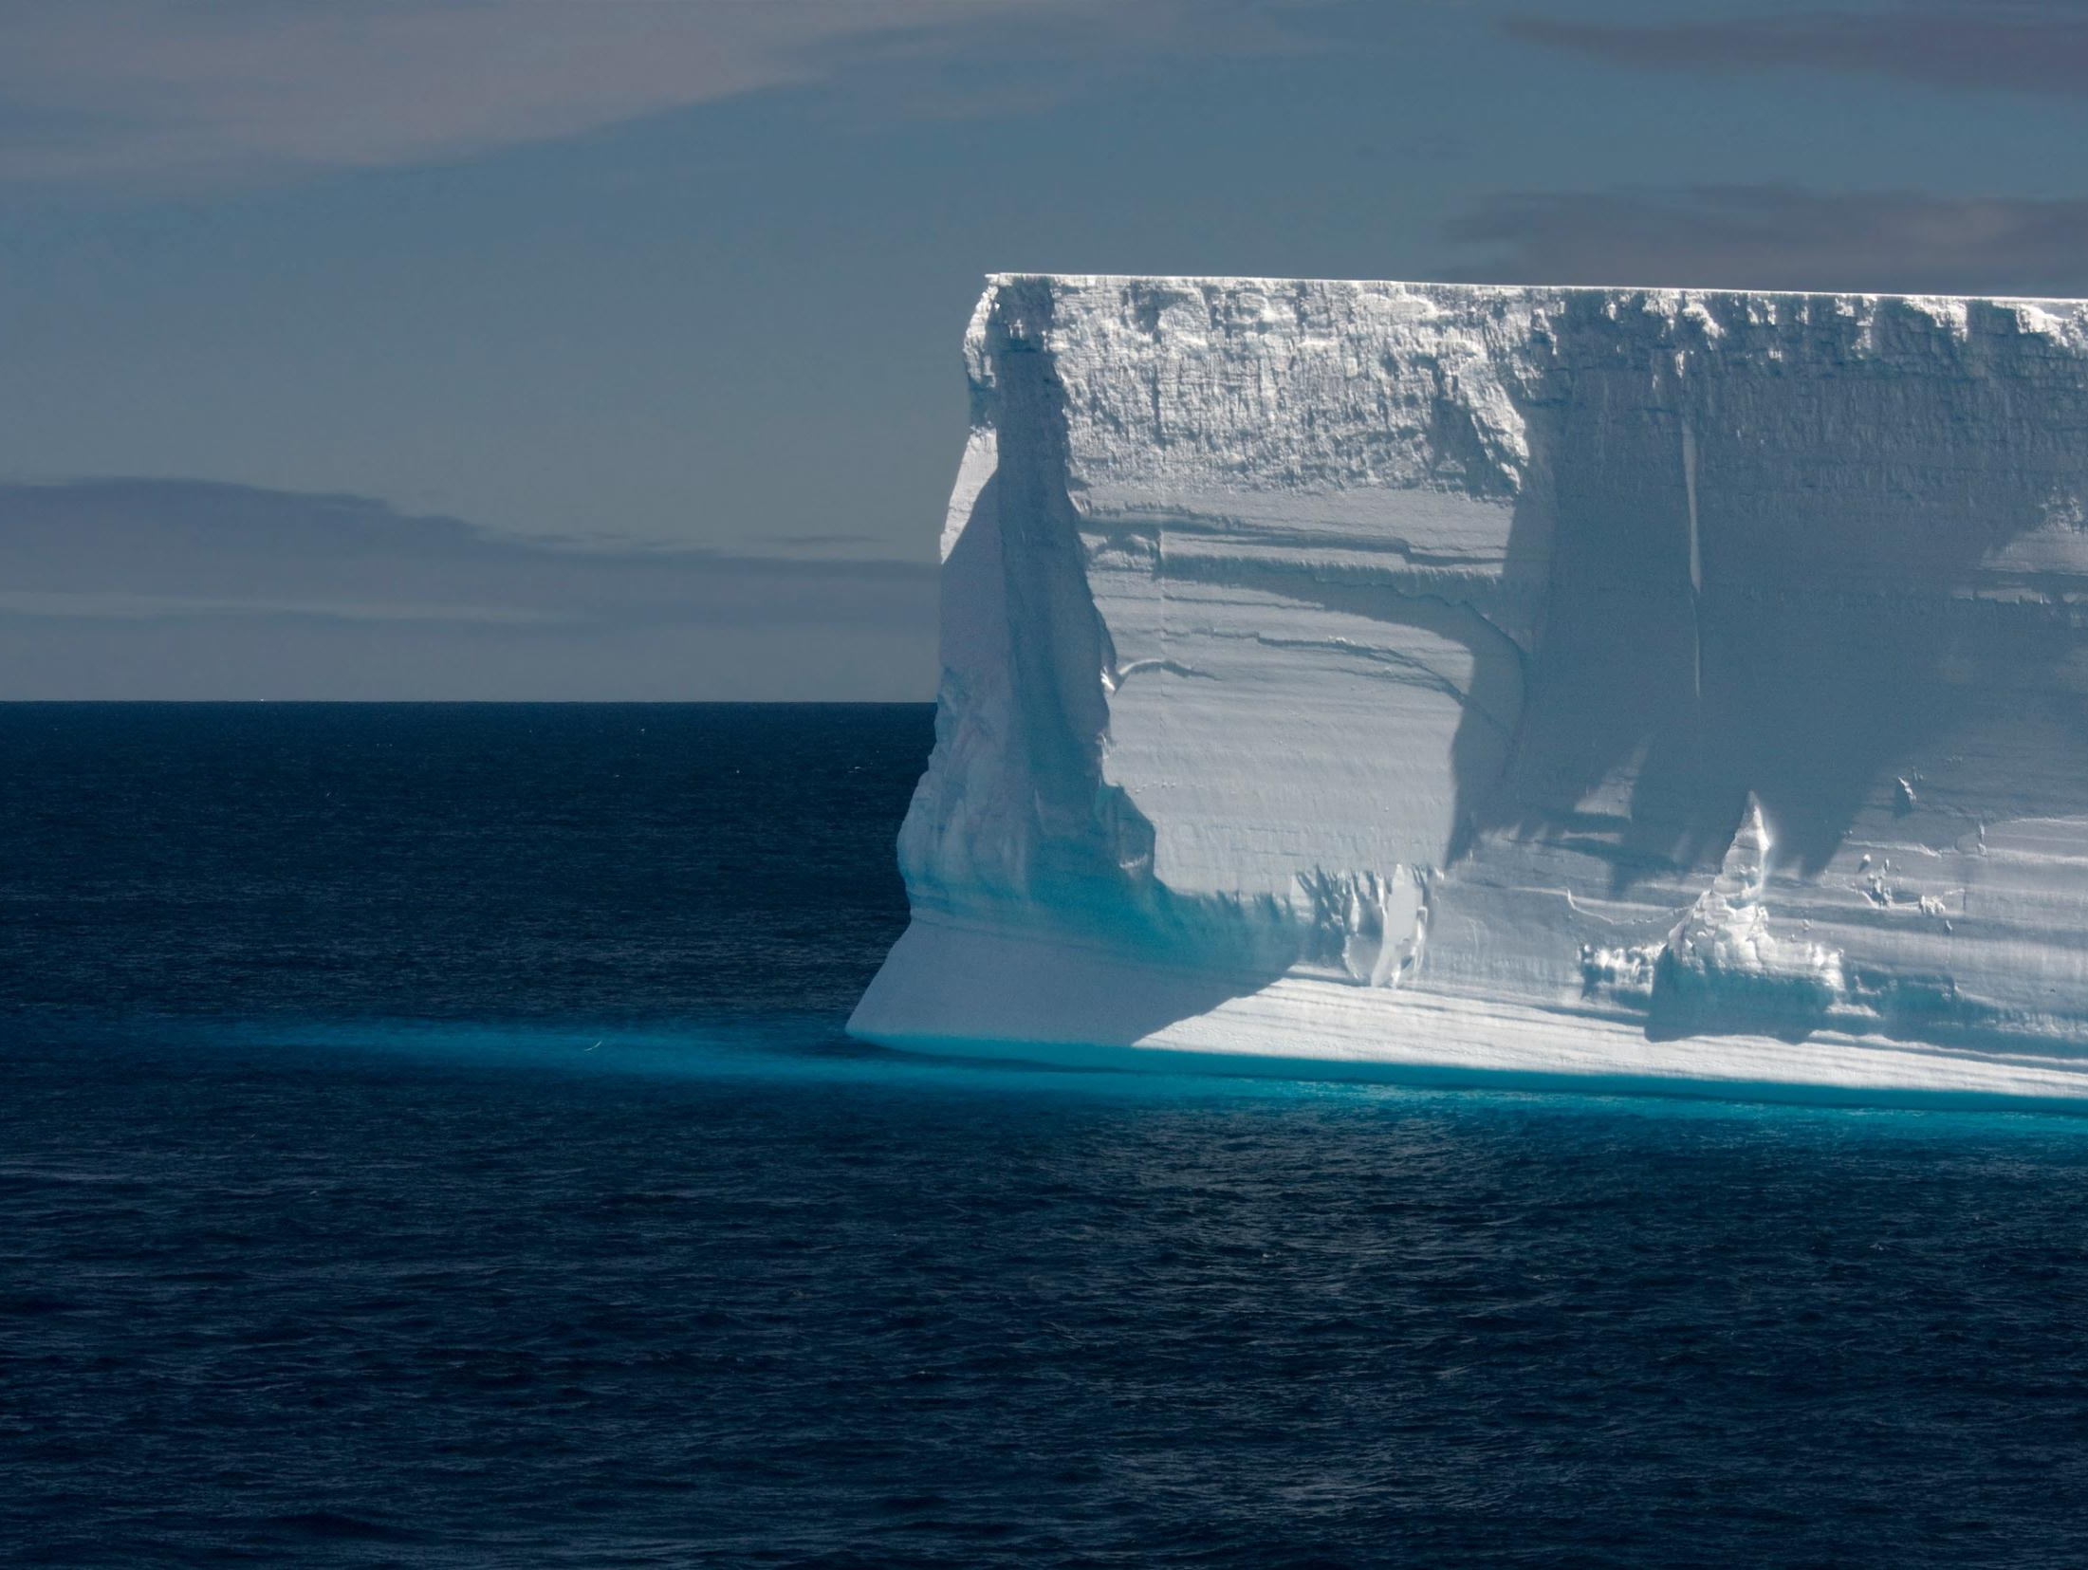
Antarctic Iceberg, 50-m high, 70% below the sea surface

Slide 21
Algebratross Geometry Math Model
Weight, 11 kg
Wing span 3.5-m
Wing aspect ratio, 16
Notes:
Meet “Algebratross,” modeled with equations from beak to tail, and from wingtip to wingtip. Algebratross weighs 11 kg. Its 3.5-m wing has an aspect ratio of 16.
As we shall see, high aspect ratio is essential to reduce drag during high-g turns associated with dynamic soaring.

Slide 22
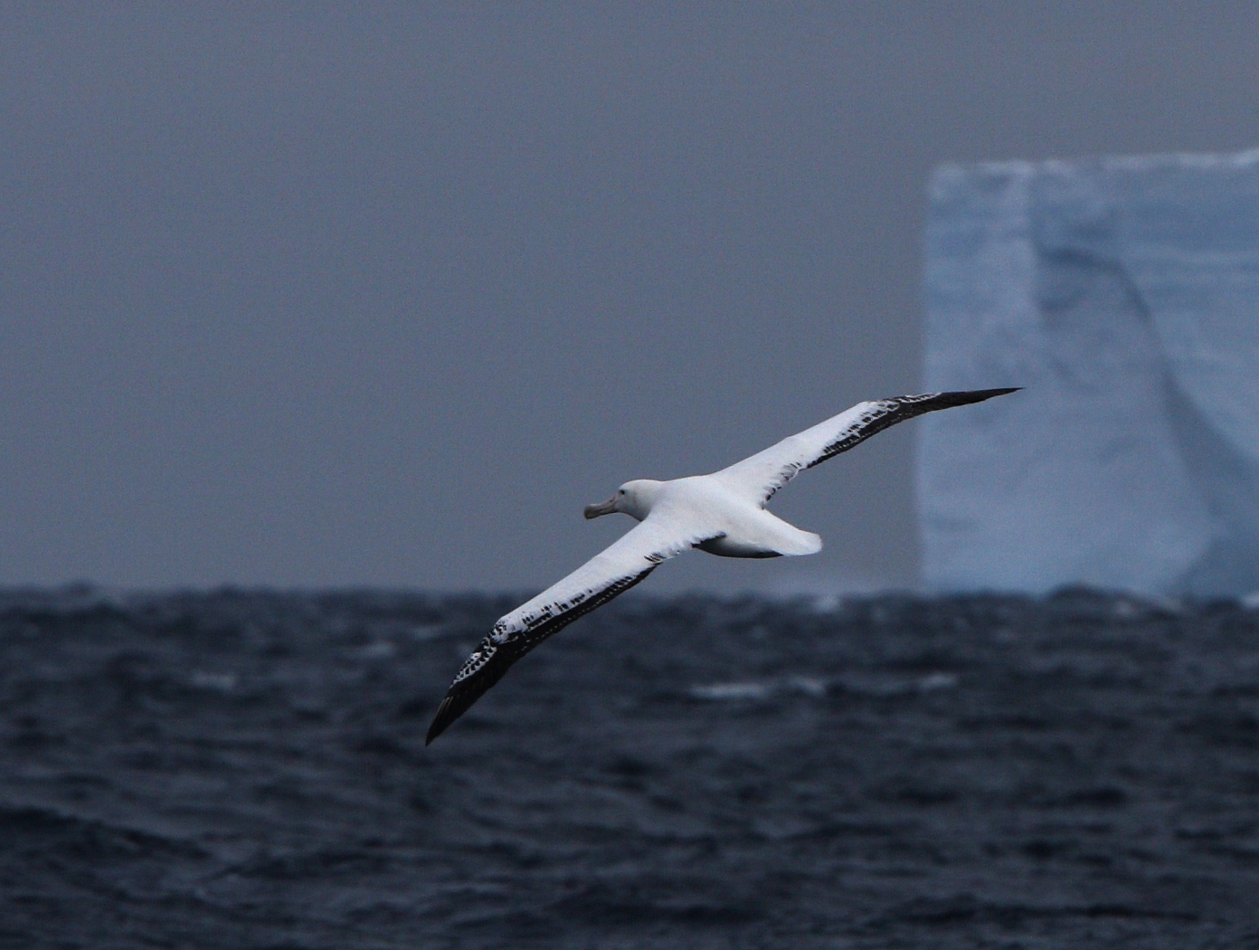
Wandering Albatross maneuvers gracefully between our ship and an iceberg
Notes:
This wandering albatross appeared from the horizon and put on a lengthy display of graceful maneuvers between our ship and a mile-line iceberg. As the author shouting with excitement rushed between decks for various “shooting” positions with a long-lens camera, his wife claimed to her friends on deck “I do not know this man.”

Slide 23
Moonroof & Model Airplane
Kinetic energy gain in a 2-step wind profile
Flight kinetic energy is based on airspeed, not groundspeed
airspeed
90 km/hr
90 km/hr groundspeed
Notes:
Imagine we are driving our car at 90 km/hr with the moonroof open. Just beneath the moonroof we hold a model airplane. The model at this condition is traveling with 90 km/hr groundspeed, but it has no kinetic energy relative to the air in the car. Letting go of the model it falls to the floor. If, however, we raise the model just above the moonroof, it suddenly gains 90 km/hr of airspeed and corresponding kinetic energy. Once released, the model converts much of its newfound kinetic energy into potential energy by climbing high in the sky.
In this example, we have employed a two-step wind “profile.” In practice, the wind profile can be thought of as a series of many small steps, and ultimately as a smooth curve of windspeed versus altitude. Near the water, such a profile has a steep gradient of windspeed, and that gradient is key to dynamic soaring.
So to summarize the essence of dynamic soaring, we first note that flight kinetic energy is based on airspeed, not groundspeed, and second that climbing against a wind “profile” adds kinetic energy. This leads us to then ask what conditions might enable sustained soaring, where the energy lost to drag is offset by that gained with smart vertical motion in the wind gradient.

Slide 24
Two methods of energy gain in a multi-step wind profile
Upwind ascent between layers
Suddenly-increased headwind
Sudden airspeed & energy gain
Downwind descent between layers
Suddenly-decreased tailwind
Sudden airspeed & energy gain
This gives rise to the Dynamic Soaring Rule
- Ascend when partly or fully pointed upwind
- Descend if partly or fully pointed downwind
Notes:
The previous example represented a single-step wind profile. Here, we progress to a multi-step wind profile, where the albatross gains energy immediately upon upwind ascent into each faster wind layer, then losing a portion of its energy to drag within that layer. Upon reaching the top of the climb, the energy gain with dynamic soaring can offset the energy lost to drag, given the high aerodynamic efficiency endowed by evolution to the albatross. But the albatross must next turn and descend downwind. Will it now gain or lose energy?
As it turns out, downwind descent provides gains in both airspeed and kinetic energy because the albatross encounters a decreasing tailwind upon descent into each lower and slower wind layer. Thus, in each new layer, it finds itself suddenly flying faster than the local airmass.
Finally, at the bottom of its cyclic trajectory, the albatross flies briefly across then wind, thus losing energy to drag, but then it quickly turns and climbs back into the wind. The high aspect-ratio wing of the albatross enables a balanced energy budget overall for each maneuvering cycle.

Slide 25
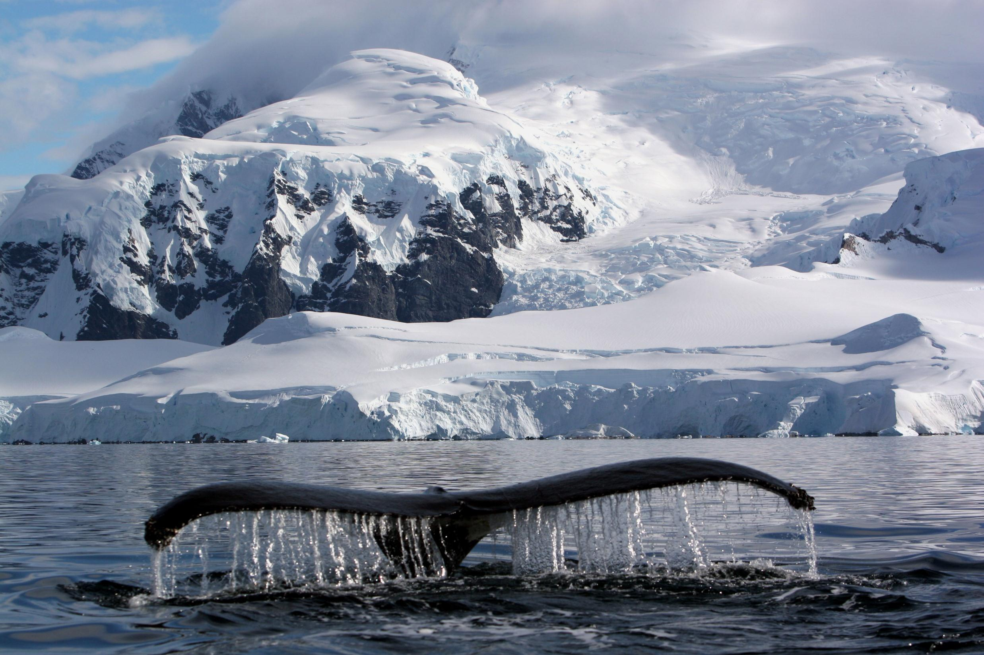
Humpback Whale, Antarctica
Notes:
The author firmly but politely claimed the apex seat of the zodiac to take this shot of a humpback whale about 20-meters away.

Slide 26
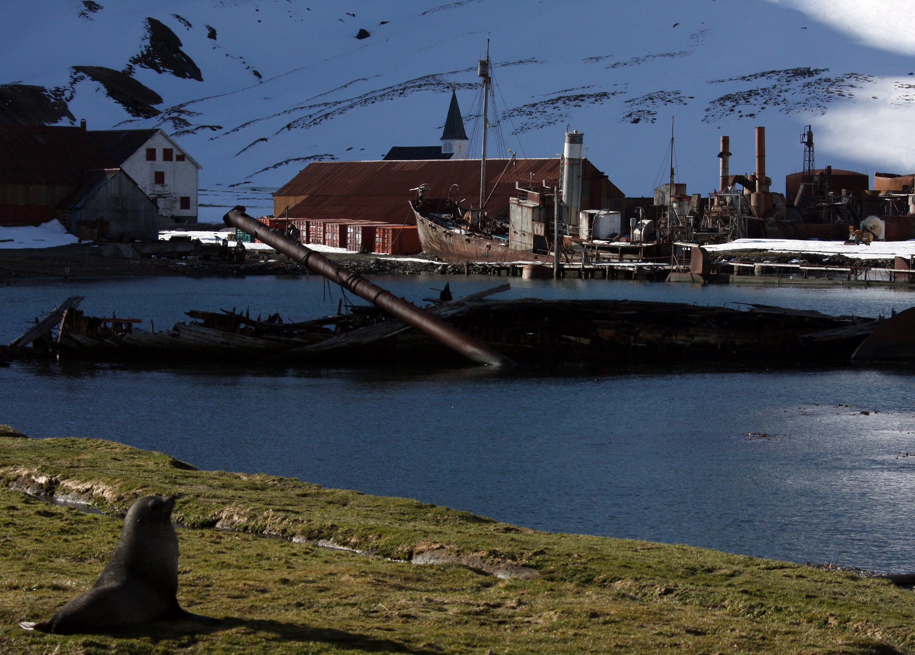
So. Georgia took 175,000 whales, 1904-1965 – here is Grytviken
1.2 million fur seals taken

Slide 27
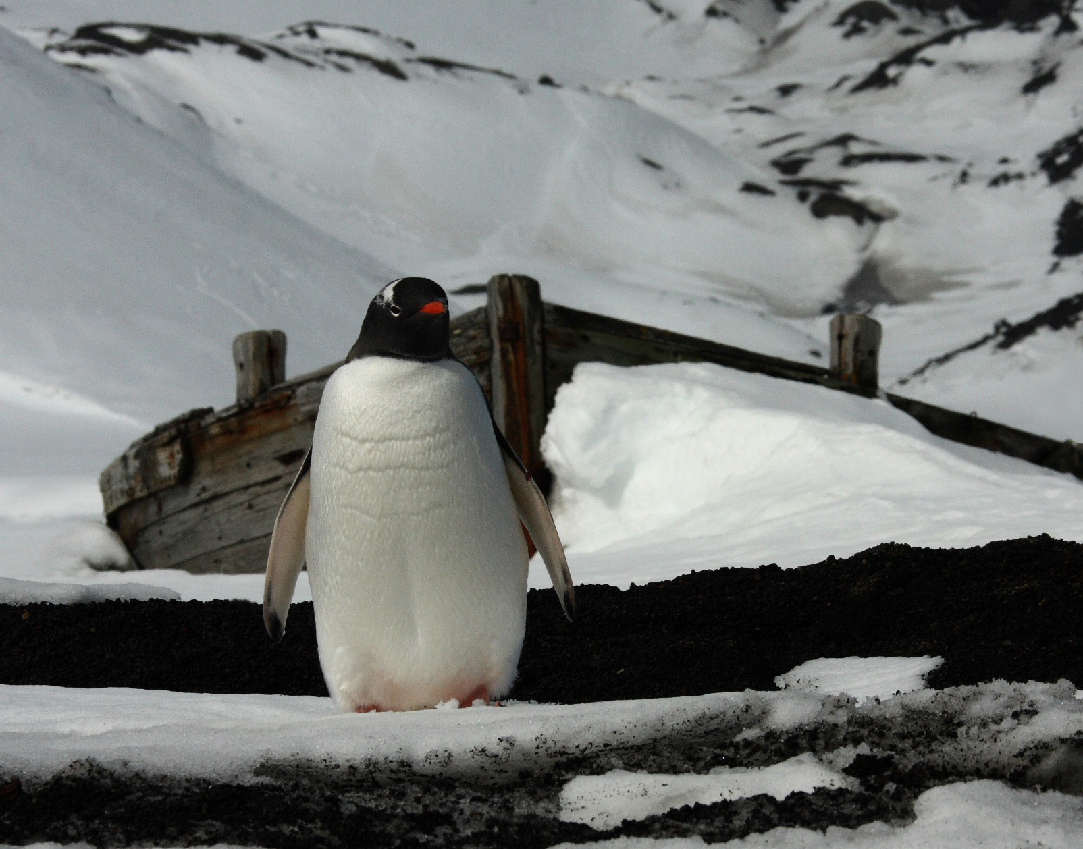
Gentoo penguin guards a whaling skiff

Slide 28
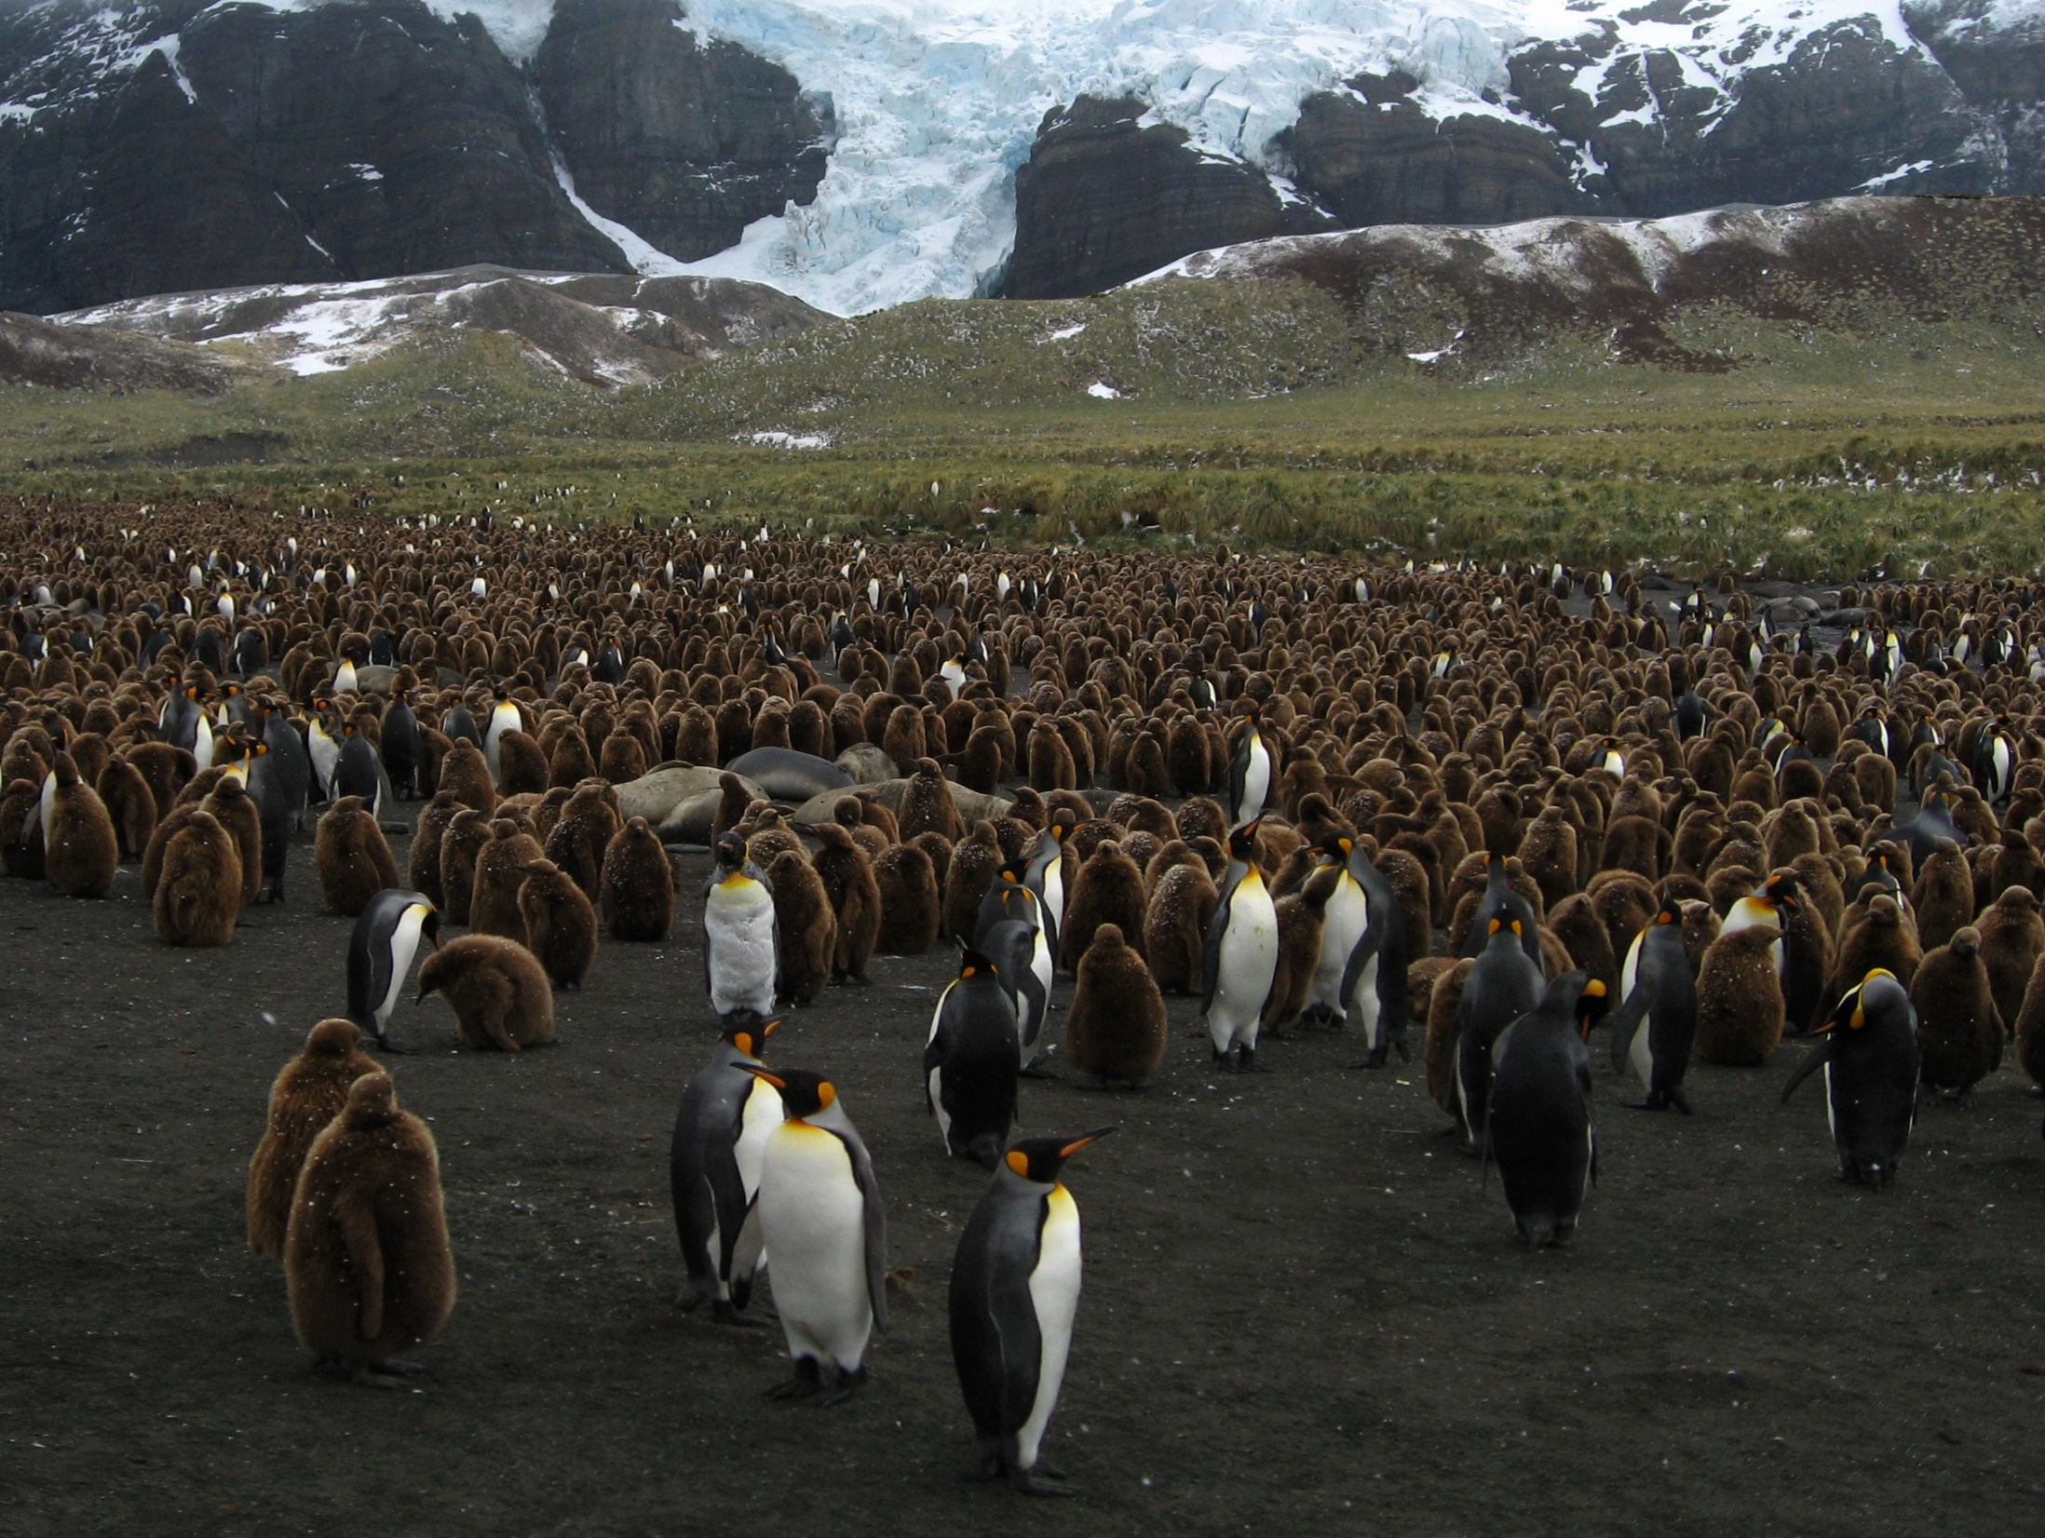
Emperor penguins,
South Georgia

Slide 29
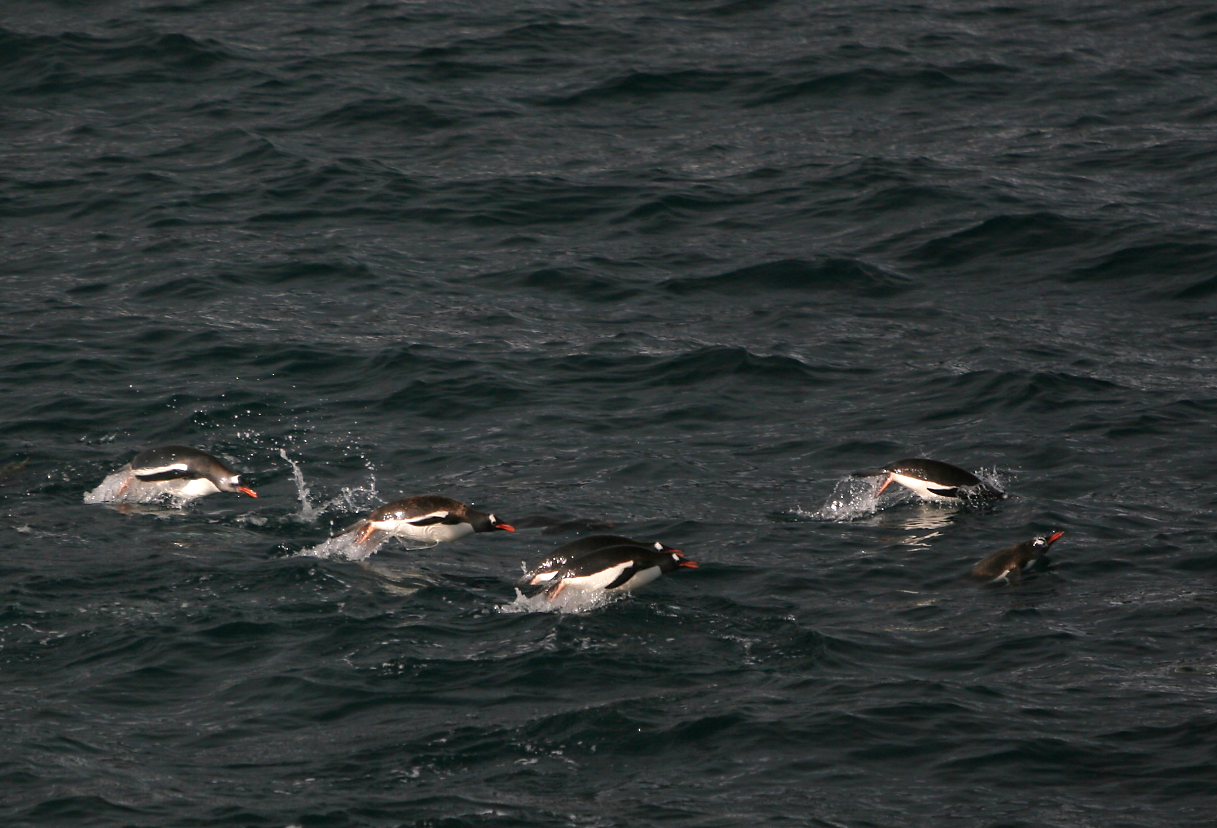
Gentoo penguins – minimizing energy lost to aero & hydro drag
Notes:
Many seafaring animals below a certain size have evolved for long-distance travel a combined shape and cyclic motion which minimizes the time integral of the power expended to accelerate under water, with attendant hydrodynamic drag, and then to decelerate in the air, with attendant and much-reduced aerodynamic drag.

Slide 30
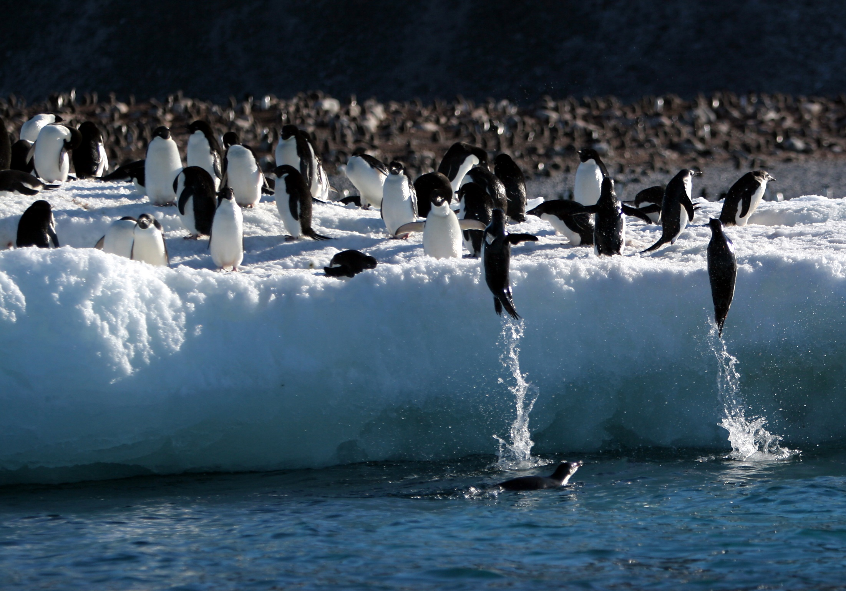
Adelie penguins jump on board
Notes:
These penguins begin their near-vertical trajectory deep under water and often or usually end the trajectory landing upright on their feet. Such acrobatics require adjusting speed to attain the ice cliff height.

Slide 31
Maneuver angles
φ
γ
V
γ
ψ
w
Roll Circle
Roll axis along V
wind profile
Notes:
“Turning” now from penguins to the albatross, this sketch shows a wind profile (not to scale) and the three maneuver angles of our dynamic soaring analysis. One or more angles can be scheduled in accordance with the dynamic soaring rule, as the other angles have their rates numerically integrated, in accordance with Newton’s physics, to analyze the trajectory. The schedules are then adjusted by trial and error until the intended overall direction of motion over the water is attained.

Slide 32
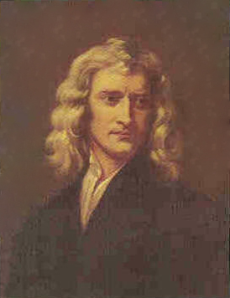
Dynamic Soaring ~ Force Diagram
φ
Dynamic Soaring Force
Horizontal Vector
Pointing upwind
L
Isaac Newton
F = m w = m (dw/dt)
= m (dw/dz) (dz/dt)
= m (dw/dz) V sin γ
v
D
γ
mw
ψ
Dynamic Soaring Thrust
W
That portion of (F) aligned with (V)
T = m (dw/dz) V (sinγ) (cosψ) (cosγ)
w
Notes:
Now that the albatross has maneuvered into position, we show all the forces, including lift, weight, drag, and in particular, the dynamic soaring force which constitutes a central postulate of our method. As the albatross maneuvers, the presumed dynamic soaring force vector of magnitude (m dw/dt) remains steadfastly level and pointed directly upwind. Since the wind profile is fixed, only by moving vertically within the wind profile does the albatross experience the rate (dw/dt) and the corresponding dynamic soaring force. During any descent, (dw/dt) is negative. Therefore, if the albatross descends downwind the dynamic soaring force vector will in effect point downwind, thus providing thrust.
Some readers may intuitively object to the inclusion of mass in the dynamic soaring force. We respond by noting that the bird flies in two vertical gradients, the first that of windspeed, and the second that (via gravity) of potential energy. The forces due to both gradients are indeed proportional to the mass of the bird.
The principles discussed here are not necessarily limited to a vertical gradient of wind. We suggest, for example, that a small uninhabited aerial vehicle with high aero efficiency might be able to soar dynamically at constant elevation, pointed partially upwind and cyclically entering and leaving the deadzone behind one side of a skyscraper on a windy day. Alternatively, but again at constant elevation, the aircraft might cyclically enter and leave a “jet stream,” flying somewhat against it. We caution, however, that such wind gradients are unlikely to necessarily match the gradient strength enjoyed by the albatross near the bottom of its trajectory.

Slide 33
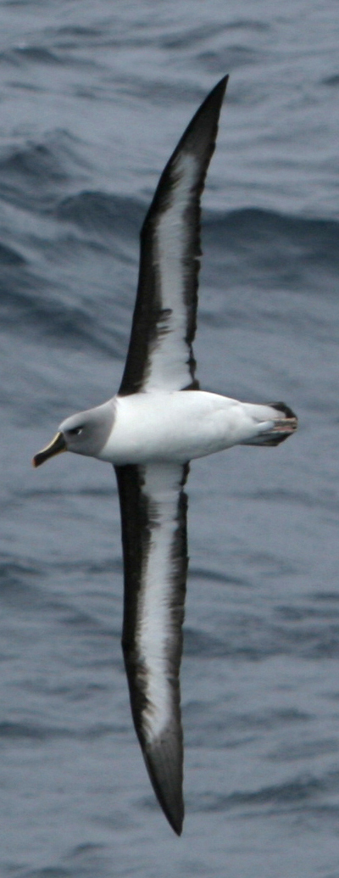
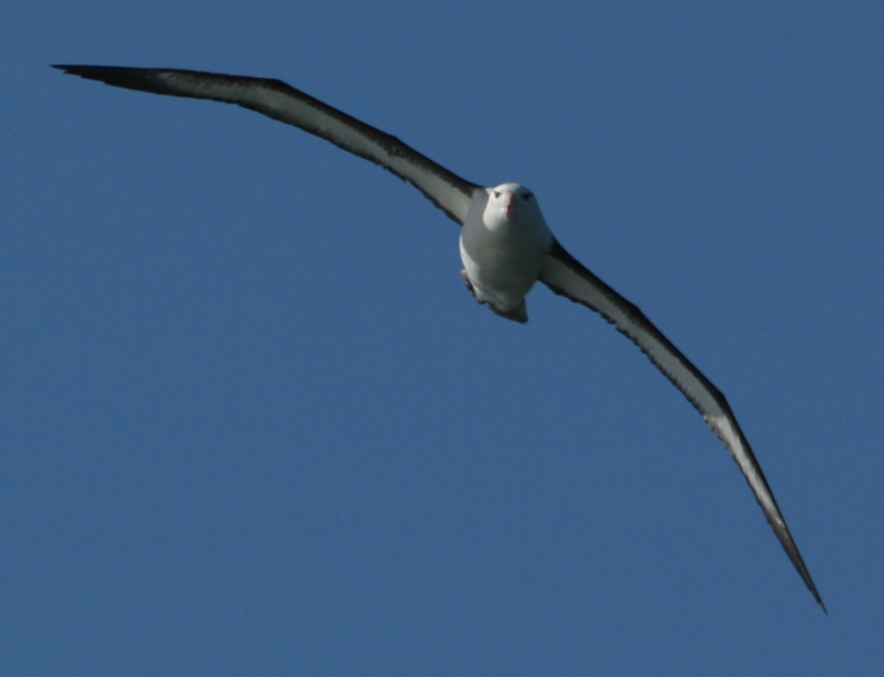
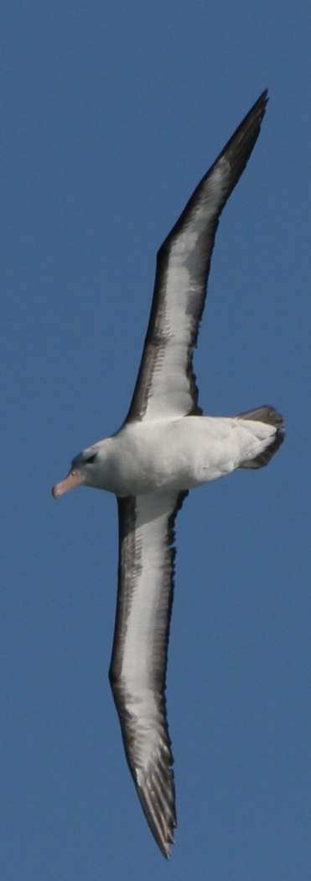
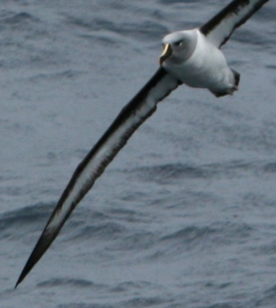
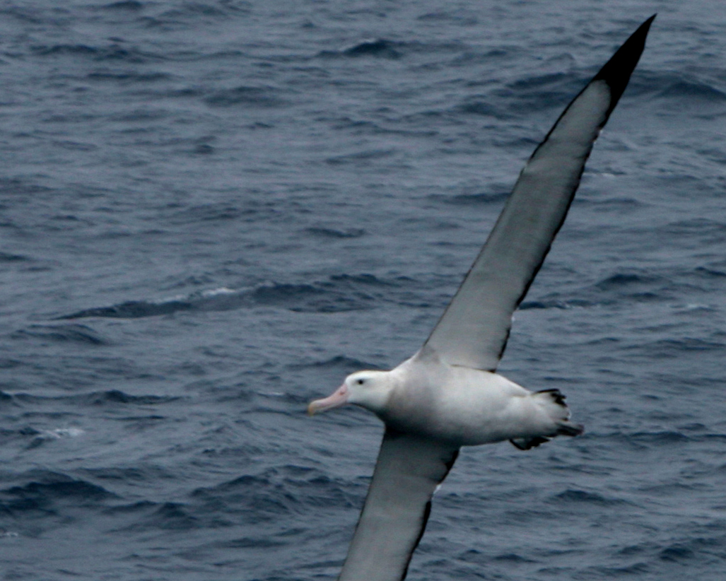
Sensor platform remains level
Notes:
The albatross, as well as apparently all soaring birds, keeps its “sensor platform” perfectly level when turning. Indeed, soaring birds can be seen with their wings banked at greater than 90-deg while holding the head perfectly level.

Slide 34
Trigonometric functions math model graceful maneuvering
Sine Wave
Midpoint Shift
Endpoint “dwell”
1.0
1.0
τ
τ
2
3
Δτ
Heading or time/period
0.5
0.5
Sin² “adder”
τ
τ
1
2
0.0
0.0
0.5
1.0
0.0
0.0
0.5
1.0
Auxiliary Time, τ₁
Auxiliary Time, τ₂
Flight Path Angle Schedule
Bank Angle
Schedule
Heading or time/period
Notes:
The best way to simulate the graceful flight of the albatross is to schedule selected maneuver angles with equations. Sinusoidal functions are particularly well suited for this. Climbing and diving in accordance with the dynamic soaring rule is readily modeled with a sine wave, together with a “sine-squared” adder which allows us to adjust the relative amplitudes of the climb and dive angle excursions. Also, we can adjust the mid-point of the maneuver with an auxiliary time, and we can model the short period where the albatross skims its wingtip on the water with second auxiliary time operating on the first.
The result represents the flight path angle versus either heading or non-dimensional time. Usually, the bank angle is computed in terms of scheduled inputs. In other cases, specifically for the “snaking-upwind” maneuver, we schedule the bank angle versus non-dimensional time. With these simple and powerful mathematical formulations, we need only adjust a handful of parameters by trial and error until the trajectory meets the various constraints, such as skimming the water, maintaining the energy balance, and traveling overall in the intended direction such as downwind, crosswind, or upwind.

Slide 35
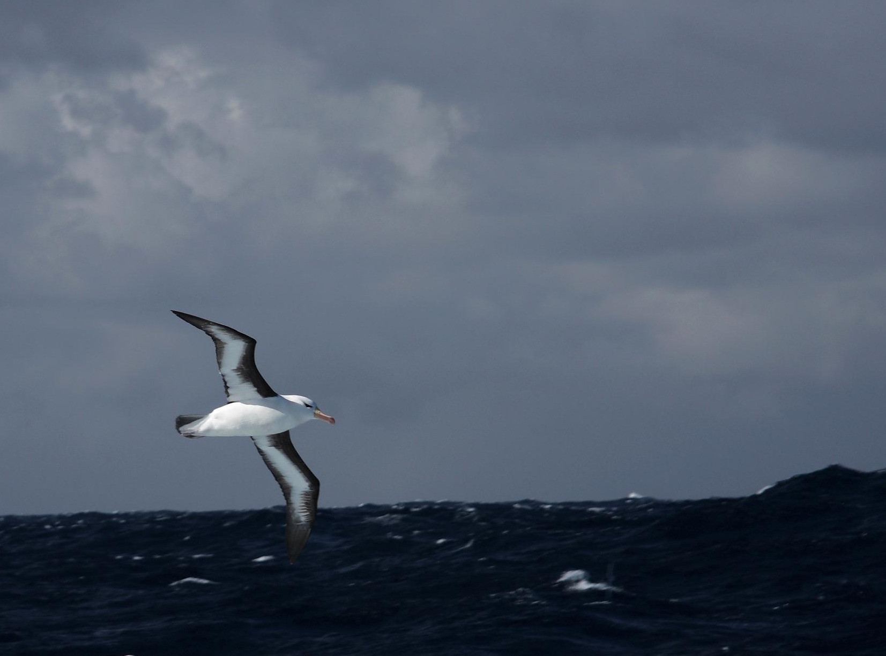
Black-browed Albatross stays with our ship

Slide 36
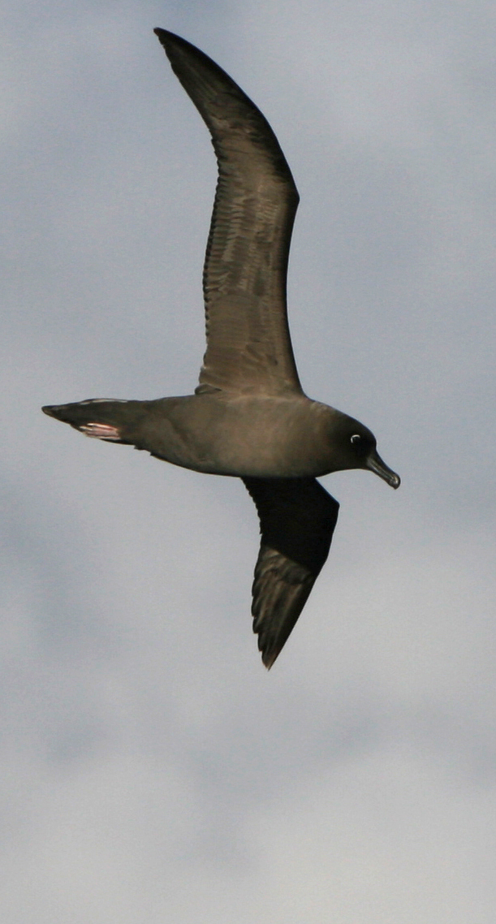
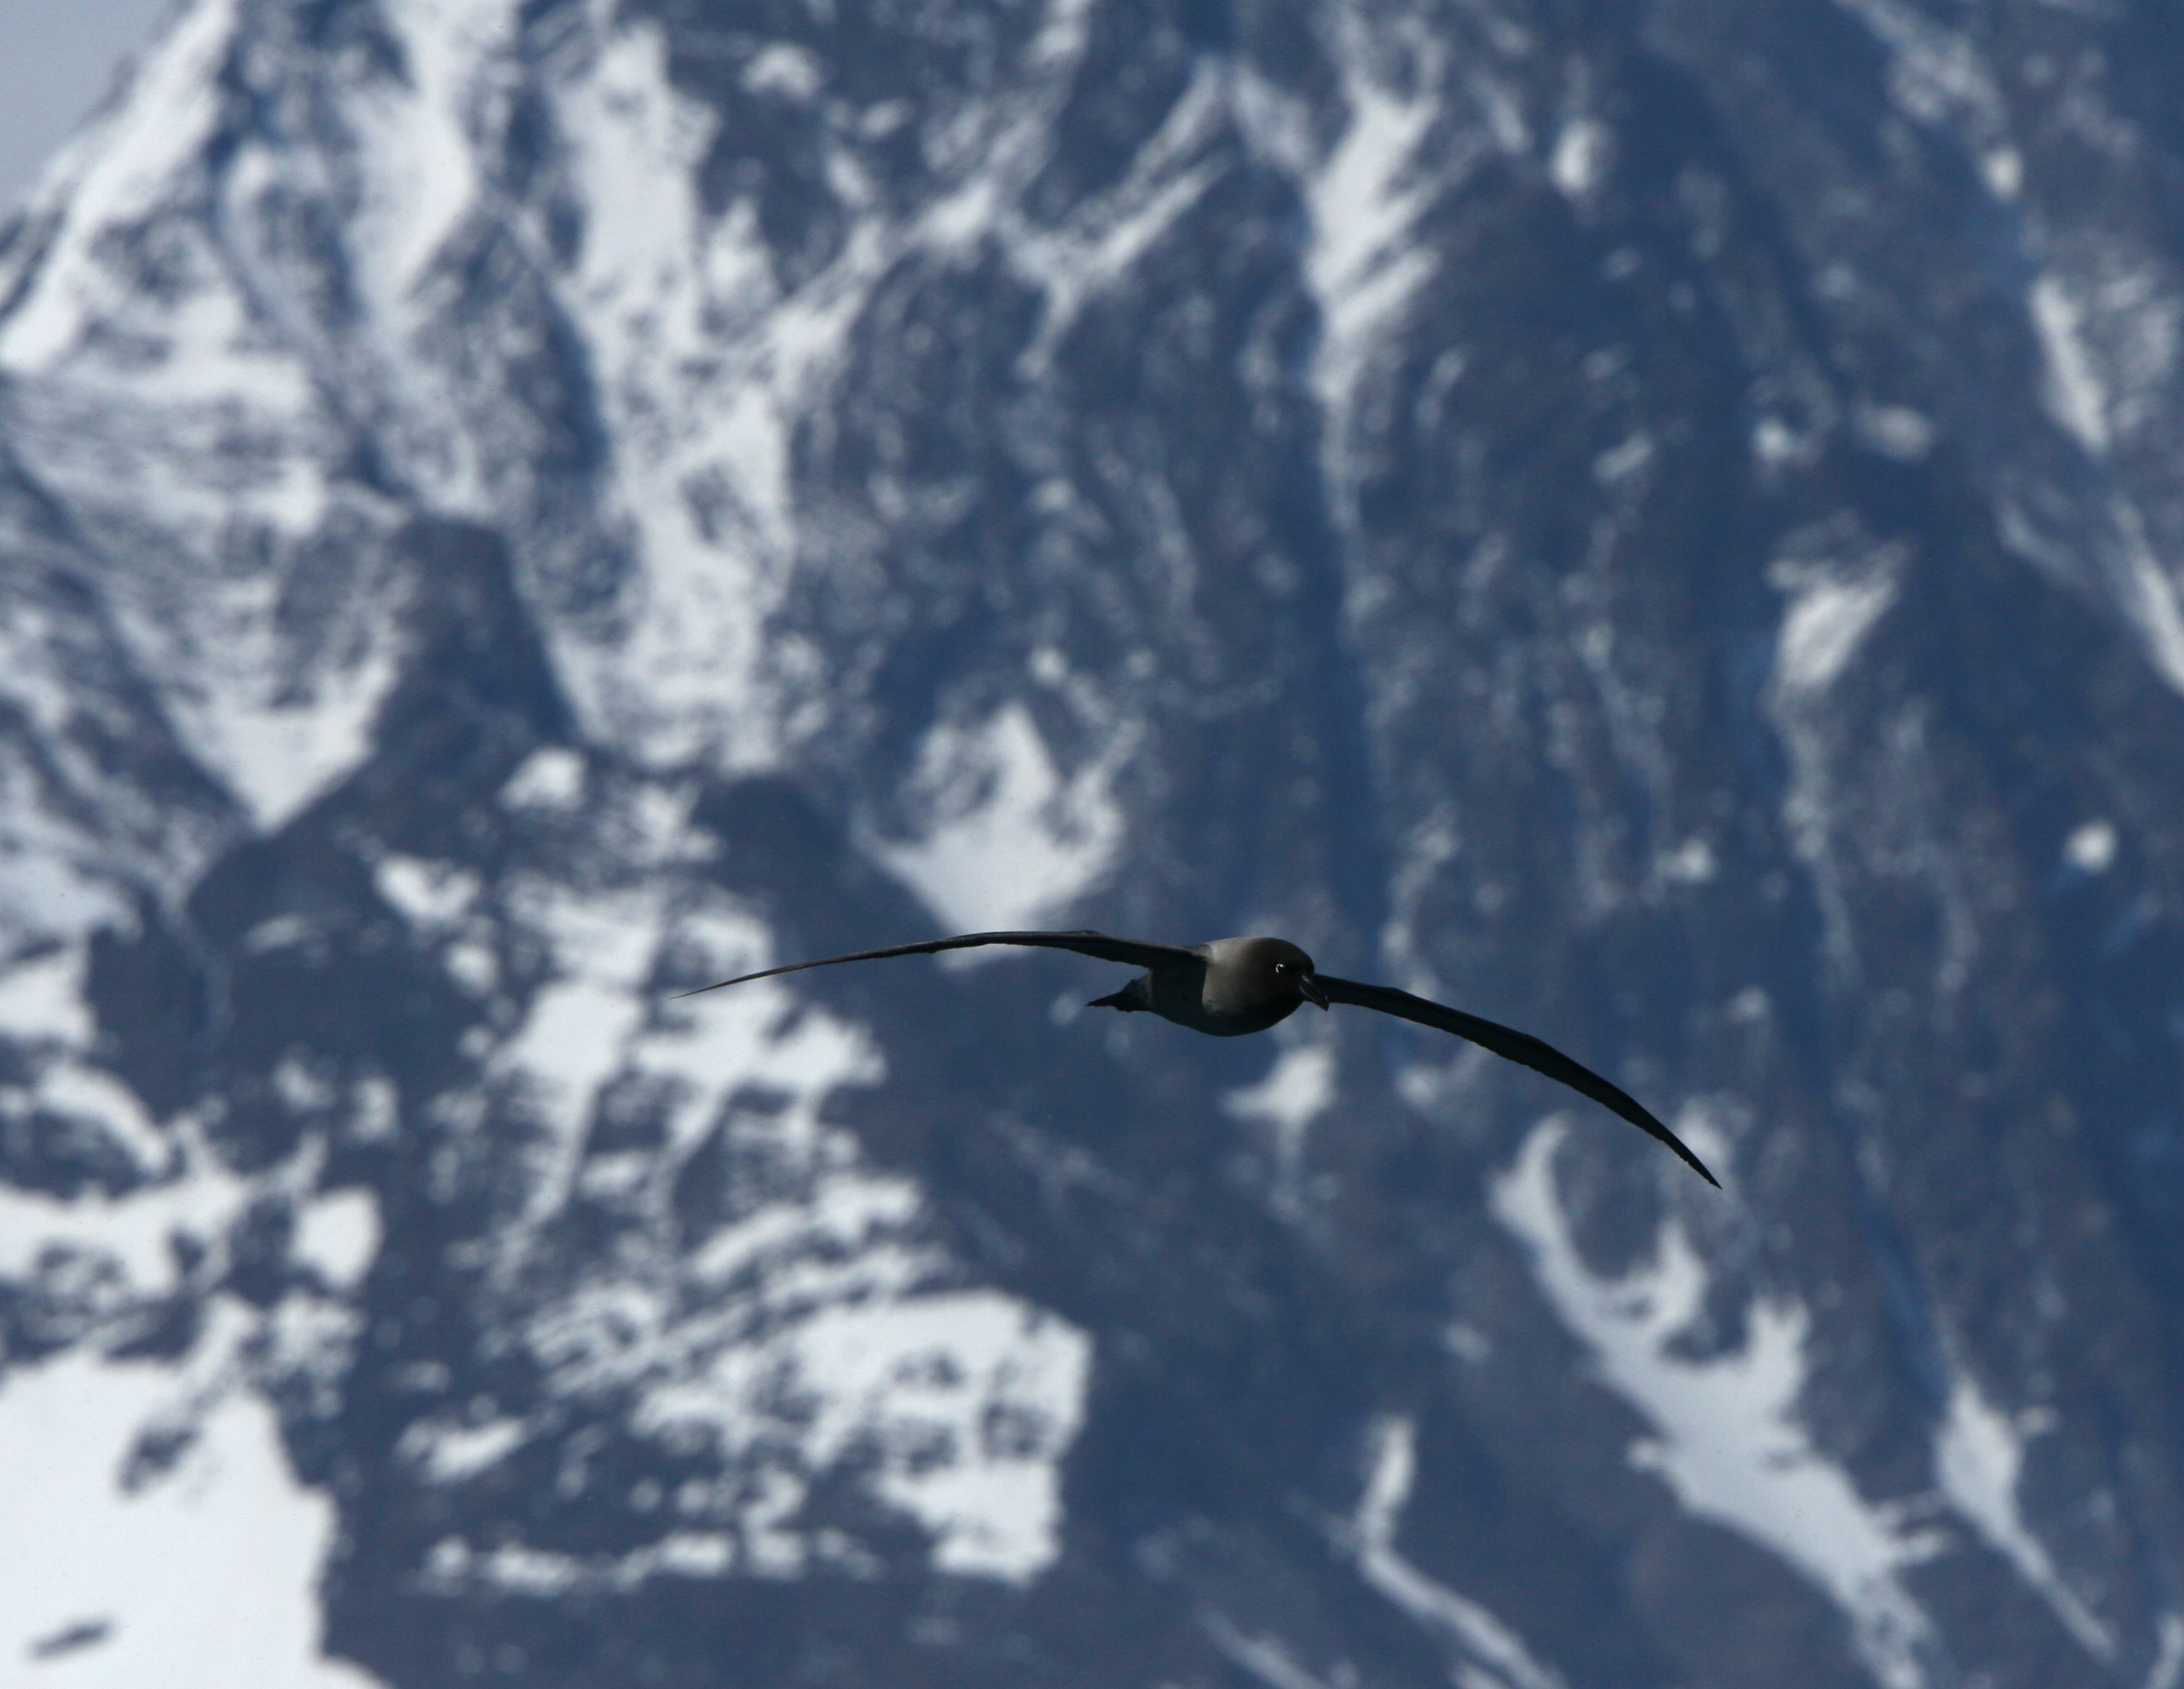
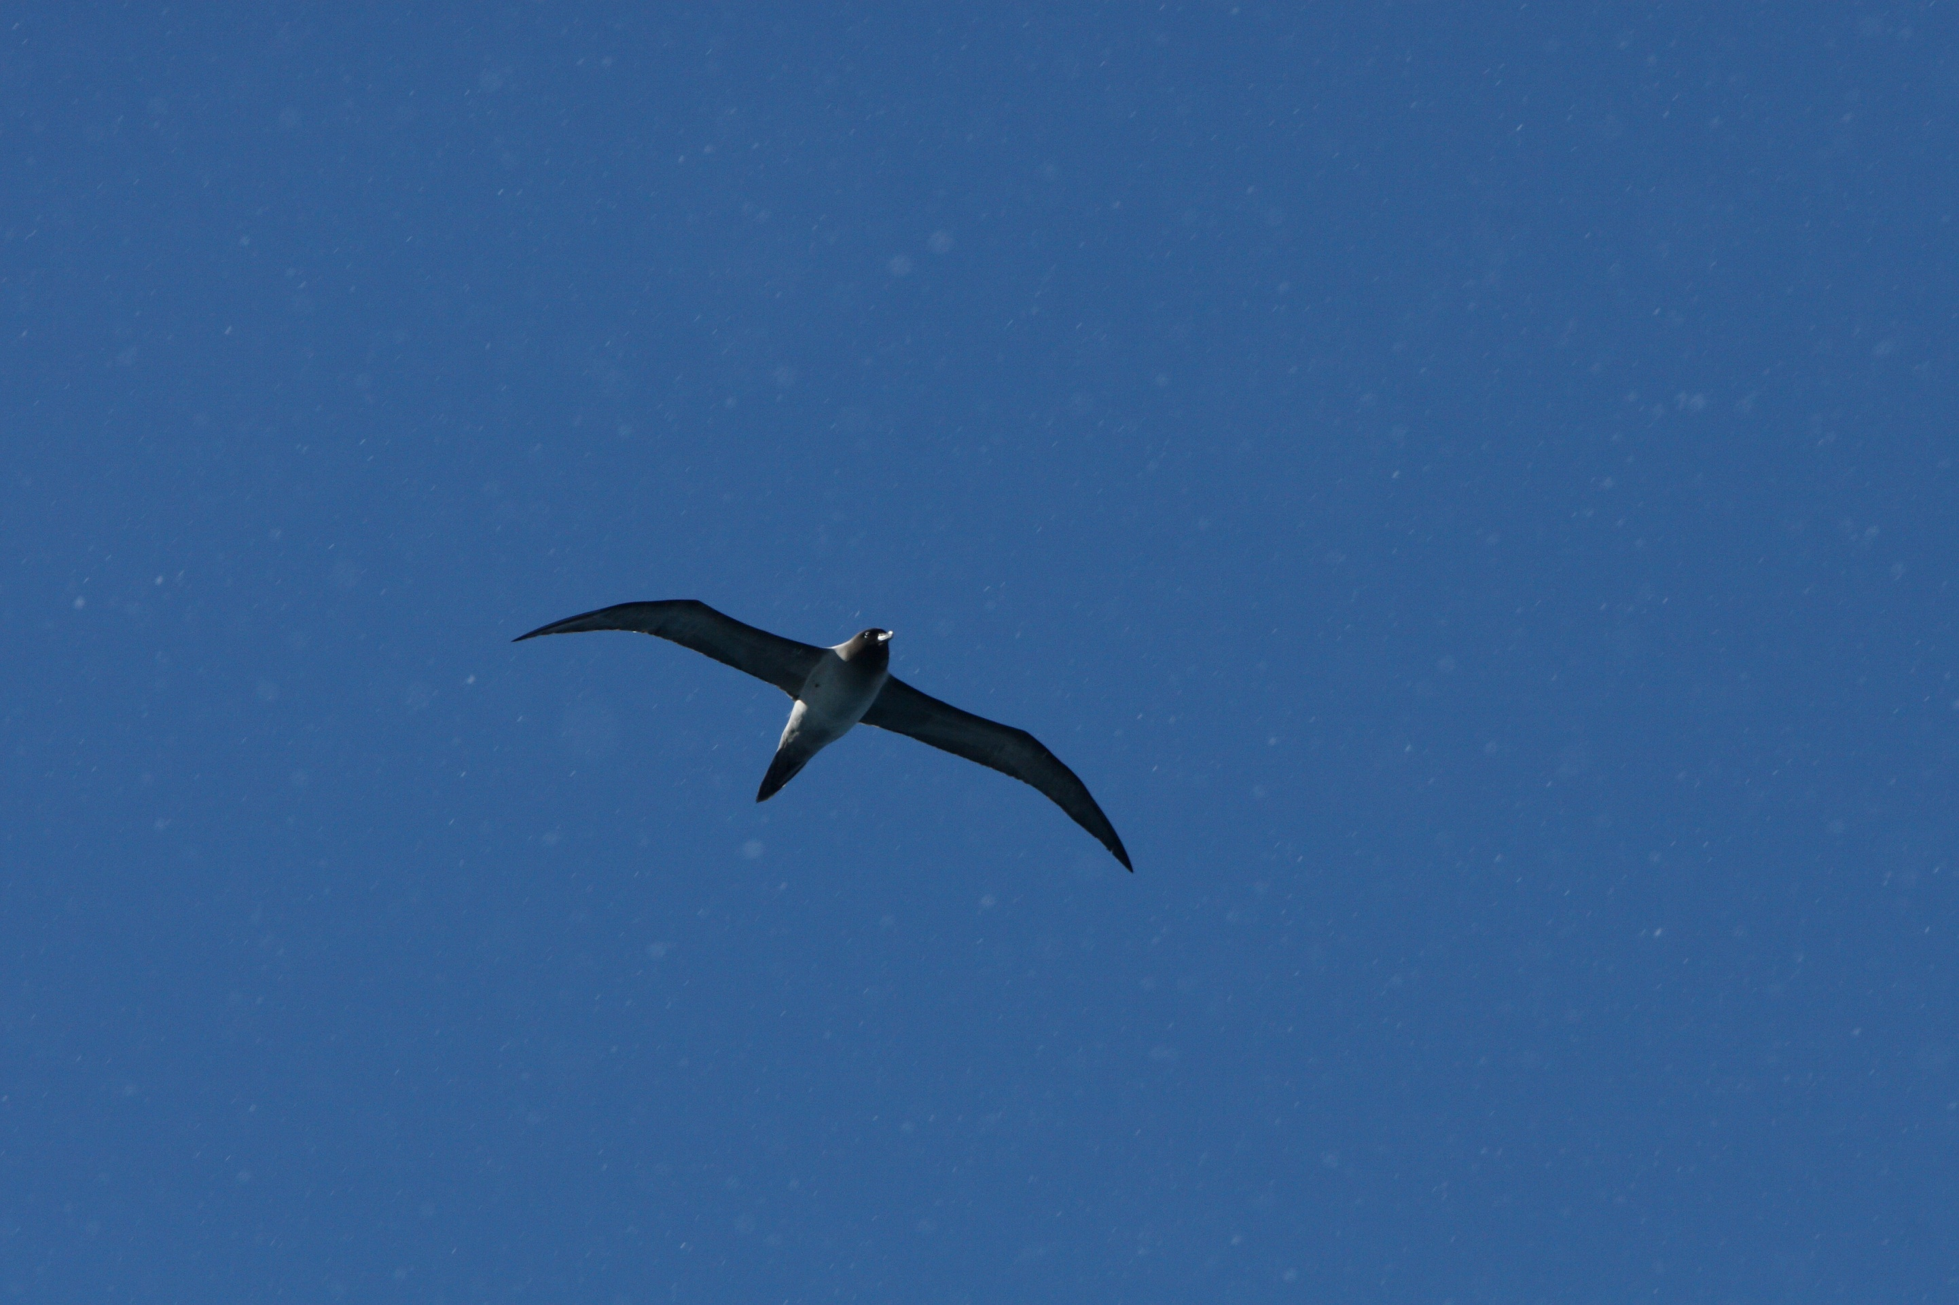
Sooty Albatross
“haunting, exultant cry” – Pauline Carr

Slide 37
Circumpolar Turn Maneuver
A
B
C
D
E
60
φ
o
Schedules
r(ψ), γ(ψ)
~ D.S. rule
Energy lost to drag is restored by upwind climb and downwind descent
40
r, m
20
z, m
0
γ
o
Heading
ψ
o
-20
-90
0
90
180
270
D
E
40
E/g
30
L/D
20
V
t
C
10
w
07 m/s windspeed
Net groundspeed 10 m/s
A
0
3
3-g pullup
n
2
n
1
C
L
0
10 n
B
t
ψ
-1
Heading
o
-90
0
90
180
270
Notes:
Here we focus on the circumpolar turn maneuver, with which the albatross makes rapid progress straight downwind overall, circumnavigating Antarctica several times per year. Point (E) is directly downwind of (A), where the cyclic trajectory begins. Here the wind profile, airborne trajectory, and ground track are drawn to scale, but the albatross is shown at 300% for clarity. Its banked wingtip just clears the water at point (A) where it is turning across the wind.
We’ll follow the dynamic soaring rule by scheduling pitch angle (gamma) with heading (psi). Also, we’ll schedule the turn radius (r, meters) with heading. Every other parameter in the trajectory then becomes a result of numerically integrating the equations of motion.
Let’s make some observations about this very-interesting maneuver:
Energy lost to drag in crosswind flight is restored overall by the upwind climb and downwind descent.
The normal load factor (Nn) is 3-g, into the wind at point (B), and 1-g, across the wind at point (C), where the turning load is offset by “pitchover.”
Lift-to-drag ratio (L/D) remains nearly constant and near-optimal at about 27 throughout the maneuver.
The tangential load factor (Nt) provides the clearest indication of energy gain or loss.
From point (A) to (E) the albatross travels overall downwind 40% faster than the wind itself.

Slide 38
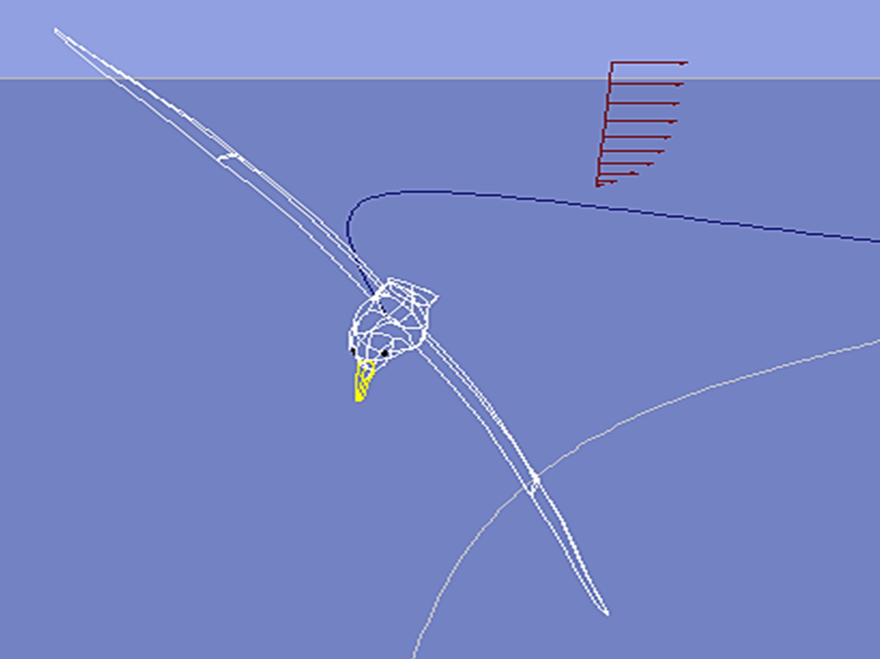
Real-time simulation
of dynamic soaring
Notes:
Our real-time simulation of albatross dynamic soaring was programmed in an early version (~1995) of Microsoft’s Visual Basic and then compiled as an (entirely-safe) executable which of course will be unliked by any computer firewall. Readers interested anyway in running the simulation must first download from Microsoft the older graphics dynamic-link library (MSVBVM50.dll), also entirely safe. Our flight simulation, freely available upon request, is now demonstrated....

Slide 39

Antarctic sunset #1

Slide 40

Antarctic sunset #2

Slide 41

Summary – How Flies the Albatross
By dynamic soaring, the albatross gains thrust from the wind profile by upwind ascent & downwind descent
On shoulder-locked wings, the albatross can progress overall in any direction
An early albatross likely shared the ocean skies with Pteranodon
The albatross soars downwind overall 40% faster than the wind
The albatross circumnavigates Antarctica several times per year, often when half asleep on the wing
The albatross, and we ourselves, are seriously threatened by plastic at sea

Slide 42

From The Rhyme of the Ancient Mariner ~ Part the Second
And the good south wind still blew behind;
But no sweet bird did follow,
Nor any day, for food or play,
Came to the mariners’ hollo!
- Samuel Taylor Coleridge
Let not the albatross vanish from earth on our short watch
- J. Philip Barnes
www.HowFliesTheAlbatross.com

Slide 43
Algebratross Static Display Model by J. Philip Barnes
Instructions:
01. Copy / enlarge on copy machine or printer
02. Paste whole page on sandwich board
03. Cut forward-center slot, width as shown
04. Cut aft-side slots, width as shown
05. Cutout 1-piece total wing & body
06. Cutout each body side-view half
07. Align & paste body halves side-by-side
08. Test fit wing / body matching slots
09. Sand slots if required; use nail file
10. Fold ea. wing, 5-deg (use table edge)
11. Assemble with lightly-glued slots. Enjoy!
12. “Pin-in-the-side” locates c.g. for mobiles.
Slot width is twice
Board thickness
Front view,
Assembled model
(not to scale)
Slot width equals
Board thickness

Slide 45

About the Author
J. Philip Barnes has a Master’s Degree in Aero Engineering from Cal Poly Pomona and BSME from the University of Arizona. He is a 40-year “veteran” of air vehicle, propulsion, and subsystems performance modeling at Northrop Grumman. Phil’s analysis and SAE paper explaining how the wandering albatross uses dynamic soaring to remain aloft on shoulder-locked wings was named “landmark” by noted aerodynamicist Bruce Carmichael. Phil was recently nominated by former Aviation Week editor Bill Sweetman, colleagues, and Phil’s academic network to deliver the AIAA 2020 von Kármán Lecture. He is now pioneering the science of regenerative electric flight, and his presentations thereof have been named “inspiring to many.” Author of diverse technical papers, Phil has delivered invited, travel-paid lectures at Cal Poly, USC, UIUC, OSU, and the University of Dayton. He was named 2014 Outstanding Aero Engineering Alum at Cal Poly Pomona, where he presented “Future Flight: Learning From the Birds” to an audience of 200 graduates, family, and faculty. Phil is a recipient of SAE’s Lloyd Withrow Excellent Speaking Award and AIAA’s 2016 Gohardani Aerospace Presentation Award. Phil’s work is freely posted at his website www.HowFliesTheAlbatross.com.

Slide 46
“Getting a Handle” on the Trajectory Parameters
Problem
  9 trajectory parameters (t, x, y, z, V, w, γ, φ, ψ)
    Time, position, airspeed, windspeed, maneuver angles
Solution
  Prescribe boundary layer profile w(z)
  Schedule pitch angle (γ) with heading (ψ)
    Follow the Dynamic Soaring Rule
  Schedule one more parameter, say bank angle φ(ψ)
    -- to travel overall in the intended direction, say downwind
  Equations of Motion determine all other parameters
  Numerically integrate dψ/dt, dx/dt, dy/dt, dz/dt
Notes:
The dynamic soaring trajectory has nine parameters: time, 3 coordinates, airspeed, windspeed, and 3 maneuver angles. This may leave us asking “where do we start?” The solution is first to prescribe the wind-profile and then to recognize that the albatross must follow the dynamic soaring rule, whereby we can schedule the pitch angle with heading. Then, if we schedule one more parameter, such as bank angle versus time, the equations of motion will determine all other parameters when we numerically and simultaneously integrate the various rates.

Slide 47

Three Accelerations ~ Newton’s Law Applied
Loop
Radius
2
V_{h} ψdt
a = =
V_{h} ψ
Isaac Newton
2 dt
γ
V
γ
V_{h} ψdt
V_{h}
V γ
ψdt
V_{h} ψ
ψ
V_{h}
V
Turn Radius
V_{h}
V_{h} ψdt
Horizontal loop, vertical loop, and along the flight path
Notes:
A three-dimensional trajectory can be computed by breaking down the motion into two components, one in a horizontal plane, and the other in a vertical plane. At any point the airspeed vector is tangent to the flight path, with a horizontal velocity component given by V cos gamma. We can then look down on the trajectory to fit a local horizontal radius of curvature, with attendant turn rate “psi dot.” As shown to us by Isaac Newton, the acceleration toward the center of the horizontal circle is the product of horizontal velocity and turn rate. Similarly, we can stand off to the side and fit a roller-coaster-loop radius to the motion in a vertical plane. The corresponding acceleration toward the center of that loop is then given by the product of airspeed and pitch rate, “gamma dot.” Last, but not least, the third acceleration is along the flight path itself, and this is determined by dynamic soaring thrust in relation to drag and the component of weight tangent to the flight path.

Slide 48
Wind Profile and Gradient
w = windspeed
V = airspeed
z = elevation
Z = 20 m
V=60 km/hr
w = 25 km/hr
“Specific” energy
E ≡ V²/2 + gz
w
z
Wind gradient,
w’ ≡ dw/dz
90 km/hr
Notes:
Let’s now study a real, and continuous, wind profile. Although the “boundary layer” shape looks quite familiar, we may be surprised to learn that its height is perhaps 20-meters. With the wind profile now shown as continuous, we conclude that the albatross uses the local gradient (dw/dz) of the wind profile to maintain dynamic soaring. Exchanging kinetic and potential energy in each zoom maneuver, the albatross flies 90 km/hr down along the water, and 60 km/hr at the top of the loop.
By now, we see that dynamic soaring is somehow providing a thrust which overall offsets the drag. Let’s next quantify that thrust, which as you might expect, is determined by both the wind gradient (dw/dz) and the orientation of the albatross, relative to the wind.

Slide 49
Equations of Motion for Dynamic Soaring
1
Thrust group
Drag group
2
3
4
5
C_{L} = n_{n} W / (½ ρ V² S)
1: Local wind gradient
2: Tangential load factor
6
D/L ≈ (C_{Do}/C_{L}) + C_{L}/(3A)
3: Normal load factor
x = u – V cosγ cosψ downwind
y = V cosγ sinψ crosswind
z = V sinγ vertical
4: Turn rate
5: Lift coefficient
7
6: Drag-to-lift ratio
7: Trajectory
Notes:
Here we apply the foregoing analysis to compute the dynamic soaring trajectory of the albatross. Those interested can study these later, but our intent here is to show all the equations through which the computer cycles, perhaps 20 times per second, to determine the changes in position and orientation of the albatross. These equations represent the wind gradient, tangential load factor, maneuver or normal load factor, turn rate, lift coefficient, drag-to-lift ratio, and trajectory in terms of the Cartesian coordinates (x,y,z).
Now focusing only on equation (2), representing the “Dynamic Soaring Equation,” we see that the tangential load factor, or acceleration along the flight path normalized with gravity, is given simply by a “thrust group” in relation to a “drag group.”
For the dynamic soaring thrust, notice the proportionality to airspeed (v), wind gradient (u’=du/dz), and orientation of the albatross relative to the wind. Next, notice that the drag group includes the maneuvering or normal load factor (Nn), whereby evolution has endowed the albatross with a high-aspect-ratio wing to reduce its drag-to-lift ratio during maneuvering with lift at several times its weight.
It would appear that over fifty million years, the weight, wingspan, and shape of the albatross have been perfectly optimized for the wind profile which constitutes its home.

Slide 50
Albatross Dynamic Soaring Simulation
Net Crosswind Maneuver
60
φ
30
o
γ
o
0
-30
ψ
o
-60
-90
-120
τ
-150
= ( t,sec ) /13
0.0
0.2
0.4
0.6
0.8
1.0
1.2
35
E/g
30
25
L/D
20
V
15
z
Bird
10
Relative
5
u
Relative
Ground
0
2
n
n
Phil Barnes July 2004
1
C
L
0
10 n
25 m
11 kg, b = 3.5 m, A = 16
t
U = 7.0 m/s @ Z = 20 m
-1
τ
= ( t,sec ) /13
0.0
0.2
0.4
0.6
0.8
1.0
1.2

Slide 51
Albatross Dynamic Soaring Simulation
Snaking Upwind
10
A
B
C
Bird Relative
Ground Relative
γ
m = 11 kg b = 3.5 m
0
o
-10
B
U = 7.0 m/s @ Z=20 m
τ
= t / 8.0
25 m
-20
0.0
0.5
1.0
1.5
2.0
90
45
φ
ψ
C
A
o
o
0
-45
-90
35
Bird scaled to
30
E/g
B
300% for detail
25
V
A
20
15
L/D
C
10
z
5
u
0
Net Progress
2
n
3.6 m/s Upwind
C
n
1
L
0
10 n
t
τ
Phil Barnes June 2004
-1
= t / 8.0
Show Simulation
0.0
0.5
1.0
1.5
2.0

